Slide 1
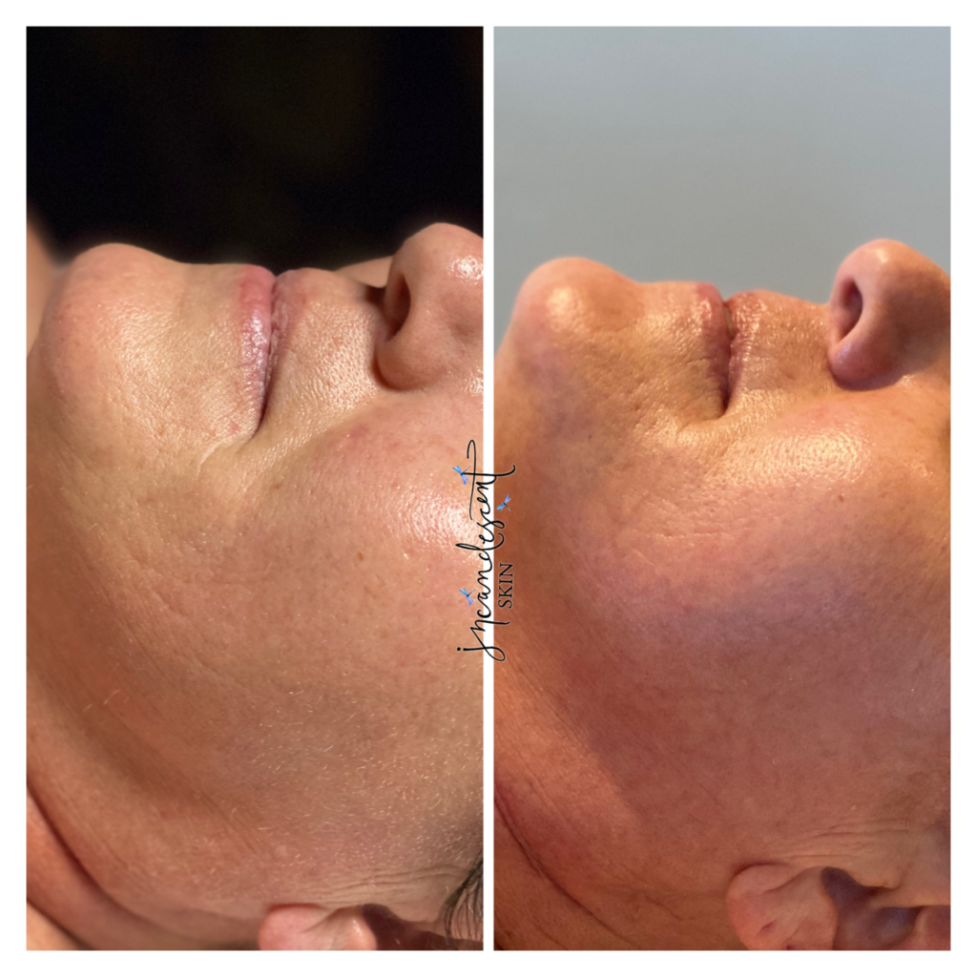
Tucson Healthy Skin
Achieve Tucson healthy skin with advanced treatments and expert guidance. Our customized solutions help rejuvenate, nourish and enhance your natural glow.

Slide 2
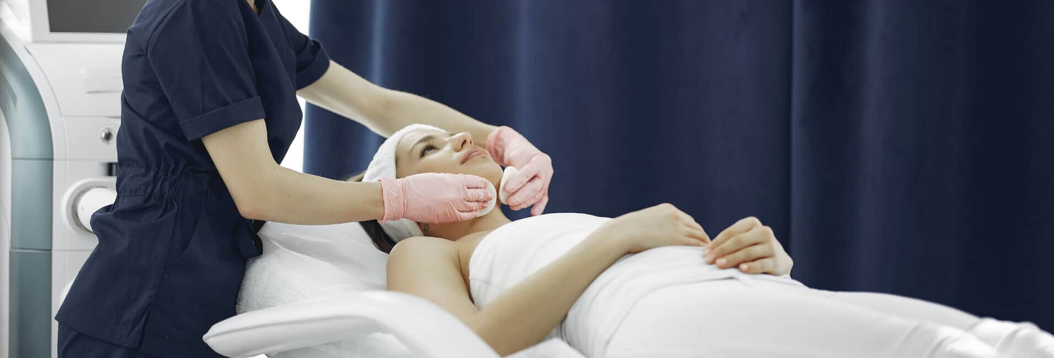
Tucson Skin Therapist
Need a Tucson skin therapist? Alissa provides expert care and customized treatments to address your skin concerns, helping you achieve a healthy, radiant glow.

Slide 3

Tucson Acne Clinic
At our Tucson acne clinic, we provide effective treatments to manage and clear acne, helping you achieve smoother, healthier skin with expert care and guidance.

Slide 4

Contact Us
Website:- https://incandescentskin.com/
Email:- Alissa@incandescentskin.com
Location:- 1200 N. El Dorado Place, Tucson, AZ 85715, United States

