Slide 1

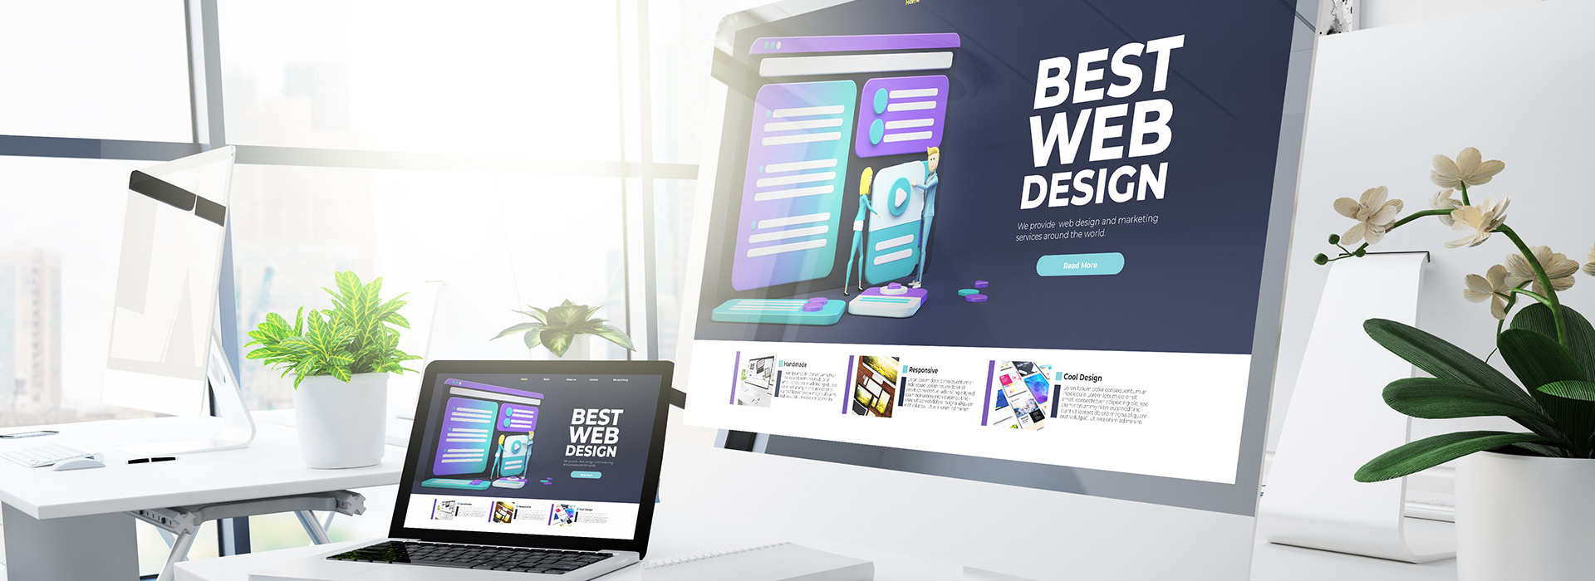
Quora Web Solution
Website Design and
Development
Company
Web Design & Web Development
Company in Bangalore, India
www.quorawebsolution.com
+91 9986 056 909
info@quorawebsolutions.com
24A, 1st Main Rd, Chandra Reddy
Layout, Koramangala 4th Block,
Koramangala, Bengaluru,
Karnataka 560034

Slide 2
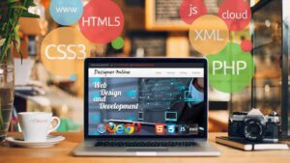
The Cost of Web Design and Development: What’s Included, What’s Not, and How to Plan Your Budget
When it comes to building a website, understanding the costs involved can be tricky.
www.quorawebsolution.com

Slide 3
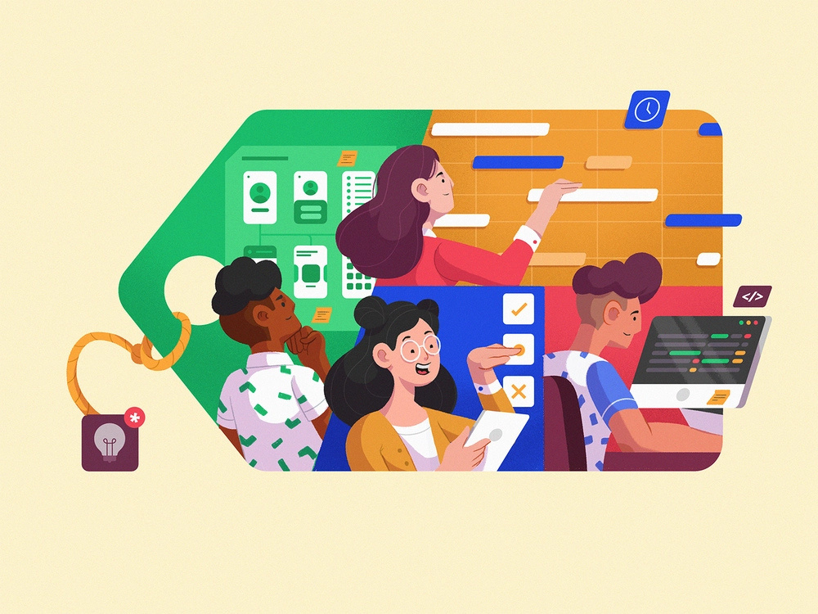
Whether you’re a small business or a larger enterprise, having a clear idea of the budget required for web design and development is essential to avoid surprises later on.
www.quorawebsolution.com

Slide 4
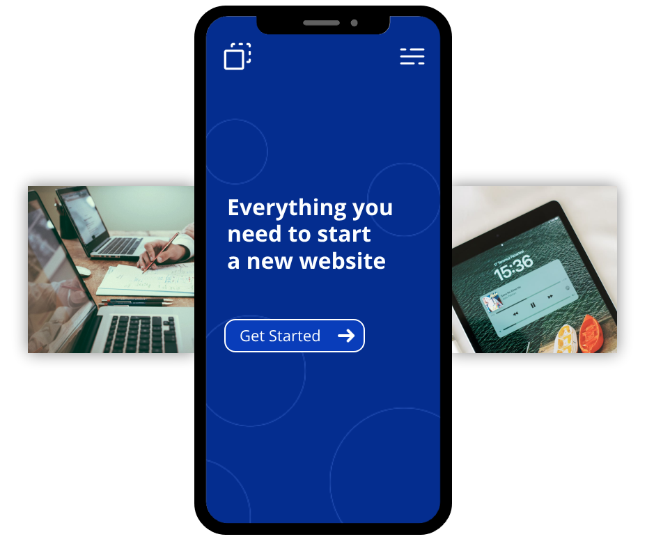
In this article, we’ll break down the costs of web design and development, what’s included, what might be left out, and how you can effectively plan your budget.
www.quorawebsolution.com

Slide 5

What’s Included in the Cost of Web Design and Development?
www.quorawebsolution.com

Slide 6
Consultation and Planning Before the actual design and coding begin, you’ll typically have a series of meetings with the web design team to discuss your goals, target audience, branding, and functionality needs. This phase is crucial for establishing the foundation of your website and usually includes competitor analysis, content planning, and choosing the best platform for your needs.
Design and Prototyping This is the phase where your ideas start to take shape. A designer will create wireframes and mockups, giving you a visual idea of what the site will look like. User experience (UX) and user interface (UI) are key considerations here, ensuring your website is visually appealing and easy to navigate.
Development and Coding Once the design is approved, the development team steps in to bring it to life. This includes front-end (what users see) and back-end (server-side logic, database management) development. Depending on your needs, this could also involve integrating third-party software like CRMs, e-commerce platforms, or other tools.
www.quorawebsolution.com

Slide 7
Testing and Quality Assurance Before the site goes live, it undergoes rigorous testing. This includes ensuring the website works across multiple devices and browsers, testing for broken links, checking page load speed, and confirming that all forms and functionalities work correctly.
Launch and Post-Launch Support After the site has been tested and optimized, it’s time to go live. A professional development team will help you launch your site, monitor for any issues, and provide support for troubleshooting or tweaks post-launch.
What’s Not Included?
While the above list covers the core elements of web design and development, there are some services that might come with additional costs:
Content Creation
www.quorawebsolution.com

Slide 8
Writing the content for your website (text, images, videos) is usually not included unless specifically agreed upon. Many companies expect you to provide the content, or you may need to hire a separate copywriter and photographer.
Ongoing Maintenance
Websites require regular updates to stay secure and functional. This might include updating plugins, software, or security patches, and fixing bugs. Many agencies offer maintenance packages, but these are often an additional cost.
SEO and Marketing
While web developers may optimize the basic structure for SEO (search engine optimization), advanced SEO work and digital marketing services (like pay-per-click advertising or social media management) usually require a separate budget.
www.quorawebsolution.com

Slide 9
E-Commerce Setup and Integration
If you need an e-commerce platform, such as Shopify or WooCommerce, integrated into your site, this could add to the cost, especially if you require features like custom shopping carts, payment gateways, or inventory management.
Custom Features
Anything beyond basic functionality can add to the cost. If you want features like custom user dashboards, advanced forms, or specific animations, you’ll need to budget for the extra time and development resources these require.
How to Plan Your Budget
Planning your budget involves understanding both the core features you need and the potential for extra costs down the line. Here’s how you can approach it:
www.quorawebsolution.com

Slide 10
Define Your Goals Clearly
Understand what you want your website to achieve—whether it’s increasing sales, providing information, or serving as an online portfolio. The clearer your goals, the easier it will be to determine what’s necessary for your website and how much it will cost.
Consider Future Needs
Websites are never “set it and forget it.” Consider ongoing costs like maintenance, SEO, hosting, and future upgrades. Factor these into your long-term budget.
Request Multiple Quotes
Get quotes from several web development agencies, but don’t just go for the lowest price. Make sure you understand what’s included and what isn’t in each offer.
www.quorawebsolution.com

Slide 11
A cheaper quote might leave out essential services like post-launch support or mobile optimization.
Be Prepared for Additional Costs
Sometimes the unexpected happens—additional revisions, custom functionalities, or special requests. Having a buffer in your budget for these unplanned costs can help avoid headaches later.
Conclusion
Web design and development can be a significant investment, but it’s also a vital part of your business’s online presence. By understanding the core services included in the price, identifying potential extra costs, and planning your budget accordingly, you’ll ensure that your project goes smoothly from start to finish.
www.quorawebsolution.com

Slide 12
Whether you're building a simple informational site or a complex e-commerce platform, clear expectations and proper budgeting will help you get the best value for your investment.
Top 10 Benefits of Working with a Website Design and Development Company for Your Business Growth
In today’s digital age, a professional, well-designed website is no longer just a luxury—it's a necessity for businesses of all sizes.
www.quorawebsolution.com

Slide 13
As more consumers turn to the internet for information, shopping, and engagement, your website plays a crucial role in driving business growth. Partnering with a reputable website design and development company can offer numerous advantages that go beyond just aesthetics. Here are the top 10 benefits of working with such a company to help propel your business forward:
1. Expertise and Experience
One of the biggest advantages of hiring a website design and development company is the access to professional expertise. These companies employ experienced designers and developers who understand the latest trends, technologies, and best practices in web development. They can offer insightful advice tailored to your business needs and create a site that not only looks great but also functions seamlessly.
www.quorawebsolution.com

Slide 14
2. Custom Design That Reflects Your Brand
A professional website design company will create a custom website that aligns with your brand's identity and values. Unlike generic templates, a tailor-made design helps build trust with your audience, providing a cohesive look across all of your digital platforms. This personalization gives your website a unique edge over competitors, helping to establish a solid, recognizable brand.
3. Mobile Optimization
With more people accessing websites via smartphones and tablets, mobile optimization is essential. A website design and development company ensures that your site is responsive, meaning it automatically adjusts to fit any screen size.
www.quorawebsolution.com

Slide 15
This enhances the user experience, reduces bounce rates, and can positively impact your search engine rankings.
4. Improved User Experience (UX)
User experience (UX) is a crucial element for retaining visitors and encouraging them to take action. A website design company focuses on creating an intuitive layout that makes it easy for users to navigate, find information, and complete tasks like making a purchase or filling out a contact form. A seamless, user-friendly website enhances customer satisfaction and increases the likelihood of conversions.
5. SEO Best Practices
www.quorawebsolution.com

Slide 16
A website design and development company doesn’t just focus on the aesthetic aspect of the website; they also ensure that it’s optimized for search engines. Implementing search engine optimization (SEO) strategies from the start helps improve your site's visibility, driving more organic traffic. A professional web development company knows how to incorporate SEO-friendly elements, such as optimized images, meta tags, and content structure, without compromising the design.
6. Faster Load Times
Page load time plays a significant role in both user experience and SEO. Slow-loading websites can frustrate users and lead to higher bounce rates, which negatively impacts your search engine ranking.
www.quorawebsolution.com

Slide 17
Website design and development experts use efficient coding practices and cutting-edge technologies to create fast-loading websites, ensuring a smooth experience for users and improving your search engine ranking.
7. Scalability and Future Growth
As your business grows, so should your website. A website design and development company builds sites with scalability in mind, meaning they can easily add new features and functionalities as your business expands. Whether you want to add an e-commerce platform, integrate customer relationship management (CRM) systems, or enhance security features, a professional web development team ensures that your website can grow alongside your business.
www.quorawebsolution.com

Slide 18
8. Ongoing Support and Maintenance
A website is not a one-time project—it requires regular updates, security patches, and occasional redesigns to stay current. A website design and development company offers ongoing support and maintenance services to ensure your website remains functional and secure. This peace of mind allows you to focus on your core business activities, knowing that your website is in good hands.
9. Enhanced Security Features
Website security is more important than ever in the wake of rising cyber threats.
www.quorawebsolution.com

Slide 19
A professional web development team ensures that your website is built with robust security features, such as SSL encryption, secure payment gateways, and regular security updates. This not only protects your business and customers' sensitive data but also boosts your website’s credibility.
10. Increased Conversion Rates
Ultimately, the goal of any website is to convert visitors into customers. A well-designed website optimized for user experience, speed, and SEO increases the likelihood of conversion.
www.quorawebsolution.com

Slide 20
A website design and development company understands how to integrate calls to action (CTAs), lead capture forms, and optimized landing pages that encourage users to take the next step, whether it’s making a purchase, signing up for a newsletter, or contacting your team for more information.
Conclusion
Investing in a professional website design and development company can pay off significantly in the long run.
www.quorawebsolution.com

Slide 21
From creating a custom website that truly reflects your brand to improving SEO, mobile optimization, and user experience, the benefits are undeniable. A well-designed website doesn’t just attract visitors—it converts them into loyal customers, boosts your online presence, and supports your business growth.
If you want to stay ahead of the competition and achieve long-term success, partnering with a website design and development company is a step in the right direction.
www.quorawebsolution.com

Slide 22
Quora Web Solution: Quora Web Solution is a trusted website development company based in Bangalore, India, offering a wide array of services to not only domestic but global clientele. Be it Website Design and Development, SEO services, Digital Marketing, Branding, App Development, Ecommerce Solution, and Logo Creation . Quora Web Solution has the best website developers offering top quality services and that is the reason why we are well known as one of the best Website Development Companies in Bangalore, India.
Visit Us - www.quorawebsolution.com
Call Us - +91 9986 056 909
Mail Us - info@quorawebsolutions.com
www.quorawebsolution.com

Slide 23

WORDPRESS DEVELOPMENT
ECOMMERCE DEVELOPMENT
PHP DEVELOPMENT
CMS DEVELOPMENT
DRUPAL DEVELOPMENT
WEBSITE SERVICES
WEBPORTAL DEVELOPMENT
MAGENTO DEVELOPMENT
WEBSITE DEVELOPMENT
JOOMLA DEVELOPMENT
SMALL BUSINESS DEVELOPMENT
CHEAP WEBSITE DEVELOPMENT
STATIC WEBSITE DEVELOPMENT
DYNAMIC WEBSITE DEVELOPMENT
WEBSITE DESIGN COMPANY
TOUR AND TRAVEL WEBSITE DEVELOPMENT
Services

