Slide 1
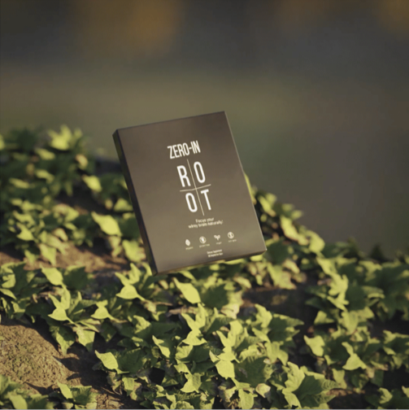
Root Zero In
Reach new heights of wellness with our Root Zero In products, which are packed with a variety of premium ingredients like turmeric, pine bark extract & more.

Slide 2

Root Duo Pack
Root Duo Pack at Walgenbach offers Clean Slate and Restore products, which are highly beneficial for people who want to add more nutrients to their bodies.

Slide 3
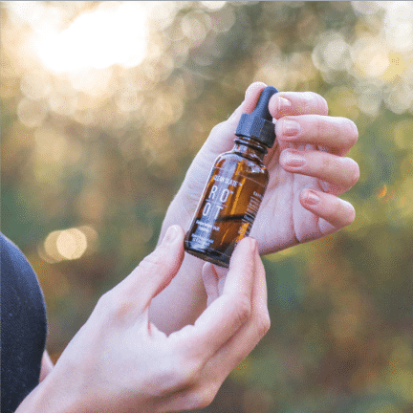
Root Clean Slate
See our extensive range of Root Clean Slate products, which is the original mineral solution enhanced with vitamin C that provides daily support for wellness.

Slide 4

Contact Us
Website:
https://walgenbach.in/
About: At Walgenbach, we offer a curated selection of natural supplements to detox your body and boost your immune system, as we are your trusted supporter in achieving a healthier, more balanced lifestyle.

