Slide 1
ITE Hearing Aids in Delhi | Kavya Speech & Hearing Clinic
Untreated hearing loss can impact your self-esteem, relationships and everyday life. However, with advances in technology, today's solutions are more comfortable, discreet and powerful. One of the most widely used solutions are In-the-ear (ITE) hearing aids in Delhi, particularly for those seeking a combination of comfort and discreteness.
At Kavya Speech & Hearing Clinic, we offer people the chance to regain the pleasure of hearing with new, tailored solutions. So, if you're considering ITE hearing aids in Delhi, this comprehensive guide will cover all the essential information: features, benefits, costs and how to choose the right one.
What Are ITE Hearing Aids?
ITE hearing aids in Delhi, also known as "In-The-Ear" hearing aids, are worn in the outer ear. They are individually crafted to match your ear's contours for a tailored fit.
ITE hearing aids in Delhi are inconspicuous yet powerful hearing devices. They contain the necessary components - microphone, amplifier and speaker - all in one small housing.
Patients at Kavya Speech & Hearing Clinic are choosing ITE hearing aids in Delhi for their convenience and features.
Why Choose ITE Hearing Aids in Delhi?
There are several reasons why patients are opting for ITE hearing aids in Delhi over conventional ones:
Custom Fit & Comfort
All of the ITE hearing aids in Delhi are custom-made to fit your ear, providing all-day comfort.
Discreet Design
The latest ITE hearing aids in Delhi are less visible than behind-the-ear devices and match your skin colour.
Easy to Use
ITE hearing aids in Delhi are simpler to put in and take out, making them a good choice for the elderly.

Slide 2
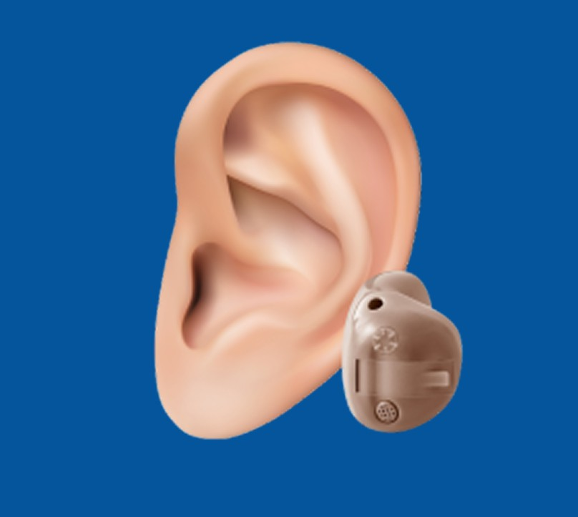
Advanced Technology
ITE hearing aids in Delhi also include features such as Bluetooth, noise reduction, and smartphone connectivity.
Applicable for Different Levels of Hearing Loss
Delhi ITE hearing aids can be used for mild to moderately severe hearing loss.
Variations of ITE Hearing Aids in Delhi
There are a few variations of ITE hearing aids in Delhi according to size and fit:
Full Shell ITE
Fills most of the outer ear; provides the most power.

Slide 3
Half Shell ITE
Smaller, but easier to insert.
ITC (In-The-Canal)
Partially inserted into the ear canal and more attractive.
CIC (Completely-In-Canal)
Very discreet and nearly invisible.
At Kavya Speech & Hearing Clinic, we help you decide which type of ITE hearing aids in Delhi would suit your hearing needs and lifestyle.
Features of Modern ITE Hearing Aids in Delhi
ITE hearing aids in Delhi are now digital. Some key features include:
Digital sound processing
Directional microphones
Noise reduction technology
Rechargeable batteries
Bluetooth connectivity
Smartphone app control
The best ITE hearing aids in Delhi even adapt sound automatic to the environment using artificial intelligence (AI).

Slide 4
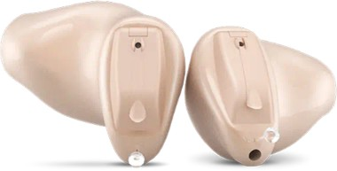
Benefits of ITE Hearing Aids in Delhi
There are many benefits of choosing ITE hearing aids in Delhi:
Improved Communication
You can hear others in all situations, even with background noise.
Better Social Confidence
ITE hearing aids in Delhi help you not shun social gatherings.
Natural Sound Experience
These hearing aids in Delhi take advantage of your ear's natural contours for sound localization.
Comfortable Everyday Use
ITE hearing aids in Delhi that are tailored to the ear are more comfortable.
Who Should Use ITE Hearing Aids in Delhi?
There's no one-size-fits-all hearing aid. ITE hearing aids in Delhi are ideal for:
Adults with mild to moderate hearing loss
Elderly seeking convenience
Those who want a discreet hearing device
People who desire powerful features in a small package

Slide 5
But for severe hearing problems, our audiologists at Kavya Speech & Hearing Clinic may recommend other options, along with ITE hearing aids in Delhi.
Popular ITE Hearing Aid Options
Some of the popular variants are:
Budget Option
ITE Acrylic Digital Hearing Aid
Inexpensive custom-style ITE hearing aid for mild hearing loss
Entry-Level Device
Enlinea KF-60 ITE Hearing Aid
Mild to moderate hearing loss with easy controls
Premium Smart Device
Signia Active Pro ITE Hearing Aid
Premium Bluetooth-capable ITE hearing aid with superior sound quality
What to Consider When Buying ITE Hearing Aids in Delhi
When choosing ITE hearing aids in Delhi, seek professional advice. Here's what you should consider:
Hearing Test
Make sure you get a diagnosis before purchasing ITE hearing aids in Delhi.
Lifestyle Needs
Do you go to meetings, travel or stay home? Your lifestyle affects your choice.
Budget
There are a range of prices for ITE hearing aids in Delhi.
Features Required
Decide on basic, advanced or high-end features.
At Kavya Speech & Hearing Clinic, we offer an in-depth consultation for the best ITE hearing aids in Delhi.
Why Choose Kavya Speech & Hearing Clinic?
The right clinic is as important as the right device when it comes to ITE hearing aids in Delhi.

Slide 6
Expert Audiologists
We are experts in fitting and customizing ITE hearing aids in Delhi.
Advanced Technology
We use the most up-to-date international brands and models.
Personalized Care
We provide a unique solution for each patient.
Aftercare Support
We offer aftercare support for your ITE hearing aids in Delhi.
TIPS to Maintain ITE Hearing Aids
Here are some maintenance tips to prolong the life of your ITE hearing aids in Delhi:
Clean regularly
Avoid moisture exposure
Store in a dry case
Replace batteries on time
Schedule regular check-ups
Good maintenance helps your ITE hearing aids in Delhi last for a long time.
Final Thoughts
A good hearing solution can make all the difference. Delhi's ITE hearing aids are an excellent choice for people looking for comfort, discretion and effective sound amplification.
At Kavya Speech & Hearing Clinic, we strive to improve your hearing and quality of life. Whether you are a new user or looking to upgrade, we will help you make the best decision.

