Slide 1

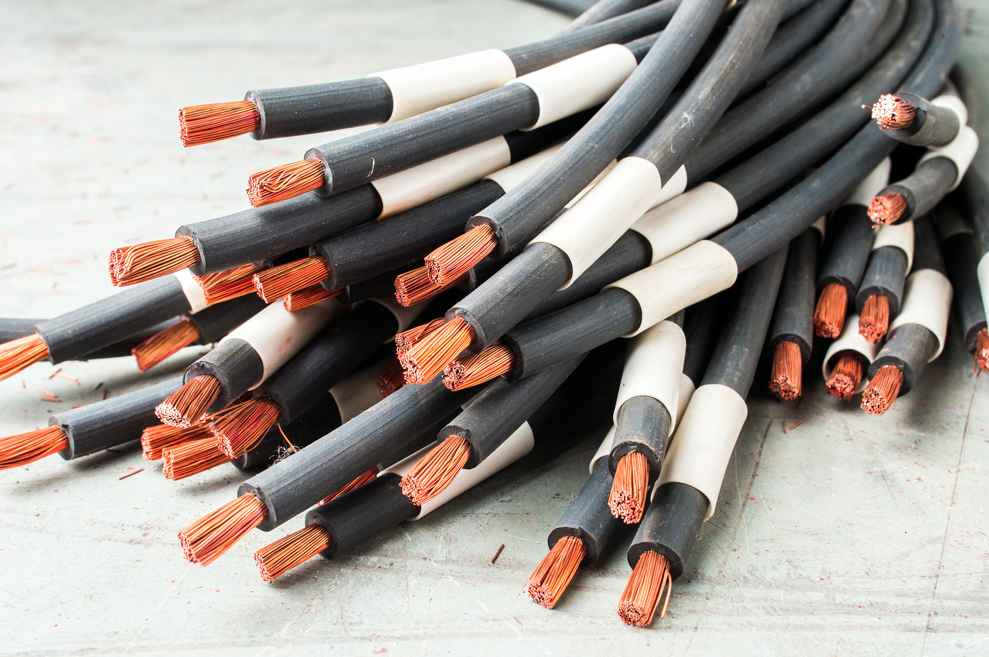
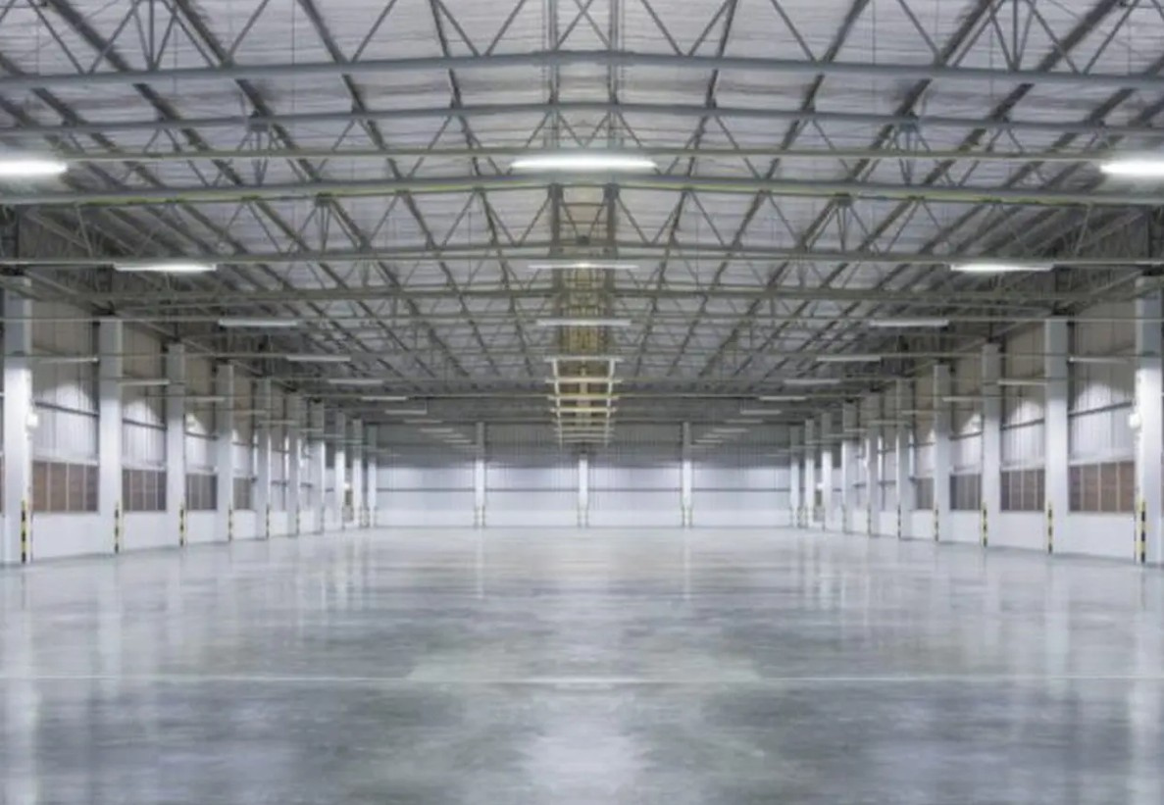
Reliable Scrap Metal Charlestown Services for Your Property
Kangaroo Copper Recycling provides trusted Scrap Metal Charlestown services, helping
residents and businesses recycle metal efficiently. Whether you have copper, aluminium,
brass, or other non-ferrous metals, their team ensures fair prices and fast service. They focus
on making scrap metal collection easy and convenient for everyone in Charlestown and
nearby areas.

Slide 2
Services Offered for Scrap Metal in Charlestown
They offer a wide range of services for different properties, including residential, commercial,
industrial, and civil sites. The key services include:
Free pickup from your location
Competitive pricing for all non-ferrous metals
On-the-spot cash or direct credit payment
Same-day collection for urgent requests
Drop-off options at their recycling yard
Expert advice on scrap metal sales
The metals they accept include copper, copper wires, copper pipes, aluminium, brass pipes,
mag wheels, and other non-ferrous metals. This makes it easy to recycle almost any scrap
metal you have.

Slide 3
Why Choose Kangaroo Copper Recycling
When you select a good Scrap Metal Charlestown service, you are guaranteed fair payment, and
your scrap
metal is handled in a responsible manner. Kangaroo Copper Recycling provides:
Senior experts with a high sense of quality and efficiency.
Sustainable and recycled products that are safe and environmentally friendly.
Fast and hassle-free service without waiting.
The advice of the professional on how to get maximum incentive out of your scrap.
They possess commercial-grade trucks and equipment to handle large quantities of scrap metal.
The process is easy, even when you are unable to get to their yard, since their pick-up service
takes care of that.

Slide 4
Services Extend to Scrap Metal Maitland
They have their services, which are not restricted to Charlestown. Their effective metal recycling can also be of service to the customers in other nearby areas, like Scrap Metal Maitland. These are free collections, immediate payments and professional guidance of any non-ferrous metals.
How to Sell Your Scrap Metal
Selling scrap metal is simple:
Contact Kangaroo Copper Recycling via phone or email
Specify the type and quantity of scrap metal
Schedule a pickup or drop-off at the yard
Receive instant payment on collection
This straightforward approach saves time and ensures customers receive competitive
prices.

Slide 5
Frequently Asked Questions
What types of metals are accepted?
Non-ferrous metals like copper, aluminium, brass, and steel are accepted.
Do they offer pickup services?
Yes, free pickup is available across Charlestown and the surrounding areas.
How soon will I get paid?
Payment is provided immediately in cash or via direct credit.
Is there a drop-off option?
Yes, customers can drop off scrap metal at their recycling yard if preferred.
Kangaroo Copper Recycling offers good, convenient, and friendly Scrap Metal Charlestown and Scrap
Metal Maitland services. Get them to collect your scrap metal and pay you promptly.

Slide 6
Thank You
Phone: 61405404040
Website:https://kangaroocopperrecycling.com.au/

