Slide 1


San Jose SEO Strategies for Local Business Growth
A practical guide to strengthening your online presence and driving measurable results in the competitive Silicon Valley market
Notes:
1

Slide 2

Why Local SEO Matters for San Jose Businesses
San Jose is home to over 6,600 small businesses competing for visibility in a tech-saturated market. Standing out requires strategic digital presence.
93%
76%
of consumers
of local searches
Use search engines to find local businesses before making purchase decisions
Result in a same-day store visit when conducted on a mobile device
Effective SEO delivers measurable ROI by connecting your business with high-intent local customers
68%
of clicks
Go to the top five search results, with position #1 capturing 33% of all traffic
Notes:
2

Slide 3
Your SEO Roadmap: What We'll Cover
Implementing these proven strategies will help your San Jose business gain visibility, traffic, and conversions
1
2
3
Local Search Optimization
Strategic Keyword Targeting
Content That Converts
Dominate Google Maps and local pack results with targeted San Jose-specific strategies
Identify and leverage high-value search terms your Silicon Valley customers actually use
Create compelling content that serves both search engines and real San Jose customers
4
5
Technical SEO Excellence
Analytics & Measurement
Build a solid technical foundation to maximize visibility and user experience
Track performance with clear metrics that demonstrate tangible business growth
Notes:
3

Slide 4
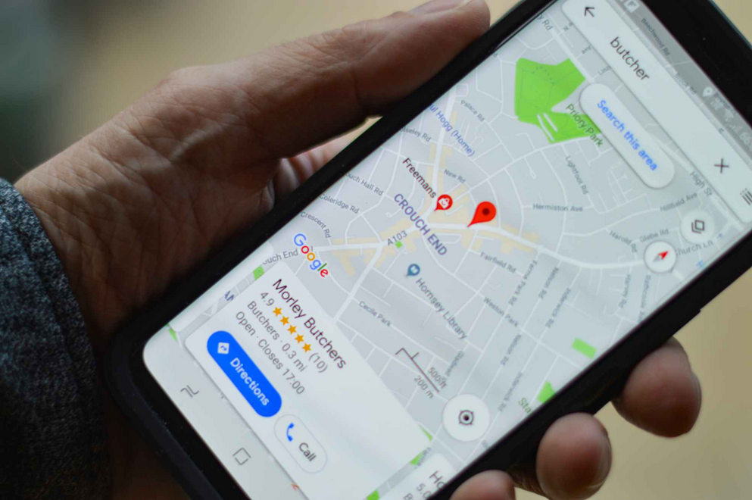

Winning the Local Search Game in San Jose
San Jose consumers search differently than those in other markets. Capitalizing on local search behavior requires:
Google Business Profile Optimization
Complete all fields with search engine optimization san jose -specific details, accurate business hours, and regular updates
Local Citations Management
Consistent NAP (Name, Address, Phone) across directories like Yelp, Yellow Pages, and industry-specific platforms
Review Generation Strategy
Local Success Metric: 78% of our San Jose clients achieve Google 3-pack placement within 90 days of implementing these strategies
Proactive approach to earning and responding to reviews from local customers
Notes:
4

Slide 5

Strategic Keyword Research for San Jose Markets
Discover what your customers are actually searching for
Geo-Modified Terms
Neighborhood Targeting
  "San Jose accountant"
  Cambrian Park
  "Best pizza in Willow Glen"
  Downtown San Jose
  "Santana Row hair salon"
  Berryessa
  Almaden Valley
Industry + Local Intent
  "Affordable roofing near me"
  "Emergency plumber 95110"
  "B2B tech services Silicon Valley"
We'll help you identify the specific terms with highest commercial intent for your industry, prioritizing phrases with demonstrated conversion value
Notes:
5

Slide 6

Creating Content That Converts San Jose Customers
Content isn't just about keywords—it's about answering the specific questions your San Jose customers are asking:
"After implementing Fair Marketing's content strategy, our landscaping company saw a 217% increase in qualified leads from San Jose homeowners within just 4 months."
Localized Service Pages
Develop dedicated pages for each service, optimized for San Jose-specific terms and addressing local market needs
Neighborhood Guides
Create content highlighting your service area expertise in Willow Glen, Almaden Valley, Cambrian Park, and other key neighborhoods
Local Case Studies
Showcase success stories from businesses you've helped in San Jose, with measurable results and testimonials
FAQ Content
Answer common questions specific to your San Jose market to capture featured snippets and voice search opportunities
Notes:
6

Slide 7




Technical SEO: Building a Solid Foundation
The invisible factors that make or break your search performance
53%
68%
of visitors
of searches
Abandon websites that take longer than 3 seconds to load—a critical issue for San Jose's tech-savvy consumers
In San Jose are performed on mobile devices, making mobile optimization essential
Site Speed Optimization
Mobile-First Design
Image compression, code minification, and server response improvements
Responsive layouts, touch-friendly elements, and accelerated mobile pages
Security & Structure
Indexation Control
SSL implementation, schema markup, and structured data for rich results
XML sitemaps, robots.txt optimization, and crawl budget management
Our technical audits identify the specific issues holding back your San Jose business from achieving maximum visibility
Notes:
7

Slide 8

Measuring What Matters: SEO Analytics
100%
Visibility Tracking
Monitor rankings for San Jose-specific keywords and track improvements over time
75%
Traffic Analysis
Measure organic traffic growth, focusing on visitors from San Jose and surrounding areas
50%
Engagement Metrics
Track time on site, pages per session, and bounce rate to assess content quality
25%
Conversion Tracking
Set up goals to measure leads, calls, form submissions, and sales from organic search
We focus on business metrics that demonstrate real ROI, not vanity statistics
Our clients receive monthly reports with clear visualizations of their progress and actionable insights for continued growth
Notes:
8

Slide 9




Ready to Dominate San Jose Search Results?
Free SEO Audit
Custom Strategy
Discover what's holding your San Jose business back with our comprehensive 22-point technical and competitive analysis
Get a tailored SEO roadmap designed specifically for your business goals and San Jose target market
Measurable Results
Experience the difference our data-driven approach makes with transparent reporting and consistent growth
Contact Fair Marketing today at (866-426-7443) or visit www.fairmarketing.com
Notes:
9

