Slide 1







Technology Guidance for Business Success in a Digital-First World
The environment in which modern organizations are being managed is one in which technology decisions have a direct impact on the growth, efficiency and competitiveness. The technology guidance for business success is used to assist businesses in leaving behind ad-hoc upgrades and instead having a purposeful digital transformation. Rather than following the fads, systematic direction focuses the technology on the objectives of the business, individuals, and procedures.
By having a clear technology guidance process step by step, organizations will be able to minimize risks, control costs, and speed up innovation. Knowledge of the stages of technology guidance in digital transformation also promotes the ease of adoption, improved alignment of the stakeholders, and value generation in the digital place of the market, in the long term.
page 001
www.reallygreatsite.com

Slide 2

1. Aligning Strategy to Business Objectives
Technology guidance for business success is achieved by aligning the digital initiatives to the fundamental business objectives and not the independent IT needs. This step will make sure that investments made will encourage growth of revenue, customer experience and efficient operation, which are the basis of technology guidance to business success.
Observable conformity saves money that is spent in vain and avoids disjointed systems. Once the choices made in technology are directly correlated with the results, the leader is confident, the team develops a sense of purpose, and the digital transformation will not go in the wrong direction or meet with opposition.
2. Evaluation of Existing Technology Environment
The comprehensive review examines systems, tools, infrastructure, and skills gaps that are in place throughout the organization. The technology guidance process step by step identifies inefficiencies, redundancies, and threats that can hamper transformation.
Organizations do not experience unnecessary replacements by knowing what is already functioning and what requires improvement. Such a realistic base can help in smarter road maps and also help in ensuring that a technology decision made in the future will not disrupt current operations, but will complement them.
page 002

Slide 3


3. Creation and Prioritization of Roadmap
The translation of strategy into actionable phases takes the form of building a technology roadmap. It is the step where timelines, priorities, and dependencies are identified in the stages of technology guidance in digital transformation, to have initiatives that are manageable and measurable.
Prioritization aids a team in concentrating on the most significant wins initially and aims to accomplish long-term change. A definite roadmap is one that is fast enough and stable enough to enable organizations to innovate without overloading the teams and affecting the basic functions of the organization.
4. Technology Selection and Solution Design
Considerable design of solutions makes sure that the chosen technology guidance for business success is appropriate, increases in scale, and combines with ease. This step strengthens the technology direction to business success by focusing on something appropriate rather than popular or hype.
The choice of technology, as per the usability, security and flexibility, avoids the future rework. Promising solutions fit teams, make adoption easier, and provide an ecosystem that enables continuous improvement as opposed to temporary solutions.
page 003

Slide 4
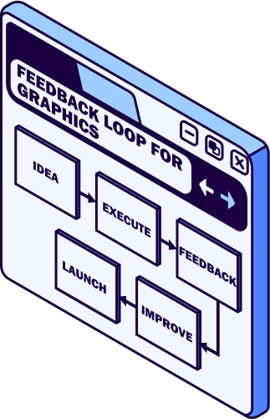


5. Change Enablement and Implementation.
Implementation takes plans into action through organized implementation and change management. The technology guidance process step by step will guarantee rollouts, minimize downtimes, and increase adoption levels.
The emphasis of change enablement is more human-centered than platform-centered. Training, communication, and stakeholder participation will enable the teams to take up the new systems without fear, and the upgrades of technologies will become productive instead of disruptive operations.
6. Optimization, Measurement, and Evolution
The digital transformation is not over when implemented. The stages of technology guidance in digital transformation are essential for continuous improvement and help the system adapt to changing business needs.
Processes and technologies are refined with the help of performance metrics, feedback loops, and frequent reviews. This ongoing approach keeps organizations dynamic, strong, and ready to adapt as markets, consumers, and technologies evolve.
page 004

Slide 5


Concluding Note!
Good technology has the power to turn digital complexity into a strategic advantage. Organizations will be clear, minimize risk and achieve sustainable growth by adhering to articulated steps. An organized process is required to make sure that technology guidance for business success serves people and size with business change. Digital transformation can be a lifelong process of enhancement instead of a singular effort, with the help of the right direction, and businesses will be prepared to be relevant and successful in the long term.
With Westgate Technology Corp., explore digital transformation support and expert-led technology guidance to turn strategic vision into scalable, future-ready technology solutions.
page 005

Slide 6



Contact Now:
www.wgtcorp.com
page 014

