Slide 1





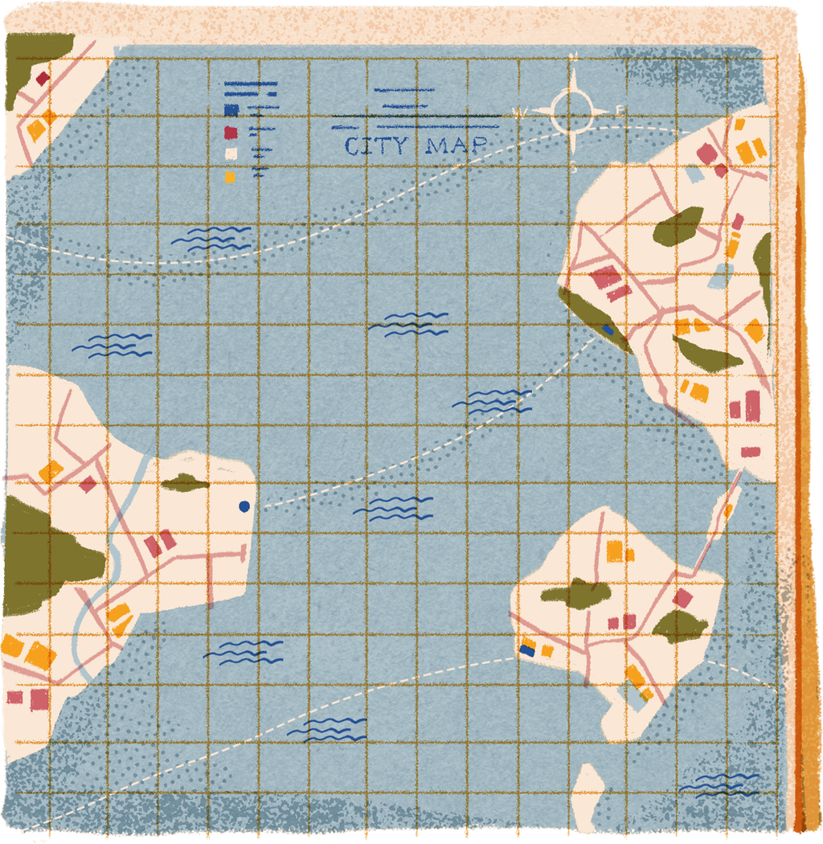



How to Get a 50% Student Discount on American Airlines Flights
American Airlines Student Discounts — Student Travel Savings Made Easy

Slide 2




What Is It?
American Airlines Student Discounts
American Airlines offers special discounted fares for students — up to 50% off regular flight prices on select routes.
Affordable Travel
Student travel savings make flying accessible for high school, college, and university students — domestic and international routes included.
Flexible Booking
Enjoy flexible booking options designed around student schedules, with easy fare adjustments and student-friendly policies.

Slide 3


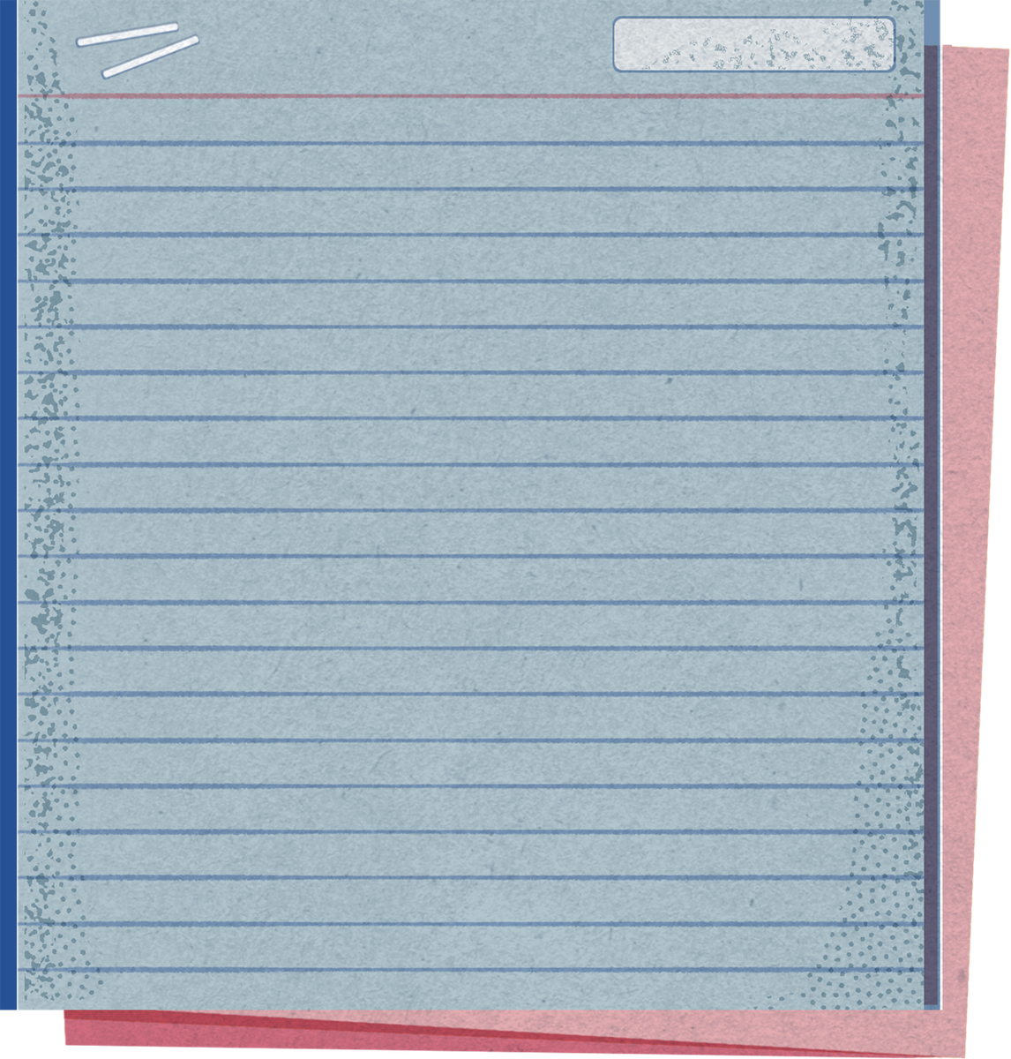

Eligibility Criteria
Must be enrolled in an accredited institution (high school, college, or university)
Valid student ID or enrollment letter required
Applies to domestic and international flights

Slide 4






How to Apply for the Discount
Step 1: Visit the Website
Step 2: Register via Partner
Step 3: Verify Student Status
Go to the American Airlines student travel website or an authorized partner portal to begin your discount application process.
Sign up or log in through a recognized student verification service such as UNiDAYS or StudentUniverse to access exclusive fares.
Complete the student verification process by submitting your student ID or enrollment letter to confirm your eligibility for the discount.
Step 4: Search Discounted Flights
Step 5: Book Your Flight
Step 6: Present ID at Check-In
Browse available flights with the 50% student discount automatically applied. Filter by date, route, and price to find your ideal trip.
Select your preferred flight and complete the booking using your verified student account to lock in the discounted student fare.
At the airport, present your valid student ID at check-in to confirm your eligibility and board your flight at the discounted rate.

Slide 5





Tips & Extra Info
Smart ways to maximize your American Airlines student discount!
Book in advance for the best fares
Check blackout dates & restrictions
Combine discounts with other offers
Set fare alerts for price drops
Watch for seasonal aa student deals
Contact AA customer service for help
Start saving on your next flight today!

Slide 6


Thank you!
Start saving on your next flight today! Safe travels and happy savings!

