Slide 1



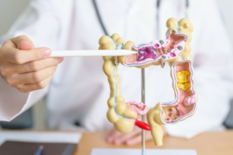
Detox Therapy India
Nourish renewal with detox therapy in India integrating colon cleanse, gallstone detox, herbal oils, steam therapy, yoga and mental detox rituals for mind care.

Slide 2
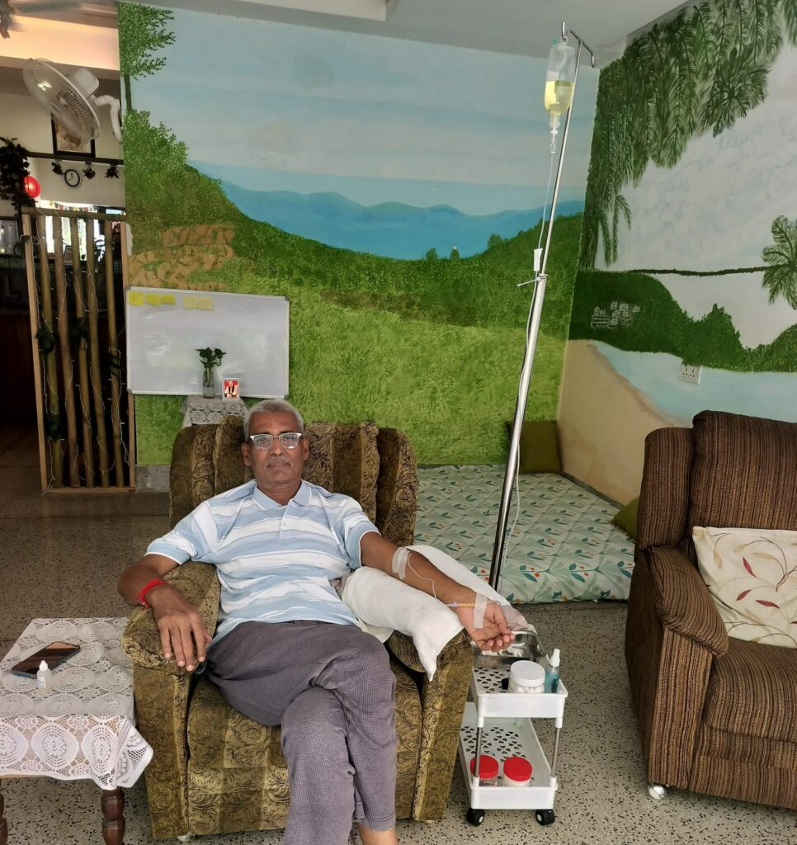
Ozone Therapy Treatment
Detoxify and energize with ozone therapy treatment that clears toxins, harmful microbes, and inflammation while safely boosting cellular antioxidant levels.

Slide 3
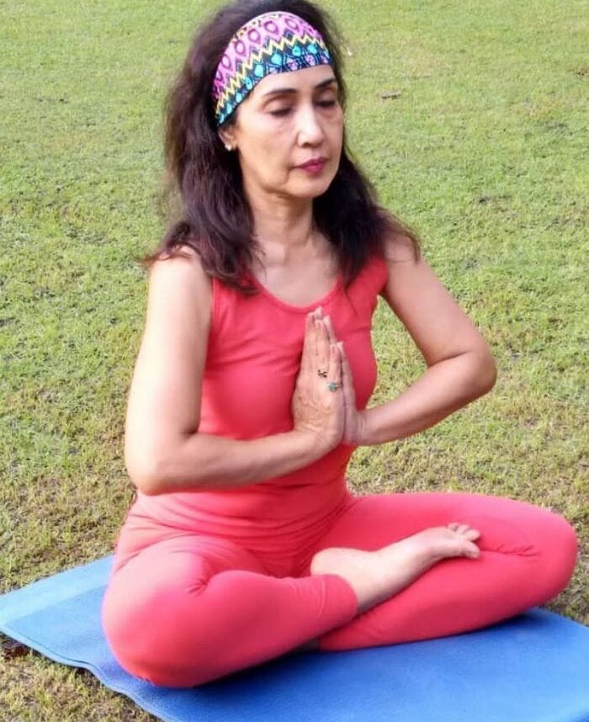
Meditation Centre in South Delhi
Balance your mind, body, and energy at a meditation centre in South Delhi, offering personalized meditation sessions to boost immunity, sleep, and wellness.

Slide 4
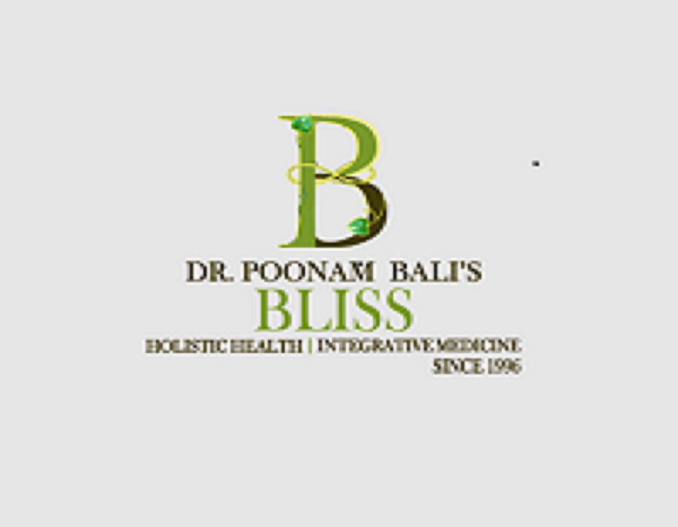
Contact Us
About: At Dr. Bali’s Bliss, our expert team brings together years of experience in holistic health & wellness. We combine natural therapies like Homeopathy, Ayurveda, Naturopathy, and Yoga with advanced treatments.
Address: 23, near NIFT, Block X, Hauz Khas, New Delhi, Delhi 110016
Website: https://drbalisbliss.com/

