Slide 1


Quora Web Solution
Website Design and
Development
Company
Web Design & Web Development
Company in Bangalore, India
www.quorawebsolution.com
+91 9986 056 909
info@quorawebsolutions.com
24A, 1st Main Rd, Chandra Reddy
Layout, Koramangala 4th Block,
Koramangala, Bengaluru,
Karnataka 560034

Slide 2
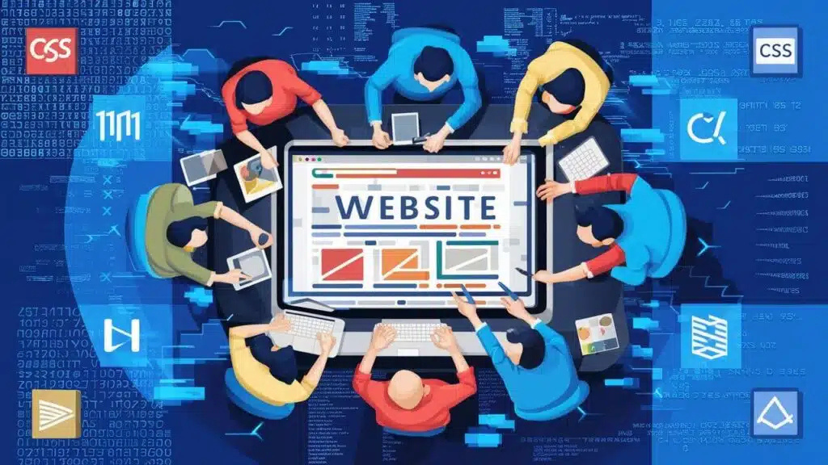
Choosing the Right Web Development Technologies: A Comprehensive Guide for Businesses
Introduction
In today's digital landscape, having a well-designed and functional website is crucial for businesses of all sizes.
www.quorawebsolution.com

Slide 3
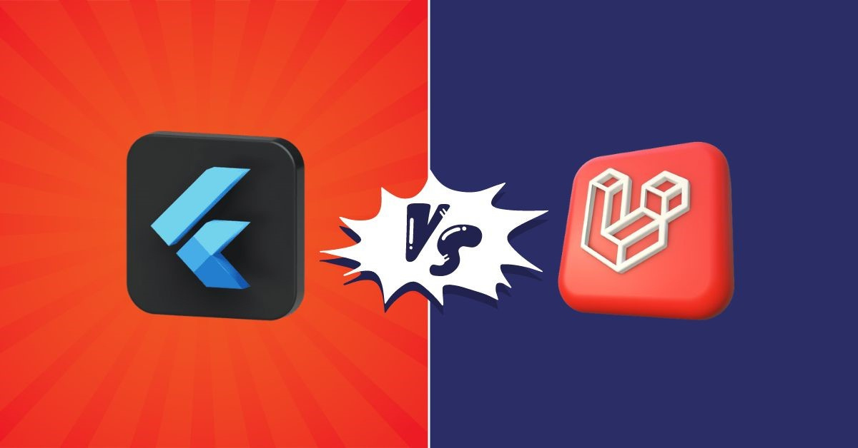
However, choosing the right web development technologies can be a challenging task, as there are numerous programming languages, frameworks, and tools available. Selecting the right technology stack ensures scalability, performance, and security while aligning with business goals.
www.quorawebsolution.com

Slide 4

This guide will help businesses understand key considerations when choosing web development technologies.
Understanding Web Development Technologies
www.quorawebsolution.com

Slide 5

Web development technologies can be categorized into three main components:
Frontend Technologies: These include HTML, CSS, JavaScript, and frameworks such as React, Angular, and Vue.js. They define how a website looks and interacts with users.
www.quorawebsolution.com

Slide 6
Backend Technologies: These consist of server-side programming languages like Node.js, Python, Ruby, PHP, and Java, along with frameworks like Django, Express.js, Laravel, and Spring.
Databases: Databases store and manage website data. Common options include MySQL, PostgreSQL, MongoDB, and Firebase.
Factors to Consider When Choosing Web Development Technologies
1. Project Requirements
Different projects have different requirements. A simple business website may need a CMS like WordPress, while a complex web application might require a combination of frontend and backend frameworks.
2. Scalability and Performance
Consider how much traffic your website is expected to handle.
www.quorawebsolution.com

Slide 7
Technologies like Node.js and Golang are known for handling high concurrency, while databases like PostgreSQL and MongoDB offer great scalability options.
3. Security
Security is a critical factor in web development. Frameworks like Django (Python) and Spring (Java) offer built-in security features, while DevSecOps practices ensure secure development from the start.
4. Development Speed and Ease of Use
For rapid development, frameworks like Laravel (PHP) and Ruby on Rails (Ruby) provide pre-built components that reduce coding efforts. Low-code and no-code platforms can also be an option for businesses needing quick solutions.
5. Cost and Budget Constraints
Open-source technologies like React, Node.js, and Python can help reduce licensing costs.
www.quorawebsolution.com

Slide 8
However, managed hosting services and cloud-based solutions like AWS, Google Cloud, and Azure might require additional investments.
6. Community Support and Documentation
Choosing technologies with strong community support ensures access to tutorials, forums, and troubleshooting resources. Popular technologies like JavaScript, Python, and PHP have vast developer communities.
7. Integration Capabilities
If your business requires integrations with third-party services like CRM, payment gateways, or APIs, choose technologies that support seamless integration, such as RESTful APIs or GraphQL.
Recommended Tech Stacks for Different Business Needs
www.quorawebsolution.com

Slide 9
Small Business Websites: WordPress, Wix, or Webflow for easy content management.
E-Commerce Platforms: Shopify, Magento, WooCommerce, or custom-built solutions using React and Node.js.
Enterprise Applications: Java (Spring Boot), .NET, or Python (Django) for robust and secure solutions.
Startups and MVPs: MERN (MongoDB, Express.js, React, Node.js) or MEAN (MongoDB, Express.js, Angular, Node.js) stacks for flexibility and rapid prototyping.
Data-Driven Applications: Python (Flask/Django) with PostgreSQL or MongoDB for AI-driven or analytics-based platforms.
Conclusion
Choosing the right web development technologies depends on various factors, including project complexity, budget, scalability, and security needs.
www.quorawebsolution.com

Slide 10
Businesses should assess their goals and consult experienced developers or agencies to determine the best tech stack. By selecting the right technologies, businesses can create efficient, secure, and scalable web applications that meet customer expectations and industry standards.
The Ultimate Guide to Website Design and Development: From Concept to Launch
Introduction
www.quorawebsolution.com

Slide 11
Creating a website is an essential step for businesses, entrepreneurs, and organizations looking to establish a strong online presence. A well-designed and developed website not only enhances brand credibility but also improves user experience and increases conversions. This guide will take you through every stage of website design and development, from initial planning to a successful launch.
Phase 1: Planning and Research
1. Define Your Goals and Objectives
Determine the purpose of your website (e.g., business, e-commerce, portfolio, blog).
Identify your target audience and their needs.
Set clear, measurable goals for performance and engagement.
www.quorawebsolution.com

Slide 12
2. Conduct Market and Competitor Research
Analyze industry trends and customer expectations.
Analyze competitors' websites to understand their strengths, identify potential gaps, and discover opportunities for differentiation.
Gather inspiration for design and functionality.
3. Choose the Right Website Platform
Content Management Systems (CMS): WordPress, Joomla, Drupal.
E-commerce Platforms: Shopify, Magento, WooCommerce.
www.quorawebsolution.com

Slide 13
Custom Development: HTML, CSS, JavaScript with frameworks like React or Angular.
Phase 2: Website Design
1. Wireframing and Prototyping
Create wireframes to outline layout and navigation.
Use tools like Figma, Adobe XD, or Sketch for prototyping.
2. UI/UX Design Principles
Focus on intuitive navigation and user-friendly interfaces.
Ensure accessibility and mobile responsiveness.
Optimize for fast loading times and clean aesthetics.
www.quorawebsolution.com

Slide 14
3. Visual Elements and Branding
Select a color palette that reflects your brand's personality and enhances user engagement.
Use high-quality images, graphics, and typography.
Design call-to-action (CTA) buttons to enhance user engagement.
Phase 3: Website Development
1. Frontend Development
Convert designs into code using HTML, CSS, and JavaScript.
Implement animations and interactive elements using libraries like GSAP or jQuery.
2. Backend Development
Set up server-side logic using Node.js, PHP, Python, or Ruby.
www.quorawebsolution.com

Slide 15
Connect databases like MySQL, PostgreSQL, or MongoDB.
Develop APIs to enable data exchange between frontend and backend.
3. Content Management and SEO Optimization
Implement an SEO-friendly structure with proper meta tags and schema markup.
Optimize images and content for faster loading speeds.
Use strategic keywords to improve search engine ranking.
Phase 4: Testing and Launch
1. Quality Assurance (QA) Testing
Test website functionality, forms, and interactive elements.
www.quorawebsolution.com

Slide 16
Conduct cross-browser and mobile responsiveness testing.
Check security features and SSL certification.
2. Performance Optimization
Minify CSS, JavaScript, and HTML files.
Enable caching and use Content Delivery Networks (CDN).
Optimize images using next-gen formats like WebP and compress files to enhance loading speeds and overall performance.
3. Website Deployment and Monitoring
Choose a reliable hosting provider and set up domain configurations.
www.quorawebsolution.com

Slide 17
Deploy the website using FTP, Git, or cloud services.
Track website performance and user behavior using analytics tools such as Google Analytics, Search Console, and heatmaps for deeper insights.
Conclusion
Website design and development require careful planning, execution, and testing to create a seamless online experience for users. By following these phases, businesses can ensure a successful website launch that meets industry standards, attracts visitors, and achieves their digital goals. Regular updates, security maintenance, and performance monitoring will keep the website relevant and efficient over time.
www.quorawebsolution.com

Slide 18
Quora Web Solution: Quora Web Solution is a trusted website development company based in Bangalore, India, offering a wide array of services to not only domestic but global clientele. Be it Website Design and Development, SEO services, Digital Marketing, Branding, App Development, Ecommerce Solution, and Logo Creation . Quora Web Solution has the best website developers offering top quality services and that is the reason why we are well known as one of the best Website Development Companies in Bangalore, India.
Visit Us - www.quorawebsolution.com
Call Us - +91 9986 056 909
Mail Us - info@quorawebsolutions.com
www.quorawebsolution.com

Slide 19

WORDPRESS DEVELOPMENT
ECOMMERCE DEVELOPMENT
PHP DEVELOPMENT
CMS DEVELOPMENT
DRUPAL DEVELOPMENT
WEBSITE SERVICES
WEBPORTAL DEVELOPMENT
MAGENTO DEVELOPMENT
WEBSITE DEVELOPMENT
JOOMLA DEVELOPMENT
SMALL BUSINESS DEVELOPMENT
CHEAP WEBSITE DEVELOPMENT
STATIC WEBSITE DEVELOPMENT
DYNAMIC WEBSITE DEVELOPMENT
WEBSITE DESIGN COMPANY
TOUR AND TRAVEL WEBSITE DEVELOPMENT
Services

