Slide 1

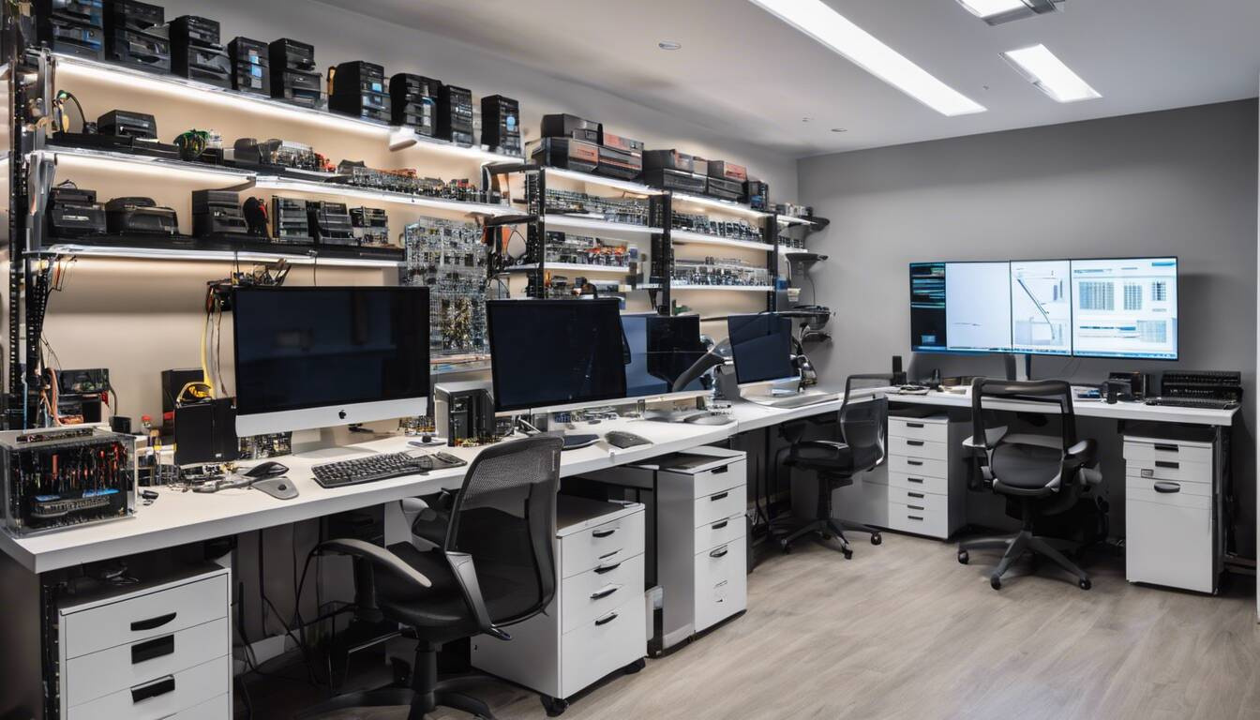
Quora Web Solution
Website Design and
Development
Company
Web Design & Web Development
Company in Bangalore, India
www.quorawebsolution.com
+91 9986 056 909
info@quorawebsolutions.com
24A, 1st Main Rd, Chandra Reddy
Layout, Koramangala 4th Block,
Koramangala, Bengaluru,
Karnataka 560034

Slide 2

From Concept to Launch: A Step-by-Step Guide to Building a High-Performance Website
A well-designed and high-performance website is crucial for businesses, brands, and individuals looking to establish a strong online presence. Whether you’re creating a new website from scratch or revamping an existing one, following a structured approach ensures success.
www.quorawebsolution.com

Slide 3

This guide will walk you through the entire process, from the initial concept to the final launch.
Step 1: Define Your Goals and Objectives
Before you start designing or developing, it’s essential to have a clear understanding of what you want to achieve. Ask yourself:
www.quorawebsolution.com

Slide 4

What is the purpose of the website? (e.g., e-commerce, portfolio, informational, blog, etc.)
Who is the target audience?
What key actions do you want visitors to take?
What are the performance expectations?
www.quorawebsolution.com

Slide 5

Clearly defining these goals will help guide every subsequent decision in the development process.
Step 2: Research and Planning
A strong foundation begins with thorough research and planning:
Competitive Analysis – Study similar websites in your industry to identify strengths and weaknesses.
www.quorawebsolution.com

Slide 6
User Persona Development – Understand your target audience's needs, behaviors, and preferences.
Content Strategy – Plan the type of content (text, images, videos, etc.) that will best serve your audience.
Wireframing & Site Architecture – Create a blueprint outlining the website’s structure, navigation, and user flow.
Step 3: Choose the Right Technology Stack
The choice of technology impacts website performance, scalability, and maintenance. Some common options include:
Content Management Systems (CMS): WordPress, Joomla, Drupal
Custom Development: HTML, CSS, JavaScript frameworks (React, Angular, Vue.js)
Backend Technologies: PHP, Node.js, Python, Ruby on Rails
Hosting Providers: AWS, Bluehost, SiteGround, or self-hosting
www.quorawebsolution.com

Slide 7
## Step 4: Design the User Experience (UX) and User Interface (UI)
Creating a seamless and engaging user experience is essential for a high-performance website. The design should be visually appealing, easy to navigate, and accessible to all users. Here are key elements to consider:
Mobile Responsiveness: Ensure the design adapts smoothly to different screen sizes and resolutions.
User-Centered Navigation: Structure menus, buttons, and layout logically to enhance usability.
Consistent Branding: Use uniform colors, typography, and visual elements to strengthen brand identity.
Engaging Interactions: Incorporate animations, hover effects, and interactive elements to enhance user engagement.
Accessibility Features: Optimize for all users, including those with disabilities, by following WCAG guidelines.
Loading Speed Optimization: Use efficient design elements that do not compromise website performance.
www.quorawebsolution.com

Slide 8
A well-crafted UX/UI enhances user satisfaction, increases engagement, and contributes to overall website success. Crafting an engaging and seamless user experience is essential for a high-performance website. A well-thought-out UX/UI design ensures users can navigate effortlessly, find information quickly, and enjoy a visually appealing interface. Key aspects to consider include:
Responsive Design: Adapting layouts for various screen sizes and devices to provide a consistent experience.
User-Centered Navigation: Structuring menus and site architecture for easy access to information and intuitive browsing.
Visual Hierarchy: Using strategic typography, colors, and spacing to highlight important content and calls-to-action.
www.quorawebsolution.com

Slide 9
Interactive Elements: Implementing animations, hover effects, and micro-interactions to enhance engagement.
Branding & Consistency: Aligning the design with your brand identity through fonts, colors, and imagery.
Accessibility & Inclusivity: Ensuring the website is usable by all individuals, including those with disabilities, through proper contrast, alt text, and keyboard navigation. A visually appealing and user-friendly design enhances engagement and conversions. Key design considerations include:
Responsive Design: Ensuring compatibility with different screen sizes and devices.
Intuitive Navigation: Making it easy for users to find what they need.
Brand Consistency: Using color schemes, typography, and imagery that align with your brand identity.
Accessibility: Ensuring the website is usable for all individuals, including those with disabilities.
Step 5: Develop the Website
www.quorawebsolution.com

Slide 10
Once the design is finalized, developers bring it to life. The development process includes:
Front-end Development: Building the visible aspects of the website using HTML, CSS, and JavaScript.
Back-end Development: Implementing databases, user authentication, and other server-side functions.
Content Integration: Adding text, images, videos, and other media.
Performance Optimization: Compressing images, optimizing code, and leveraging caching techniques.
Step 6: Testing and Quality Assurance
Before launch, rigorous testing ensures functionality, security, and performance. This includes:
Cross-browser and Device Testing: Ensuring the website works on all major browsers and mobile devices.
Performance Testing: Checking load times and optimizing speed.
SEO Auditing: Ensuring on-page SEO elements (meta tags, alt text, headings) are properly implemented.
Security Checks: Implementing SSL, firewalls, and protection against vulnerabilities.
Step 7: Launch and Deployment
www.quorawebsolution.com

Slide 11
With thorough testing complete, it’s time to go live! Key launch steps include:
Domain Setup and Hosting Configuration: Connecting your website to your domain name.
Final Performance Check: Ensuring everything functions as expected before making the site public.
Marketing and Promotion: Announcing the launch through social media, email newsletters, and other channels.
Monitoring and Maintenance: Regularly updating content, fixing bugs, and ensuring long-term performance.
Conclusion
Building a high-performance website requires careful planning, execution, and continuous optimization. By following this structured approach, you can create a website that not only meets your business goals but also provides a seamless user experience. Whether you’re developing an e-commerce platform, a personal portfolio, or a corporate site, the key is to prioritize usability, performance, and long-term scalability.
Need help with your website development? Our team of experts is here to guide you from concept to launch!
www.quorawebsolution.com

Slide 12
The Ultimate Guide to Website Design and Development: Trends, Technologies, and Best Practices for 2025
In an ever-evolving digital landscape, website design and development continue to play a crucial role in business success. As we step into 2025, emerging trends, advanced technologies, and best practices are shaping the future of web development. Whether you're a business owner, a developer, or a designer, staying updated with these changes is essential for creating high-performing, visually stunning, and user-friendly websites.
Web Design Trends for 2025
1. AI-Driven Personalization
Artificial intelligence (AI) is revolutionizing website design by offering personalized user experiences. AI algorithms analyze user behavior to deliver tailored content, product recommendations, and interactive elements in real-time.
2. Dark Mode and Minimalist Design
www.quorawebsolution.com

Slide 13
Dark mode continues to gain popularity due to its aesthetic appeal and reduced eye strain. Additionally, minimalistic designs with clean layouts, bold typography, and strategic whitespace create a modern, user-friendly experience.
3. 3D Elements and Immersive Graphics
With advancements in web technologies, 3D visuals and immersive design elements are becoming more prominent. These enhance engagement, especially in industries like e-commerce, gaming, and real estate.
4. Microinteractions and Animations
Small, interactive elements such as hover effects, button animations, and loading indicators improve user engagement and provide a more dynamic experience.
5. Voice User Interface (VUI) Integration
Voice search and voice-controlled interactions are on the rise. Websites are now optimizing for voice commands, making navigation more seamless for users.
www.quorawebsolution.com

Slide 14
6. Augmented Reality (AR) in Web Design
AR technology is making its way into websites, allowing users to visualize products in real-world settings before making purchasing decisions.
Web Development Technologies for 2025
1. Progressive Web Apps (PWAs)
PWAs continue to dominate due to their ability to provide a fast, app-like experience within a browser. They offer offline functionality, quick loading speeds, and improved engagement.
2. Headless CMS and API-First Development
Decoupling the front-end and back-end with a headless CMS provides greater flexibility in content management and enhances performance.
3. Serverless Architecture
www.quorawebsolution.com

Slide 15
Serverless computing eliminates the need for traditional server management, enabling developers to build and deploy applications more efficiently and at a lower cost.
4. WebAssembly (Wasm)
WebAssembly allows developers to run high-performance applications in the browser, expanding the capabilities of web-based applications.
5. Enhanced Cybersecurity Measures
With increasing cyber threats, developers are integrating stronger security protocols such as multi-factor authentication (MFA), biometric authentication, and end-to-end encryption.
Best Practices for Modern Website Development
1. Mobile-First Design
www.quorawebsolution.com

Slide 16
With mobile traffic surpassing desktop usage, designing for mobile-first ensures a seamless user experience across all devices.
2. Core Web Vitals Optimization
Google’s Core Web Vitals focus on page speed, interactivity, and visual stability, all of which impact SEO rankings and user satisfaction.
3. Sustainable Web Design
Eco-friendly websites with optimized code, reduced server requests, and green hosting solutions contribute to a more sustainable digital ecosystem.
4. Accessibility Compliance
www.quorawebsolution.com

Slide 17
Ensuring your website meets Web Content Accessibility Guidelines (WCAG) improves inclusivity and broadens your audience reach.
5. SEO-Optimized Structure
A well-structured website with clean code, proper meta tags, and schema markup enhances search engine visibility and rankings.
Conclusion
As we move into 2025, website design and development will continue evolving with new trends, technologies, and best practices. Staying ahead of these changes will help businesses create high-performance, secure, and visually appealing websites that provide exceptional user experiences.
www.quorawebsolution.com

Slide 18
Whether you're launching a new site or revamping an existing one, integrating these innovations will set you apart in the competitive digital landscape.
Are you ready to future-proof your website for 2025? Let’s build something extraordinary!
www.quorawebsolution.com

Slide 19
Quora Web Solution: Quora Web Solution is a trusted website development company based in Bangalore, India, offering a wide array of services to not only domestic but global clientele. Be it Website Design and Development, SEO services, Digital Marketing, Branding, App Development, Ecommerce Solution, and Logo Creation . Quora Web Solution has the best website developers offering top quality services and that is the reason why we are well known as one of the best Website Development Companies in Bangalore, India.
Visit Us - www.quorawebsolution.com
Call Us - +91 9986 056 909
Mail Us - info@quorawebsolutions.com
www.quorawebsolution.com

Slide 20

WORDPRESS DEVELOPMENT
ECOMMERCE DEVELOPMENT
PHP DEVELOPMENT
CMS DEVELOPMENT
DRUPAL DEVELOPMENT
WEBSITE SERVICES
WEBPORTAL DEVELOPMENT
MAGENTO DEVELOPMENT
WEBSITE DEVELOPMENT
JOOMLA DEVELOPMENT
SMALL BUSINESS DEVELOPMENT
CHEAP WEBSITE DEVELOPMENT
STATIC WEBSITE DEVELOPMENT
DYNAMIC WEBSITE DEVELOPMENT
WEBSITE DESIGN COMPANY
TOUR AND TRAVEL WEBSITE DEVELOPMENT
Services

