Slide 1
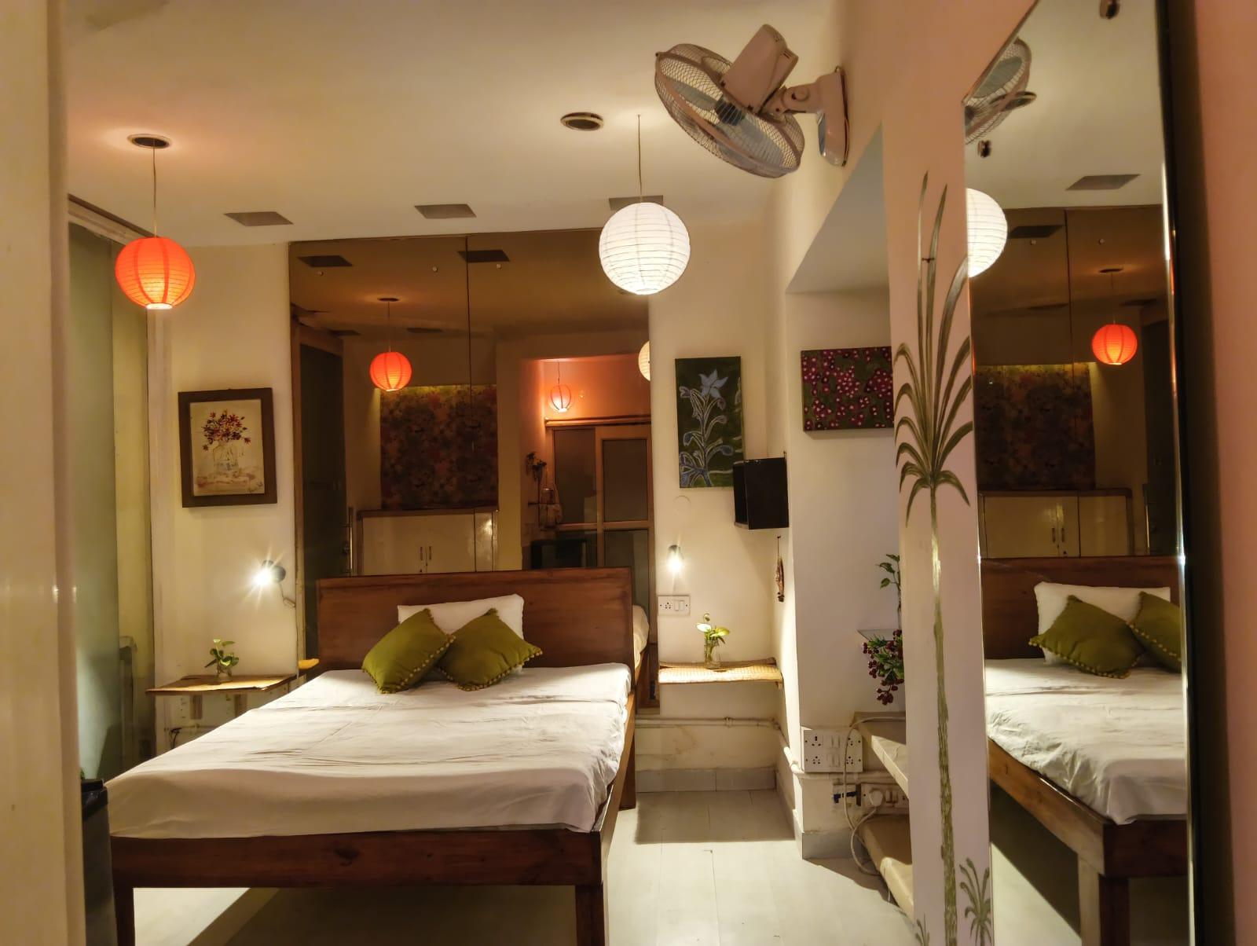
  Dr. Bali's Bliss Homestay
Homestay with Hot Water Facilities
Recharge your body and mind at a homestay with hot water facilities, nourishing detox meals, peaceful meditation spaces & calm greenery for ultimate wellness.
  https://drbalishomestay.com/

Slide 2
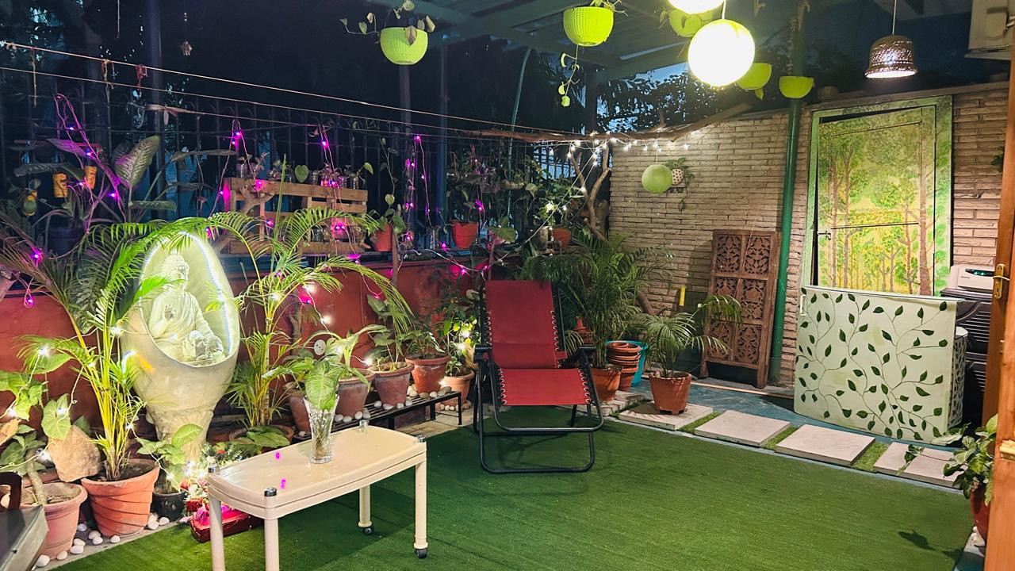
  Dr. Bali's Bliss Homestay
Delhi Homestay with Amenities
Enjoy a tranquil escape at a Delhi homestay with amenities, featuring well-lit reading spaces, breathtaking greenery, heritage park strolls & nourishing meals.
  https://drbalishomestay.com/

Slide 3
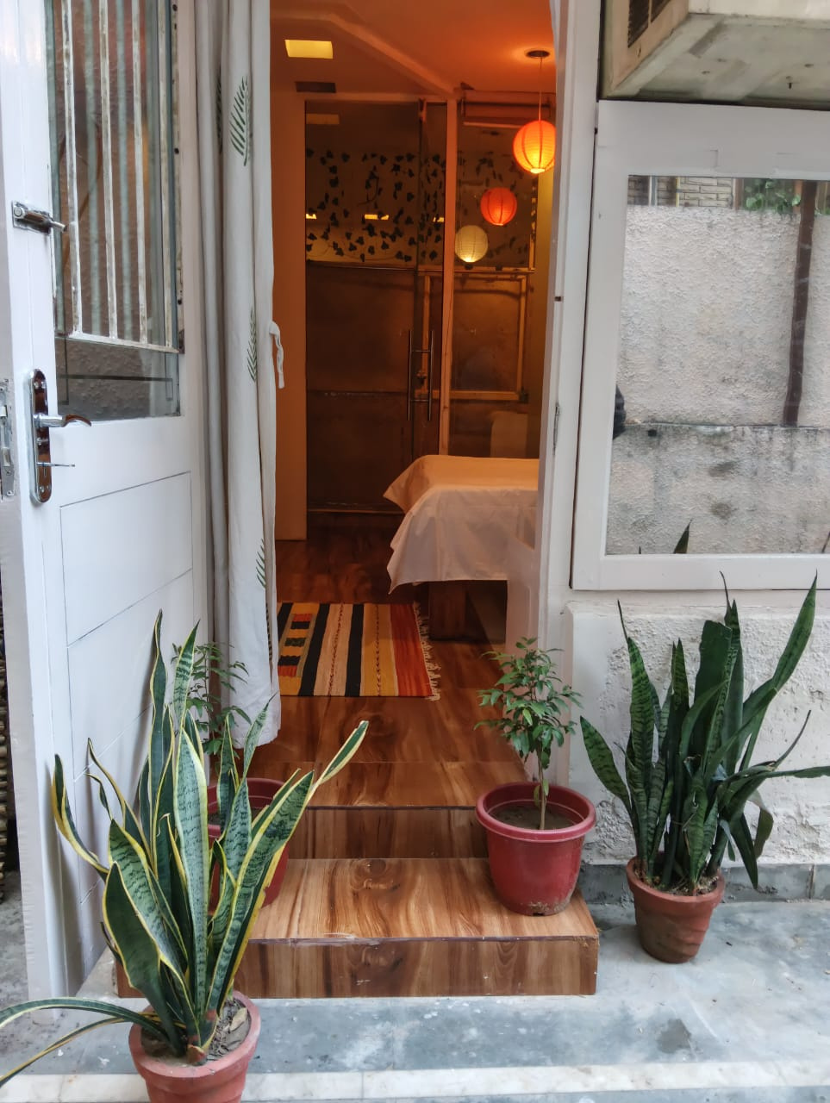
  Dr. Bali's Bliss Homestay
Comfortable Homestay in Delhi
Embrace ultimate relaxation and holistic wellness with meditation corners, scenic green views, and thoughtful comforts at a comfortable homestay in Delhi.
  https://drbalishomestay.com/

Slide 4
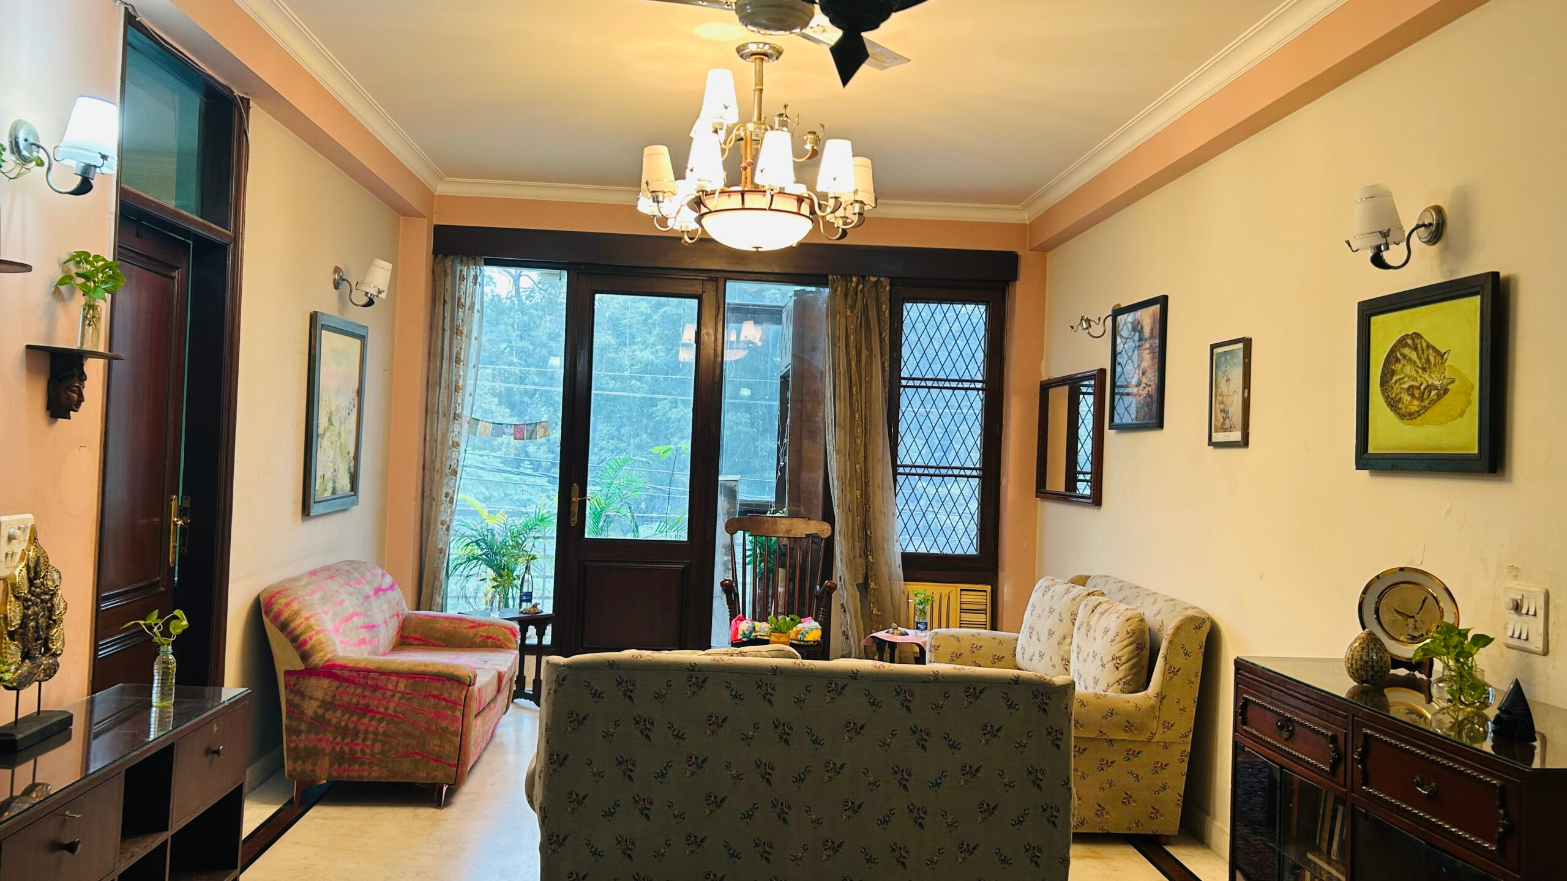




OUR CONTACT
+91 9810265484
https://drbalishomestay.com/
balisblisshomestay@gmail.com
X 22, GF, Hauz Khas, New Delhi – 110016

