Slide 1
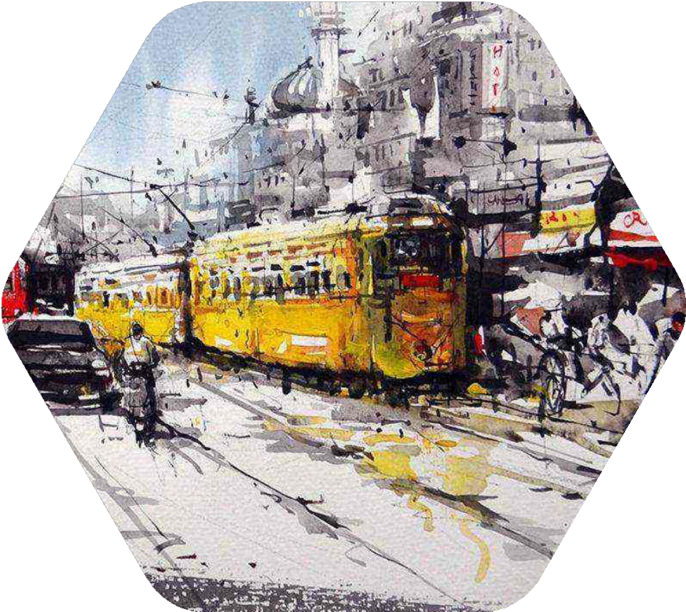
www.mojarto.com

Slide 2
Mojarto, founded in 2005, has been the largest and most innovative online art platform in the country. We are strong believers in the transformational power of technology and have long been the pioneering art entity in the country; bringing together artists, collectors, dealers, galleries and resellers onto a single powerful online platform. With a state of the art user experience, and a leading edge art portal backed by some
amazing analytics and data, we transform the art shopping experience, empower artists, and provide a huge convenience for those who wish to re-sell their art.Founded a decade ago, Mojarto was ahead of its time, bringing to the art world a number of 'firsts'. It was the first platform to democratize the art buying process, while also empowering the artist; the first platform with a completely transparent pricing and purchase process; the first platform to proactively help collectors re-sell their art. It was the first portal to bring on board galleries and dealers, art critics and writers alike – to bring art to every home. It is now also the first art portal in the country to be backed by
cutting-edge technology and data to drive its unique art selection and display process.
Mojarto was started by a small team of people who believed the art world experience would thrive online. We have grown to become a revolutionary international service that puts the best of Indian art at your fingertips to explore, engage with and bring home.
Our mission is to nurture and promote emerging artists side-by-side with masters of their field and create a unique, cutting-edge viewing experience with always-on international exhibitions, guest curations, gallery partnerships and daily updated videos and blogs that explore the ecology of the vibrant world of Indian art in a fun and engaging way.
www.mojarto.com

Slide 3
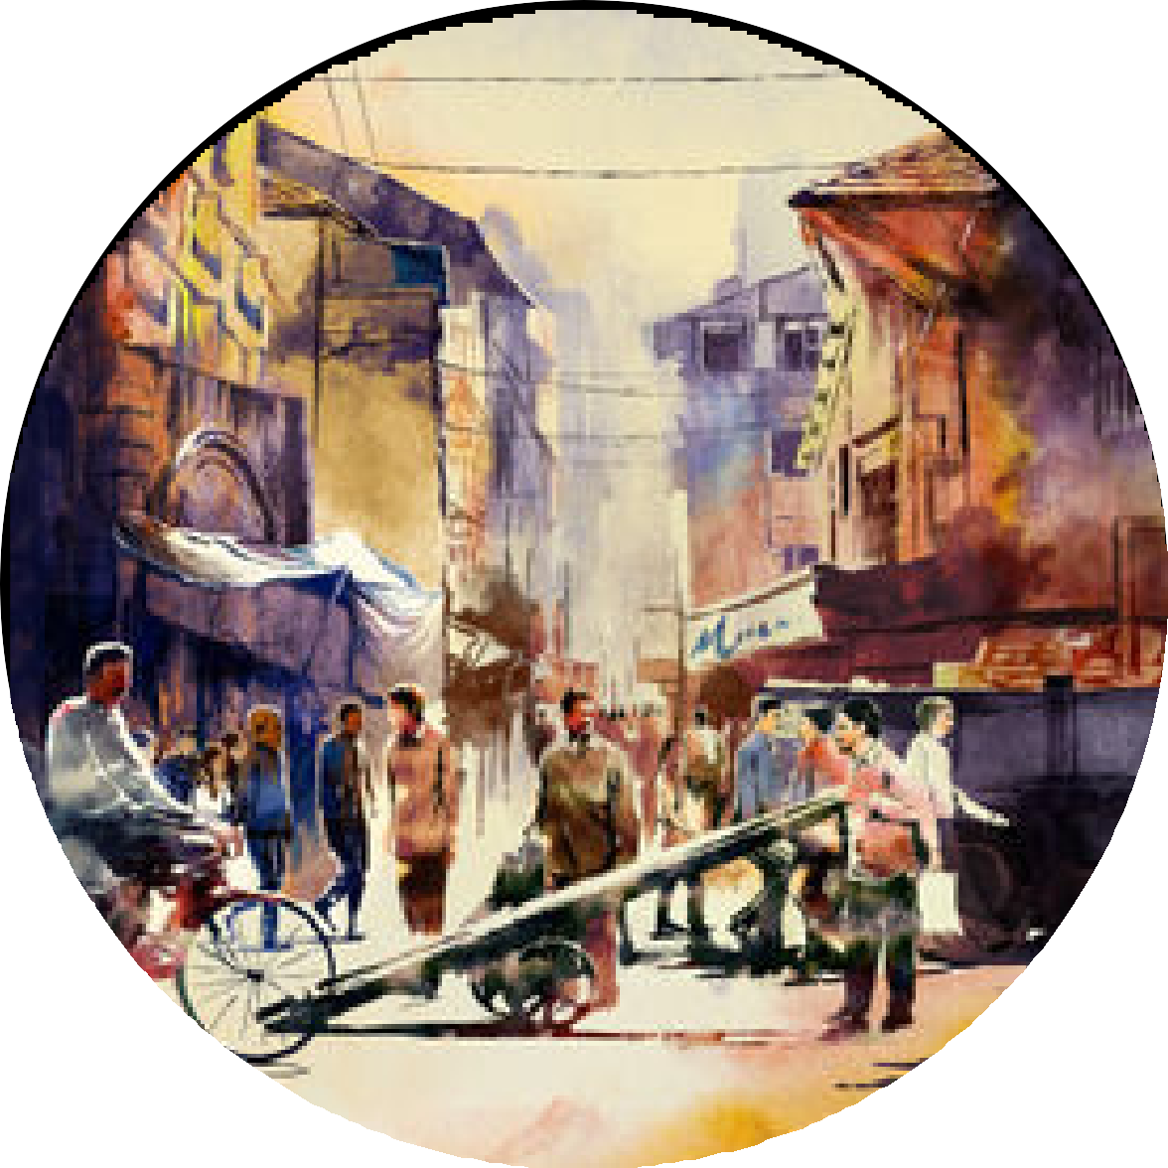
Why Buy Paintings Online in India?
Convenience of discovering authentic Indian art from home Access to exclusive collections not available offline Curated selections with quality assurance
Trusted platforms like Mojarto bring art closer to collectors
About Mojarto
India’s leading online art marketplace
Over 18,000+ artworks by emerging and established artists Verified artists and 100% original artworks
Easy browsing and secure buying experience
Explore Indian Art Styles
When you buy paintings online India with Mojarto, explore a variety of art styles: Contemporary Art
Traditional Indian Folk Art
Abstract, Figurative, and Landscape Paintings Watercolor, Oil, Acrylic & Mixed Media
Top Reasons to Choose Mojarto
Wide range of curated artworks Authenticity guaranteed
Smooth browsing and purchase experience Supporting Indian artists directly
How to Buy Paintings Online India with Mojarto
Visit www.mojarto.com
Browse by artist, style, or medium
View detailed artwork profiles with artist info
Choose your favorite artwork and place an order securely
Seamless Delivery Across India
Artworks safely packed and shipped to your doorstep Nationwide delivery with tracking
Trusted by thousands of collectors across India
www.mojarto.com

Slide 4



+916385753122
support@mojarto.com www.mojarto.com

Slide 5
www.mojarto.com

