Slide 1
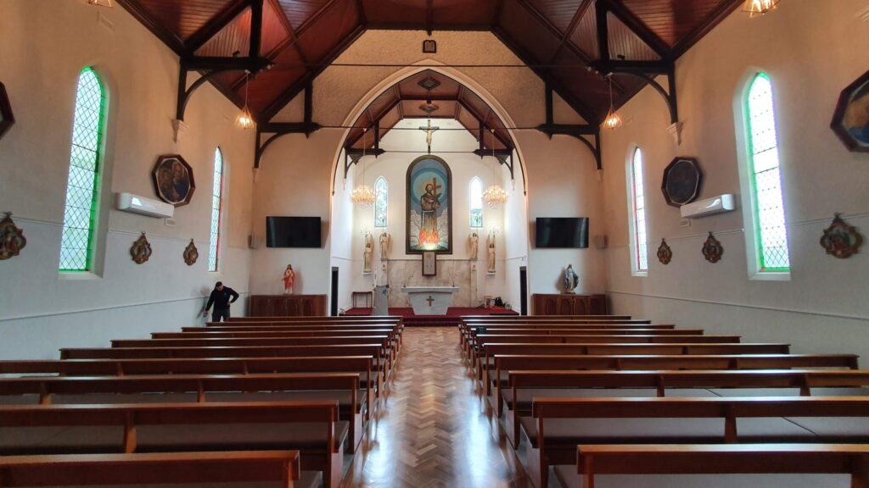
Commercial Electrician
Trusted commercial electrician at Electra Electrics deliver reliable installations, lighting, switchboards, and data solutions for businesses across Melbourne.

Slide 2
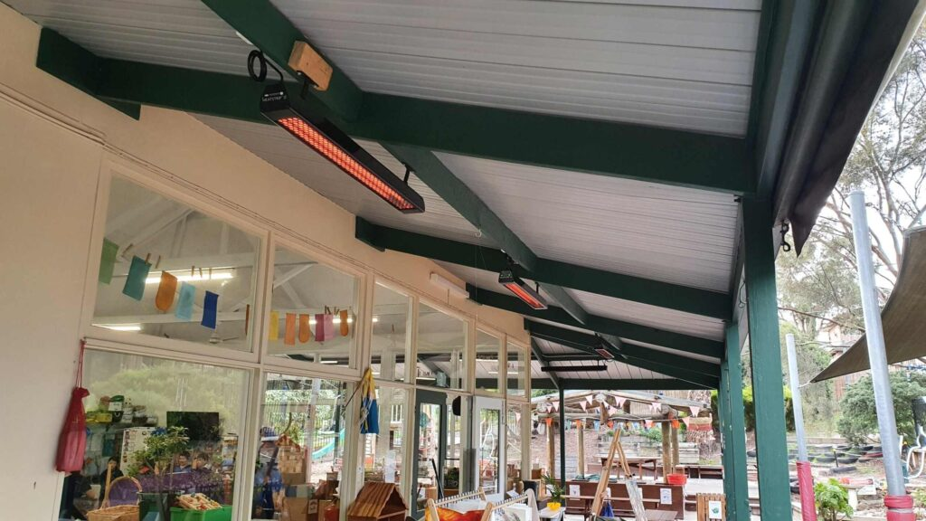
Residential Services
Electra Electrics provides expert residential services, including electrical installations, lighting, switchboard upgrades, smoke alarms & smart home systems.

Slide 3
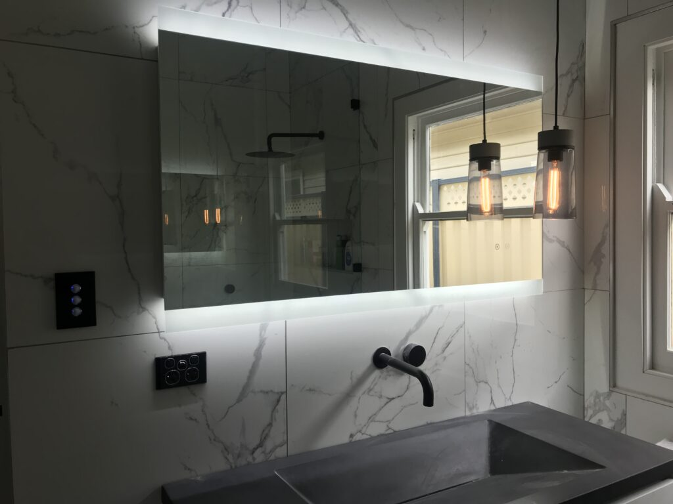
Residential Electrical Services
Keep your home safe and efficient with Electra Electrics’ residential electrical services, from lighting and power points to smoke alarms and smart systems.

Slide 4

Contact Us
Bio: Electra Electrics is your trusted local electrician for homes and businesses across Australia. From residential installations to commercial fit-outs, data, and security systems, our team delivers high-quality electrical work.
Country: Australia
Phone No.: 0433 057 123
Website: https://electraelectrics.com.au/

