Slide 1

How Rooftop Event Space NYC Adds Charm to Any Event
Any event must feel special without fail. It should likewise leave lasting memories. An event space matters a lot in this case. A rooftop event space NYC will elevate any event. They offer charm along with open air in one location. You can celebrate where the sky will be your ceiling. This setting will feel personal as well as grand. This guide will explore how rooftop event spaces can add charm to any event.

Slide 2

THE EXPERIENCE
Breathtaking Panoramic Views
Every guest would like to get spectacular views from the rooftop. The biggest draw will be the panoramic views. This scene almost resembles a painting. The spectacular landmarks will become an integral part of your story. The view will remain memorable even when the sunlight shifts. There will be no window between the scenery and you. Your celebration will feel momentous due to this enhanced setting. A rooftop event space NYC adds drama to every event.

Slide 3
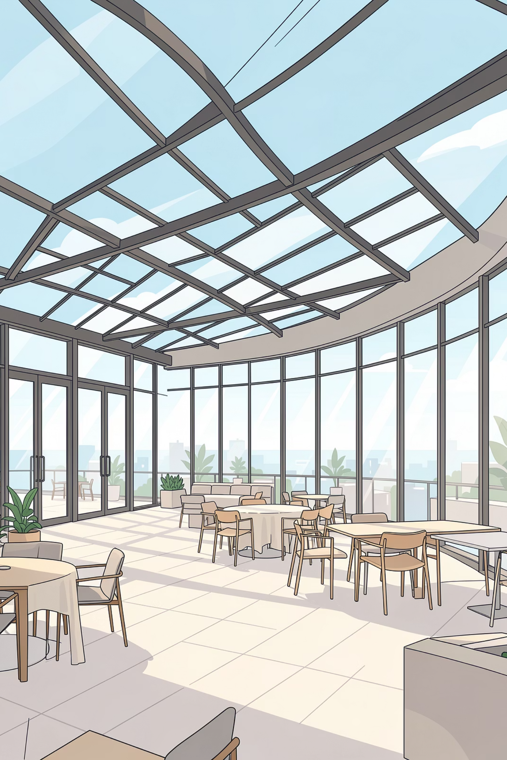
Unparalleled Photographic Opportunities
Every photographer prefers a rooftop wedding for capturing photos. This elevated location opens numerous creative opportunities. It is possible to sweep romantic silhouettes and skyline shots. The photographer will get artistic chances due to the changing light. Every corner provides a picture-perfect location. Your wedding album will become a visual story. It will be packed with energy. It will also be filled with light and timeless elegance. These types of photo opportunities will create charming memories.

Slide 4
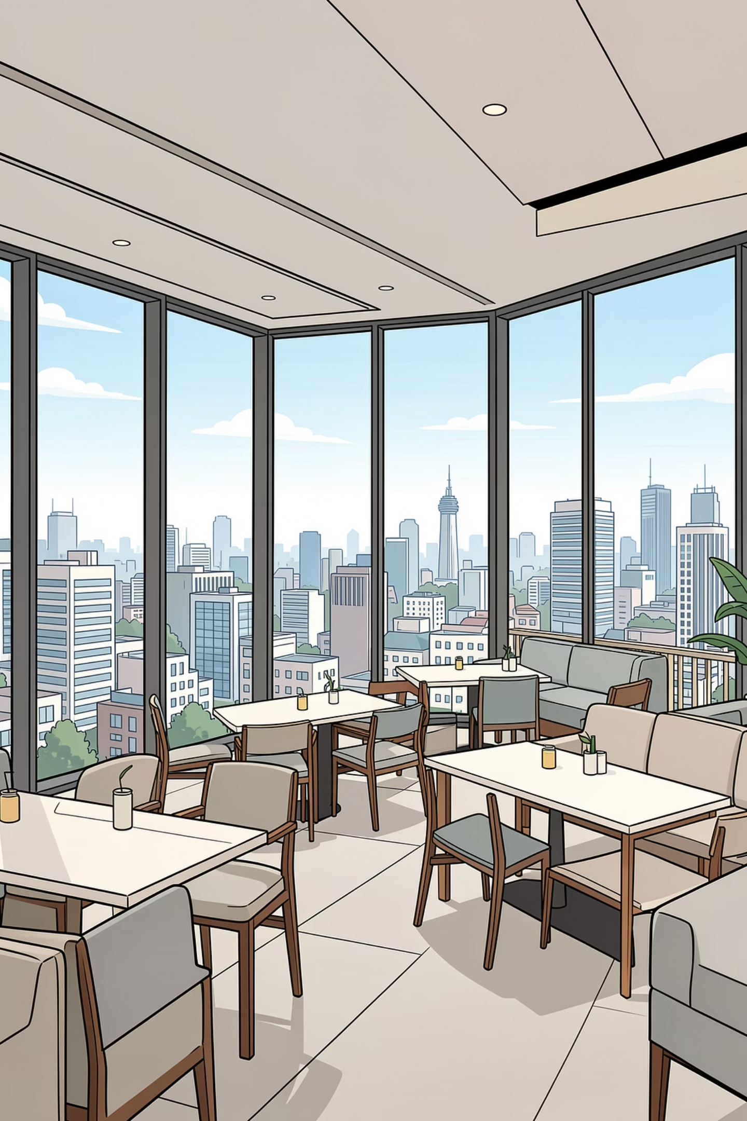
A Happier Open-Air Experience
Breathtaking Design
Fresh air will change everything on the rooftop. Individuals prefer those open rooftop venues NYC where they can breathe better. There will be adequate sunlight. There will likewise be adequate ventilation of air. People will feel lighter. There will be adequate space to roam. People can converse with each other easily. This rooftop experience is extraordinary in every way. This healthy feeling will add undeniable charm.

Slide 5
Ideal for Diverse Events
One can use the rooftop lounge for various events. Everything will appear to be magical under the open sky. It is ideal for weddings. It is also perfect for corporate events. One can also celebrate a birthday right here. You can also organize a chill barbecue night. It will work wonders for intimate dinners as well. The rooftop space offers a stylish setting for virtually any celebration. It will add charm to any occasion.
Summing up
In summary, the best rooftop venues will add charm successfully. They can do this by providing breathtaking views. It creates a relaxed atmosphere for every guest out there. It will also provide unique photo opportunities. The open-air experience is healthier. The guests will also feel happy in these settings. A rooftop venue will make any occasion outstanding. It will transform your event into a charming celebration.
Resource URL:- https://tumblrblog.com/how-rooftop-event-space-nyc-adds-charm-to-any-event/

Slide 6

Contact Us
Business Name:- BEST VENUES
Phone: +1 (212) 969-9804
Mail:- info@bestvenuesgroup.com
Website:- https://www.bestvenuesnewyork.com/
Add:- 601 W 57th St, New York, NY 10019, USA

