Slide 1



Quora Web Solution
Website Design and
Development
Company
Web Design & Web Development
Company in Bangalore, India
www.quorawebsolution.com
+91 9986 056 909
info@quorawebsolutions.com
24A, 1st Main Rd, Chandra Reddy
Layout, Koramangala 4th Block,
Koramangala, Bengaluru,
Karnataka 560034

Slide 2

Designing the Future of Your Business: A Comprehensive Guide to Website Design and Development
In today's digital age, a website is no longer just an online brochure; it's the cornerstone of your business's online presence.
www.quorawebsolution.com

Slide 3

A well-designed and developed website can significantly impact your brand image, customer engagement, and ultimately, your bottom line. In this comprehensive guide, we'll delve into the intricacies of website design and development, exploring the key elements that contribute to a successful online platform.
www.quorawebsolution.com

Slide 4
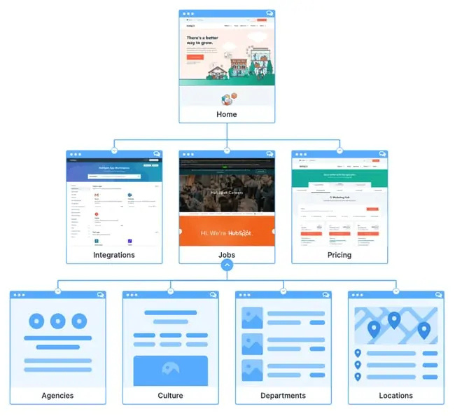
The Foundation: Understanding Your Goals
www.quorawebsolution.com

Slide 5
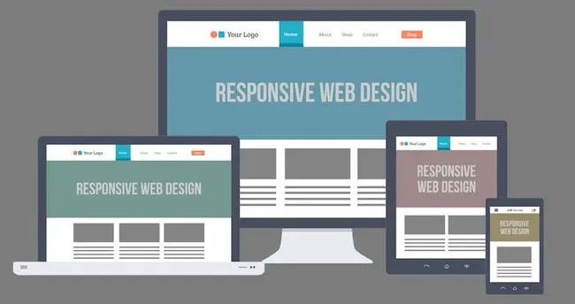
Before embarking on your website development journey, it's crucial to define your goals. Consider the following:
www.quorawebsolution.com

Slide 6
  Brand Identity: What is your brand's unique message?
  Key Performance Indicators (KPIs): What metrics will measure success?
Once you have a clear understanding of your objectives, you can begin to shape the direction of your website.
The Blueprint: Planning Your Website Structure
A well-structured website is easy to navigate. Here are some key considerations for planning your website's structure:
  Organize content logically.
  User Experience (UX) Design: Prioritize user needs and create intuitive flows.
  User Interface (UI) Design: Design functional interfaces for a seamless user experience.
The Aesthetics: Crafting a Visually Appealing Design
A visually appealing website can captivate your audience and leave a lasting impression. Consider the following design elements:
  Color Palette: Choose colors that reflect your brand identity and evoke the desired emotions.
www.quorawebsolution.com

Slide 7
  Typography: Select fonts that are easy to read and enhance your brand's personality.
  Imagery: Use high-quality images and visuals to complement your content.
The Technicalities: Building a Robust Website
A reliable website is essential for optimal performance and security.
The Content: Creating Engaging and Informative Content
Content is the heart of your website. High-quality content can attract and retain visitors. Consider the following content strategies:
  Blogging: Regularly publish blog posts to share valuable insights and drive traffic to your website.
  Content Marketing: Create engaging content to attract and nurture your target audience.
  Call-to-Action (CTA): Encourage visitors to act.
The Launch and Beyond: Maintaining and Optimizing Your Website
www.quorawebsolution.com

Slide 8
Once your website is launched, the work isn't over. Maintain and optimize it for long-term success.. Here are some key considerations:
  Regular Updates: Keep your website's content fresh and up-to-date.
  Performance Monitoring: Track your website's performance and identify areas for improvement.
  Security Audits: Conduct regular security audits to protect your website from vulnerabilities.
By following these guidelines and working with experienced website design and development professionals, you can create a website that drives business growth and helps you achieve your online goals.
From Concept to Click: The Art and Science of Exceptional Website Design and Development
In today's digital age, a website is more than just an online brochure; it's a powerful tool that can shape your brand's image, drive customer engagement, and ultimately, boost your bottom line.
www.quorawebsolution.com

Slide 9
A well-crafted website is a harmonious blend of art and science, combining stunning design with robust functionality.
The Art of Design:
  Visual Identity: Reflect your brand's personality and values.
  User Experience (UX): A great website is easy to navigate and user-friendly. Consider factors like information architecture, layout, and readability.
  User Interface (UI): The UI elements, such as buttons, forms, and menus, should be intuitive and visually appealing.
The Science of Development:
  Responsive Design: Ensure your website looks and functions seamlessly across all devices, from desktops to smartphones.
  Web Performance: Optimize your website's loading speed to improve user experience and search engine rankings.
  Security: Protect your website and your users' data with robust security measures.
  Accessibility: Design with everyone in mind.
www.quorawebsolution.com

Slide 10
The Power of Content:
  Engaging Content: Create high-quality, informative, and engaging content that resonates with your target audience.
  SEO: Optimize your website for search engines to improve visibility.
  Content Marketing: Use content marketing strategies to attract and retain visitors.
The Importance of Maintenance:
  Regular Updates: Keep your website's content fresh and up-to-date.
  Performance Monitoring: Monitor your website's performance.
  Security Audits: Conduct regular security audits to protect your website from vulnerabilities.
Choosing the Right Partner:
  Experience and Expertise: Choose a company with a proven track record.
www.quorawebsolution.com

Slide 11
  Communication: Effective communication is key.
  Client Reviews and Testimonials: Read reviews and testimonials to gauge a company's reputation.
  Pricing and Packages: Choose a package that fits your budget and needs.
By combining the art of design and the science of development, you can create a website that leaves a lasting impression and drives real results for your business.
www.quorawebsolution.com

Slide 12
Quora Web Solution: Quora Web Solution is a trusted website development company based in Bangalore, India, offering a wide array of services to not only domestic but global clientele. Be it Website Design and Development, SEO services, Digital Marketing, Branding, App Development, Ecommerce Solution, and Logo Creation . Quora Web Solution has the best website developers offering top quality services and that is the reason why we are well known as one of the best Website Development Companies in Bangalore, India.
Visit Us - www.quorawebsolution.com
Call Us - +91 9986 056 909
Mail Us - info@quorawebsolutions.com
www.quorawebsolution.com

Slide 13




Services
WORDPRESS DEVELOPMENT
ECOMMERCE DEVELOPMENT
PHP DEVELOPMENT
CMS DEVELOPMENT
DRUPAL DEVELOPMENT
WEBSITE SERVICES
WEBPORTAL DEVELOPMENT
MAGENTO DEVELOPMENT
WEBSITE DEVELOPMENT
JOOMLA DEVELOPMENT
SMALL BUSINESS DEVELOPMENT
CHEAP WEBSITE DEVELOPMENT
STATIC WEBSITE DEVELOPMENT
DYNAMIC WEBSITE DEVELOPMENT
WEBSITE DESIGN COMPANY
TOUR AND TRAVEL WEBSITE DEVELOPMENT

