Slide 1
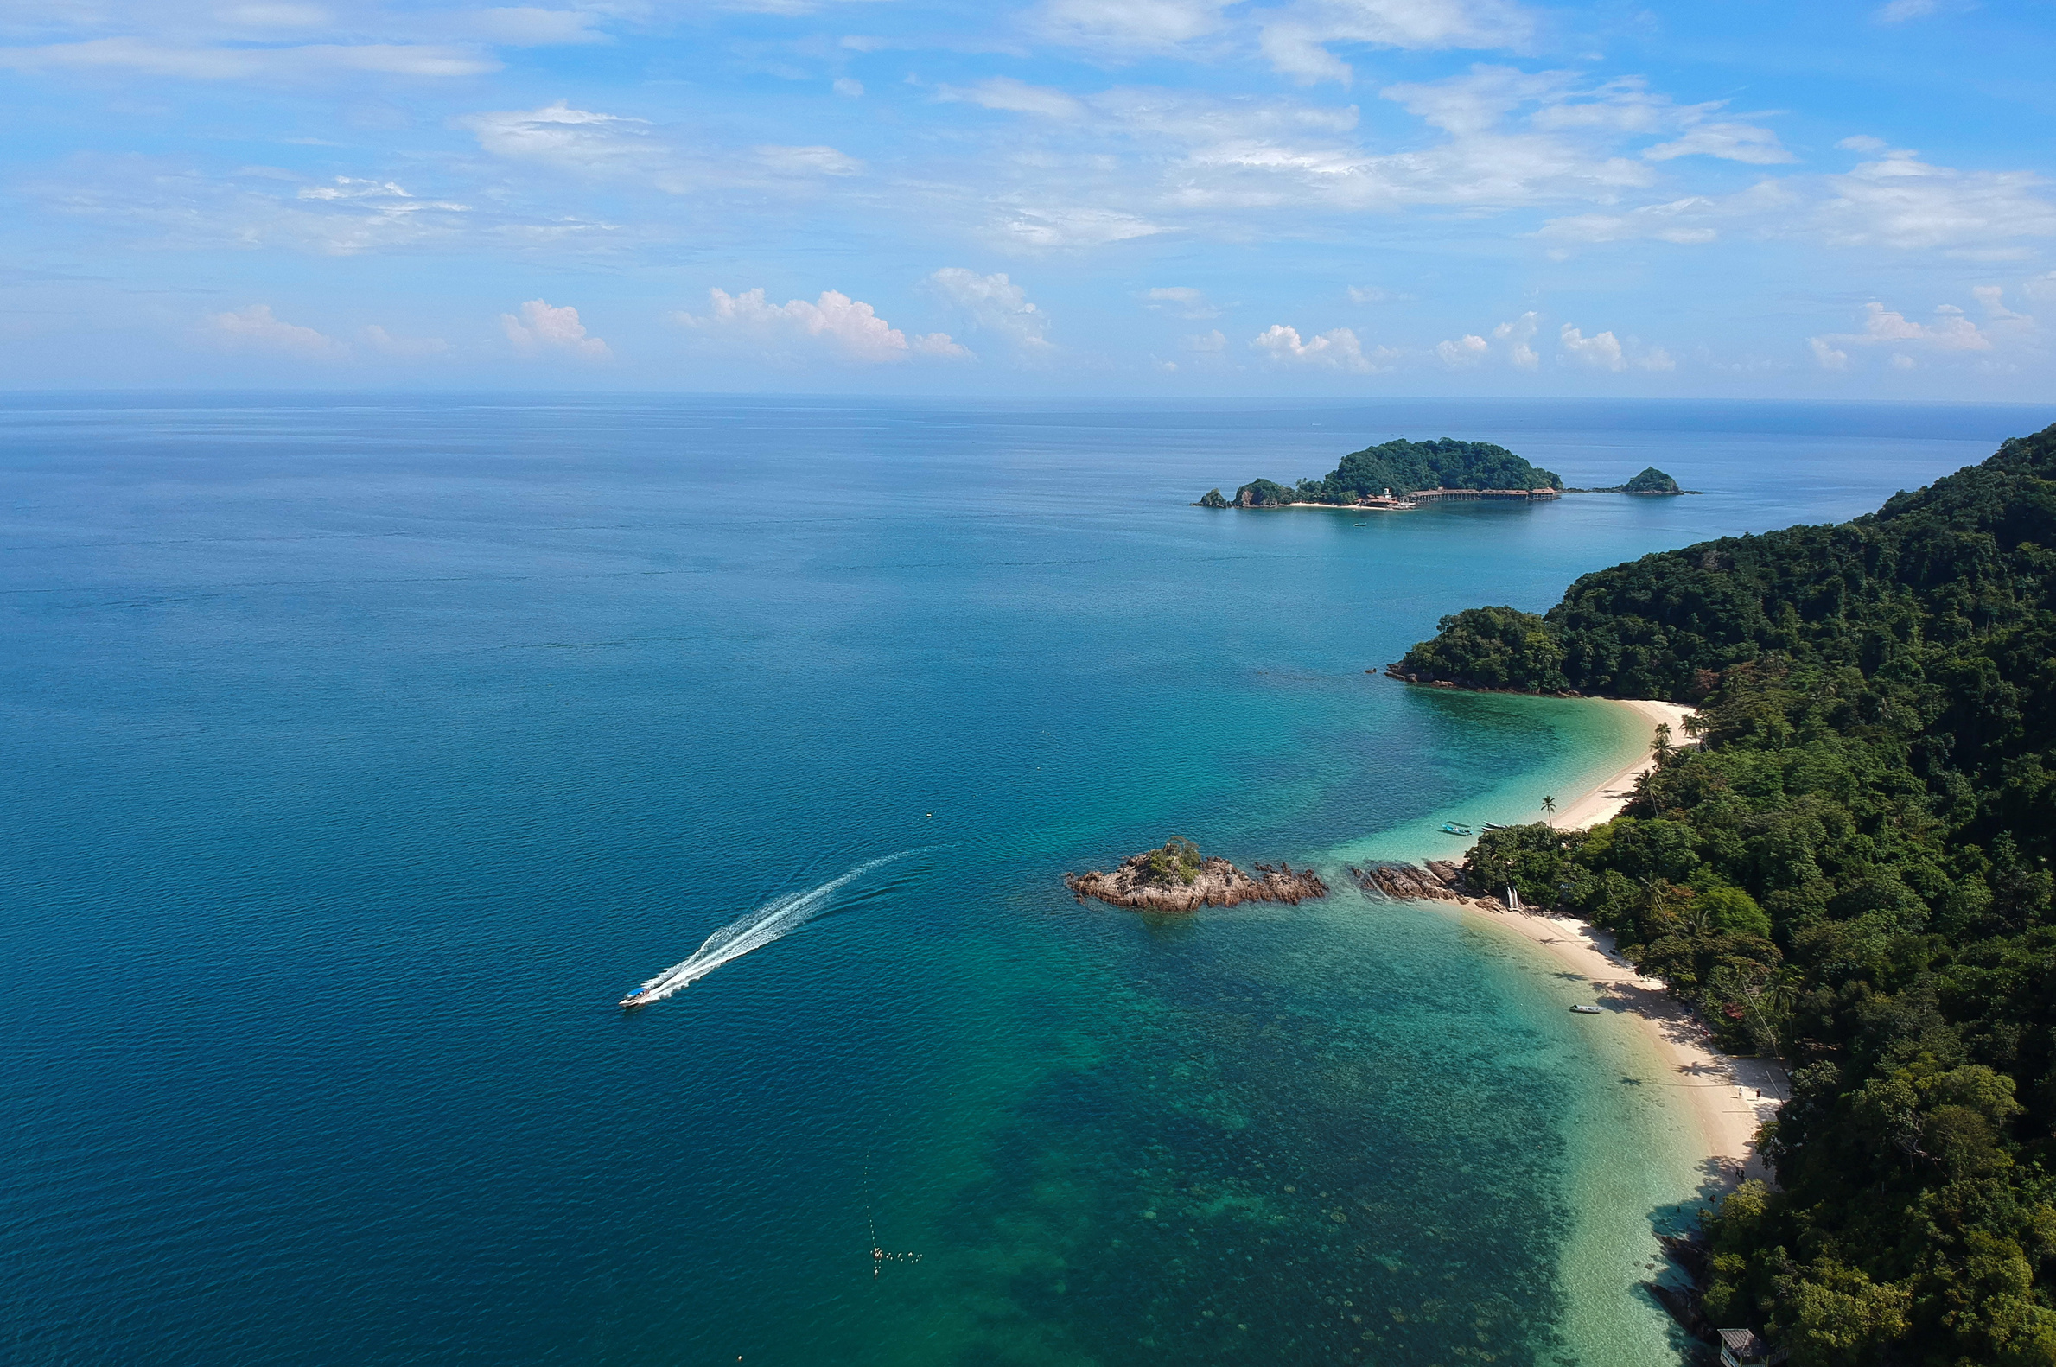
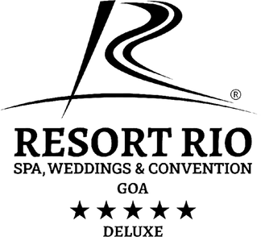
It’s time to
TRAVEL
Start Slide
WWW.RESORTRIO.COM

Slide 2
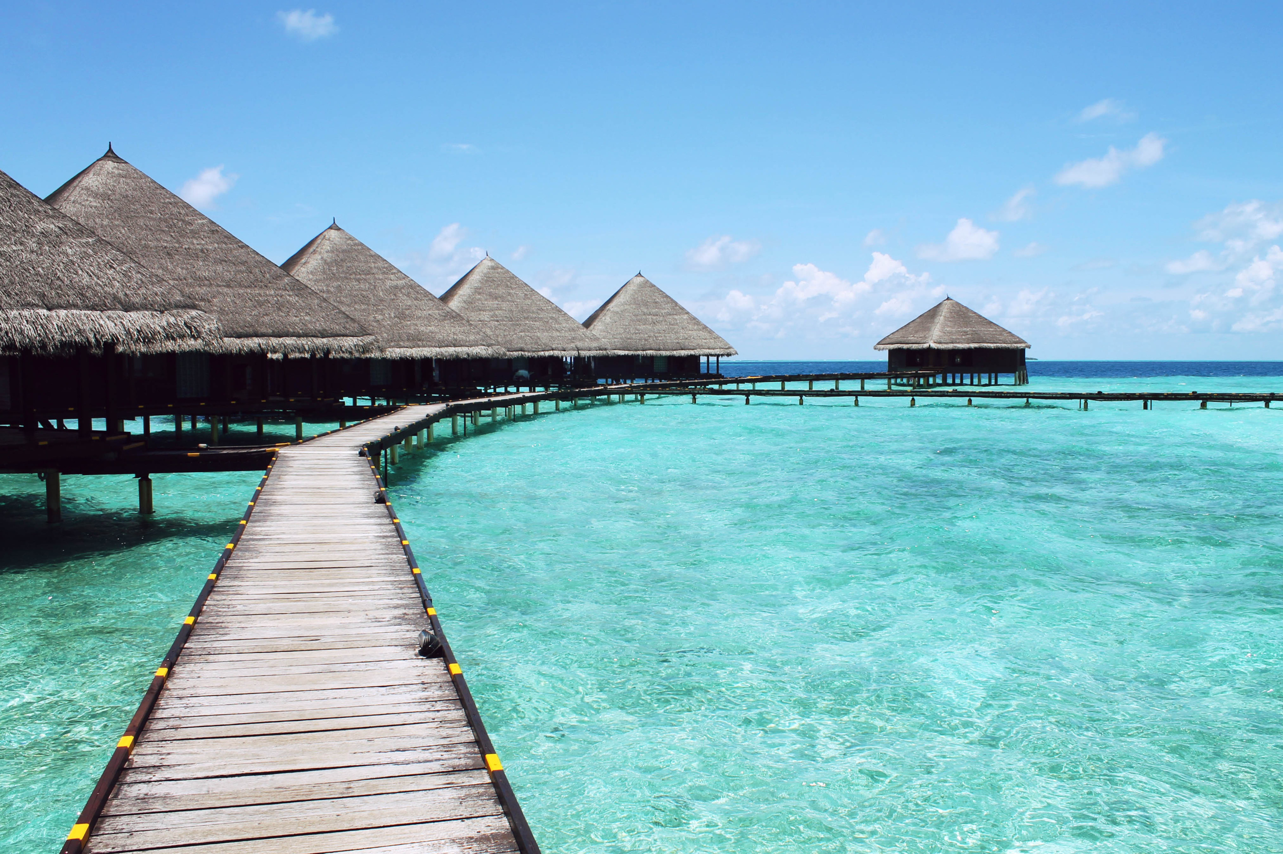

Search...
It’s Time to Discover Goa Like Never Before
Goa, India’s crown jewel, is where golden beaches meet the deep blue sea, vibrant nightlife blends with serene retreats, and every sunset feels magical. At the heart of it lies Resort Rio — one of the top luxury resorts in North Goa, offering comfort, culture, and class.
Just minutes from lively Baga Beach, our scenic location and world-class facilities make us a leading choice among the best resorts in Goa, perfect for couples, families, or friends seeking unforgettable moments.

Slide 3
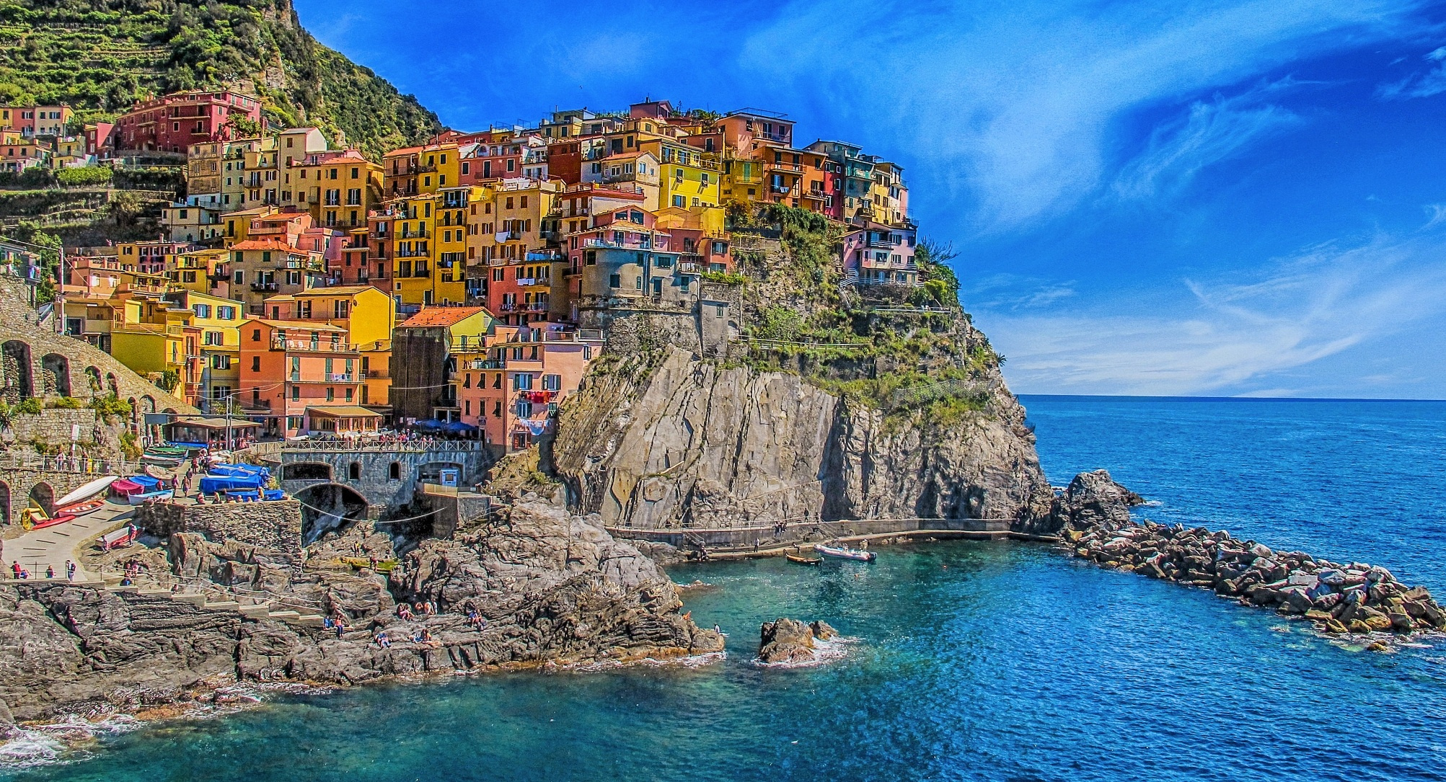
Search...
The Perfect Location for Every Traveler
One of the most loved aspects of Resort Rio is its unbeatable location. We’re not just another resort in North Goa near Baga Beach — we’re a destination in ourselves. The vibrant streets of Baga, the calming stretch of sand, and Goa’s most popular nightlife hubs are right around the corner.
This makes us the best resort near Baga Beach Goa for those who want to explore without compromising on comfort. Wake up to a delicious breakfast spread, head out for a day of beach hopping or shopping, and return to your luxurious room to unwind before enjoying live music or a candlelight dinner under the stars.

Slide 4
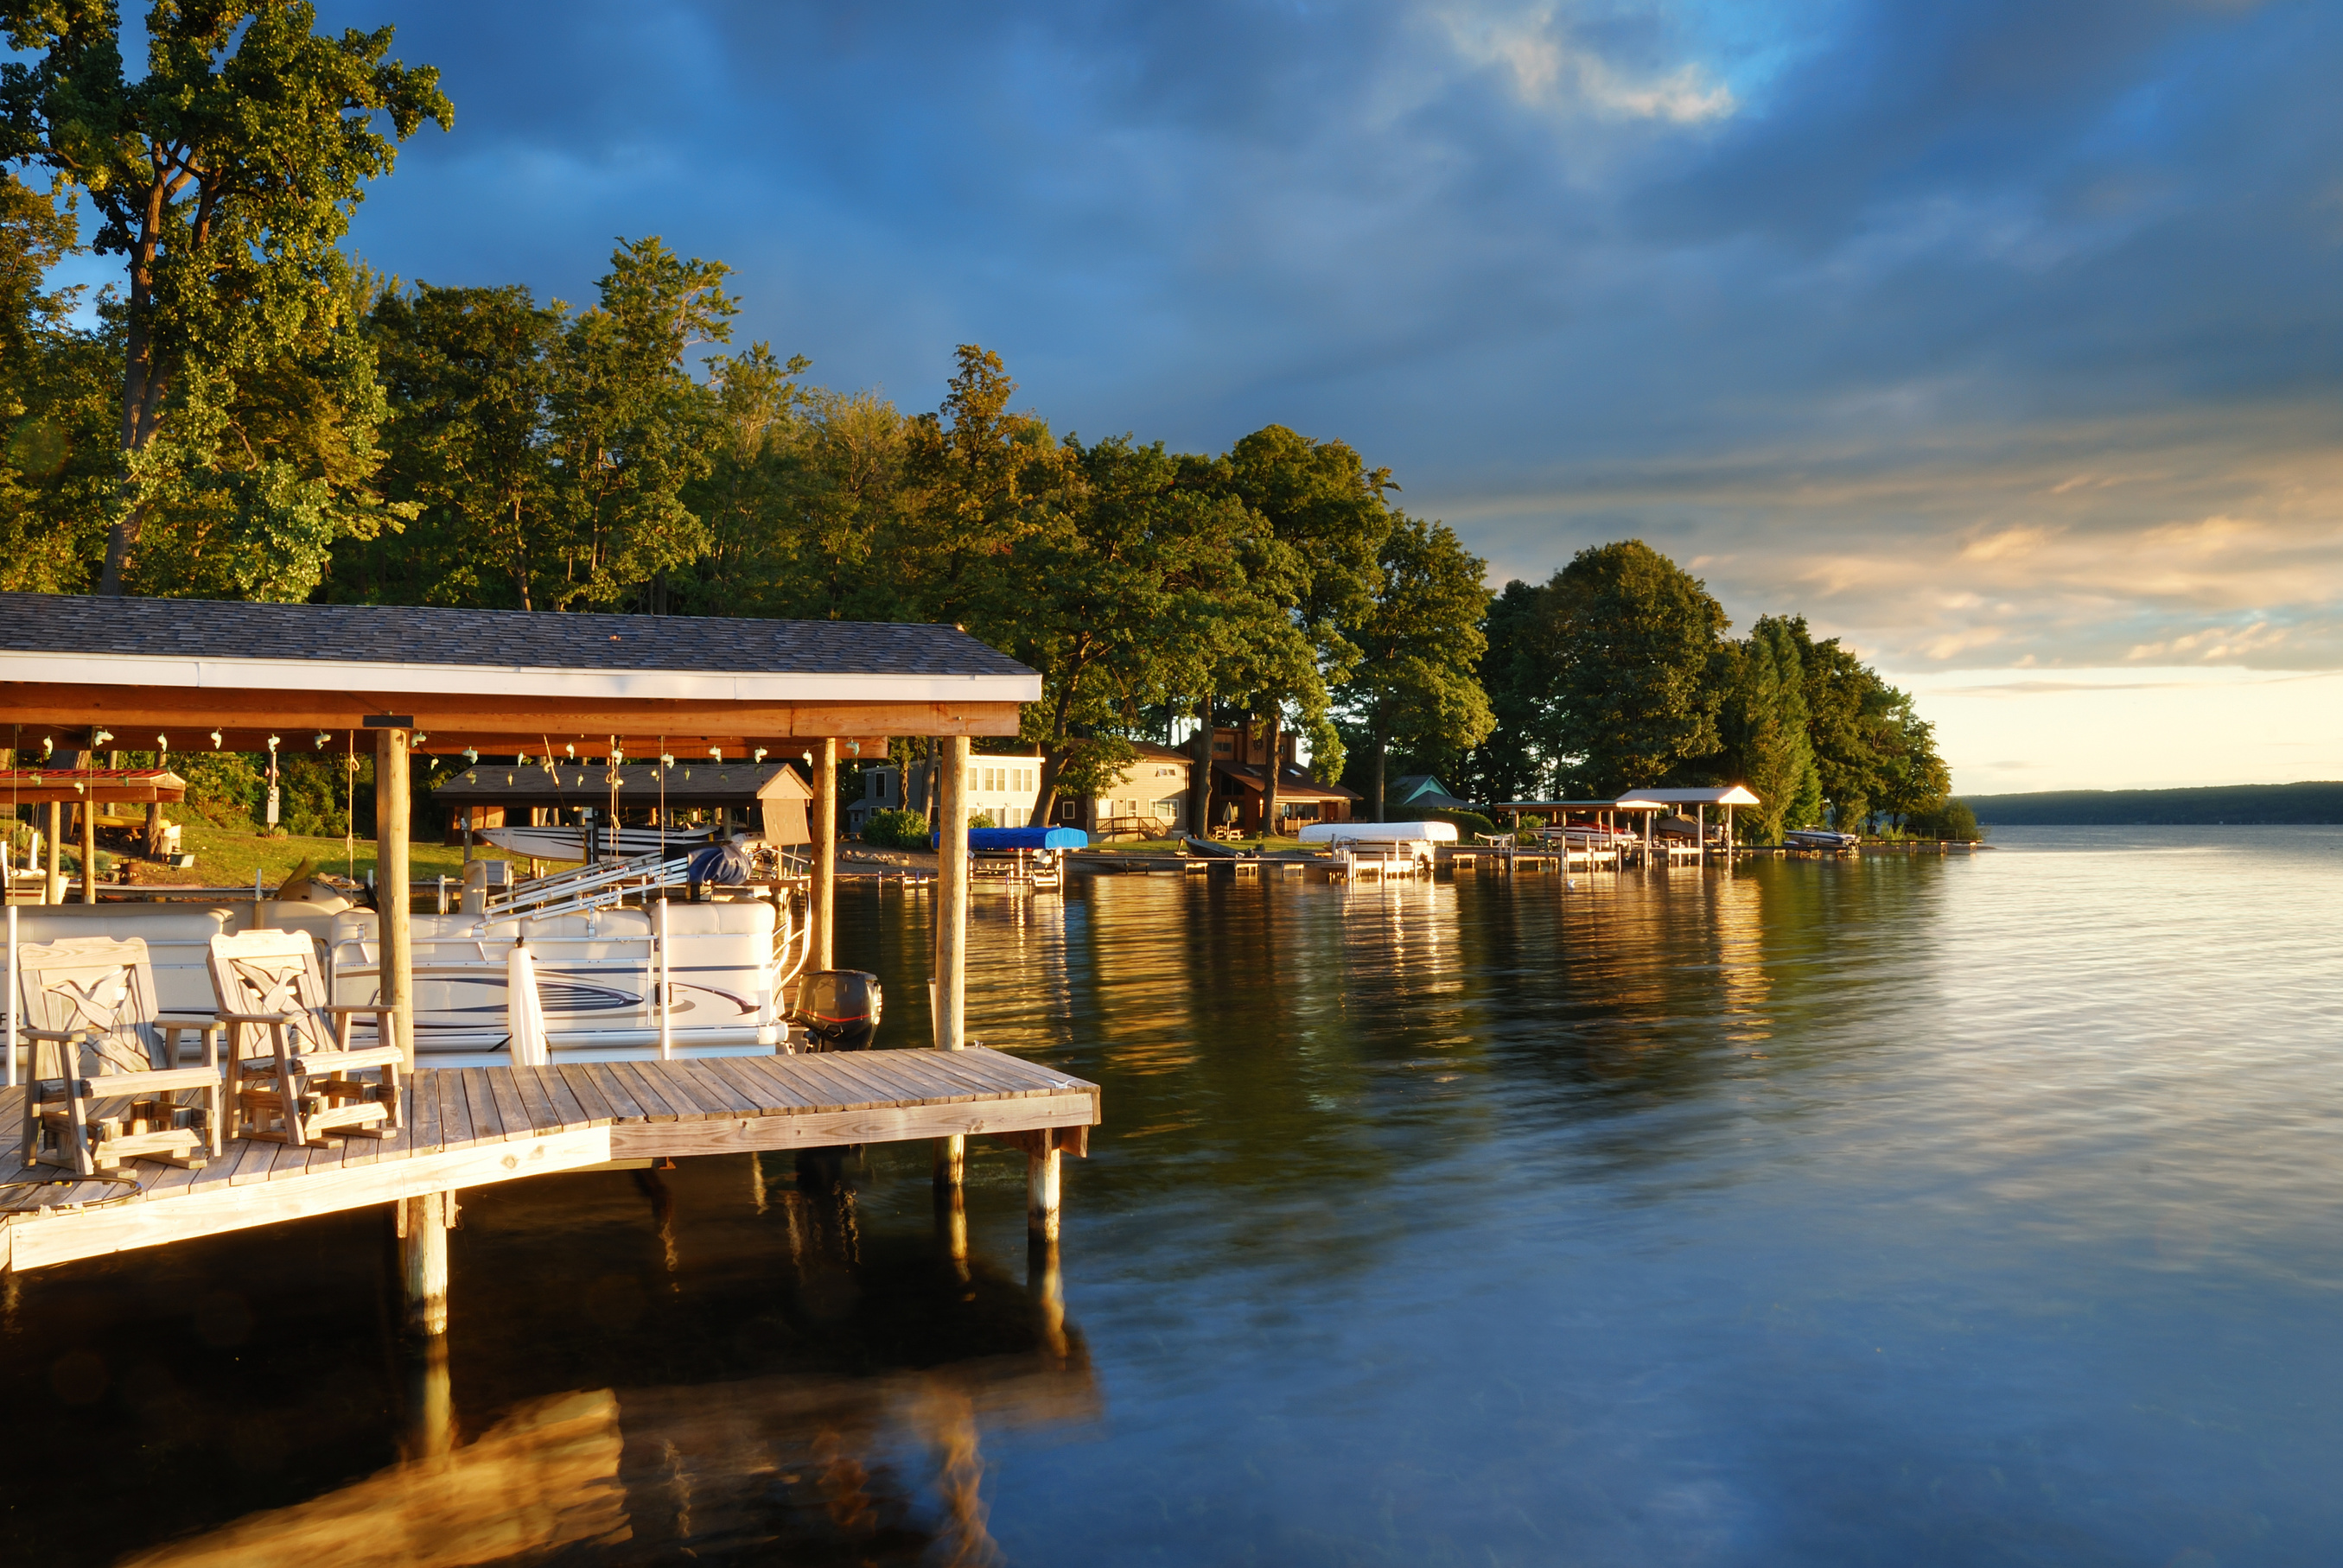
Unmatched 5-Star Comfort
When you choose Resort Rio, you choose more than just a place to stay — you choose one of the best 5 star resorts in Goa. Our spacious rooms and villas are designed with elegance, featuring plush bedding, modern amenities, and breathtaking views.
From the moment you step in, our dedicated team ensures your every need is met. Whether it’s arranging personalized sightseeing tours, offering in-room spa treatments, or curating special dining experiences, we make sure every guest leaves with memories to cherish.

Slide 5
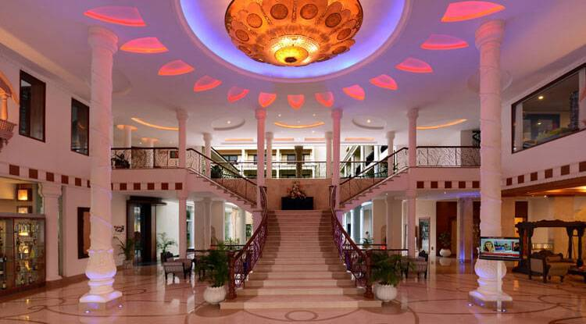
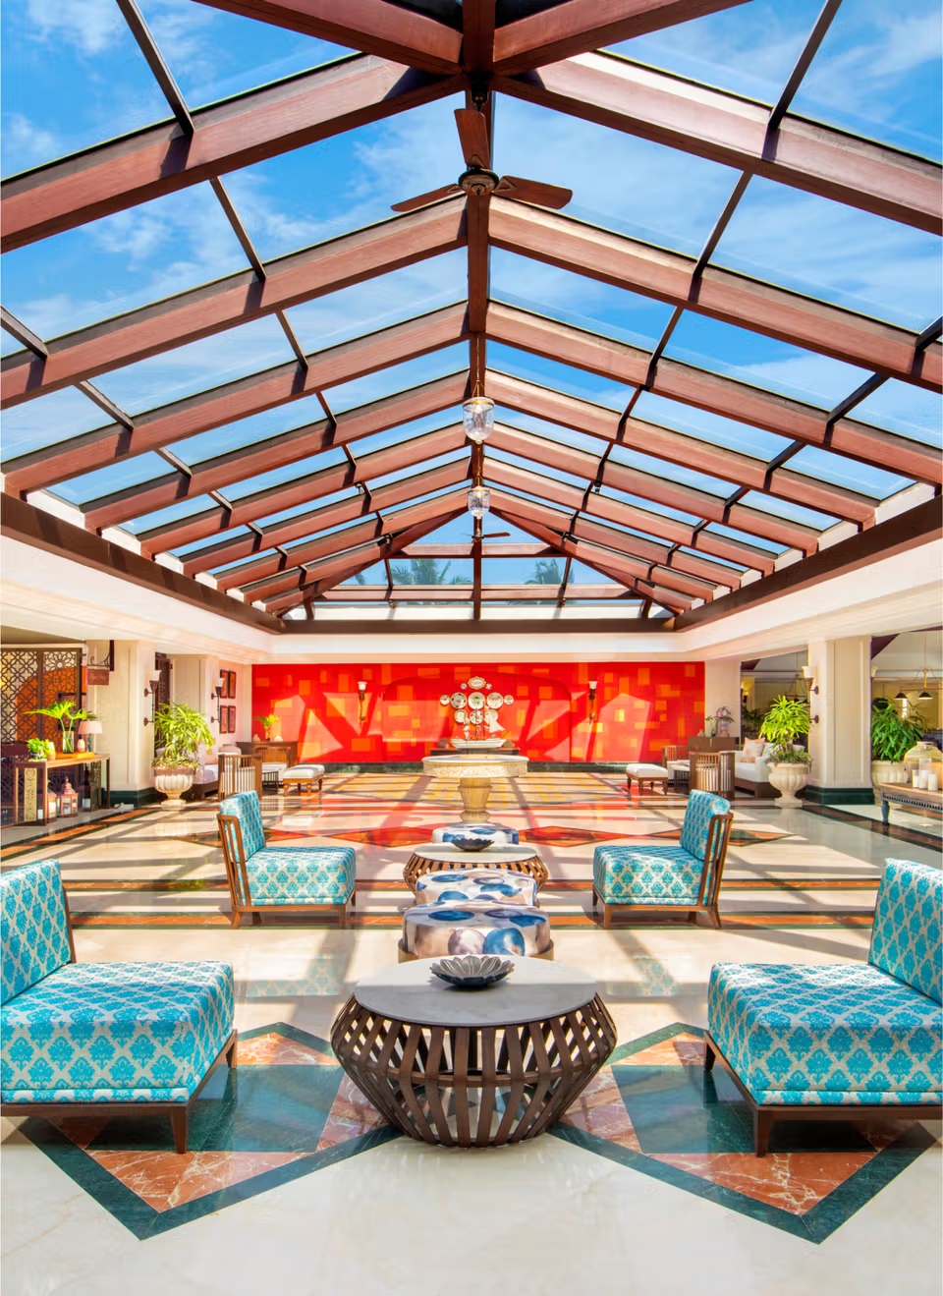
Search...
Luxury for All Occasions
Our property is often ranked among the 5 star resorts in North Goa not just because of our accommodations, but because of the complete lifestyle experience we offer. Planning a romantic proposal? Hosting a family reunion? Or perhaps a corporate retreat? Our range of event spaces and amenities make it all possible.m vitae lacus lobortis lacinia. Donec tristique arcu massa, at pharetra tortor feugiat non.
From intimate gatherings to large celebrations, our team handles every detail so you can simply enjoy the moment. And yes — that includes arranging beachside dinners, cultural performances, and even themed parties inspired by Goa’s vibrant traditions.

Slide 6
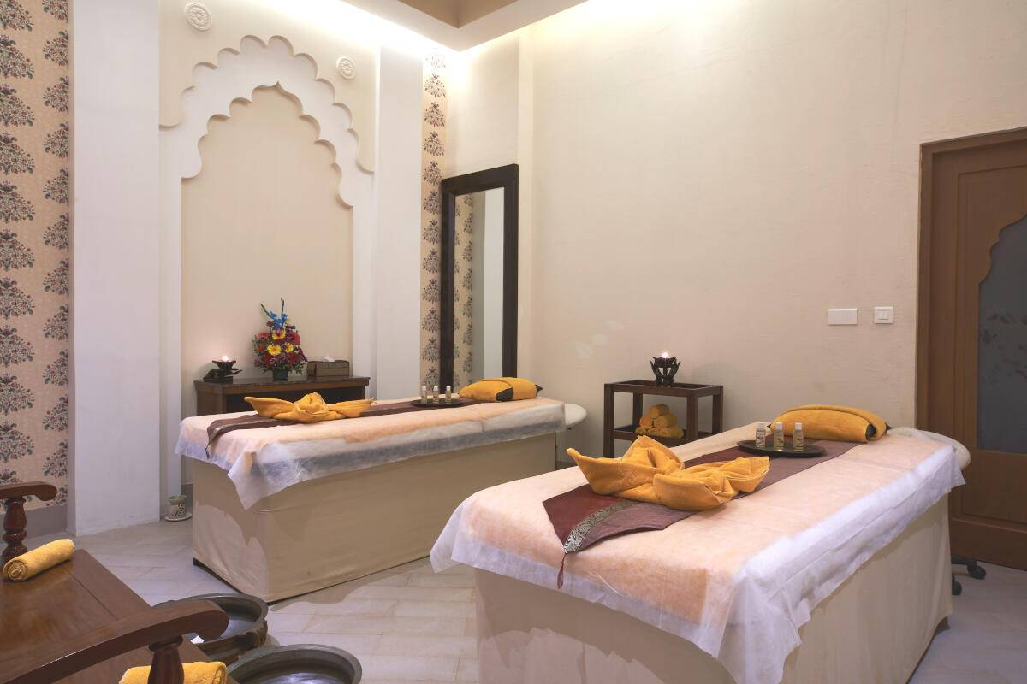
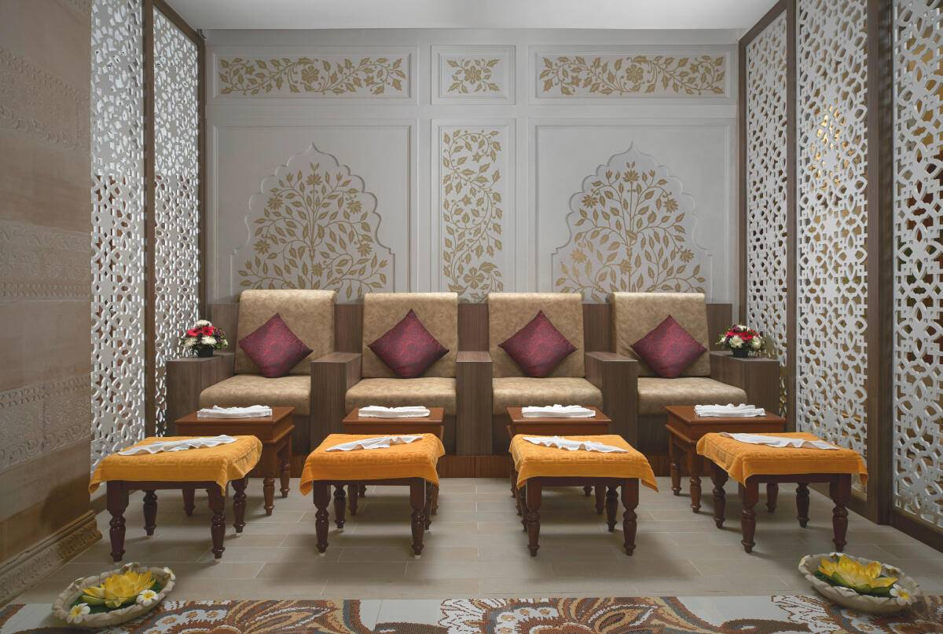
Wellness Meets Indulgence
Holidays are about recharging your soul, and our luxury spa in goa is the perfect sanctuary for that. Indulge in holistic therapies, rejuvenating massages, and wellness rituals that help you reconnect with yourself. After all, Goa isn’t just about beaches and nightlife — it’s also about slowing down and embracing peace.

Slide 7
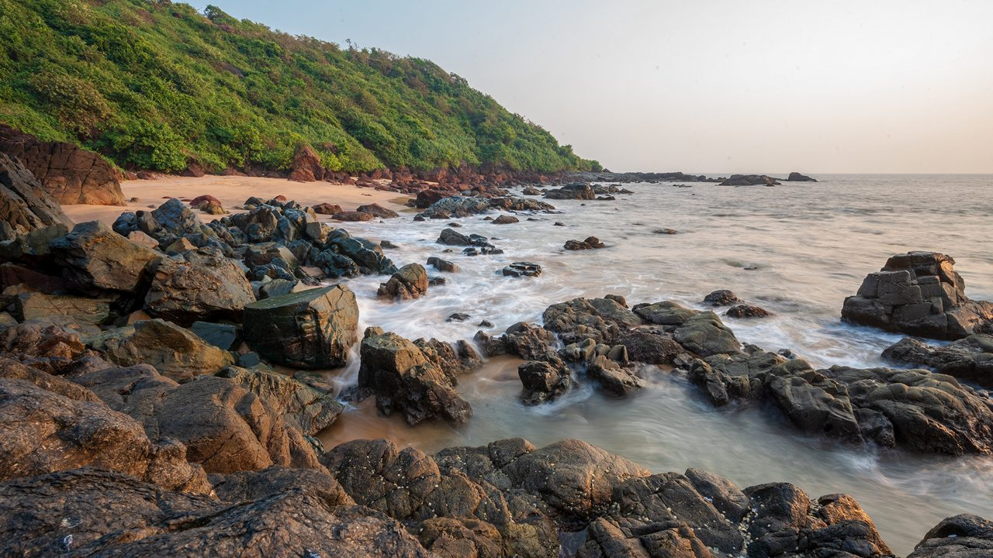
Your Gateway to Authentic Goa
Staying with us means you’re not just booking a hotel room — you’re opening the door to the best of Goa. Explore bustling flea markets, take part in watersports, discover heritage churches, or simply lounge by the pool with a refreshing drink in hand.
We are consistently rated among the luxury resorts in Goa for our commitment to guest satisfaction, thoughtful service, and ability to make every holiday feel tailor-made.

Slide 8
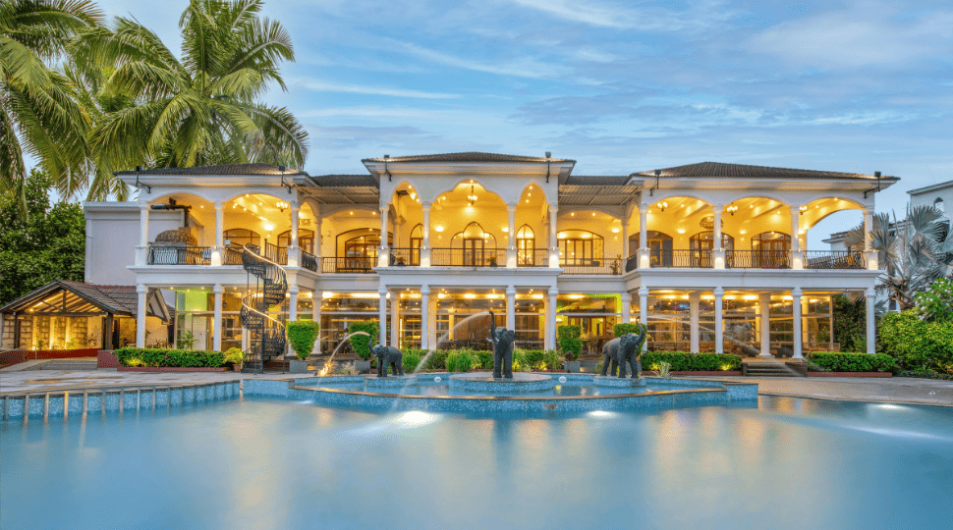
Prime Location
Why Choose Resort Rio?
Near Baga Beach and North Goa’s most loved attractions.
Spacious Accommodations
Rooms and villas that redefine comfort.
Culinary Excellence
Multiple dining options, including vegetarian specialities.
Luxury Amenities
Pool, spa, wellness centre, banquet facilities, and more.
Personalized Service
Every detail catered to with care.
Our goal is simple — to ensure that when you think of the best 5 star hotels in Goa, Resort Rio is the first name that comes to mind.

Slide 9




Contact Us
www.resortrio.com
reservations@resortrio.com
+91-83222 67301
Book now!

