Slide 1



https://www.mojarto.com/

Slide 2




























































































https://www.mojarto.com/

Slide 3
























































Slide 4











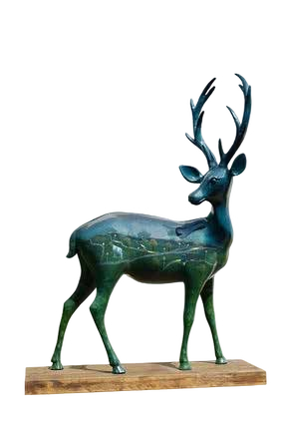












































Slide 5






https://www.pinterest.com/mojartoofﬁcial/
https://www.facebook.com/Mojarto-191313941210803/ https://www.instagram.com/mojarto_ofﬁcial/ https://twitter.com/Mojarto https://www.youtube.com/channel/UCR4FbHC8JGcz2T1KVHfQzRg/ https://in.linkedin.com/company/mojarto-presented-by-ndtv
https://www.mojarto.com/

Slide 6

https://www.mojarto.com/

