Slide 1


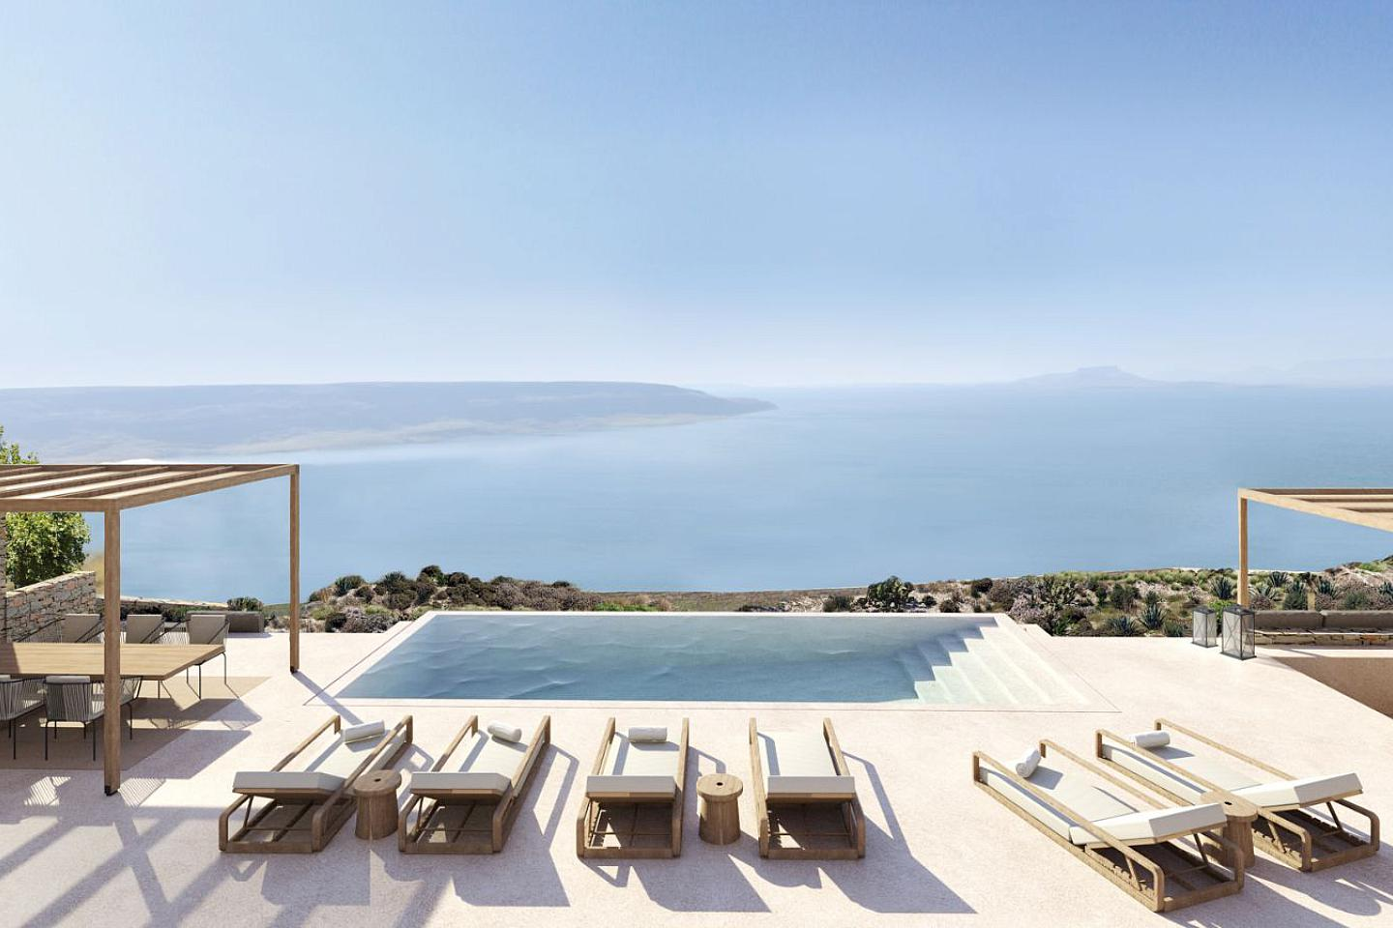
Villas à Kea
Find elegant villas in Kea, combining Mediterranean charm with modern comfort, perfect for year-round living or holiday retreats in one of Greece’s beautiful island destinations.

Slide 2
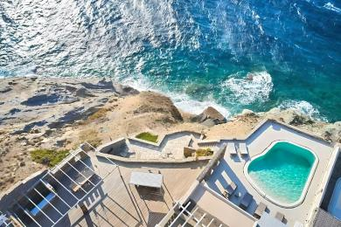
Waterfront Villa For Sale Greece
Explore luxury waterfront villas for sale in Greece, offering stunning sea views, high-end design, and exceptional living spaces in desirable coastal settings.

Slide 3
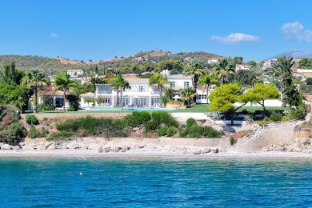
Villa Waterfront
Browse exquisite waterfront villas, showcasing premium architecture and direct sea access, ideal for luxury lifestyle buyers seeking exceptional Greek coastal properties.

Slide 4
Contact Us
Bio:- Demeures de Grece, taking advantage of its knowledge of the Greek estate market and legal specificities of Greece, assists you throughout the entire process of purchasing a property in Greece. Our company is very selective in its listings in order to offer you the best of what is on and off-market.
Address :- 33 vasilissis sofias, 106 75, αthens, greece
Website:- https://www.demeuresdegrece.com/en/

