Slide 1

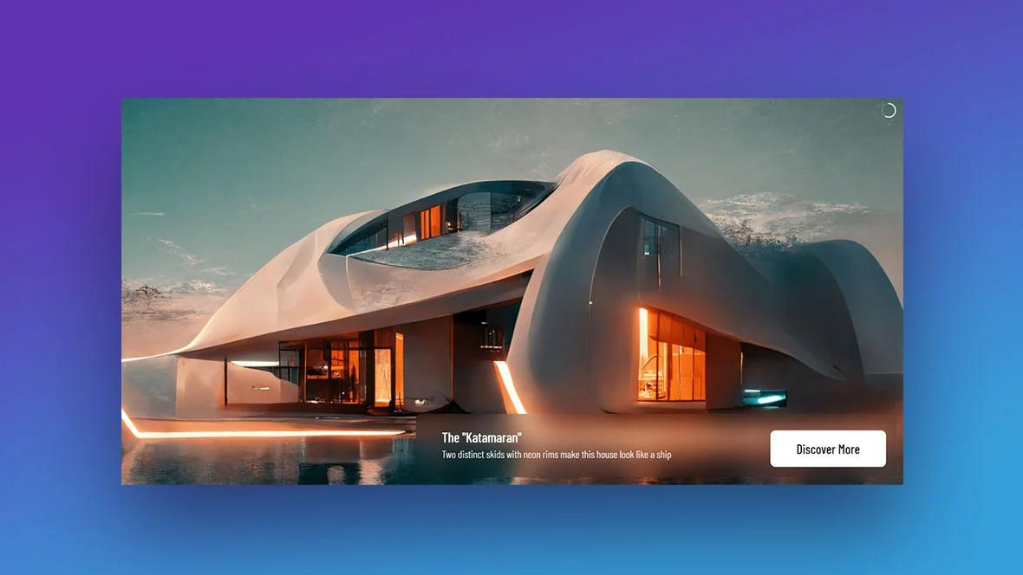

Quora Web Solution
Website Design and
Development
Company
Web Design & Web Development
Company in Bangalore, India
www.quorawebsolution.com
+91 9986 056 909
info@quorawebsolutions.com
24A, 1st Main Rd, Chandra Reddy
Layout, Koramangala 4th Block,
Koramangala, Bengaluru,
Karnataka 560034

Slide 2
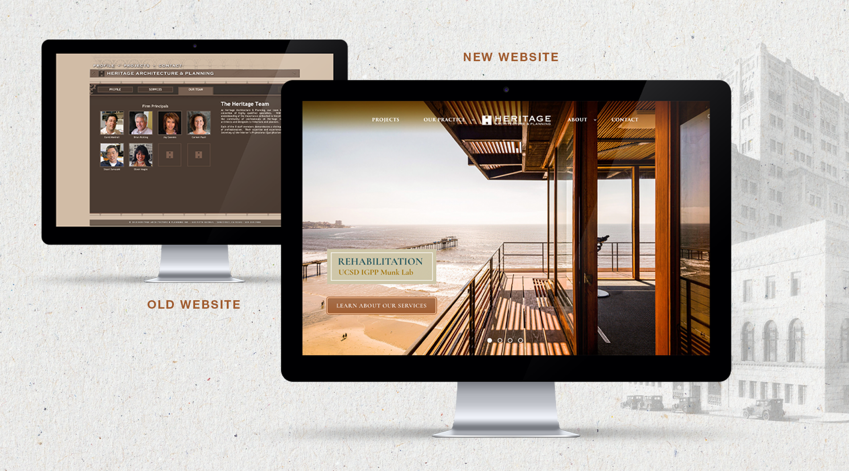
Your Digital Architect: Crafting a Website That Captivates and Converts
www.quorawebsolution.com

Slide 3

A digital craftsmanship studio dedicated to crafting bespoke websites that resonate with your brand's essence and captivate your audience.
www.quorawebsolution.com

Slide 4

We specialize in weaving together stunning visuals, intuitive navigation, and compelling storytelling to create online experiences that drive engagement and conversion.
www.quorawebsolution.com

Slide 5
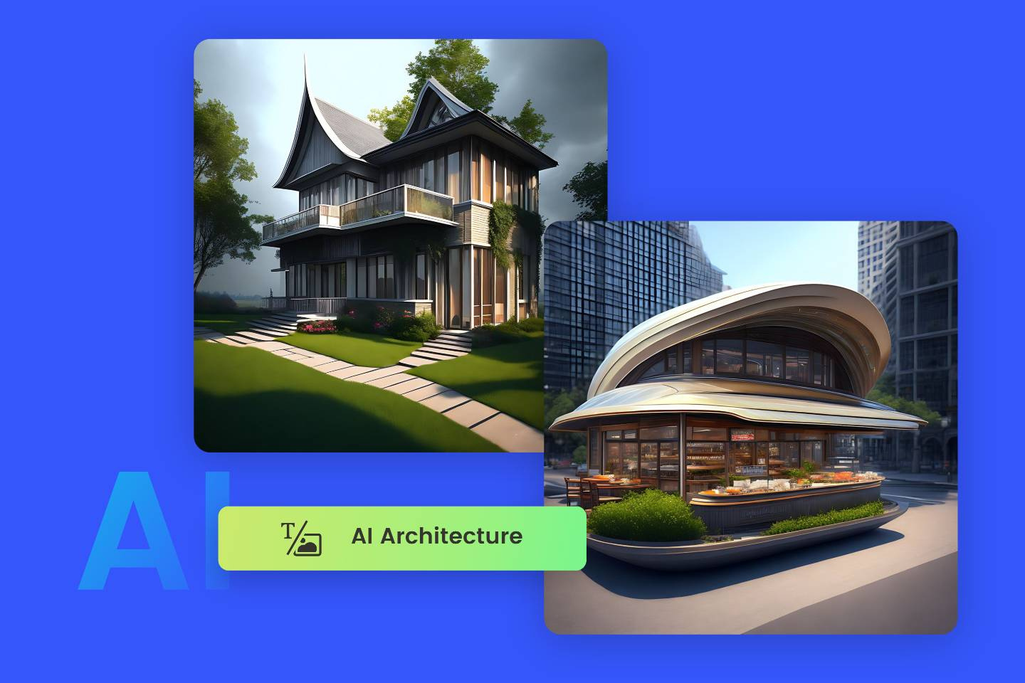
  Website Design: Crafting visually captivating and user-friendly website layouts that seamlessly integrate with your brand's identity, utilizing a harmonious blend of colors, fonts, and imagery.
www.quorawebsolution.com

Slide 6
  Website Development: Building robust and scalable technical foundations for your website, ensuring optimal performance, security, and compatibility across devices.
  Content Management Systems (CMS): Empowering you with intuitive and user-friendly CMS platforms that enable effortless content updates and management, streamlining your workflow and saving you time.
  E-commerce Development: Creating visually appealing and functional online stores that showcase your products or services in the best possible light, facilitating seamless transactions and enhancing your customer experience.
  Search Engine Optimization (SEO): Optimizing your website to improve its visibility in search engine results, driving organic traffic and increasing your online reach.
www.quorawebsolution.com

Slide 7
  Web Hosting: Providing reliable and high-performance web hosting solutions that ensure your website is always accessible and loads quickly for your visitors.
When selecting a website design and development company, it is crucial to consider the following factors:
  Experience and Expertise: Look for a company with a proven track record of success in your specific industry, demonstrating a deep understanding of your target audience and the unique challenges and opportunities within your market.
  Portfolio: Review the company's portfolio to assess their ability to create visually stunning, user-friendly, and effective websites that align with your brand's vision and goals.
www.quorawebsolution.com

Slide 8
  Communication: Ensure that the company has excellent communication skills and is responsive to your needs, providing clear and timely updates throughout the project.
  Pricing: Get quotes from several companies to compare pricing and services, ensuring that you are getting the best value for your investment.
By partnering with a reputable website design and development firm, you can unlock the full potential of your online presence. Our team of skilled professionals will work closely with you to create a website that not only looks stunning but also effectively engages your target audience, drives conversions, and helps you achieve your business objectives. Together, we will build a digital platform that reflects your brand's unique identity and propels your business forward.
www.quorawebsolution.com

Slide 9
Website Design and Development Partner
Choosing the right website design and development company is a critical decision for your business. A reputable partner can help you establish an online presence, enhance your brand image, and drive sales. Here's a comprehensive guide to finding the perfect collaborator for your digital journey.
Introduction
In today's digital landscape, a well-crafted website is essential for businesses of all sizes. Whether your goal is to establish a strong online presence, enhance your brand identity, or drive sales, a reputable website design and development company can provide the expertise you need.
Essential Considerations When Selecting a Website Design and Development Company
www.quorawebsolution.com

Slide 10
  Portfolio and Experience:
    Assess their design aesthetic, technical capabilities, and industry experience by reviewing their portfolio.
    Look for examples of websites similar to yours in terms of size, complexity, and target audience.
    Ensure the company has a strong understanding of design principles, including user experience (UX) and user interface (UI).
    A good website should be visually appealing, easy to navigate, and mobile-friendly.
  Development Skills:
www.quorawebsolution.com

Slide 11
    Evaluate the company's technical proficiency in web development languages (HTML, CSS, JavaScript) and frameworks (React, Angular, Vue).
    Consider their experience with content management systems (CMS) like WordPress, Drupal, or Joomla.
  Communication and Collaboration:
    Effective communication is crucial for a successful project. Look for a company that is responsive, transparent, and genuinely interested in understanding your vision. They should be willing to listen to your ideas, provide honest feedback, and collaborate closely with you throughout the project.
    A collaborative approach will help ensure that the final product meets your expectations.
www.quorawebsolution.com

Slide 12
  Project Management:
    Inquire about the company's project management process, including timelines, milestones, and quality control measures.
    A well-organized approach will help keep the project on track and within budget.
  Scalability and Maintenance:
    Consider the company's ability to handle future growth and changes to your website.
    Ask about their maintenance and support services, such as updates, security patches, and ongoing optimization.
  Pricing and Budget:
    Obtain detailed pricing information and compare quotes from different companies.
    Be mindful of hidden costs or additional fees that may arise during the project.
www.quorawebsolution.com

Slide 13
Conclusion
By carefully evaluating these key factors, you can confidently select a website design and development company that will help you create a digital presence that aligns with your business objectives and exceeds your expectations. Remember, a well-crafted website is not just a marketing tool; it's a valuable asset that can drive growth, enhance your brand reputation, and foster customer loyalty.
www.quorawebsolution.com

Slide 14
Quora Web Solution: Quora Web Solution is a trusted website development company based in Bangalore, India, offering a wide array of services to not only domestic but global clientele. Be it Website Design and Development, SEO services, Digital Marketing, Branding, App Development, Ecommerce Solution, and Logo Creation . Quora Web Solution has the best website developers offering top quality services and that is the reason why we are well known as one of the best Website Development Companies in Bangalore, India.
Visit Us - www.quorawebsolution.com
Call Us - +91 9986 056 909
Mail Us - info@quorawebsolutions.com
www.quorawebsolution.com

Slide 15




Services
WORDPRESS DEVELOPMENT
ECOMMERCE DEVELOPMENT
PHP DEVELOPMENT
CMS DEVELOPMENT
DRUPAL DEVELOPMENT
WEBSITE SERVICES
WEBPORTAL DEVELOPMENT
MAGENTO DEVELOPMENT
WEBSITE DEVELOPMENT
JOOMLA DEVELOPMENT
SMALL BUSINESS DEVELOPMENT
CHEAP WEBSITE DEVELOPMENT
STATIC WEBSITE DEVELOPMENT
DYNAMIC WEBSITE DEVELOPMENT
WEBSITE DESIGN COMPANY
TOUR AND TRAVEL WEBSITE DEVELOPMENT

