Slide 1
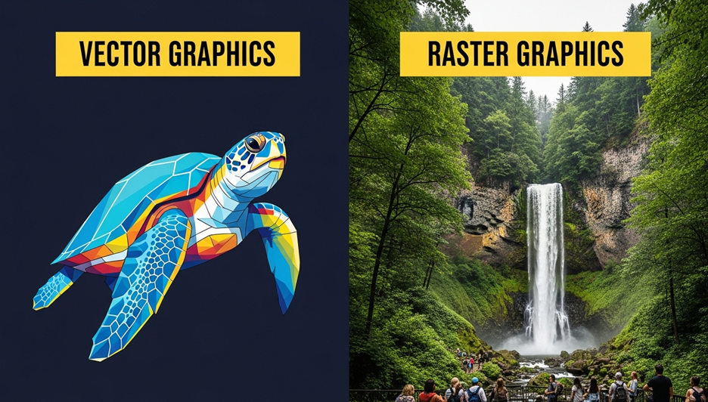
What Raster and Vector Images – Key Differences Explained

Slide 2
What Raster and Vector Images Are Made Of
Understanding what raster and vector images are begins with their structure. Raster images consist of tiny color pixels, while vector images are formed using paths and mathematical curves.

Slide 3
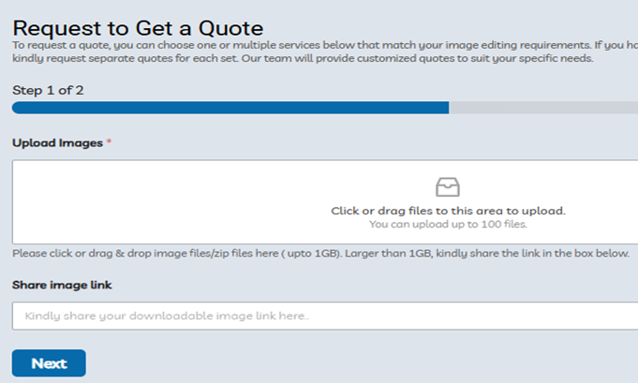
Scalability in What Raster and Vector Images Offer
One major difference in what raster and vector images deliver is scalability. Raster images lose quality when enlarged, while vector graphics stay sharp at any size—perfect for everything from icons to billboards.

Slide 4
File Types Used in What Raster and Vector Images
When discussing what raster and vector images are, file format matters. Raster uses formats like JPG and PNG. Vector relies on SVG, AI, and EPS—ideal for clean, crisp graphics across platforms.

Slide 5
Usage Scenarios for What Raster and Vector Image
Choosing what raster and vector images suit your project depends on the task. Use raster for photographs and complex visuals. Choose vector for logos, signage, and anything that needs resizing

Slide 6
Why It’s Important to Know What Raster and Vector Images Are
Knowing what raster and vector images are helps in making smarter design choices. Whether you're printing t-shirts or building a brand, using the right format ensures quality and consistency in your visuals.

Slide 7
Company Information:
Website: https://clippingpathzone.com/
Facebook: https://www.facebook.com/clippingpathzone/
Contact : https://clippingpathzone.com/contacts/
Resources: https://clippingpathzone.com/blog/
Pinterest: https://www.pinterest.com/cpzmedia/
Twitter: https://www.linkedin.com/in/clipping-path-zone-187698137/
Quote: https://clippingpathzone.com/request-to-get-a-quote/
Skype: skype:Clippingpathzone?chat
Office Address:
United States Office
30 North Gould Street, Sheridan, WY 82801
19173362276
customer_support@clippingpathzone.com
Bangladesh Office
1188/1, East Shewrapara, Mirpur, Dhaka-1216 Bangladesh
8801612348152
info@clippingpathzone.com

