Slide 1

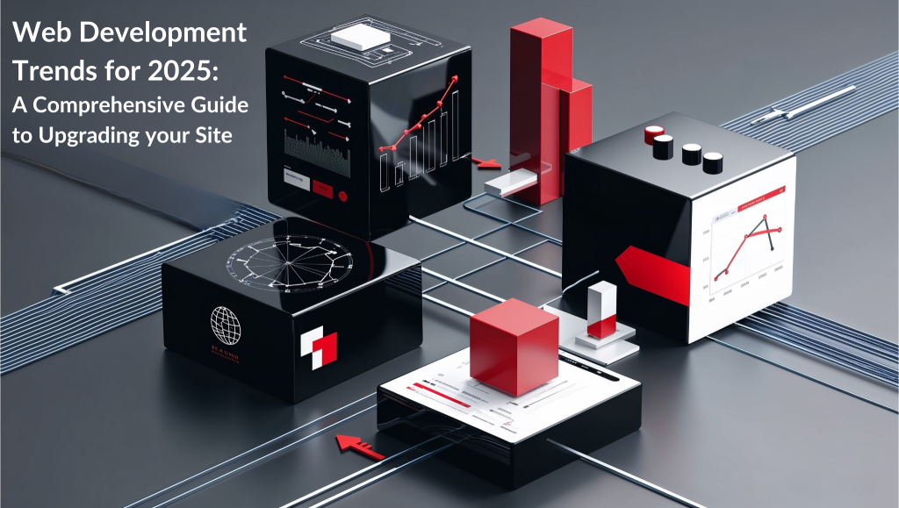

Quora Web Solution
Website Design and
Development
Company
Web Design & Web Development
Company in Bangalore, India
www.quorawebsolution.com
+91 9986 056 909
info@quorawebsolutions.com
24A, 1st Main Rd, Chandra Reddy
Layout, Koramangala 4th Block,
Koramangala, Bengaluru,
Karnataka 560034

Slide 2
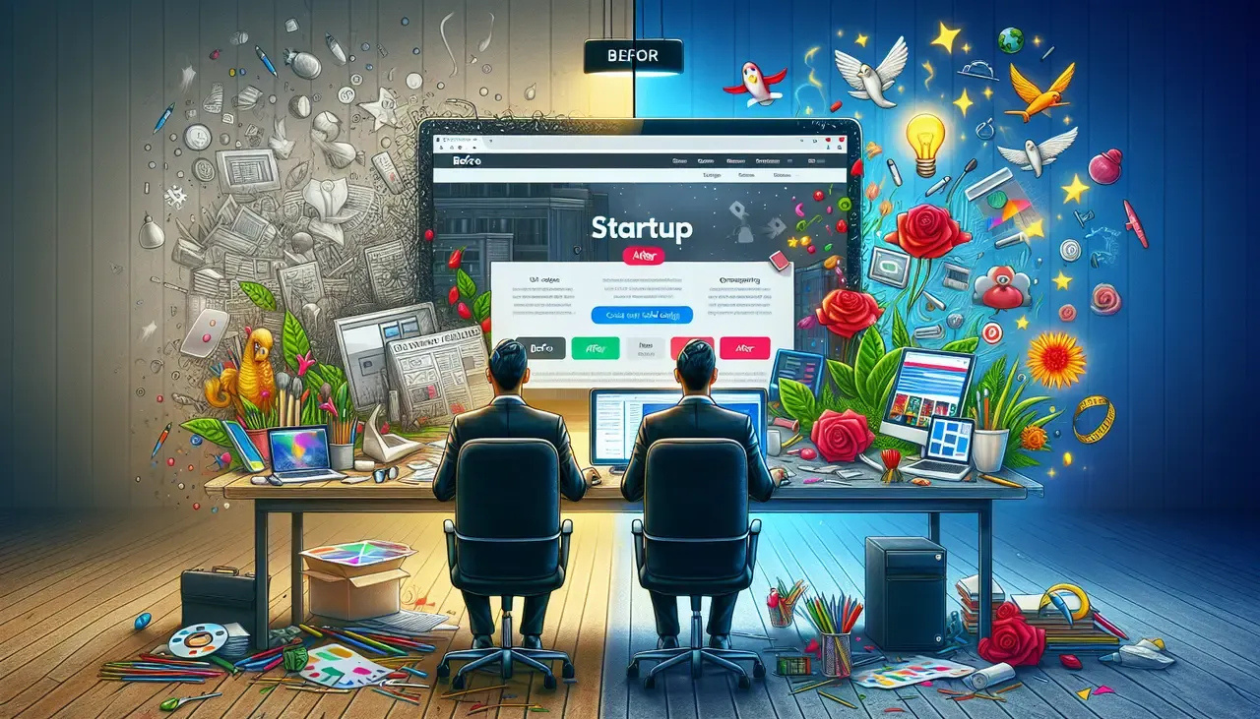
Transform Your Online Presence: A Comprehensive Guide to Website Design and Development Companies
In today's digital age, a well-designed and developed website is essential for businesses of all sizes.
www.quorawebsolution.com

Slide 3

A professional website can significantly impact your brand's visibility, customer engagement, and overall success. This is where website design and development companies come into play.
www.quorawebsolution.com

Slide 4
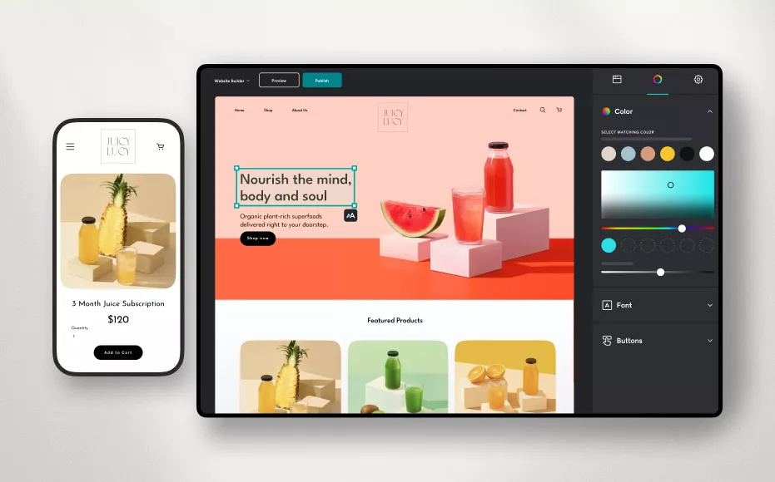
What is a Website Design and Development Company?
www.quorawebsolution.com

Slide 5

A website design and development company is a specialized firm that focuses on creating and maintaining websites.
www.quorawebsolution.com

Slide 6
These companies employ skilled professionals, including:
  Web Designers: These creative visionaries craft the visual identity of a website, ensuring it's not just functional but also visually appealing. They meticulously design layouts, select harmonious color palettes, and choose typography that enhances user experience.
  Web Developers: These technical wizards bring designs to life, transforming them into fully functional websites. They possess a deep understanding of programming languages like HTML, CSS, and JavaScript, using them to structure, style, and program website functionality.
Why You Need a Website Design and Development Company
A website design and development company can provide numerous benefits to your business, including:
  Enhanced Brand Image: A professionally designed website creates a positive first impression and strengthens your brand identity.
  Improved User Experience: A well-structured and intuitive website provides a seamless experience for your visitors, leading to increased engagement and conversions.
www.quorawebsolution.com

Slide 7
  Increased Online Visibility: A website design and development company can optimize your website for search engines, helping you rank higher in search results and attract more organic traffic.
  Cost-Effective Solutions: Partnering with a company often offers cost-effective solutions compared to hiring an in-house team.
  Scalability: As your business grows, your website needs to adapt. A reputable company can help you scale your website to accommodate increased traffic and evolving needs.
  Time Efficiency: Building a website from scratch can be time-consuming. A professional company can streamline the process and deliver a high-quality website in a timely manner.
Key Considerations When Choosing a Website Design and Development Company
When choosing a website design and development company, it's important to consider the following factors:
  Portfolio: Review the company's past projects to assess their design and development capabilities.
www.quorawebsolution.com

Slide 8
  Experience: Look for a company with a proven track record in your industry or niche.
  Communication: Effective communication is crucial. Ensure the company is responsive and keeps you informed throughout the project.
  Pricing: Get detailed quotes from multiple companies to compare pricing and services.
  Customer Support: A reliable company should offer excellent customer support and be available to address any issues promptly.
  Company Culture: Consider the company's culture and values. Do they align with your own? A good fit culturally can lead to a more successful partnership.
  Reviews and Testimonials: Read reviews and testimonials from past clients to get a sense of the company's reputation.
  Security: Make sure the company prioritizes website security and takes measures to protect your data and website from cyber threats.
In Conclusion
www.quorawebsolution.com

Slide 9
A well-designed and developed website can be a powerful tool for your business. By partnering with a reputable website design and development company, you can create a digital presence that leaves a lasting impression and drives business growth. A high-quality website can enhance your brand image, improve user experience, increase online visibility, and ultimately lead to more leads and sales.
Elevating Your Digital Presence: A Comprehensive Guide to Website Design and Development Companies
In today's digital age, a well-designed and functional website is a powerful tool for businesses of all sizes. A strong online presence can significantly impact your brand's visibility, customer engagement, and ultimately, your bottom line. Your website is often the first impression potential customers have of your business, and a poorly designed or outdated website can damage your credibility and drive away potential customers.
www.quorawebsolution.com

Slide 10
On the other hand, a well-designed and optimized website can attract new customers, generate leads, and boost your sales. That's why partnering with a reputable website design and development company is essential for businesses looking to succeed in the digital age.
A robust online presence can significantly impact your brand's visibility, customer engagement, and ultimately, your bottom line. Your website is often the first impression potential customers have of your business, and a poorly designed or outdated website can damage your credibility and drive away potential customers. On the other hand, a well-designed and optimized website can attract new customers, generate leads, and boost your sales. That's why partnering with a reputable website design and development company is essential for businesses looking to succeed in the digital age.
What is a Website Design and Development Company?
A website design and development company is a team of experts who create, design, and maintain websites. They work together to ensure that your website is not only visually appealing but also functional, user-friendly, and effective in achieving your business goals.
Here are the key roles and services provided by website design and development companies:
www.quorawebsolution.com

Slide 11
  Web Design: Creating the visual elements of a website, including the layout, color scheme, typography, and imagery.
  Web Development: Building the technical infrastructure of a website, including the programming and coding that make it functional.
  E-commerce Development: Designing and developing online stores, including product catalogs, shopping carts, and payment gateways.
  Web Application Development: Creating custom web applications tailored to specific business needs.
  Search Engine Optimization (SEO): Optimizing a website to improve its visibility in search engine results.
  Website Maintenance: Keeping a website up-to-date, secure, and performing optimally.
There are different types of website design and development companies, including:
  Full-service agencies: These companies offer a wide range of services, including web design, development, marketing, and SEO.
www.quorawebsolution.com

Slide 12
  Freelance designers and developers: These individuals work independently and can be hired for specific projects or ongoing support.
  Specialized firms: These companies focus on specific areas of expertise, such as e-commerce, web application development, or SEO.
Why You Need a Website Design and Development Company
A website design and development company can provide numerous benefits to your business, such as:
  Professionalism and Expertise: A reputable company brings years of experience and knowledge to the table. They understand the latest web design trends, SEO best practices, and user experience principles.
  Time-Saving: Building a website from scratch can be time-consuming and complex. A professional company can streamline the process and deliver a high-quality website in a timely manner.
www.quorawebsolution.com

Slide 13
  Cost-Effective: While hiring a company may involve an upfront cost, it can save you money in the long run. They can identify potential issues and implement solutions efficiently, preventing costly mistakes.
  Scalability: As your business grows, your website may need to adapt. A professional company can help you scale your website to accommodate increased traffic and evolving needs.
  Search Engine Optimization (SEO):: A well-optimized website is more likely to rank higher in search engine results, attracting more organic traffic. A skilled company can implement SEO strategies to improve your website's visibility.
  Improved User Experience: A website design and development company can create a website that is easy to navigate, visually appealing, and provides a seamless user experience. This can lead to higher engagement, better user retention, and ultimately, more conversions.
www.quorawebsolution.com

Slide 14
  Enhanced Brand Image: A professional website can help you project a polished and trustworthy image of your brand.
  Increased Sales and Leads: A well-designed and optimized website can attract more visitors and convert them into customers or leads.
Key Considerations When Choosing a Website Design and Development Company
Portfolio: Review the company's past projects to assess their design aesthetic, development capabilities, and overall quality of work. Look for projects that are similar to your own in terms of industry, complexity, and target audience. Pay attention to the website's visual appeal, user experience, and functionality.
Experience and Expertise: Look for a company with a proven track record of success in your industry or niche. They should have a deep understanding of your target audience, business goals, and the specific challenges you face. This expertise will help them create a website that is tailored to your needs and delivers results.
www.quorawebsolution.com

Slide 15
Communication: Effective communication is crucial. Ensure the company is responsive, proactive, and keeps you informed throughout the project. They should be able to understand your vision and translate it into a compelling online presence.
Pricing: Get detailed quotes and compare pricing structures. Consider the scope of work, the company's experience, and the quality of services offered. Don't always choose the cheapest option, as it may compromise quality.
Client Reviews: Read testimonials and reviews from past clients to gauge customer satisfaction. Look for feedback on the company's professionalism, responsiveness, and the quality of their work. You can also ask for references from past clients to get firsthand insights and feedback on their experience working with the company. This can help you assess their communication skills, project management abilities, and overall client satisfaction.
www.quorawebsolution.com

Slide 16
By partnering with a reliable website design and development company, you can establish a strong online presence that drives growth and success for your business. A well-crafted website can help you attract new customers, engage your audience, and ultimately achieve your business goals. Don't hesitate to invest in a professional website that reflects your brand's identity and delivers exceptional user experiences.
www.quorawebsolution.com

Slide 17
Quora Web Solution: Quora Web Solution is a trusted website development company based in Bangalore, India, offering a wide array of services to not only domestic but global clientele. Be it Website Design and Development, SEO services, Digital Marketing, Branding, App Development, Ecommerce Solution, and Logo Creation . Quora Web Solution has the best website developers offering top quality services and that is the reason why we are well known as one of the best Website Development Companies in Bangalore, India.
Visit Us - www.quorawebsolution.com
Call Us - +91 9986 056 909
Mail Us - info@quorawebsolutions.com
www.quorawebsolution.com

Slide 18




Services
WORDPRESS DEVELOPMENT
ECOMMERCE DEVELOPMENT
PHP DEVELOPMENT
CMS DEVELOPMENT
DRUPAL DEVELOPMENT
WEBSITE SERVICES
WEBPORTAL DEVELOPMENT
MAGENTO DEVELOPMENT
WEBSITE DEVELOPMENT
JOOMLA DEVELOPMENT
SMALL BUSINESS DEVELOPMENT
CHEAP WEBSITE DEVELOPMENT
STATIC WEBSITE DEVELOPMENT
DYNAMIC WEBSITE DEVELOPMENT
WEBSITE DESIGN COMPANY
TOUR AND TRAVEL WEBSITE DEVELOPMENT

