Slide 1
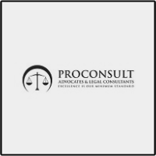
Best Legal Consultants in Dubai – Trusted Legal Support for Individuals and Businesses
www.dubai-divorce-lawyer.com

Slide 2
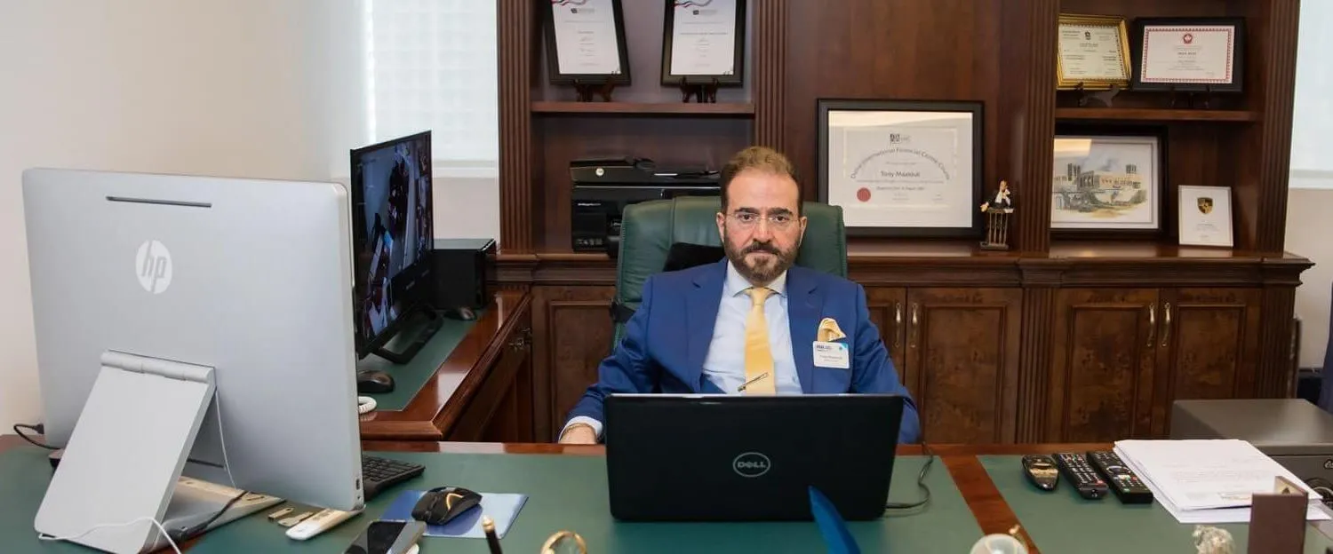
ProConsult Advocates & Legal Consultants provides practical and result-oriented legal consultation to clients in Dubai. The firm's focus is not just on providing legal advice but on understanding the client's situation and providing workable solutions. Whether it's for individual clients or business owners, every case is handled with a professional approach.
Dubai is an international business hub where new startups, companies, and investors enter every year. In such an environment, legal compliance becomes very important. Matters like company formation, contract drafting, partnership agreements, and dispute management require experienced consultants. Therefore, many businesses prefer the best legal consultants in Dubai for reliable guidance. ProConsult Advocates & Legal Consultants support companies in understanding the legal structure and following regulations.

Slide 3
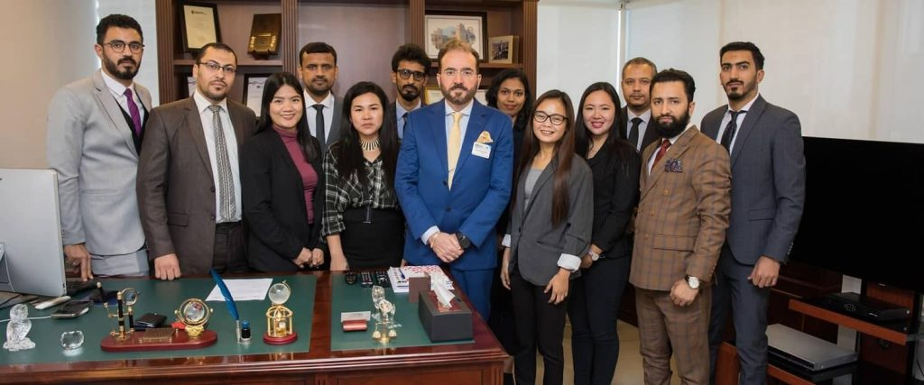
Apart from business, personal legal matters can also be challenging for people. Clear advice is essential in situations like family disputes, property issues, employment concerns, or legal documentation. ProConsult Advocates & Legal Consultants' approach is simple and client-focused, providing step-by-step guidance to each client to clearly understand their situation.
Transparency is an important part of professional legal consultancy. Clients should receive proper information regarding the progress of their case and their legal options. This approach has helped ProConsult Advocates & Legal Consultants build a strong reputation in Dubai. The firm's aim is to provide clients with practical solutions and avoid unnecessary legal complications.

Slide 4
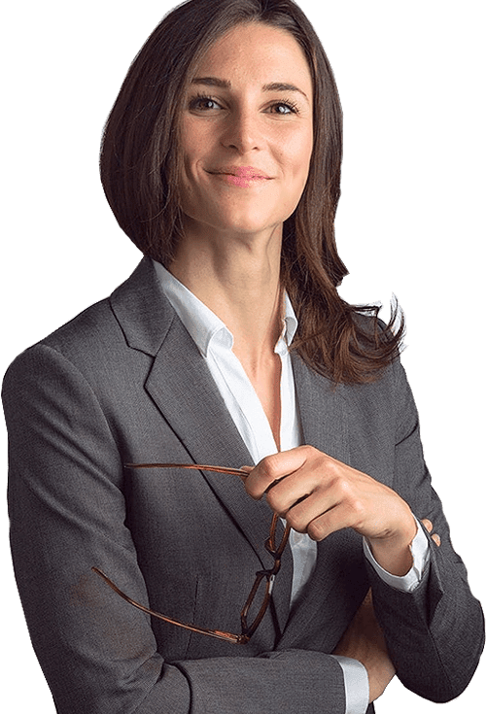
In today's competitive environment, both businesses and individuals need a reliable legal partner. When a legal consultant is experienced and well-versed in UAE laws, the legal process becomes much smoother. For this reason, many clients choose the Best Legal Consultants in Dubai for professional assistance.
If you are looking for reliable legal consultation in Dubai, you can contact ProConsult Advocates & Legal Consultants. The firm provides experienced legal support and practical guidance. For more information or consultation, you can call directly: (+971) 4 3298711. Their team will be ready to provide you with professional advice based on your legal matters.

Slide 5
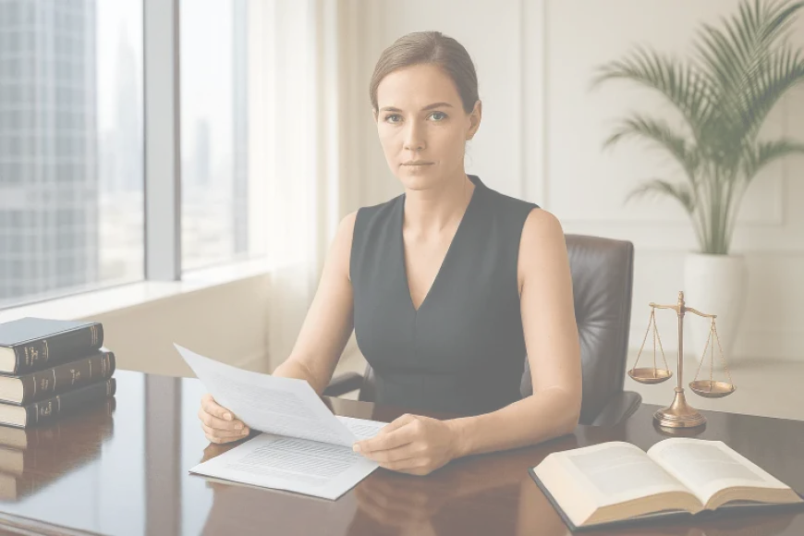



Contact Us
(+971) 4 3298711
www.dubai-divorce-lawyer.com
proconsult.familylaw@uaeahead.com
Burj Khalifa blvd., Westburry Offices Tower, 7th Floor Office 707, Business Bay

Slide 6


Thank you
www.dubai-divorce-lawyer.com

