Slide 1
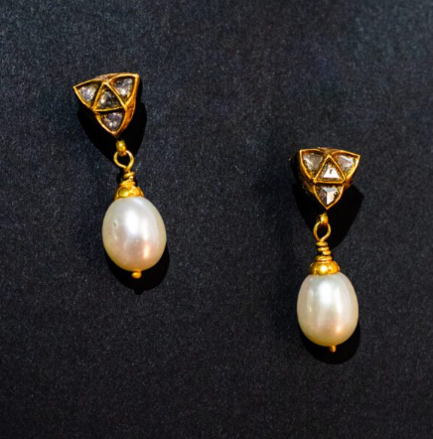


The Timeless Charm of Designer Pearl Earrings for Every Occasion

Slide 2
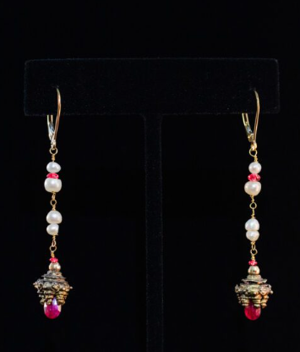

Introduction
Jewelry has a way of telling stories and tales of beauty, character, and poise. Designer pearl earrings are among the most valued items, and they have a soft shine and classic beauty. Their blend of classiness and simplicity is the key to their popularity among every generation. Pearls form a balance of exquisiteness and beauty when worn in the form of 18k gold diamond earrings or beautiful blue sapphire and diamond earrings. Both pairs are pieces of artwork and elegance, transforming banal scenes into instances of grace. These works are not just about style but about confidence, femininity, and timeless style that still rocks hearts all around the world.

Slide 3
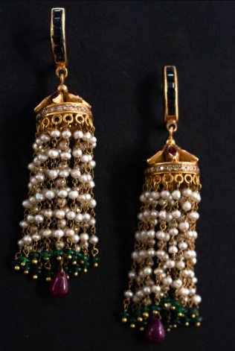
1. The Classy Charm of Designer Pearl Earrings:
Designer pearl earrings uphold elegance. Their shimmer matches all the skin tones, and they are a great favorite everywhere. Starting with the traditional studs and up to contemporary drops, pearls make any outfit look high-end with minimal effort. The combination of the purity of pearls and the brilliance of diamonds with the 18k gold diamond earrings is a matching pair. The earrings would also add a touch of color and royalty in a collection by the addition of blue sapphire and diamond, and complement elegance with each look.
2. The 18K Gold Diamond Earring Luxury:
The 8k gold diamond earrings are of ultimate beauty. Perfectly designed, they are charmingly warm and luminous and will not fade away. The richness of the gold makes all the diamonds shinier, which makes the pieces stand out with ease. As the pearl earrings worn are of a designer quality, the combination of glitz and glamour is achieved. For those who adore deeper hues, blue sapphire and diamond earrings provide the perfect balance of color and sophistication. In case of people who prefer more vivid coloring, blue sapphire and diamond earrings are the best choice regarding color and elegance.

Slide 4
3. The Mystique of Blue Sapphire and Diamond Earrings
Sapphires have a royal and mysterious tint of blue. Blue sapphire and diamond earrings denote wisdom, strength, and elegance. Their differences in colors make them seem like magic images: bright white diamonds and blue sapphires of the ocean. They create a theatrical effect and richness to an ordinary appearance when they are paired with designer pearl earrings. Combined with a pair of 18k gold diamond earrings, this makes the combination glittering with a glamorous celebration of the luxury of all time.
4. Styling with Confidence and Grace
Jewelry is truly beautiful when it is versatile. The earrings of designer pearls are excellent to match both a modern and an outfit of vintage inspiration. 18k gold diamond earrings may enhance the formal outfit with a touch of classy glitter. In the meantime, blue sapphire and diamond earrings add some color to neutral and evening wear. Confusion and combination of these styles provide smooth transitional effects between day and night, providing looks that are polished, powerful, and personal.

Slide 5
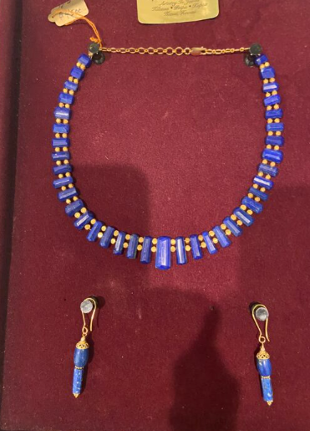
5. The Symbolism behind the Sparkle
Each gemstone tells a story. Pearls are the symbols of purity and balance, and diamond earrings are the symbols of eternity. 18k gold earrings are the symbols of brilliance that endure generations. Blue sapphire and diamond earrings are a symbol of fidelity and prudence, which are suitable for important events. A pair of jewelry, such as wearing designer pearl earrings or combining these gemstones with it, can turn jewelry into something other than decorations, as it is a note of beauty, as well as an eternal power within.
6. A Gift beyond Compare
Designer pearl earrings are the best designer jewels to be worn during anniversaries, weddings, or milestones. 18k gold diamond earrings signify eternal love, and blue sapphire and diamond earrings show emotional richness. Every work is sentimental and handmade, giving one a life-long memory and an ode to the spirit of beauty and love.

Slide 6

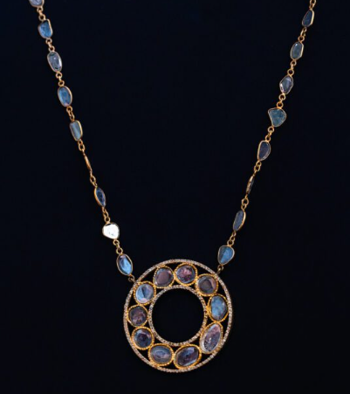

Conclusion
Each piece of jewelry has a story of emotion and craftsmanship. It could be that it is the gentle outshine ofdesigner pearl earrings, the luster of 18k gold diamond earrings, or the intensity of blue sapphire and diamond earrings; every design portrays elegance and uniqueness. These magnificent works introduce more than shine; they provide personality and trustworthiness to each appearance. The ideal gift or self-indulgence, every item has a classical beauty and good craftsmanship. They are reminders of wearers in all reflections of the grace that lasts and the beauty that remains unaffected.
Find eternal beauty- get the best designer pearl earrings at Jewel of the Lotus.
Thank You
www.jewelofthelotus.com

