Slide 1


Quora Web Solution
Website Design and
Development
Company
Web Design & Web Development
Company in Bangalore, India
www.quorawebsolution.com
+91 9986 056 909
info@quorawebsolutions.com
24A, 1st Main Rd, Chandra Reddy
Layout, Koramangala 4th Block,
Koramangala, Bengaluru,
Karnataka 560034

Slide 2
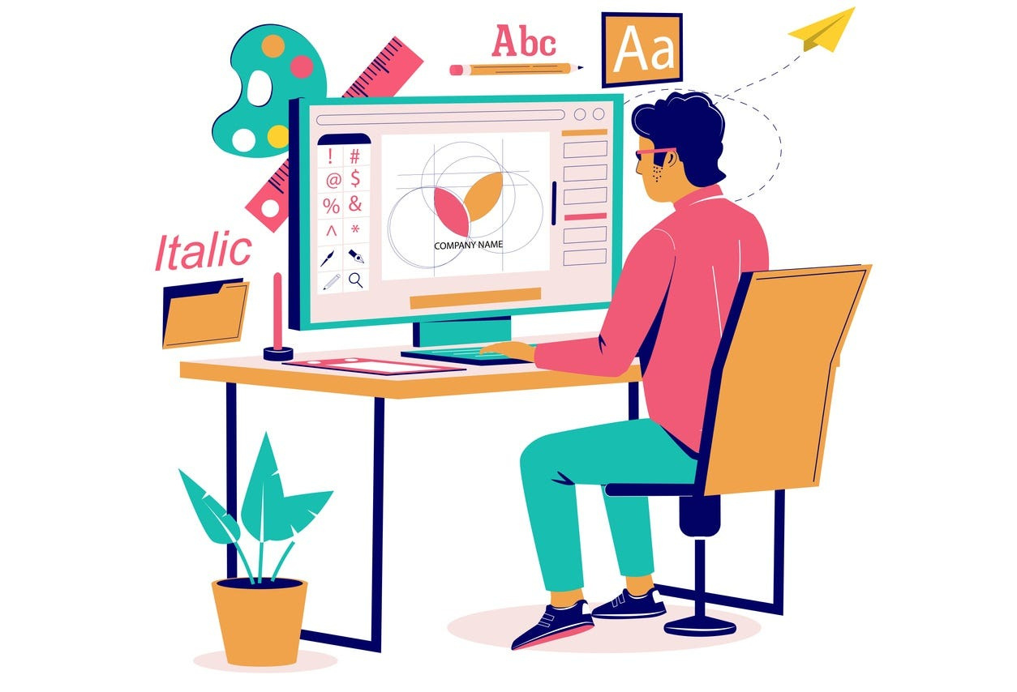
The Role of Web Design and Development in Enhancing Brand Identity and Online Engagement
In today’s digital world, a well-designed website is crucial for establishing a strong brand identity and engaging users. Your website isn’t just an online brochure; it’s an extension of your brand.
www.quorawebsolution.com

Slide 3
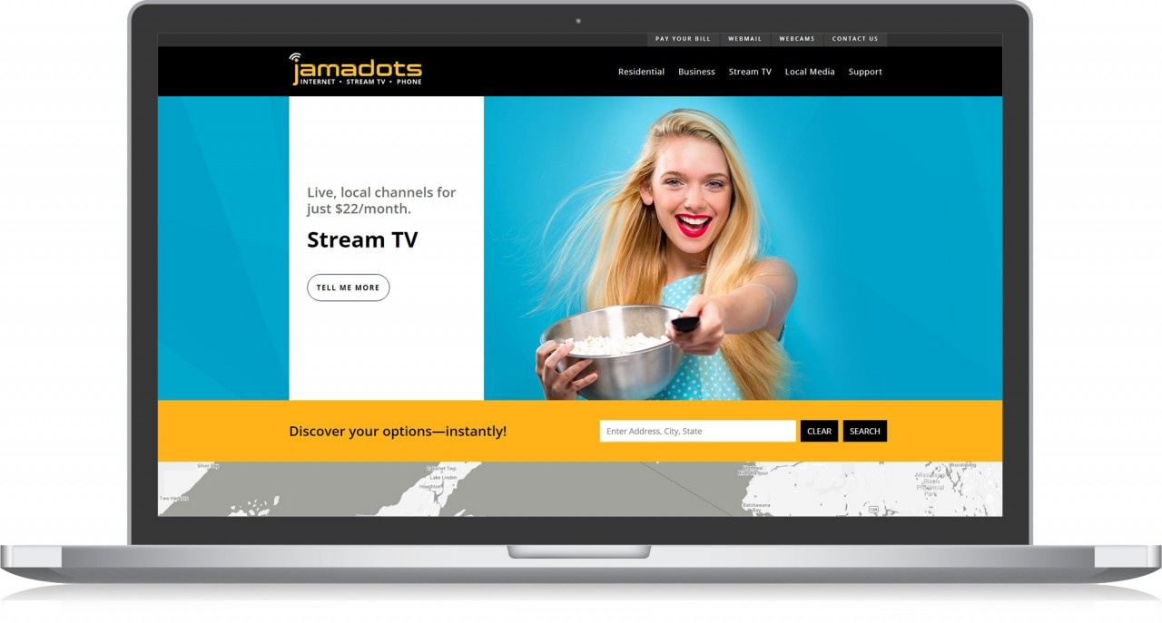
Here’s how web design and development can enhance your brand and keep visitors engaged:
First Impressions Matter
A clean, modern, and easy-to-navigate website creates a positive first impression.
www.quorawebsolution.com

Slide 4
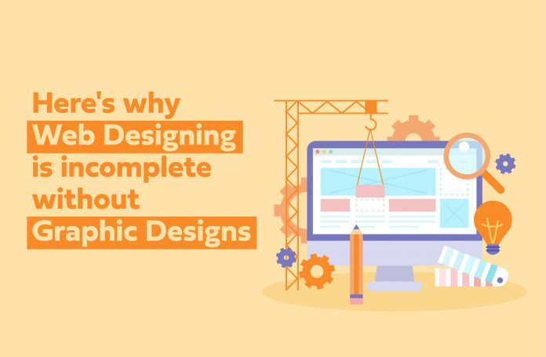
A visually appealing design helps users feel confident in your brand, encouraging them to explore more.
Consistency Across Platforms
www.quorawebsolution.com

Slide 5

Your website should reflect your brand's identity across all digital touchpoints.
www.quorawebsolution.com

Slide 6
Consistent use of your logo, colors, and fonts builds trust and recognition.
User Experience (UX)
A well-structured website ensures a smooth experience. Fast load times, easy navigation, and mobile optimization keep users engaged and reduce bounce rates.
Brand Identity Reinforcement
Every design element—from colors to images—should align with your brand’s values and personality. This helps create a memorable and cohesive brand experience.
Encouraging Interaction
www.quorawebsolution.com

Slide 7
Incorporating interactive features like forms, chatbots, and clear CTAs boosts engagement. These features make it easier for users to connect with your brand.
SEO and Visibility
A solid SEO strategy integrated into your website’s design ensures your brand is discoverable by search engines, driving more traffic and improving visibility.
Building Trust
A professional design conveys reliability. A well-developed website makes your brand appear trustworthy, encouraging users to engage and convert.
In conclusion, web design and development are powerful tools for enhancing your brand identity and fostering online engagement. By focusing on user-friendly design, seamless navigation, and a consistent brand message, you can create an unforgettable digital presence.
www.quorawebsolution.com

Slide 8
Why Partnering with a Website Design and Development Company is Essential for Your Digital Success
In the digital era, a website is more than just a marketing tool; it’s often the first impression of your business. Partnering with a professional website design and development company can play a crucial role in your business’s digital success. Here's why:
Expertise and Experience
Professional web design and development companies bring valuable expertise to the table. They understand the latest trends, technologies, and best practices to create a website that not only looks good but functions well.
Custom Solutions
A good website isn’t one-size-fits-all. A design and development company tailors the site to fit your business needs, ensuring it serves your unique goals and audience.
www.quorawebsolution.com

Slide 9
Responsive and User-Friendly Design
A web design company ensures your site is mobile-friendly and optimized for a smooth user experience across all devices, improving engagement and retention.
SEO and Performance Optimization
Designing a visually appealing site is only part of the equation. A professional team integrates SEO strategies and optimizes your website’s performance, ensuring it’s discoverable and runs smoothly.
Long-Term Support and Maintenance
Websites require ongoing maintenance and updates. Partnering with a design and development company ensures you have the support you need to keep your site up-to-date and secure.
Focus on Your Business
www.quorawebsolution.com

Slide 10
With experts handling the technical aspects of your website, you can focus on growing your business, knowing that your online presence is in good hands.
In conclusion, working with a professional website design and development company can boost your digital presence, drive more traffic, and ultimately contribute to the long-term success of your business.
www.quorawebsolution.com

Slide 11
Quora Web Solution: Quora Web Solution is a trusted website development company based in Bangalore, India, offering a wide array of services to not only domestic but global clientele. Be it Website Design and Development, SEO services, Digital Marketing, Branding, App Development, Ecommerce Solution, and Logo Creation . Quora Web Solution has the best website developers offering top quality services and that is the reason why we are well known as one of the best Website Development Companies in Bangalore, India.
Visit Us - www.quorawebsolution.com
Call Us - +91 9986 056 909
Mail Us - info@quorawebsolutions.com
www.quorawebsolution.com

Slide 12

WORDPRESS DEVELOPMENT
ECOMMERCE DEVELOPMENT
PHP DEVELOPMENT
CMS DEVELOPMENT
DRUPAL DEVELOPMENT
WEBSITE SERVICES
WEBPORTAL DEVELOPMENT
MAGENTO DEVELOPMENT
WEBSITE DEVELOPMENT
JOOMLA DEVELOPMENT
SMALL BUSINESS DEVELOPMENT
CHEAP WEBSITE DEVELOPMENT
STATIC WEBSITE DEVELOPMENT
DYNAMIC WEBSITE DEVELOPMENT
WEBSITE DESIGN COMPANY
TOUR AND TRAVEL WEBSITE DEVELOPMENT
Services

