Slide 1
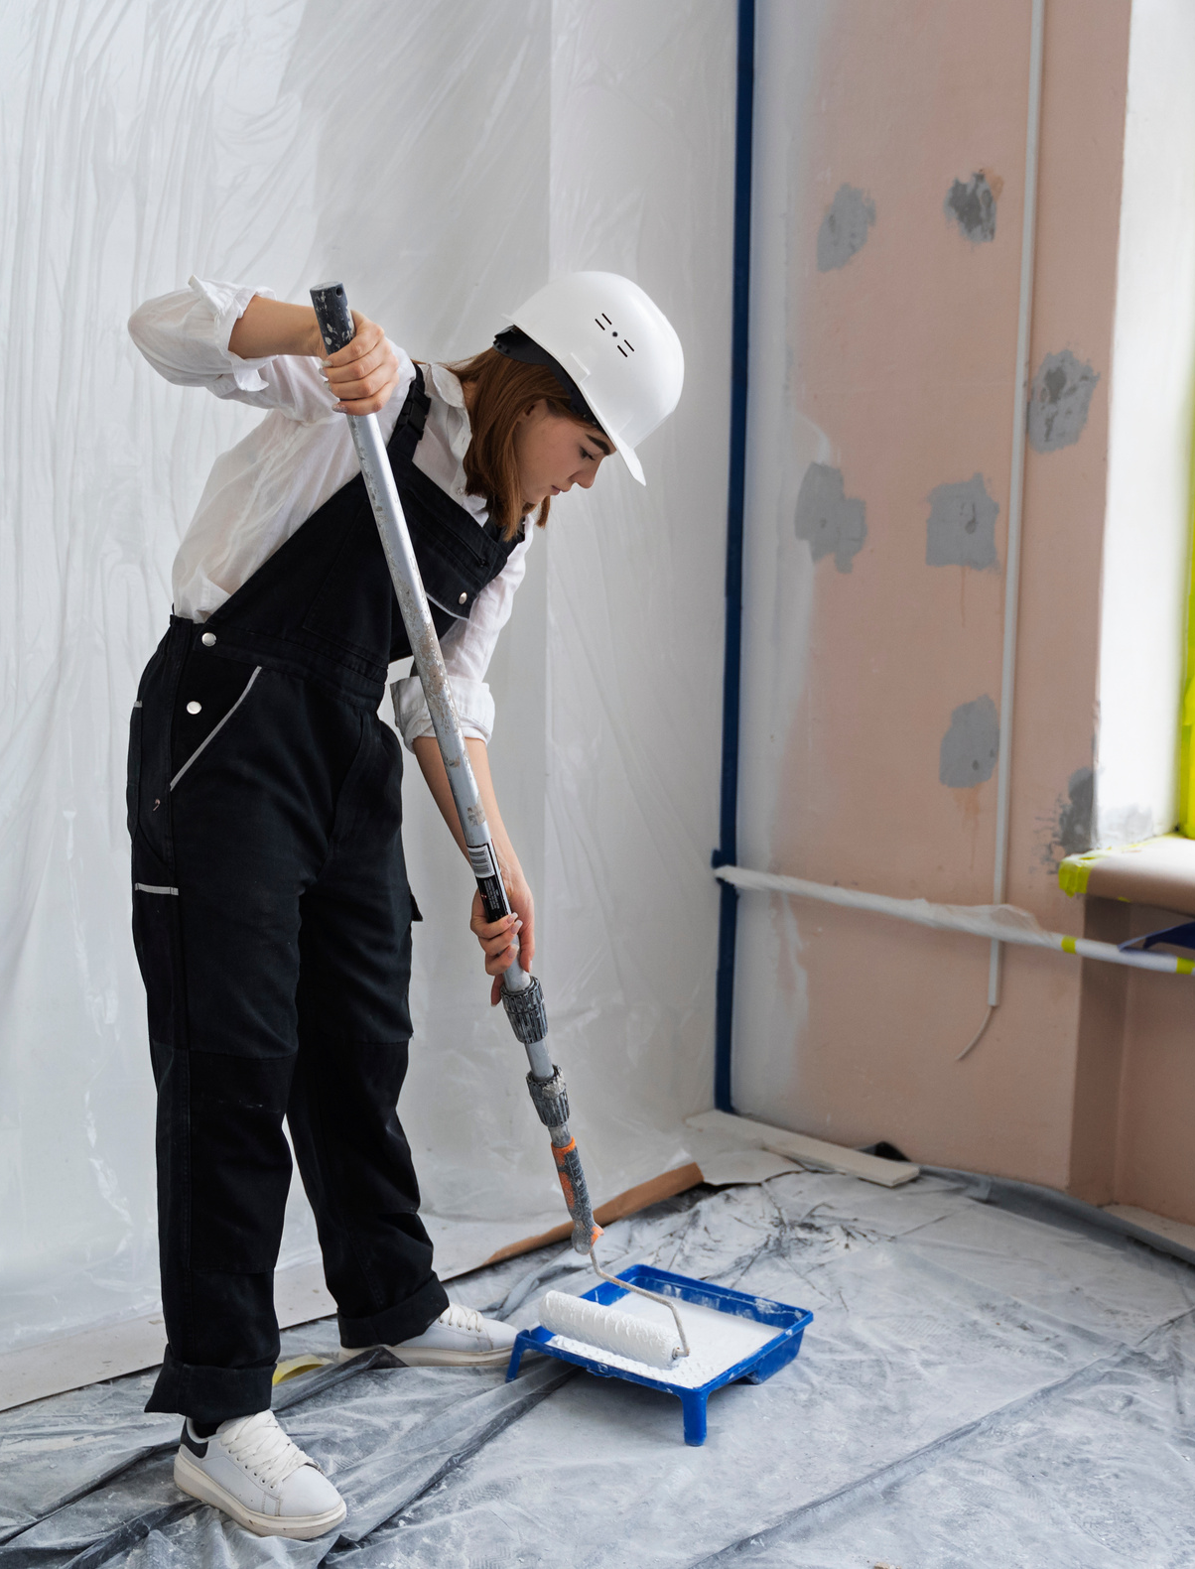
Exterior Painting Services
Transform your property’s curb appeal with precision exterior painting services. We provide weatherproof finishes that protect or impress houses all year round.

Slide 2
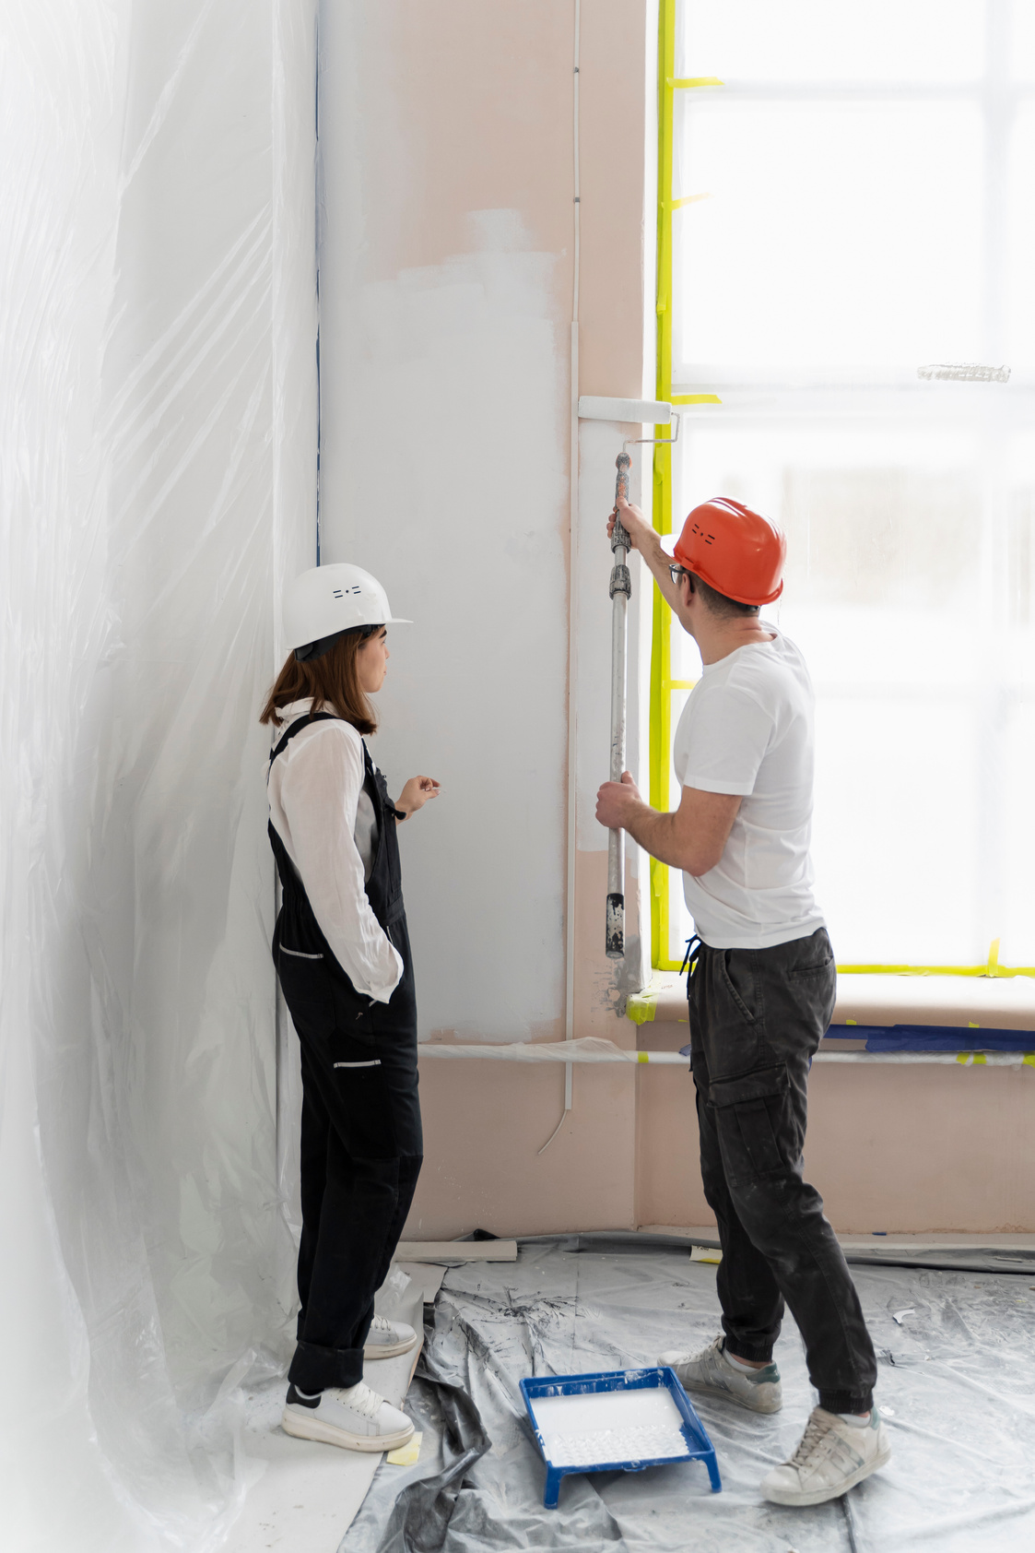
Venetian Plaster Melbourne
Elevate your interiors with timeless Venetian plaster in Melbourne for luxurious texture, smooth detailing, & artisan application tailored for Melbourne spaces.

Slide 3

Painters Melbourne
Tackle heavy-duty spaces with our industrial-coated painters in Melbourne. We deliver safe, efficient, & durable finishes for factories, warehouses, and plants.

Slide 4

Contact Us
At Finest Finish, we offer trusted painting solutions across Melbourne. From interiors to exteriors, our professional team ensures every project is finished with perfection and care.
Address: 71 Robert St, Lalor, Victoria (VIC), Australia, 3075
website: https://finestfinishpd.com.au

