Slide 1


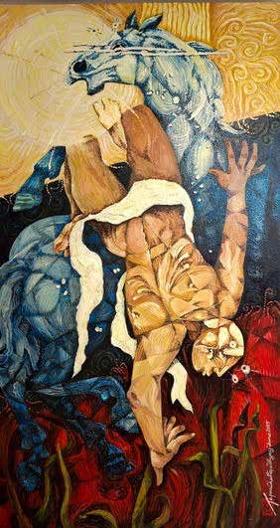
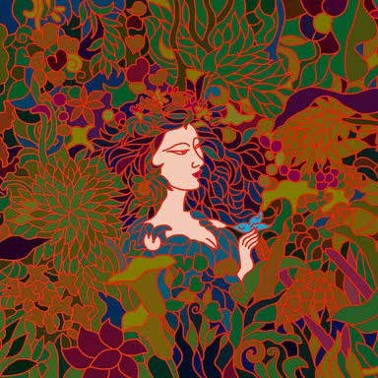
https://www.mojarto.com/

Slide 2
















































































https://www.mojarto.com/

Slide 3























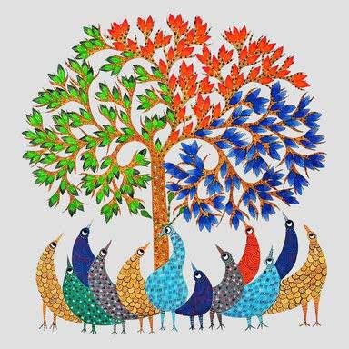









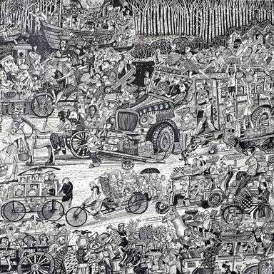








Pattachitra – Scroll paintings from Odisha with detailed mythological themes

Slide 4

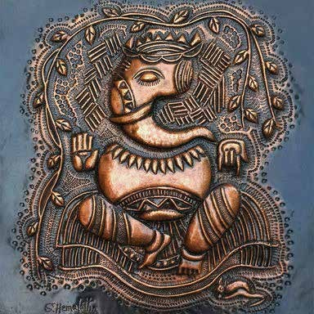



















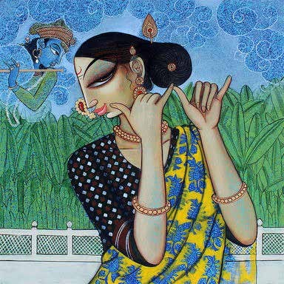










Slide 5

https://www.mojarto.com/

Slide 6






https://www.mojarto.com/
https://www.pinterest.com/mojartoofﬁcial/
https://www.facebook.com/Mojarto-191313941210803/ https://www.instagram.com/mojarto_ofﬁcial/ https://twitter.com/Mojarto https://www.youtube.com/channel/UCR4FbHC8JGcz2T1KVHfQzRg/ https://in.linkedin.com/company/mojarto-presented-by-ndtv

Slide 7
https://www.mojarto.com/

