Slide 1

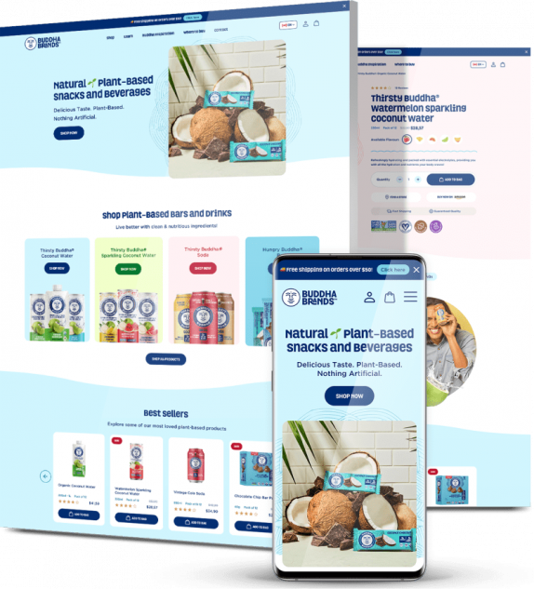

Quora Web Solution
Website Design and
Development
Company
Web Design & Web Development
Company in Bangalore, India
www.quorawebsolution.com
+91 9986 056 909
info@quorawebsolutions.com
24A, 1st Main Rd, Chandra Reddy
Layout, Koramangala 4th Block,
Koramangala, Bengaluru,
Karnataka 560034

Slide 2
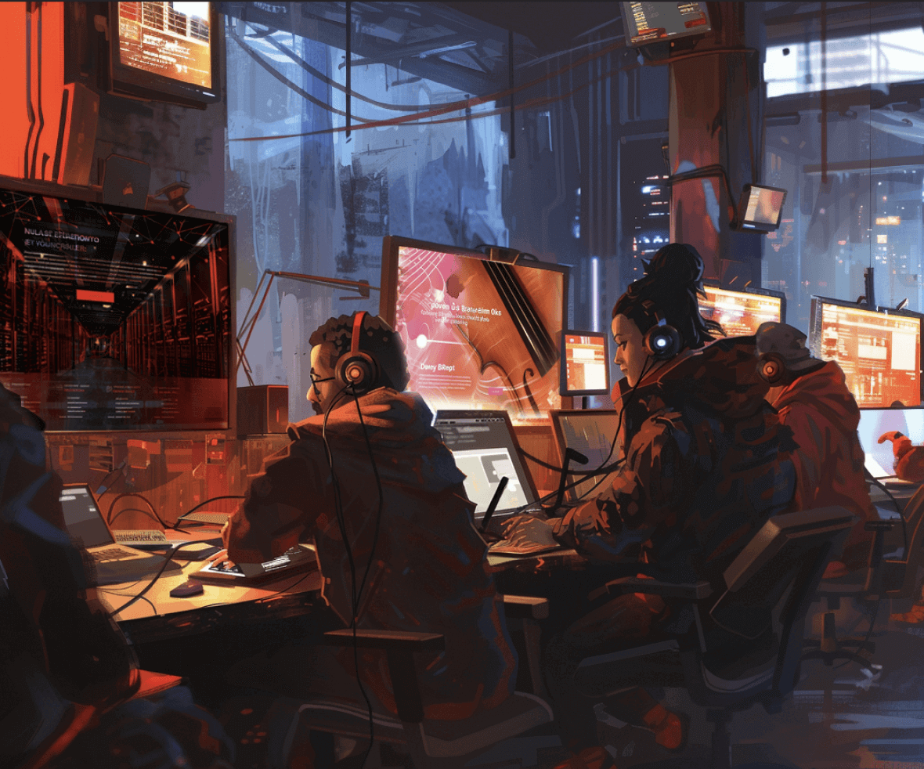
Crafting Digital Magic: Leading Website Design and Development Companies
A website is a digital storefront, brand ambassador, and revenue generator.
www.quorawebsolution.com

Slide 3

A well-designed and developed website can captivate audiences, drive conversions, and elevate your brand to new heights.
www.quorawebsolution.com

Slide 4
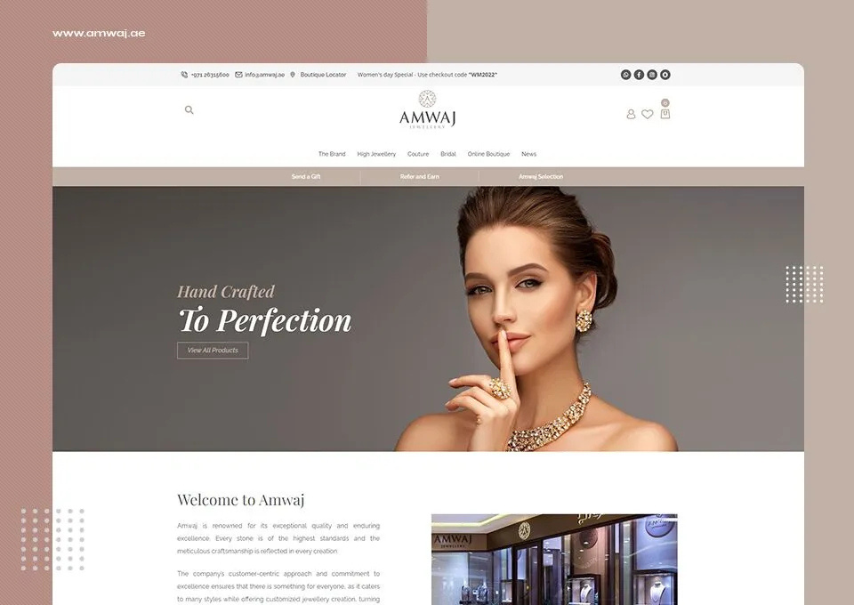
To help you navigate the vast landscape of website design and development companies, we've curated a list of industry leaders who are redefining the digital experience.
www.quorawebsolution.com

Slide 5

These companies craft stunning digital experiences.
www.quorawebsolution.com

Slide 6
Key Factors to Consider When Choosing a Web Design and Development Partner
Before diving into the list, let's explore some key factors to consider when selecting a website design and development company:
  Expertise and Experience: Look for a company with a proven track record and a team of skilled professionals.
  Portfolio: Review the company's portfolio to assess their design aesthetic, technical prowess, and ability to deliver across various industries.
  Client Testimonials: Positive feedback from previous clients can provide valuable insights into the company's reliability and quality of work.
  Communication Skills: Choose a company that listens to your needs and provides regular updates.
www.quorawebsolution.com

Slide 7
  Technical Proficiency: Ensure the company has a strong understanding of the latest web technologies and frameworks to build responsive, secure, and high-performance websites.
  SEO and Digital Marketing Knowledge: A good website design and development company should have a solid understanding of SEO principles to optimize your website for search engines.
  Post-Launch Support: Inquire about ongoing maintenance, updates, and support services to ensure your website remains up-to-date and secure.
The Future of Web Design and Development
The digital landscape is constantly evolving, and so are the trends in web design and development. Here are some emerging trends to watch:
www.quorawebsolution.com

Slide 8
  AI-Powered Design Tools: AI is revolutionizing the design process, automating tasks and generating creative ideas.
  Voice Search Optimization: As voice assistants become more prevalent, optimizing websites for voice search is crucial.
  Augmented Reality (AR) and Virtual Reality (VR) Experiences: AR and VR are transforming the way users interact with websites.
  Progressive Web Apps (PWAs): PWAs offer a seamless user experience across devices and platforms, making them ideal for modern businesses.
  Serverless Architecture: This emerging technology enables scalable and cost-effective web applications.
By staying ahead of these trends and partnering with a forward-thinking web design and development company, you can ensure your online presence remains competitive and engaging.
A well-designed website is an investment in your brand.
www.quorawebsolution.com

Slide 9
How to Choose the Right Website Design and Development Company
In today's digital age, a website is more than just an online presence; it's a powerful tool that can help you connect with your audience, generate leads, and boost your business. To maximize the potential of your website, it's crucial to partner with the right website design and development company.
Here are some key factors to consider when selecting a company:
1. Experience and Expertise:
  Track Record: Look for a company with a proven track record of delivering successful projects.
  Industry Knowledge: Consider a company that has experience in your specific industry.
  Team Skills: Ensure the company has a team of skilled designers, developers, and digital marketers.
2. Portfolio:
www.quorawebsolution.com

Slide 10
  Review Past Work: Analyze the company's portfolio to assess their design aesthetic, technical skills, and ability to deliver projects across various industries.
  Pay Attention to Details: Look for attention to detail, user experience, and responsiveness in their designs.
3. Communication Skills:
  Effective Communication: A good company should be able to communicate effectively, understand your needs, and provide regular updates.
  Client-Centric Approach: Look for a company that prioritizes client satisfaction and maintains open communication channels.
4. Technical Expertise:
  Latest Technologies: Ensure the company stays up-to-date with the latest web technologies and frameworks.
www.quorawebsolution.com

Slide 11
  Responsive Design: A responsive website adapts to different screen sizes, ensuring a seamless user experience.
  Security: A secure website protects your business and your customers' data.
5. SEO and Digital Marketing Knowledge:
  Search Engine Optimization: A well-optimized website will rank higher in search engine results, driving more organic traffic.
  Digital Marketing Strategies: A good company should have a solid understanding of digital marketing strategies to help you reach your target audience.
6. Post-Launch Support:
www.quorawebsolution.com

Slide 12
  Ongoing Maintenance: Inquire about ongoing maintenance, updates, and support services to ensure your website remains up-to-date and secure.
  Scalability: A good company should be able to scale your website as your business grows.
7. Pricing and Packages:
  Transparent Pricing: Choose a company with transparent pricing and clear package options.
  Value for Money: Consider the value you're getting for the price, not just the lowest cost.
Tips for Choosing the Right Company:
  Request References: Ask for references from previous clients to get firsthand feedback.
  Set Clear Goals: Clearly communicate your website goals and expectations to the company.
  Ask Questions: Don't hesitate to ask questions about their process, timeline, and team.
www.quorawebsolution.com

Slide 13
  Trust Your Gut: Choose a company that you feel comfortable working with.
By carefully considering these factors, you can select a website design and development company that will help you achieve your online goals.
www.quorawebsolution.com

Slide 14
Quora Web Solution: Quora Web Solution is a trusted website development company based in Bangalore, India, offering a wide array of services to not only domestic but global clientele. Be it Website Design and Development, SEO services, Digital Marketing, Branding, App Development, Ecommerce Solution, and Logo Creation . Quora Web Solution has the best website developers offering top quality services and that is the reason why we are well known as one of the best Website Development Companies in Bangalore, India.
Visit Us - www.quorawebsolution.com
Call Us - +91 9986 056 909
Mail Us - info@quorawebsolutions.com
www.quorawebsolution.com

Slide 15




Services
WORDPRESS DEVELOPMENT
ECOMMERCE DEVELOPMENT
PHP DEVELOPMENT
CMS DEVELOPMENT
DRUPAL DEVELOPMENT
WEBSITE SERVICES
WEBPORTAL DEVELOPMENT
MAGENTO DEVELOPMENT
WEBSITE DEVELOPMENT
JOOMLA DEVELOPMENT
SMALL BUSINESS DEVELOPMENT
CHEAP WEBSITE DEVELOPMENT
STATIC WEBSITE DEVELOPMENT
DYNAMIC WEBSITE DEVELOPMENT
WEBSITE DESIGN COMPANY
TOUR AND TRAVEL WEBSITE DEVELOPMENT

