Slide 1

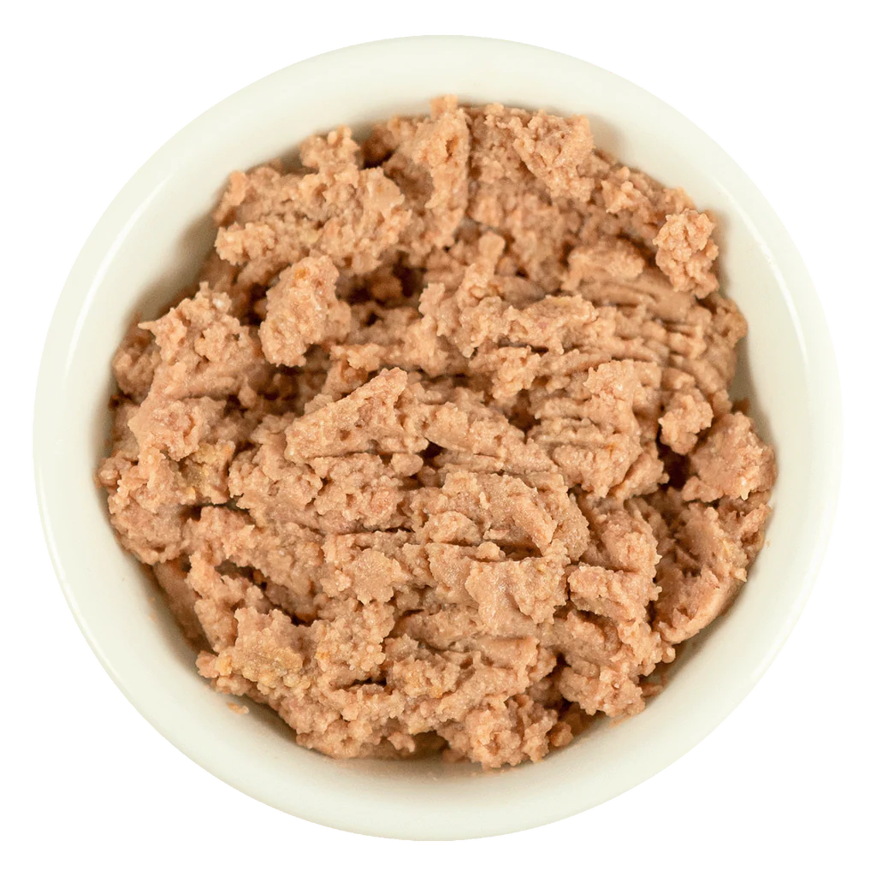
Buy Freshpet Dog Food Online
Buy Freshpet dog food online for natural, fresh meals crafted to keep your dog healthy and happy. Shop easily with fast delivery and trusted quality for your pet’s daily nutrition.

Slide 2
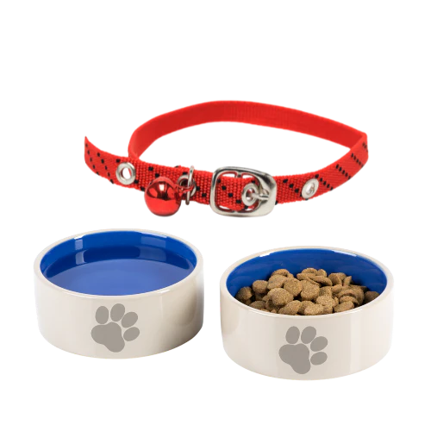

Buy Eukanuba Dog Food Online
Buy Eukanuba dog food online with premium nutrition designed to support your dog’s health, energy, and overall well-being. Enjoy high-quality ingredients and fast, reliable delivery to your doorstep.

Slide 3
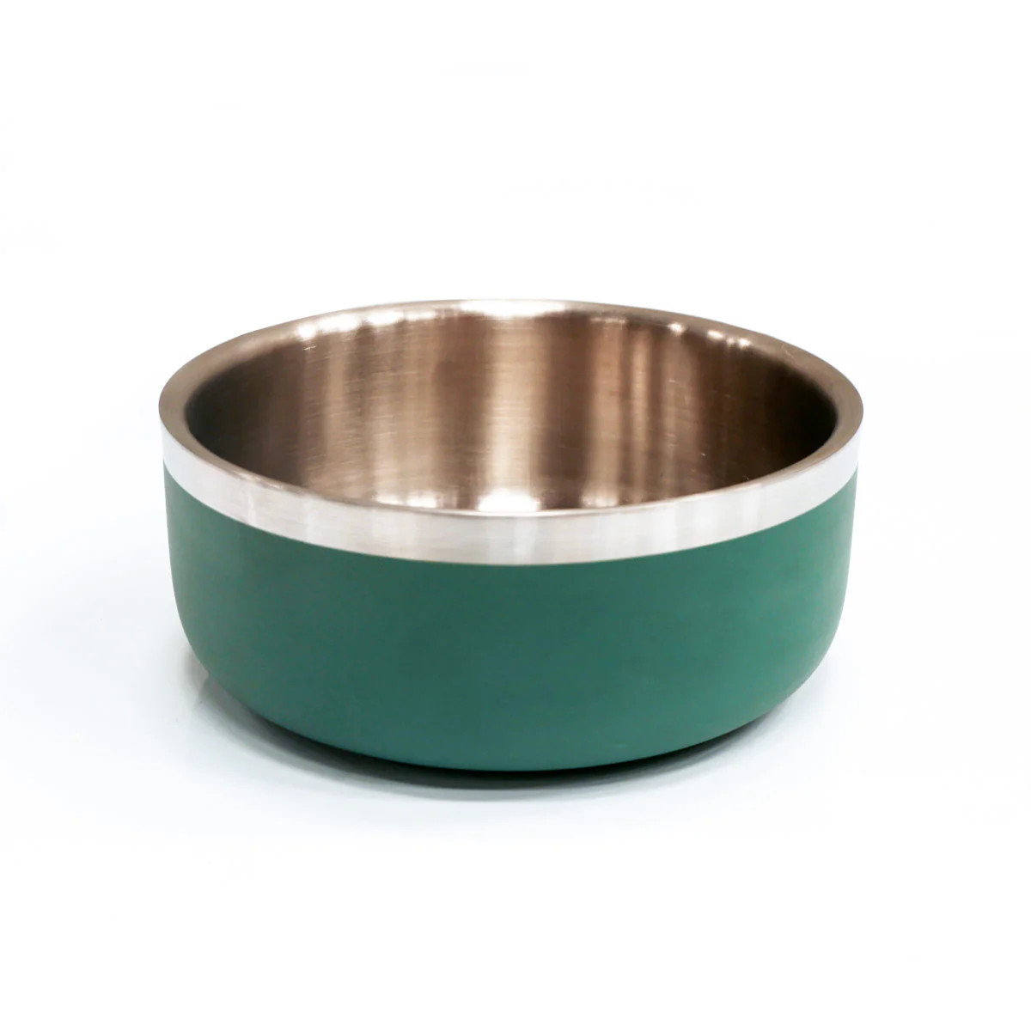
Buy Fresh Dog Food Online
Buy fresh dog food online and give your pet wholesome, nutritious meals made from high-quality ingredients. Choose from a variety of fresh options with quick and convenient delivery.

Slide 4


Contact Us
About : Emirates Pet Food is where happy tails & loud purrs begin. From pet nutrition to accessories, we deliver top brands across the UAE, fast, fresh & fuss-free. Because your pet isn’t just a pet, it’s family.
https://www.emiratespetfood.com
  Al Roza Plot No 16-17 Warsan 1 International City, Dubai, United Arab Emirates

