Slide 1


Quora Web Solution
Website Design and
Development
Company
Web Design & Web Development
Company in Bangalore, India
www.quorawebsolution.com
+91 9986 056 909
info@quorawebsolutions.com
24A, 1st Main Rd, Chandra Reddy
Layout, Koramangala 4th Block,
Koramangala, Bengaluru,
Karnataka 560034

Slide 2
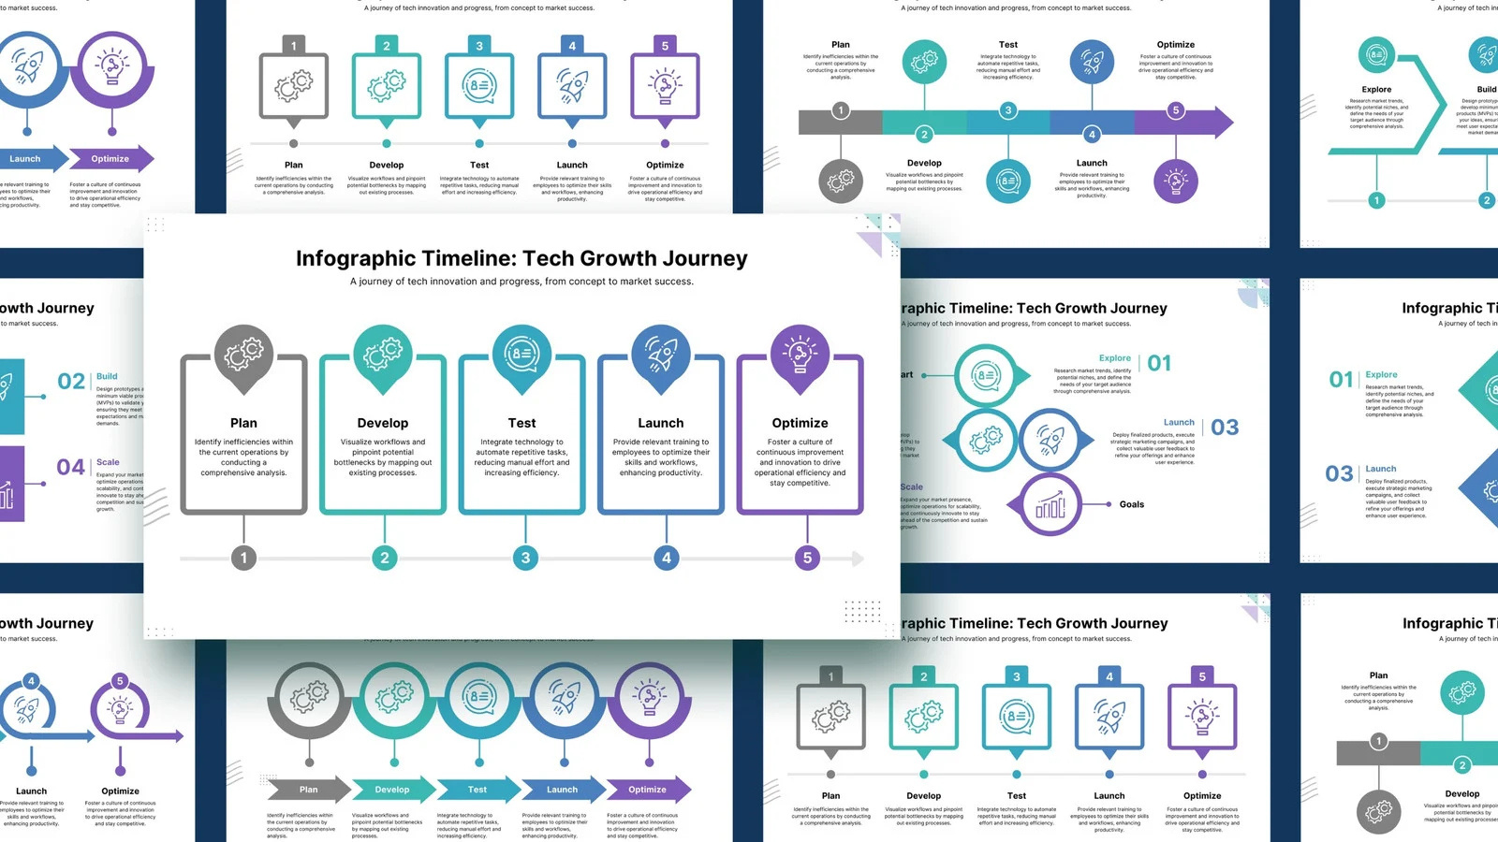
From Concept to Launch: How a Professional Website Design and Development Company Brings Your Vision to Life
Creating a website is more than just a design and coding process—it's about turning your vision into an engaging, functional online experience. Partnering with a professional website design and development company ensures your website not only looks great but also supports your business goals.
www.quorawebsolution.com

Slide 3

1. Understanding Your Vision
The process begins with an in-depth consultation to gain a clear understanding of your brand identity, target audience, and business goals. This foundation guides the entire project, ensuring the website aligns with your vision.
www.quorawebsolution.com

Slide 4

2. Planning and Strategy
Next, the team plans the site structure, creates wireframes, and develops a content and SEO strategy. They also design the user journey, ensuring seamless navigation and an intuitive, user-friendly experience.
3. Website Design
www.quorawebsolution.com

Slide 5

In this stage, the design team crafts the visual elements, ensuring your website is both aesthetically pleasing and user-friendly. They focus on responsive design to ensure the site looks great on all devices.
4. Development
Here, the design is turned into a functional site through front-end and back-end development.
www.quorawebsolution.com

Slide 6
This includes integrating features like content management systems (CMS) and e-commerce platforms, followed by rigorous testing to ensure everything works perfectly.
5. Launching the Website
Before going live, final checks are performed for content accuracy, SEO, and functionality. The team ensures the website is secure and sets up hosting. A strategic launch plan promotes the site to your audience.
6. Post-Launch Support
After launch, the company provides ongoing maintenance, security updates, and performance monitoring. They help you optimize and evolve your site as your business grows.
Conclusion
www.quorawebsolution.com

Slide 7
A professional website design and development company ensures that your website not only meets your business needs but also provides a seamless, enjoyable user experience. From vision to launch and beyond, they bring your digital presence to life.
The Essential Checklist for Partnering with a Website Design and Development Company
Choosing the right website design and development company is essential to creating a website that meets your business goals. Use this checklist to ensure you're partnering with a company that will deliver results.
1. Define Your Goals and Requirements
www.quorawebsolution.com

Slide 8
Clearly outline your website’s objectives, desired features (e-commerce, blog, etc.), and design preferences. This will assist you in finding a company that aligns with your vision.
2. Review Their Portfolio
Look at their previous work to assess the quality, variety, and functionality of the websites they've created. This will provide you with insight into their capabilities.
3. Check Client Testimonials and Reviews
Read client testimonials and reviews on independent platforms to gauge the company’s reputation and customer satisfaction.
4. Evaluate Their Expertise and Services
www.quorawebsolution.com

Slide 9
Ensure the company has the technical skills needed, such as experience with responsive design, SEO, and CMS platforms. They should also offer ongoing support after the website is live.
5. Assess Communication and Collaboration
Effective communication is crucial. Select a company that listens to your needs, offers consistent updates, and welcomes feedback.
6. Review Their Process and Timeline
Understand their approach and ensure the project timeline and budget are realistic and aligned with your goals.
7. Consider SEO and Marketing Expertise
www.quorawebsolution.com

Slide 10
A great website needs visibility. Make sure the company incorporates SEO best practices and offers digital marketing services if needed.
8. Focus on Long-Term Partnership
Choose a company that offers ongoing maintenance and scalability to help your website grow as your business evolves.
Conclusion
www.quorawebsolution.com

Slide 11
Choosing the right website design and development company is crucial for building a successful online presence. Use this checklist to ensure you're choosing a team that will bring your vision to life and support your long-term goals.
www.quorawebsolution.com

Slide 12
Quora Web Solution: Quora Web Solution is a trusted website development company based in Bangalore, India, offering a wide array of services to not only domestic but global clientele. Be it Website Design and Development, SEO services, Digital Marketing, Branding, App Development, Ecommerce Solution, and Logo Creation . Quora Web Solution has the best website developers offering top quality services and that is the reason why we are well known as one of the best Website Development Companies in Bangalore, India.
Visit Us - www.quorawebsolution.com
Call Us - +91 9986 056 909
Mail Us - info@quorawebsolutions.com
www.quorawebsolution.com

Slide 13

WORDPRESS DEVELOPMENT
ECOMMERCE DEVELOPMENT
PHP DEVELOPMENT
CMS DEVELOPMENT
DRUPAL DEVELOPMENT
WEBSITE SERVICES
WEBPORTAL DEVELOPMENT
MAGENTO DEVELOPMENT
WEBSITE DEVELOPMENT
JOOMLA DEVELOPMENT
SMALL BUSINESS DEVELOPMENT
CHEAP WEBSITE DEVELOPMENT
STATIC WEBSITE DEVELOPMENT
DYNAMIC WEBSITE DEVELOPMENT
WEBSITE DESIGN COMPANY
TOUR AND TRAVEL WEBSITE DEVELOPMENT
Services

