Slide 1

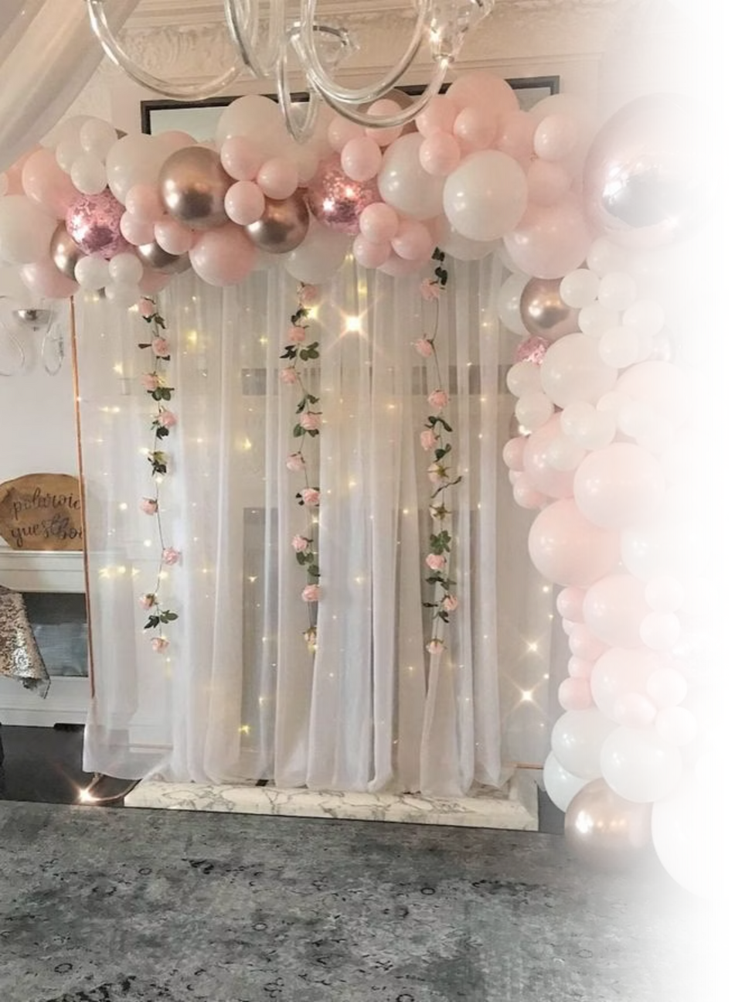

Surprise & Delight Friends with Birthday Decoration Dubai
Transform ordinary birthday celebrations into extraordinary experiences with Dubai's most spectacular decoration styles and trends.
Notes:
1

Slide 2
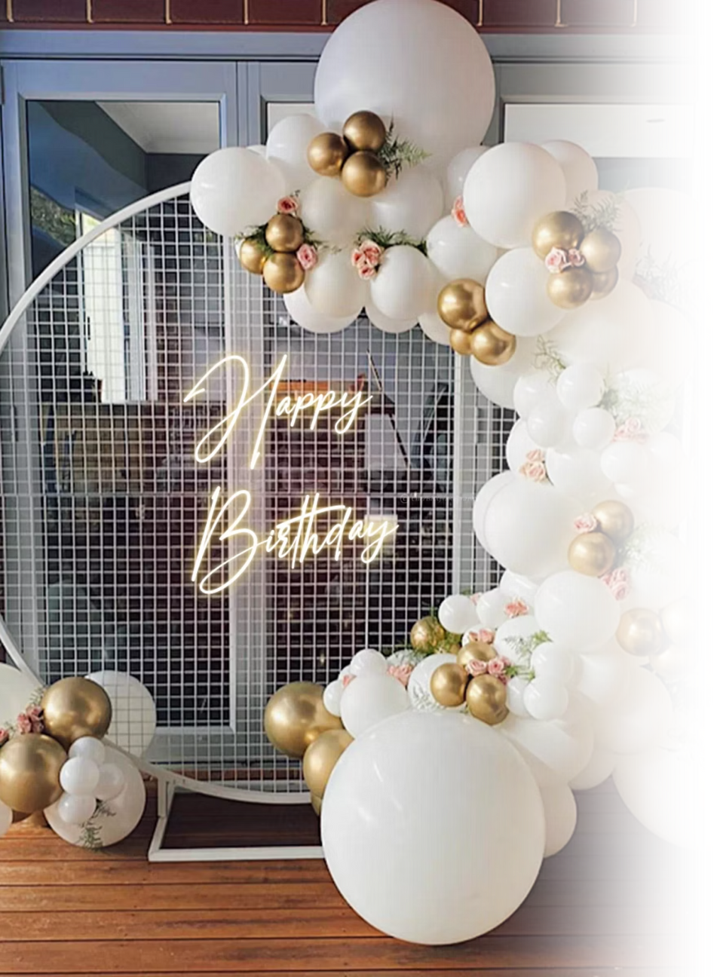



Why Dubai Birthday Decorations Are Unforgettable
Luxury Meets Creativity
Multicultural Flair
Dubai's unique blend of opulence and innovation creates decoration styles that are both elegant and imaginative, setting new standards for celebration aesthetics.
Drawing inspiration from across the world, Dubai's decorators infuse international trends with local luxury, offering diverse themes that resonate with every culture.
Memory-Making Magic
From intimate home gatherings to grand venue spectacles, expertly crafted Birthday Decoration Dubai sets the perfect mood and creates unforgettable moments worth capturing.
Notes:
2

Slide 3
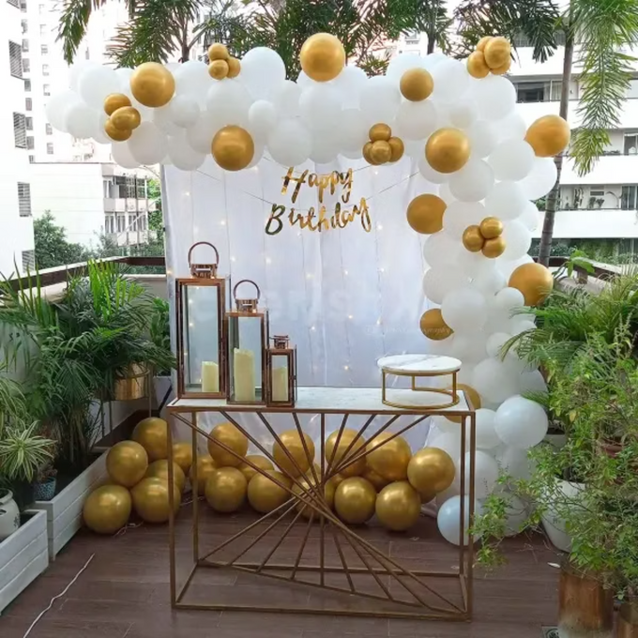
Balloon Garlands & Arches: The Ultimate Celebration Statement
Elegant & Versatile Designs
Balloon garlands with pastel tones, metallic finishes, and integrated LED fairy lights have become Dubai's signature party element. These stunning installations create instant visual impact.
  Customisable to any theme, age, or colour palette
  From kids' whimsical pastel parties to glamorous adult soirées
  Weather-resistant options for outdoor celebrations
  Available in organic or structured styles
Professional balloon artists in Dubai create bespoke installations that transform spaces, combining premium latex, chrome finishes, and innovative lighting for show-stopping results.
Notes:
3

Slide 4
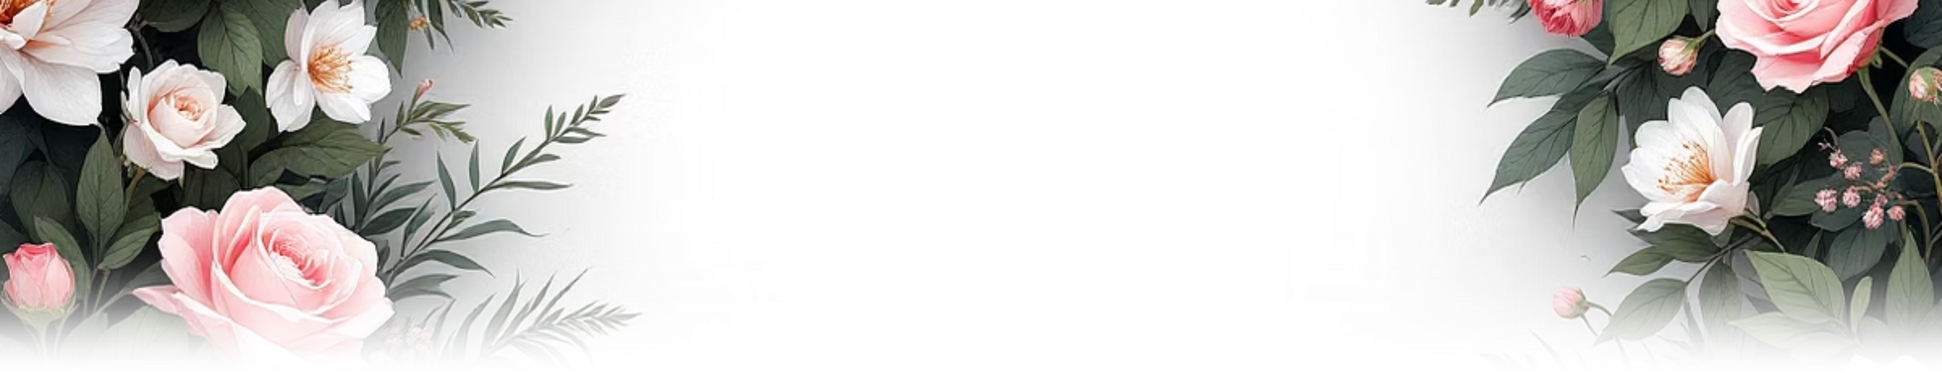
Floral Backdrops & Botanical Elegance
Premium Fresh Florals
Trending Minimalist Aesthetics
Custom Floral Installations
Fresh roses, lilies, and orchids combined with lush greenery create luxurious, fragrant displays. These botanical masterpieces serve as stunning backdrops for cake-cutting ceremonies and create picture-perfect Instagram-worthy moments.
Dubai's floral designers craft bespoke installations ranging from delicate hanging installations to dramatic floor-to-ceiling flower walls, each tailored to reflect the birthday star's personality and celebration theme.
Minimalist white and green botanical décor is currently trending for its timeless sophistication. Clean lines, carefully curated foliage, and elegant simplicity create an upscale ambiance that photographs beautifully.
Notes:
4

Slide 5
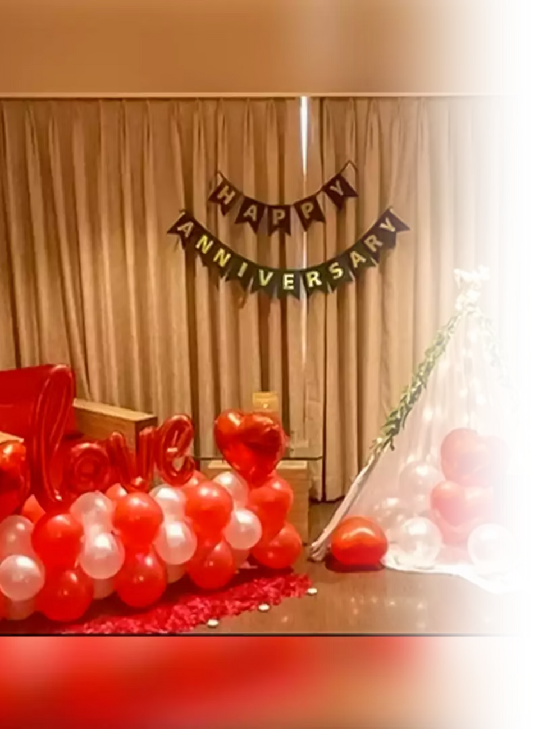
Neon Signs & Themed Party Backdrops
Modern LED Neon Magic
Neon signs can be hired or purchased, with custom designs typically ready within 7-10 days. They're perfect for both indoor and outdoor venues, adding that signature Dubai glamour to any celebration.
Custom LED neon signs like "Happy Birthday Sarah" or "Cheers to 30" add a contemporary, fun vibe whilst creating perfect photo backdrops. These energy-efficient, safe alternatives to traditional neon offer endless personalisation options.
Popular Dubai Party Themes
  Arabian Nights: Luxurious jewel tones with golden accents
  Bollywood Glamour: Vibrant colours and dramatic draping
  Tropical Paradise: Palm leaves, exotic flowers, and beach vibes
  Princess Castles: Fairytale magic with pastel elegance
Notes:
5

Slide 6

Luxury Cake Table Styling & Themed Table Setups
Show-Stopping Cake Tables
Immersive Tablescapes
Outdoor Picnic Luxury
The cake table serves as the party's focal point. Tiered stands, cascading fresh flowers, elegant candles, and themed props elevate the presentation, making the cake-cutting moment truly spectacular.
Themed table setups with coordinating plates, napkins, and centrepieces complete the immersive experience. Every detail matters, from custom place cards to colour-matched cutlery.
Dubai's chic picnic setups featuring decorated teepees, Persian rugs, and plush cushions bring bohemian elegance to outdoor celebrations. Perfect for beach or park venues.
Notes:
6

Slide 7
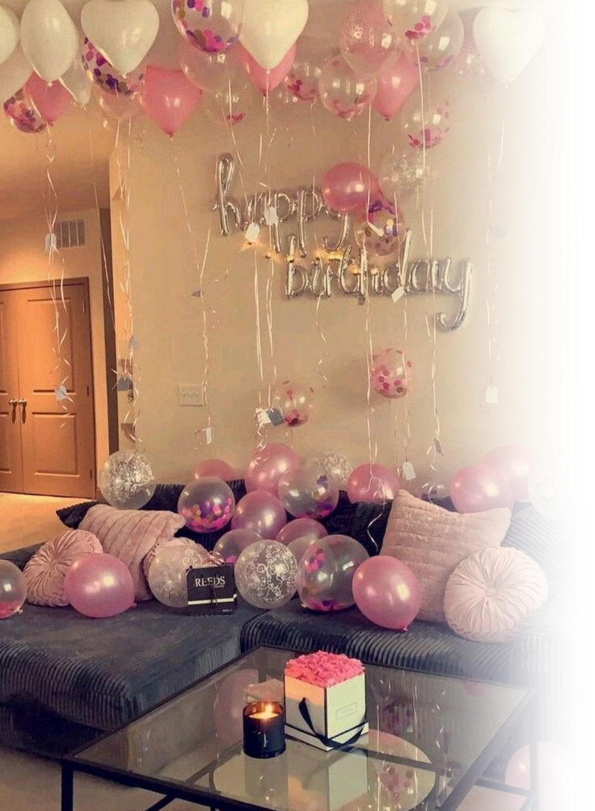



Magical Lighting: Fairy Lights & Hanging Lanterns
"Lighting doesn't just illuminate a space—it transforms it into an enchanting wonderland that guests will remember long after the celebration ends."
Warm Fairy Lights
String lights create intimate, magical atmospheres. Draped across ceilings, wrapped around columns, or cascading down walls, they add sparkle and warmth to any venue.
Elegant Lanterns
Hanging paper lanterns, Moroccan-style metal lanterns, or modern geometric designs add visual interest and ambient glow, perfect for both indoor and outdoor evening celebrations.
Versatile Application
Lighting works beautifully in gardens, rooftops, ballrooms, or home settings. Layer different lighting types for depth and create zones with varying intensities for dynamic spaces.
Notes:
7

Slide 8
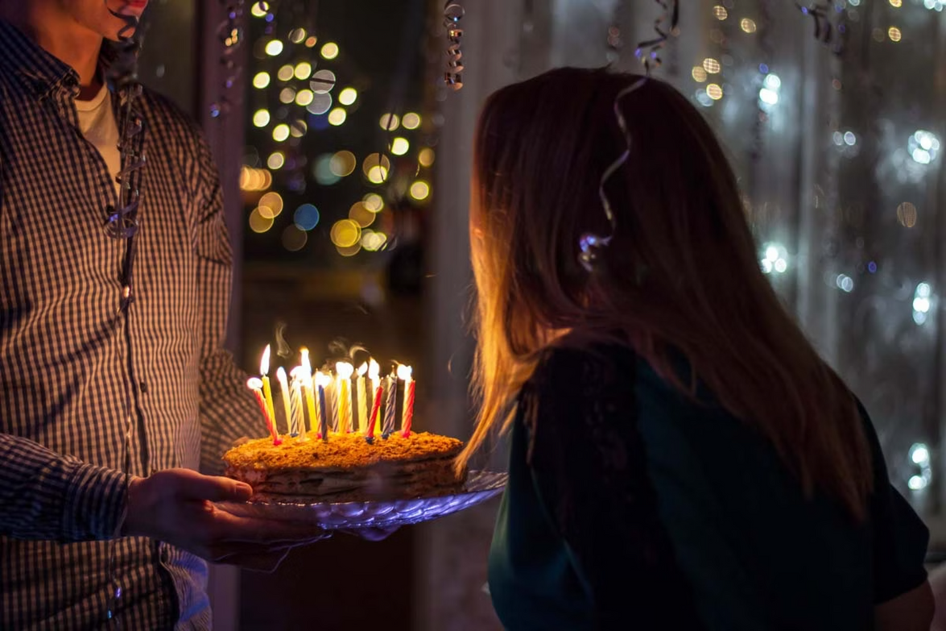
Personalised Touches: Name Boards, Cut-Outs & Photo Booths
Bespoke Personal Details
LED-lit name boards and stylish foam cut-outs add a truly bespoke feel, making the birthday star feel extraordinary. These custom elements become treasured keepsakes after the celebration.
Interactive Entertainment
Photo booths with themed props keep guests entertained throughout the event and create fun, shareable memories. With professional birthday decoration services, from vintage-style booths to modern 360° video setups, Dubai offers cutting-edge options for every celebration.
Personalisation is the key to making celebrations truly special. Consider custom signage, monogrammed details, favourite colour schemes, and meaningful quotes or phrases that reflect the birthday person's unique personality and style.
Notes:
8

Slide 9

Professional Birthday Decoration Services in Dubai
Trusted Professionals
Comprehensive Services
Planning Timeline
Renowned decorators like Man of Events and Balloon Zone specialise in customised themes, premium materials, and flawless execution. Their experienced teams handle everything from concept to completion.
Professional decorators cover all venues: homes, hotels, yachts, beach clubs, and event spaces. They offer seamless coordination, setup, and breakdown services with attention to every detail.
Booking 2+ weeks in advance is recommended for weekend events during peak season. Popular decorators often require 3-4 weeks' notice for elaborate custom designs and themed installations.
Pro Tip: Request mood boards and 3D renderings during the consultation phase to visualise your decoration plan. Many Dubai decorators offer virtual previews using advanced design software.
Notes:
9

Slide 10

Make Every Birthday a Dubai-Style Celebration
01
02
Envision the Experience
Surprise with Luxury
Thoughtful, personalised décor transforms ordinary parties into magical experiences that reflect personality and style.
Delight your friends with creative, luxurious setups that showcase Dubai's signature blend of elegance and innovation.
03
Create Lasting Memories
Start planning today to craft picture-perfect moments that will be treasured for a lifetime.
Whether you're celebrating a milestone birthday or an intimate gathering, Dubai's world-class decoration services ensure every celebration is unforgettable. Let your creativity shine and create a birthday experience that truly wows!
Notes:
10

