Slide 1
Affordable US Immigration Services Chicago Options
www.swagatusa.com

Slide 2


Navigating Affordable Immigration Legal Help in Chicago
Immigration legal help doesn't have to cost you a fortune. Chicago actually has solid options for people who need legal support but aren't wealthy. Some paths are completely free. Others cost way less than you'd think. The trick is knowing where to look and figuring out what works for your specific situation.

Slide 3

Understanding Your Legal Options
There are three main ways to get help. Nonprofits offer free or low-cost services based on income eligibility.
Private firms charge reasonable fees and may offer payment plans. Department of Justice, accredited representatives provide affordable guidance for specific immigration cases.
Each approach has its own perks. Nonprofits don't charge money, but things move more slowly. Private immigration attorney services in Chicago work faster and give you personalized attention. Accredited reps are specialists, so they really know their stuff when it comes to certain visa types or situations.

Slide 4

Free and Low-Cost Resources
Several organizations around Chicago handle immigration cases without charging fees or asking for much money.
Legal Assistance Foundation of Metropolitan Chicago takes cases based on how much you earn
Greater Chicago Legal Clinic handles family reunification and status adjustments
Chicago Legal Clinic focuses on citizenship and DACA renewals World Relief Chicagoland assists with removal defense
The Resurrection Project connects people to trusted legal partners

Slide 5

Specialized Immigration Support
Some organizations zero in on specific needs. Catholic Charities Immigrant Services handles broader case management for families. The National Immigrant Justice Center specializes in removal defense and appeals. Illinois Coalition for Immigrant and Refugee Rights helps people figure out which resources exist and find the right match for their situation.

Slide 6
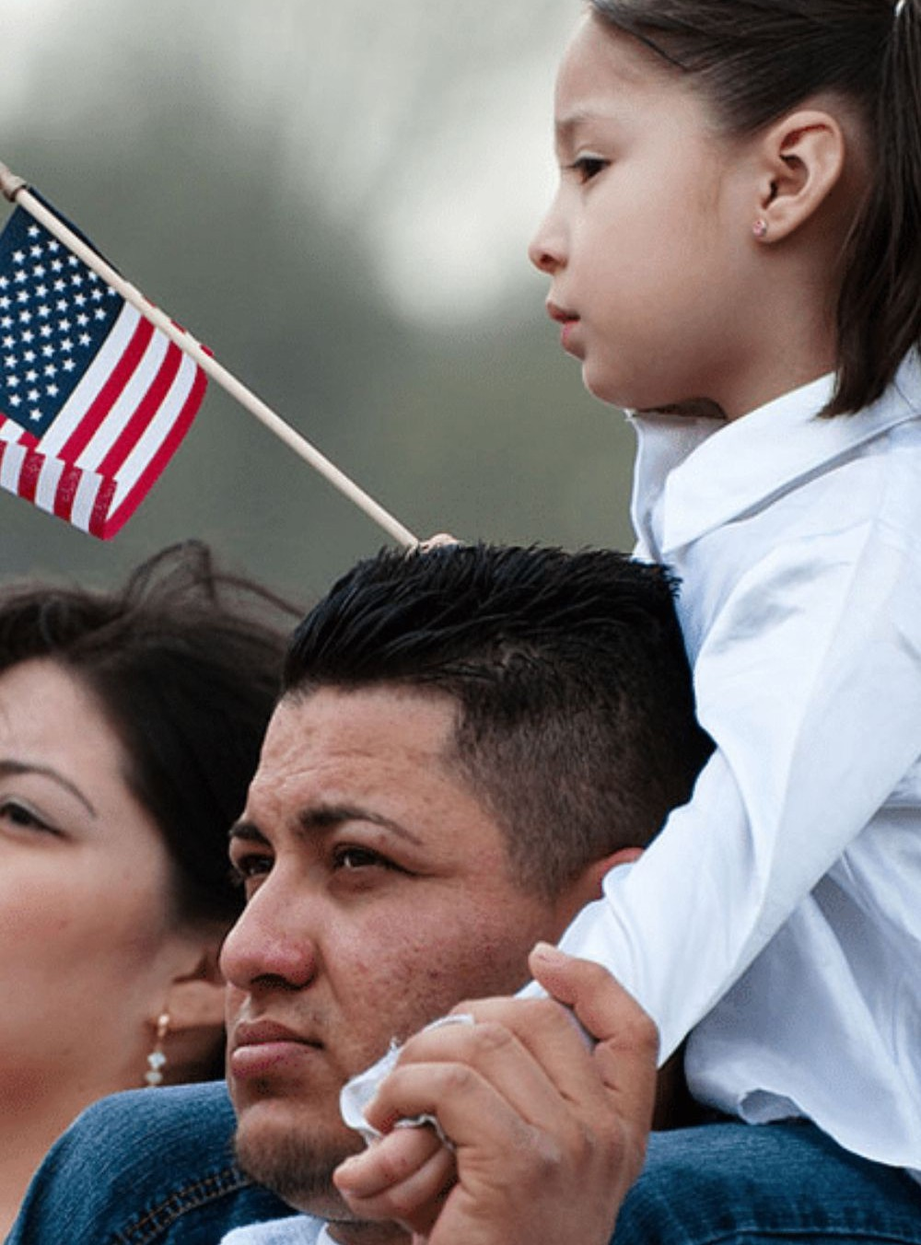
Private Immigration Attorneys
Private firms give you full-service representation with one-on-one consultation. A lot of them offer bilingual support in English and Spanish. Their offices are conveniently located near immigration courts. Payment plans make things more doable even if you don't have cash up front.
US Immigration Services Chicago, through private attorneys, covers visa applications, green card processing, citizenship preparation, and court representation.

Slide 7




Contact Us
www.swagatusa.com
leads@swagatusa.com
3128547065
230 W Monroe St, Suite 750,
Chicago, IL 60606

