Slide 1

PROFESSIONAL LED DISPLAY SCREEN MANUFACTURER FOR INDOOR & OUTDOOR DISPLAYS

Slide 2
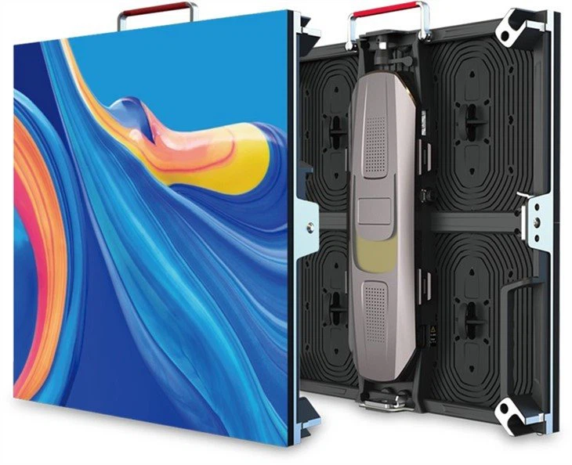
LED Display Screen Manufacturer
We are a professional LED display screen manufacturer dedicated to delivering innovative, high-quality LED display solutions. Our products are designed to help businesses enhance visibility, engagement, and brand impact through powerful visual communication.

Slide 3
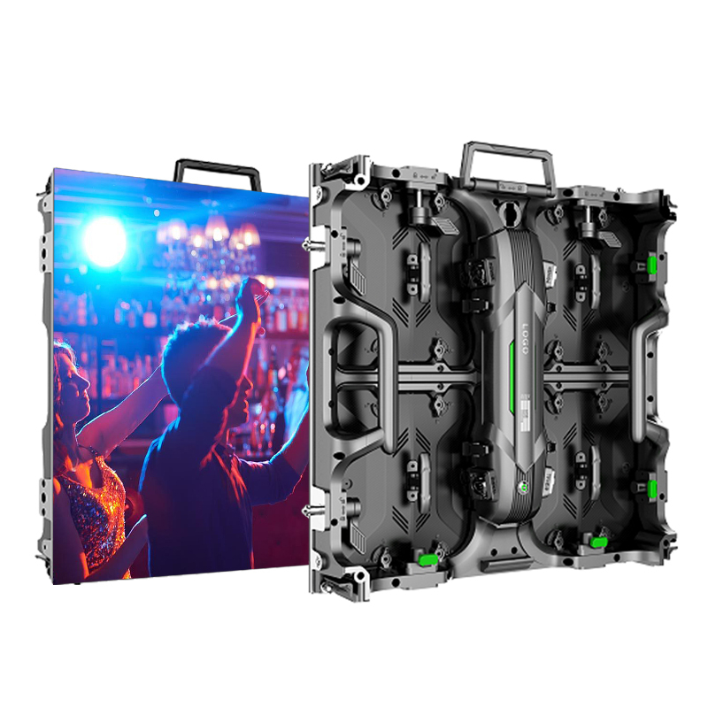
Who We Are
As an experienced LED display screen manufacturer, we focus on research, design, production, and installation of advanced LED display screens. Our goal is to provide reliable and cost-effective LED solutions that meet global quality standards.
Our LED Display Screen Solutions
  Indoor LED display screens
  Outdoor LED display screens
  LED video walls
  Advertising LED display boards
  Customized LED display solutions

Slide 4
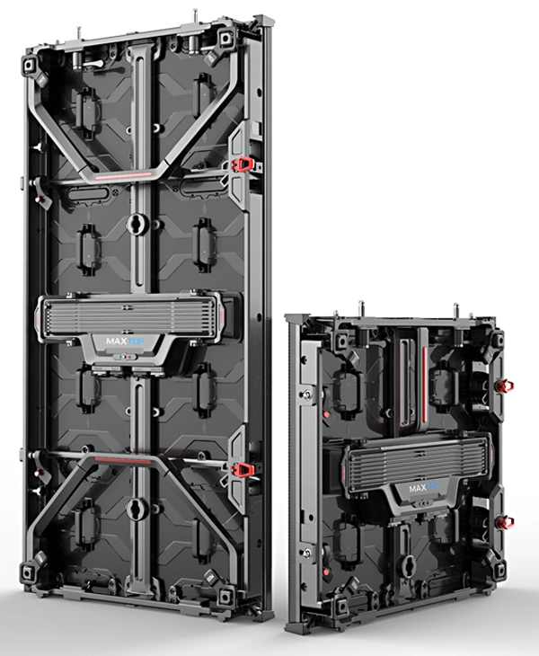
Indoor LED Display Screens
Our indoor LED display screens deliver:
  High resolution and clear images
  Smooth video playback
  Low power consumption
  Ideal use for malls, offices, conference rooms, and retail stores
Pattern Recognition
Outdoor LED Display Screens
Outdoor LED display screens are designed for:
  High brightness visibility in sunlight
  Weather resistance and durability
  Long lifespan and stable performance

Slide 5
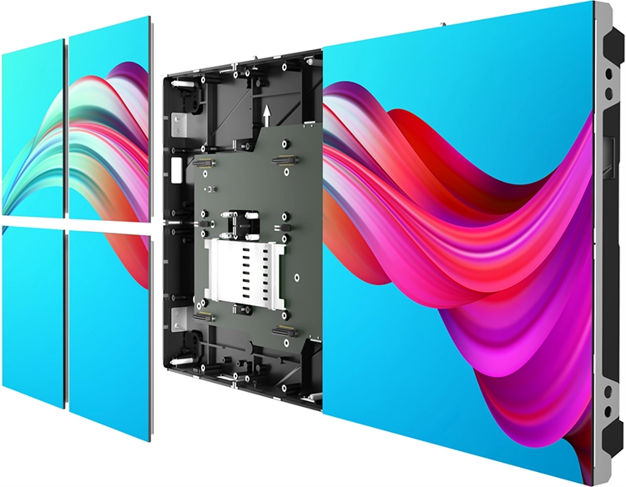
Why Choose Our LED Display Screens
  Advanced manufacturing technology
  Strict quality control
  Energy-efficient designs
  Competitive pricing
  Reliable after-sales support
Applications of LED Display Screens
  Advertising and marketing
  Corporate branding
  Events and exhibitions
  Retail and shopping malls
  Education and public spaces

Slide 6
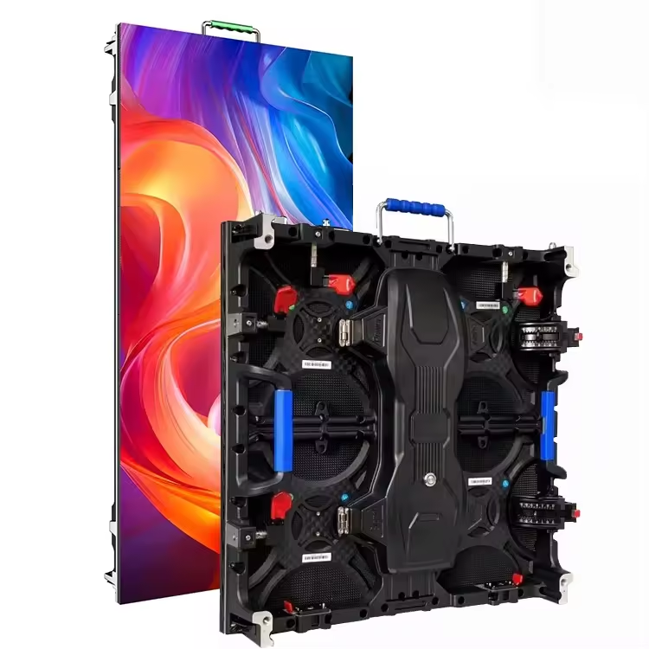
Contact US!
Partner with a reliable LED display screen manufacturer to transform your visual communication. Our LED display screens deliver performance, durability, and stunning visuals that help businesses stand out in today’s competitive market.
Contact: +86 18320889297
Website: www.cinstar-led.com

