Slide 1

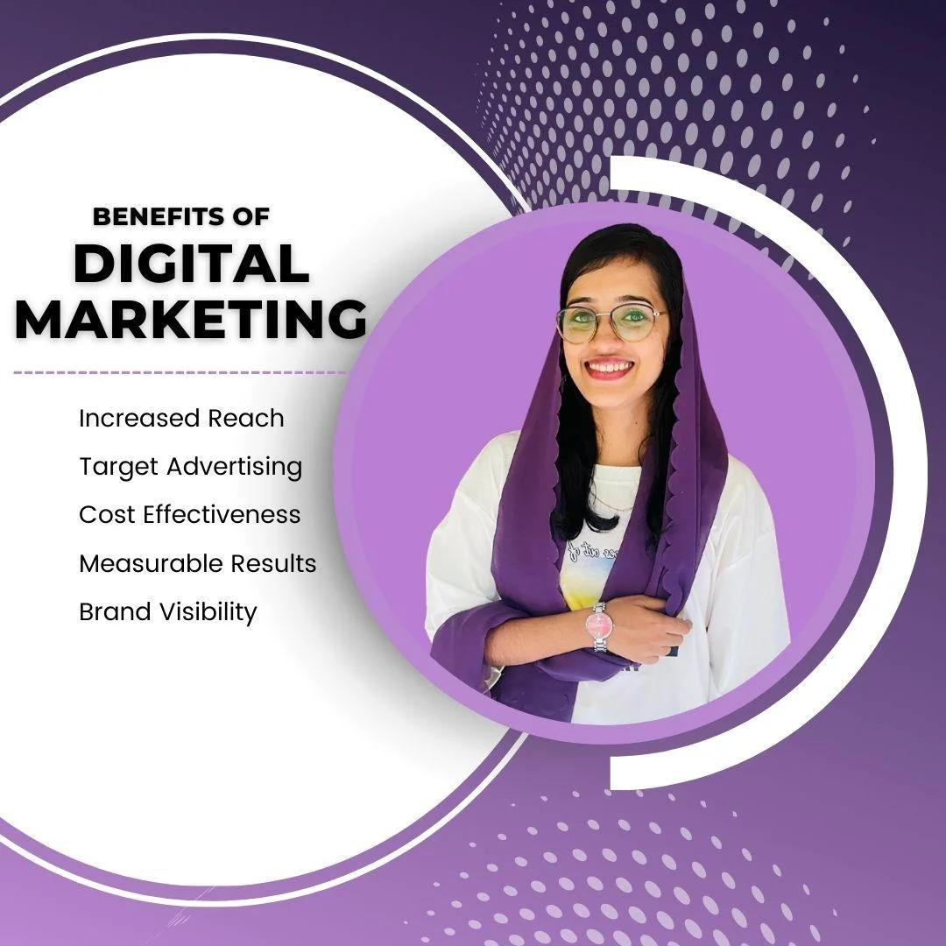

Quora Web Solution
Website Design and
Development
Company
Web Design & Web Development
Company in Bangalore, India
www.quorawebsolution.com
+91 9986 056 909
info@quorawebsolutions.com
24A, 1st Main Rd, Chandra Reddy
Layout, Koramangala 4th Block,
Koramangala, Bengaluru,
Karnataka 560034

Slide 2
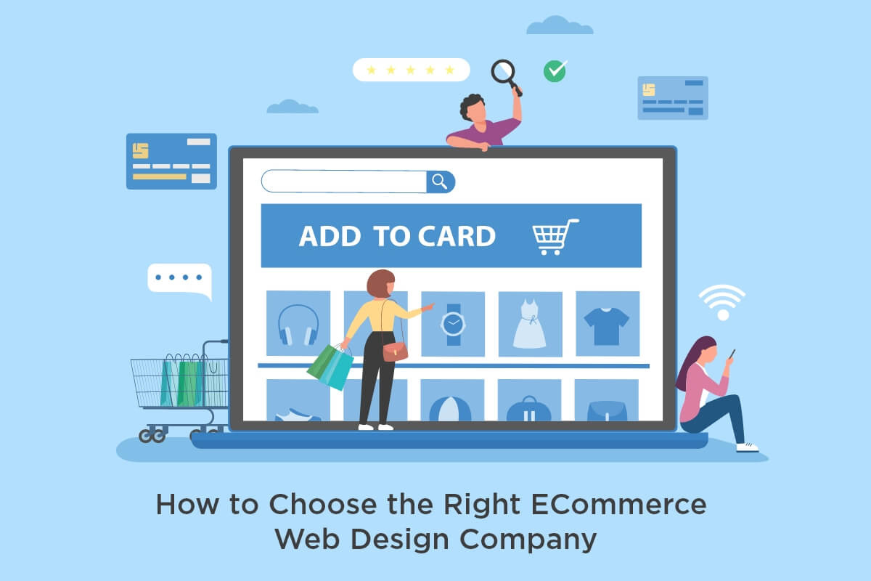
Website Design and Development Company: Your Digital Partner for Success
A website design and development company is your digital partner, specializing in crafting custom websites tailored to your unique needs and goals.
www.quorawebsolution.com

Slide 3
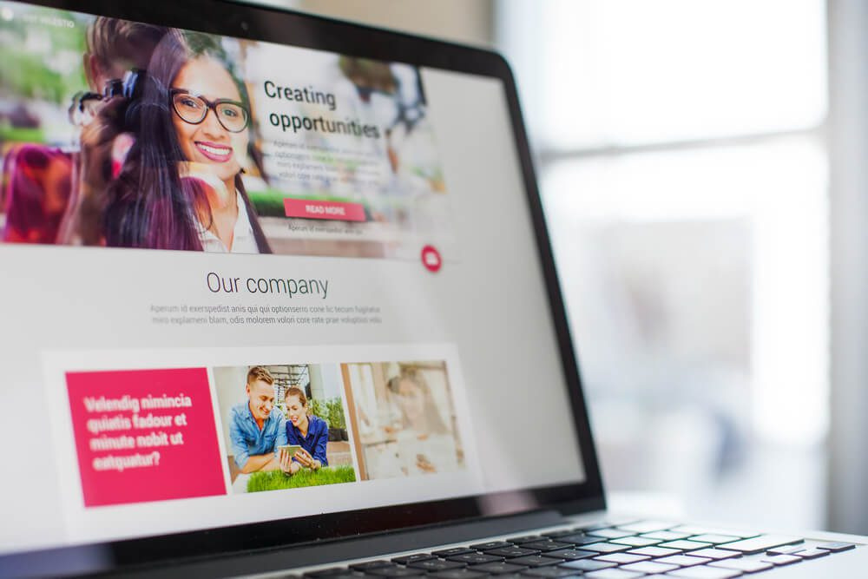
They work closely with you to understand your business, target audience, and desired outcomes, and then create a website that effectively represents your brand and drives results.
www.quorawebsolution.com

Slide 4

The process of website design and development is a collaborative effort between the client and the development team.
www.quorawebsolution.com

Slide 5
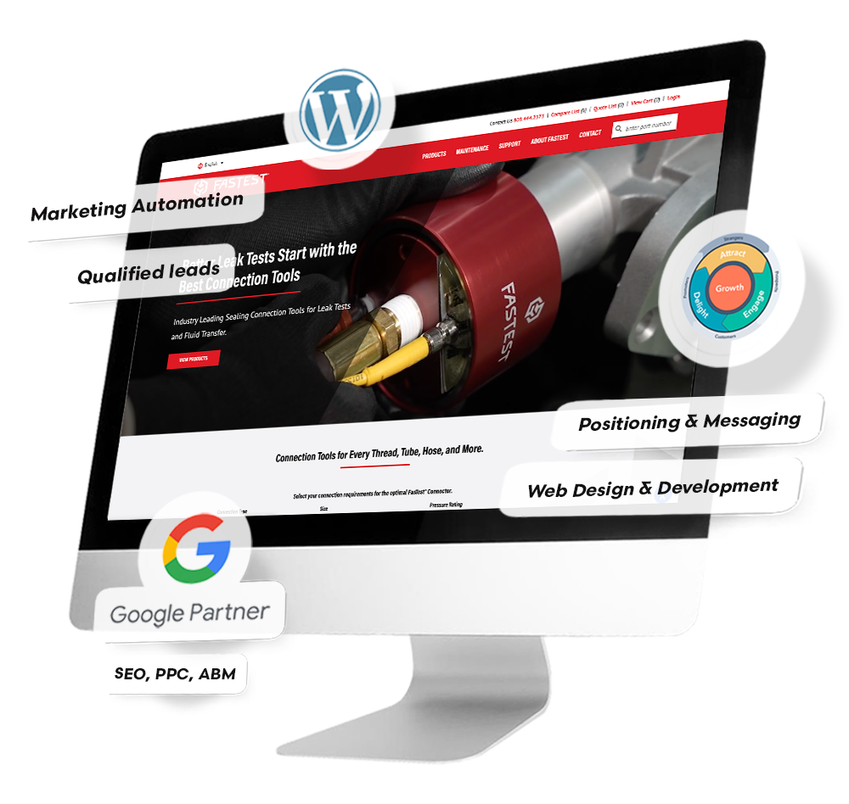
It typically involves several key stages:
Planning: This initial phase involves a comprehensive exploration of the client's business objectives, target audience demographics, and desired outcomes.
www.quorawebsolution.com

Slide 6
The development team will then create a detailed website map and wireframes that outline the structure and content of the site, ensuring a clear and effective user journey.
A website design and development company offers a comprehensive suite of services to help you achieve your online goals. These services include:
  Custom website design and development: We create unique websites that reflect your brand identity and engage your target audience.
  E-commerce website development: We build online stores that seamlessly integrate with your payment gateways and inventory management systems.
  Website redesign: We revitalize your existing website to improve its usability, aesthetics, and performance.
  Website maintenance and support: We provide ongoing support to ensure your website remains up-to-date, secure, and optimized for performance.
www.quorawebsolution.com

Slide 7
  Search engine optimization (SEO): We help you improve your website's visibility in search engine results pages (SERPs) to attract more organic traffic.
  Pay-per-click (PPC) advertising: We manage your PPC campaigns to drive targeted traffic to your website and generate leads.
  Social media marketing: We create and manage your social media presence to build brand awareness, engage with your audience, and drive traffic to your website.
When selecting a website design and development company, it's crucial to evaluate factors such as their experience, portfolio, and pricing. Additionally, ensure the company aligns with your business goals and you feel comfortable collaborating with them.
Website Design and Development Company: Your Digital Partner
www.quorawebsolution.com

Slide 8
Your website is your business's digital storefront, the first impression customers have of your brand online. A website design and development company is a team of experts who specialize in crafting and managing websites. They collaborate to create a website that is both visually appealing and functionally effective.
Services offered by a website design and development company:
  Website design: Crafting the visual identity of your website, including layout, colors, and typography.
  Website development: Building the technical infrastructure of your website using HTML, CSS, and other programming languages.
  Content management system (CMS) development: Creating a user-friendly platform for you to easily update and manage your website content.
www.quorawebsolution.com

Slide 9
  E-commerce development: Building an online store that allows you to sell your products or services online.
  Search engine optimization (SEO): Optimizing your website to improve its visibility in search engine results pages.
  Digital marketing: Promoting your website through various online channels, such as social media and email marketing.
Why choose a website design and development company? Because they offer a suite of benefits that can help your business thrive in the digital age.
www.quorawebsolution.com

Slide 10
  Expertise: Website design and development companies are staffed with professionals who possess the skills and knowledge to craft high-quality websites tailored to your specific needs. They have a deep understanding of design principles, user experience, and web development technologies, enabling them to create websites that are visually appealing, user-friendly, and effective in achieving your business objectives.
  Efficiency: Hiring a website design and development company can save you valuable time and effort. Instead of dedicating resources to learning website design and development, you can focus on other critical aspects of your business. The professionals at a website design and development company can handle all aspects of website creation, from design to development and maintenance.
www.quorawebsolution.com

Slide 11
  Cost-effectiveness: While there may be an initial investment, hiring a website design and development company can be a cost-effective long-term strategy. A well-designed and developed website can help you attract more customers, generate more leads, and increase your revenue. By partnering with experts, you can avoid costly mistakes and ensure that your website is optimized for success.
  Peace of mind: Knowing that your website is in the hands of professionals can provide you with peace of mind. You can trust that your website is being built and maintained to the highest standards, ensuring a positive online presence for your business.
Selecting the ideal website design and development company for your needs is crucial. Here are some key factors to consider when choosing a website design and development company:
www.quorawebsolution.com

Slide 12
  Industry expertise: Look for a company that has a proven track record of designing and developing websites for businesses in your industry. This will ensure that they understand the specific needs and challenges of your sector.
  Portfolio: Review the company's portfolio to see examples of their work. Pay attention to the quality of the design, functionality, and overall user experience.
  Testimonials: Read testimonials from past clients to get a sense of their experience working with the company. Look for feedback on the company's communication, responsiveness, and the quality of their work.
www.quorawebsolution.com

Slide 13
  Communication: Make sure the company is easy to communicate with and responsive to your needs. A good website design and development company will keep you informed throughout the process and be open to your feedback.
  Pricing: Get quotes from multiple reputable companies to compare pricing and value. Don't solely focus on the lowest price; consider the overall value that each company offers, including their expertise, experience, and the quality of their work.
www.quorawebsolution.com

Slide 14
In conclusion, a website design and development company can be a valuable asset to your business. By choosing the right company, you can create a website that is not only visually appealing but also effective at driving traffic, generating leads, and achieving your business objectives. Remember, your website is your digital storefront, so it's important to invest in a company that can help you create a professional and engaging online presence.
www.quorawebsolution.com

Slide 15
Quora Web Solution: Quora Web Solution is a trusted website development company based in Bangalore, India, offering a wide array of services to not only domestic but global clientele. Be it Website Design and Development, SEO services, Digital Marketing, Branding, App Development, Ecommerce Solution, and Logo Creation . Quora Web Solution has the best website developers offering top quality services and that is the reason why we are well known as one of the best Website Development Companies in Bangalore, India.
Visit Us - www.quorawebsolution.com
Call Us - +91 9986 056 909
Mail Us - info@quorawebsolutions.com
www.quorawebsolution.com

Slide 16




Services
WORDPRESS DEVELOPMENT
ECOMMERCE DEVELOPMENT
PHP DEVELOPMENT
CMS DEVELOPMENT
DRUPAL DEVELOPMENT
WEBSITE SERVICES
WEBPORTAL DEVELOPMENT
MAGENTO DEVELOPMENT
WEBSITE DEVELOPMENT
JOOMLA DEVELOPMENT
SMALL BUSINESS DEVELOPMENT
CHEAP WEBSITE DEVELOPMENT
STATIC WEBSITE DEVELOPMENT
DYNAMIC WEBSITE DEVELOPMENT
WEBSITE DESIGN COMPANY
TOUR AND TRAVEL WEBSITE DEVELOPMENT

