Slide 1




Best Football Betting Site – Play Smart & Win Big Online
www.a2klive.com

Slide 2

INTRODUCTION
  Football betting is one of the most popular forms of online sports betting worldwide.
  Choosing the best football betting site is key to safe, secure, and rewarding gameplay.
  In this presentation, we’ll explore what makes a site stand out and why players prefer trusted platforms.

Slide 3

KEY FEATURES OF THE BEST BETTING SITE
  User-Friendly Interface – Smooth navigation and live updates.
  Variety of Betting Options – Pre-match, live betting, and special markets.
  Secure Transactions – Encrypted payment methods and fast withdrawals.
  Mobile Compatibility – Easy betting on-the-go through apps or responsive sites.

Slide 4
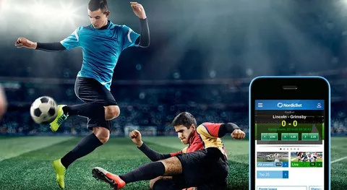
BENEFITS OF CHOOSING THE BEST FOOTBALL BETTING SITE
  Higher Winning Odds – Competitive odds for maximum returns.
  Live Streaming & Stats – Real-time match tracking for smarter bets.
  Bonuses & Promotions – Free bets, welcome offers, and loyalty rewards.
  Responsible Gaming Tools – Safe limits to protect players.

Slide 5

TIPS TO SELECT THE BEST FOOTBALL BETTING SITE
  Check licensing and reputation.
  Read user reviews & ratings.
  Compare odds and payout rates.
  Ensure 24/7 customer support.
  Look for regional support

Slide 6

CONCLUSION
  The best football betting site combines trust, features, and great rewards.
  Always choose platforms that are secure, licensed, and user-friendly.
  Smart betting leads to safe enjoyment and bigger wins.
  Explore top sites today and start your journey toward exciting football betting experiences.
www.a2klive.com

