Slide 1


Quora Web Solution
Website Design and
Development
Company
Web Design & Web Development
Company in Bangalore, India
www.quorawebsolution.com
+91 9986 056 909
info@quorawebsolutions.com
24A, 1st Main Rd, Chandra Reddy
Layout, Koramangala 4th Block,
Koramangala, Bengaluru,
Karnataka 560034

Slide 2

10 Essential Features Every Business Website Should Have: Insights from Leading Web Design and Development Experts
In today’s competitive digital landscape, a business website needs to do more than just look good—it must function seamlessly and drive results. Leading web design and development experts have identified key features that all business websites should include to ensure success.
www.quorawebsolution.com

Slide 3

Here’s a quick breakdown of the 10 essential features that will elevate your website:
1. Mobile Responsiveness
Why it matters: With more than half of web traffic coming from mobile devices, a mobile-responsive website is crucial. It provides a smooth and consistent user experience on all devices.
www.quorawebsolution.com

Slide 4
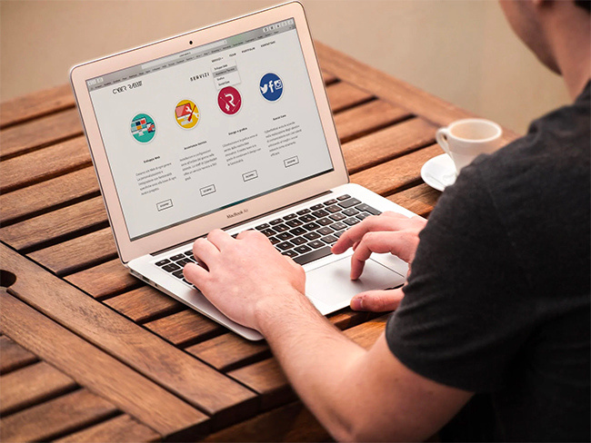
Expert Tip: "A responsive design isn't optional—it's a must for staying competitive." — Jane Foster, Senior Web Designer
2. Fast Load Times
Why it matters: Websites that load quickly retain visitors and boost conversions. Google also uses speed as a ranking factor.
www.quorawebsolution.com

Slide 5
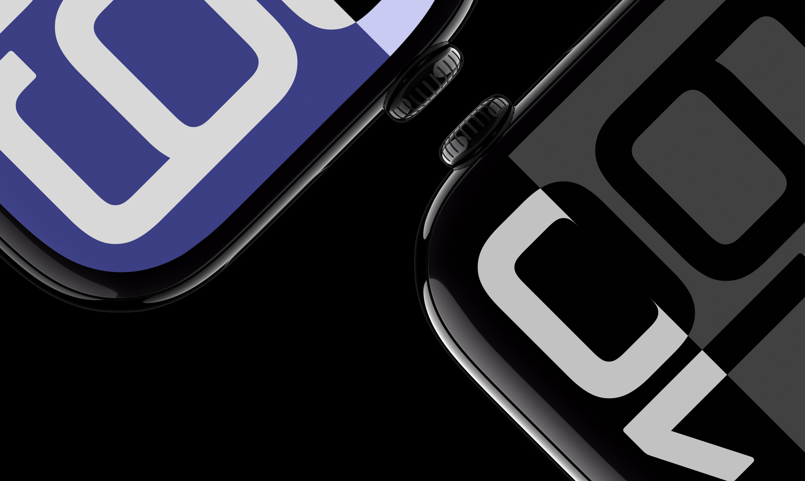
Expert Tip: "Optimizing images and reducing scripts can drastically improve your load time." — Eric Mitchell, Web Developer
3. Clear Navigation
Why it matters: Intuitive navigation helps users find what they need quickly, improving user experience and reducing bounce rates.
www.quorawebsolution.com

Slide 6
Expert Tip: "Keep navigation simple and consistent to guide users through the site." — Laura Garcia, UX/UI Specialist
4. Clear Call-to-Actions (CTAs)
Why it matters: CTAs drive user action, whether it’s making a purchase, subscribing to a newsletter, or contacting your business.
Expert Tip: "CTAs should be visually distinct and placed strategically throughout the site." — Rob Stevens, Conversion Specialist
5. High-Quality Visuals
Why it matters: Quality images, videos, and graphics enhance user engagement and help establish brand credibility.
www.quorawebsolution.com

Slide 7
Expert Tip: "Invest in custom visuals that align with your brand's message." — Sophie Lang, Graphic Design Lead
6. SEO Optimization
Why it matters: SEO increases your website’s visibility on search engines, driving organic traffic and boosting brand awareness.
Expert Tip: "SEO should be built into your website’s design and content strategy." — Emma Parker, SEO Specialist
7. Security Features (SSL Certificates)
Why it matters: SSL certificates encrypt sensitive data, improving security and building trust with users. Google also prefers secure websites.
Expert Tip: "An SSL certificate is crucial for building user trust and improving your SEO rankings." — David Green, Cybersecurity Consultant
www.quorawebsolution.com

Slide 8
8. Social Proof (Reviews, Testimonials)
Why it matters: Customer reviews and testimonials build trust, encouraging new visitors to convert.
Expert Tip: "Showcase customer success stories to provide proof of your value." — James Rivera, Content Strategist
9. Content Management System (CMS)
Why it matters: A CMS allows easy content updates, enabling your team to keep the site fresh without needing coding skills.
Expert Tip: "Choose a CMS that fits your business needs and grows with you." — Kyle Thompson, Web Developer
10. Analytics and Tracking Tools
www.quorawebsolution.com

Slide 9
Why it matters: Tracking tools like Google Analytics help you monitor performance, identify user behavior, and optimize the website over time.
Expert Tip: "Use analytics to inform decisions and continuously improve the user experience." — Daniel Hughes, Digital Marketing Specialist
Conclusion
By incorporating these 10 essential features, your website will not only look professional but also drive results. Whether you want to increase conversions, enhance user engagement, or boost search engine rankings, these features are key to building a website that works for your business.
Top 10 Features Every Modern Website Must Have: Insights from Professional Web Developers
www.quorawebsolution.com

Slide 10
In today’s fast-moving digital landscape, your website often serves as the initial point of contact between your brand and potential customers. Whether you’re a startup, an established business, or a personal brand, your website should be more than just attractive — it must be functional, fast, and user-focused. We spoke to top web developers and compiled the 10 must-have features every modern website should include in 2025 and beyond.
1. Responsive Design for Mobile and Tablet Compatibility
With over 60% of web traffic coming from mobile devices, your website must look and function flawlessly on every screen size. A responsive design ensures users on smartphones, tablets, laptops, and desktops get a consistent and optimized experience.
💡 Pro Tip: Use flexible grids and scalable images to adapt layout dynamically.
2. Fast Loading Speed
www.quorawebsolution.com

Slide 11
The speed of your website plays a crucial role in keeping users engaged and maintaining strong SEO performance. A delay of just one second in loading time could potentially reduce your conversion rate by up to 7%. Compress images, leverage browser caching, and use a reliable hosting provider to keep your site lightning-fast.
💡 Recommended Tools: Use Google PageSpeed Insights and GTmetrix to analyze your site's speed, identify performance bottlenecks, and receive actionable optimization tips.
3. Secure HTTPS Protocol
Security isn’t optional. An SSL certificate secures the data exchanged between your website and its visitors by encrypting all communications, ensuring privacy and protection against cyber threats. HTTPS is now a standard — not having it will trigger browser warnings and damage user trust.
🔐 Bonus: It also boosts your Google ranking.
www.quorawebsolution.com

Slide 12
4. Clean, User-Friendly Navigation
Users should be able to navigate your website effortlessly and locate key information within moments. Intuitive navigation, logical menu structures, and clear calls-to-action (CTAs) help users stay longer and convert more often.
💡 Checklist: Sticky headers, breadcrumb navigation, and well-designed dropdown menus all play a crucial role in improving user experience (UX).
5. Clear Call-to-Action (CTA) Buttons
Every page should lead the user somewhere — whether it's contacting you, purchasing a product, or downloading a resource. CTA buttons must be prominent, easily visible, and designed to prompt immediate user action.
www.quorawebsolution.com

Slide 13
🎯 Examples: “Book a Free Consultation,” “Start Your Free Trial,” “Download Now”
6. SEO Optimization
Even the most stunning website won’t make an impact if it’s invisible to search engines. On-page SEO practices like keyword optimization, proper header tags (H1, H2), alt text for images, and meta descriptions help your website rank higher in search engines.
🔍 Include: XML sitemap, schema markup, and canonical tags.
7. High-Quality Visuals and Engaging Content
Visual storytelling makes your brand memorable. Use professional imagery, clean typography, and videos when relevant. Pair it with compelling, benefit-driven content to build trust and credibility.
www.quorawebsolution.com

Slide 14
🎥 Hot trend: Incorporating short-form videos and subtle animations can significantly boost user engagement and time spent on site.
8. Contact Information and Lead Capture Forms
Visitors should never have to hunt for a way to contact you. Display your phone number, email address, and a contact form in highly visible areas such as the header, footer, or a dedicated contact page. For lead generation, consider pop-ups, newsletter signups, and inquiry forms.
📧 Pro Tip: Integrate with your CRM for smoother follow-ups.
9. Accessibility Features
www.quorawebsolution.com

Slide 15
An inclusive website broadens your reach. Use readable fonts, proper contrast ratios, keyboard navigation, and alt text for screen readers to ensure ADA (or WCAG) compliance.
♿ Accessibility goes beyond just good ethics; it’s a smart business strategy that can open doors to a broader audience.
10. Analytics and Performance Tracking
What gets measured gets improved. Integrate tools like Google Analytics, Hotjar, or Clarity to monitor user behavior, traffic sources, bounce rates, and conversion funnels.
📈 Pro Tip: Leverage data insights to conduct A/B testing and make ongoing improvements to user experience.
www.quorawebsolution.com

Slide 16
Final Thoughts
Your website is your most valuable digital asset. By incorporating these 10 essential features, you’ll not only create a great first impression but also build long-term trust, drive traffic, and boost conversions. Web developers agree: the foundation of a successful website lies in combining design, functionality, speed, and strategy.
www.quorawebsolution.com

Slide 17
Quora Web Solution: Quora Web Solution is a trusted website development company based in Bangalore, India, offering a wide array of services to not only domestic but global clientele. Be it Website Design and Development, SEO services, Digital Marketing, Branding, App Development, Ecommerce Solution, and Logo Creation . Quora Web Solution has the best website developers offering top quality services and that is the reason why we are well known as one of the best Website Development Companies in Bangalore, India.
Visit Us - www.quorawebsolution.com
Call Us - +91 9986 056 909
Mail Us - info@quorawebsolutions.com
www.quorawebsolution.com

Slide 18

WORDPRESS DEVELOPMENT
ECOMMERCE DEVELOPMENT
PHP DEVELOPMENT
CMS DEVELOPMENT
DRUPAL DEVELOPMENT
WEBSITE SERVICES
WEBPORTAL DEVELOPMENT
MAGENTO DEVELOPMENT
WEBSITE DEVELOPMENT
JOOMLA DEVELOPMENT
SMALL BUSINESS DEVELOPMENT
CHEAP WEBSITE DEVELOPMENT
STATIC WEBSITE DEVELOPMENT
DYNAMIC WEBSITE DEVELOPMENT
WEBSITE DESIGN COMPANY
TOUR AND TRAVEL WEBSITE DEVELOPMENT
Services

