Slide 1

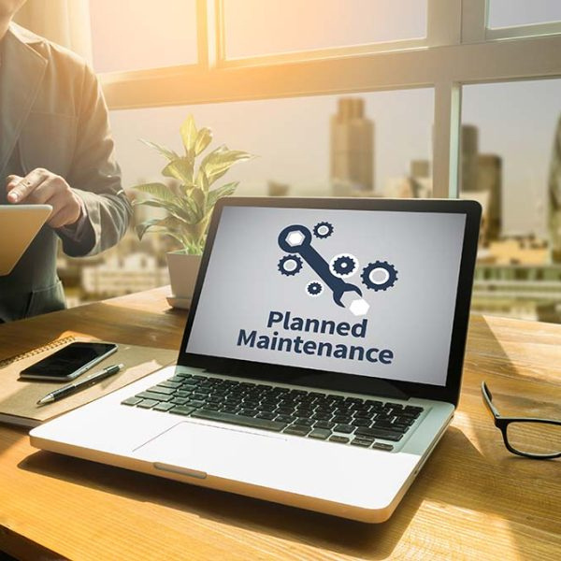
Quora Web Solution
Website Design and
Development
Company
Web Design & Web Development
Company in Bangalore, India
www.quorawebsolution.com
+91 9986 056 909
info@quorawebsolutions.com
24A, 1st Main Rd, Chandra Reddy
Layout, Koramangala 4th Block,
Koramangala, Bengaluru,
Karnataka 560034

Slide 2
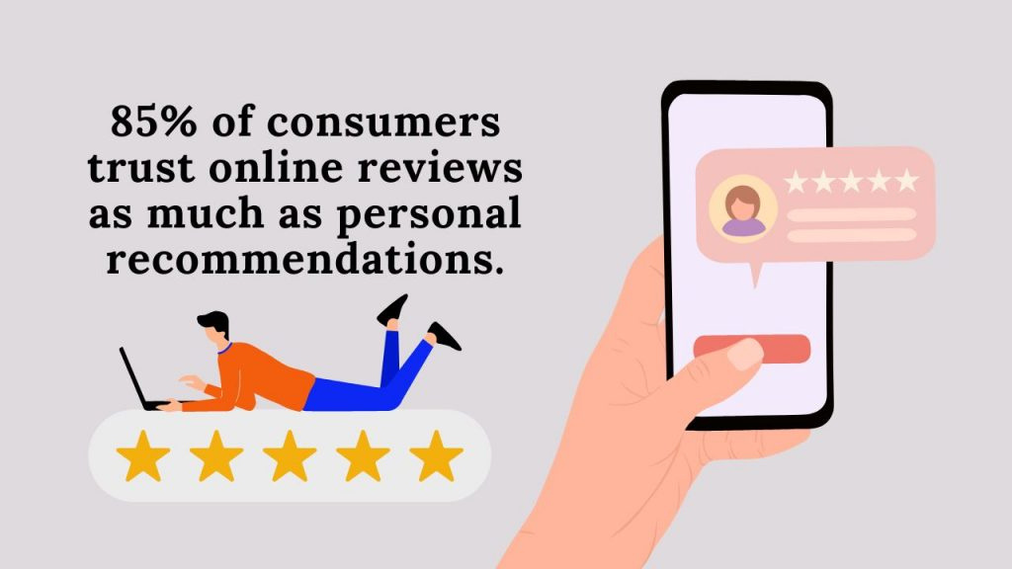
Why Website Maintenance is Just as Important as Design: A Guide to Keeping Your Site Running Smoothly
When launching a website, it’s easy to get caught up in the excitement of design and development.
www.quorawebsolution.com

Slide 3

After all, an attractive, user-friendly site is the first impression you make on potential customers.
www.quorawebsolution.com

Slide 4

However, once the design is complete and the site is live, many businesses neglect a critical ongoing process: website maintenance.
While your website might look great when it’s first launched, it's not enough to simply let it sit there.
www.quorawebsolution.com

Slide 5

Regular maintenance is vital for keeping your site secure, functional, and performing at its best. Here's why website maintenance is just as important as design and some key tasks to ensure your site runs smoothly long-term.
www.quorawebsolution.com

Slide 6
1. Security: Protecting Your Website from Threats
One of the most crucial reasons for website maintenance is security. Cyberattacks, data breaches, and malware infections are increasingly common. If you don’t regularly update your software, plugins, and security protocols, your site becomes a target for hackers. Regular maintenance, including patching vulnerabilities and updating security measures, helps safeguard both your data and your users’ privacy.
2. Performance: Speed is Key
A slow website can lead to poor user experience and higher bounce rates, meaning visitors will leave your site before engaging with your content. Regular updates to your website's code, images, and backend ensure optimal performance. In addition, clearing cache, optimizing databases, and managing server resources will help maintain fast loading times and improve user experience, which also benefits your search engine ranking.
www.quorawebsolution.com

Slide 7
3. SEO Rankings: Keep Your Site Visible
Search engine optimization (SEO) isn’t a one-time task—it's an ongoing effort. Search engines like Google prioritize sites that are updated frequently with fresh content, relevant keywords, and a smooth user experience. Routine maintenance, such as fixing broken links, optimizing images, and updating old content, ensures your site stays visible in search results, helping you attract more traffic and reach your audience.
4. User Experience: Prevent Frustration
Your website’s design might be flawless at launch, but over time, small issues can arise that frustrate users. Broken links, outdated information, or malfunctioning forms can lead to a poor user experience, reducing conversions and damaging your brand’s reputation. Regular checks and fixes ensure that your site remains intuitive, functional, and easy to navigate, encouraging visitors to stay and engage.
5. Legal and Compliance Updates
www.quorawebsolution.com

Slide 8
Laws and regulations around websites—such as GDPR compliance, data protection, and accessibility standards—can change over time. It’s essential to stay up to date on legal requirements to avoid fines or legal action. Website maintenance includes ensuring your site meets these standards and is compliant with current laws, protecting your business from potential legal issues.
6. Technology: Stay Current
Technology evolves quickly, and your website’s software is no exception. New tools, features, and technologies are regularly introduced, so it’s important to keep your website up to date with the latest versions of your content management system (CMS), plugins, and coding standards. This not only helps prevent compatibility issues but also allows you to take advantage of new features that can enhance the user experience.
In Conclusion
www.quorawebsolution.com

Slide 9
Website maintenance isn’t just about fixing things when they break—it’s about keeping your website in top shape so it continues to perform, engage, and convert. Regular maintenance ensures your site stays secure, loads fast, ranks well, and delivers a seamless experience for users. Just like your website’s design is important for making a good first impression, consistent maintenance is essential for ensuring it keeps working smoothly over time.
Remember, a well-maintained website will continue to reflect your brand’s credibility and professionalism, while an outdated, poorly maintained site can quickly tarnish your reputation. Make website maintenance a priority, and your business will reap the benefits long-term.
Top 10 Trends in Website Design and Development You Need to Know for a Competitive Edge in 2025
www.quorawebsolution.com

Slide 10
As the digital landscape continues to evolve, staying ahead of the curve in website design and development is essential for businesses aiming to maintain a competitive edge. In 2025, several trends are poised to dominate the web, reshaping how we approach user experience, functionality, and design. Let’s dive into the top 10 trends to watch for in 2025.
1. AI-Powered Personalization
Artificial intelligence (AI) is making waves in website design, particularly when it comes to personalization. AI can analyze user behavior and preferences to offer tailored content, product recommendations, and dynamic layouts. This creates a more engaging and relevant experience for visitors, increasing conversion rates and customer satisfaction.
2. Voice User Interface (VUI)
www.quorawebsolution.com

Slide 11
With the rise of voice-activated devices, integrating voice user interfaces (VUI) into websites is becoming a key trend. By incorporating voice search and voice navigation, businesses can make their websites more accessible and convenient for users. As voice assistants like Alexa and Siri continue to grow in popularity, VUI will be a must-have feature for improving user experience.
3. Dark Mode Design
Dark mode continues to gain popularity due to its sleek look and reduced eye strain. Websites offering a dark mode option give users the flexibility to choose their preferred visual style, enhancing comfort and accessibility. Expect more websites to implement dark mode as a standard feature in 2025.
4. Advanced Web Animations
Web animations have come a long way, and in 2025, they’re set to play an even bigger role in website design.
www.quorawebsolution.com

Slide 12
From interactive microinteractions to immersive background animations, these elements can help guide users, draw attention to key content, and create a more dynamic, engaging experience.
5. Mobile-First Design
As mobile internet usage continues to rise, designing websites with a mobile-first approach is more important than ever. Mobile-first design ensures that websites are optimized for smaller screens, fast loading times, and touch navigation. By prioritizing mobile usability, businesses can provide a seamless experience across all devices.
6. Minimalist and Clean Layouts
In 2025, simplicity will continue to be key. Clean, minimalist designs focus on clear typography, generous white space, and straightforward navigation. This approach not only enhances user experience but also boosts site speed and performance, making it a win for both design and functionality.
www.quorawebsolution.com

Slide 13
7. Augmented Reality (AR) Integration
Augmented reality is no longer just for gaming—it’s making its way into website design. In 2025, AR features will allow users to interact with products in new ways, such as trying on virtual clothes or visualizing furniture in their own space. This immersive technology offers a unique opportunity to increase engagement and help customers make more informed decisions.
8. Motion UI and Scroll-Activated Elements
Incorporating motion UI elements and scroll-activated effects can create a more interactive and engaging experience. For example, websites that change content or display animations as users scroll can hold attention and guide visitors through a site’s journey in a way that feels dynamic and intuitive.
9. Sustainability in Web Development
Sustainability is becoming a growing priority, even in website design.
www.quorawebsolution.com

Slide 14
Eco-friendly web development practices, such as optimizing for energy-efficient servers and reducing the carbon footprint of websites, are set to rise. Companies are increasingly focusing on creating "green" websites that use fewer resources and load faster while maintaining functionality.
10. No-Code and Low-Code Development
No-code and low-code platforms are revolutionizing web development by allowing users with little to no technical expertise to build websites. These platforms provide intuitive drag-and-drop interfaces that make it easier and faster to create and launch websites, democratizing web development and allowing businesses to move quickly in an ever-changing market.
Conclusion
As we approach 2025, these web design and development trends will shape the future of online experiences.
www.quorawebsolution.com

Slide 15
By embracing these innovations, businesses can create more engaging, user-friendly, and competitive websites that meet the evolving demands of customers. Whether it’s AI-driven personalization, immersive AR features, or a focus on sustainability, staying ahead of these trends will be crucial for maintaining a strong online presence in the years to come.
www.quorawebsolution.com

Slide 16
Quora Web Solution: Quora Web Solution is a trusted website development company based in Bangalore, India, offering a wide array of services to not only domestic but global clientele. Be it Website Design and Development, SEO services, Digital Marketing, Branding, App Development, Ecommerce Solution, and Logo Creation . Quora Web Solution has the best website developers offering top quality services and that is the reason why we are well known as one of the best Website Development Companies in Bangalore, India.
Visit Us - www.quorawebsolution.com
Call Us - +91 9986 056 909
Mail Us - info@quorawebsolutions.com
www.quorawebsolution.com

Slide 17

WORDPRESS DEVELOPMENT
ECOMMERCE DEVELOPMENT
PHP DEVELOPMENT
CMS DEVELOPMENT
DRUPAL DEVELOPMENT
WEBSITE SERVICES
WEBPORTAL DEVELOPMENT
MAGENTO DEVELOPMENT
WEBSITE DEVELOPMENT
JOOMLA DEVELOPMENT
SMALL BUSINESS DEVELOPMENT
CHEAP WEBSITE DEVELOPMENT
STATIC WEBSITE DEVELOPMENT
DYNAMIC WEBSITE DEVELOPMENT
WEBSITE DESIGN COMPANY
TOUR AND TRAVEL WEBSITE DEVELOPMENT
Services

