Slide 1

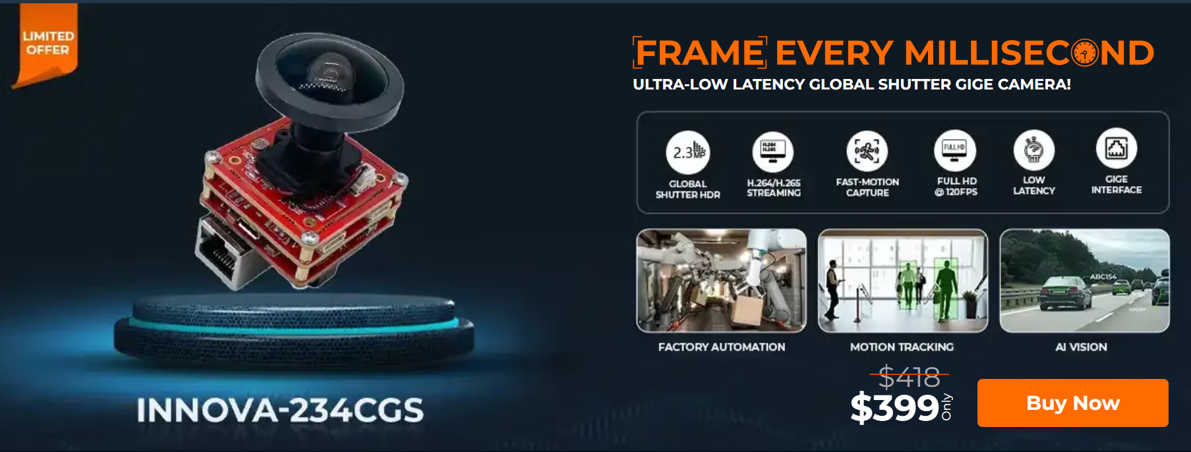


www.vadzoimaging.com
Welcome
To
Vadzo Imaging
+91- 80809-09980
support@gamethon.live
+1 817-678-2139
Support@vadzoimaging.com
© Copyright 2025. vadzoimaging.com

Slide 2
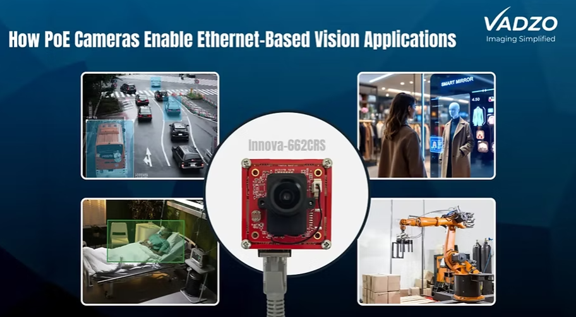
www.vadzoimaging.com
Power over Ethernet Camera for Reliable Imaging
Vadzo Imaging offers advanced Power over Ethernet Camera solutions with reliable connectivity, high-quality imaging, simplified installation, and efficient data transmission for industrial, machine vision, and surveillance applications.
+91- 80809-09980
© Copyright 2025. vadzoimaging.com

Slide 3
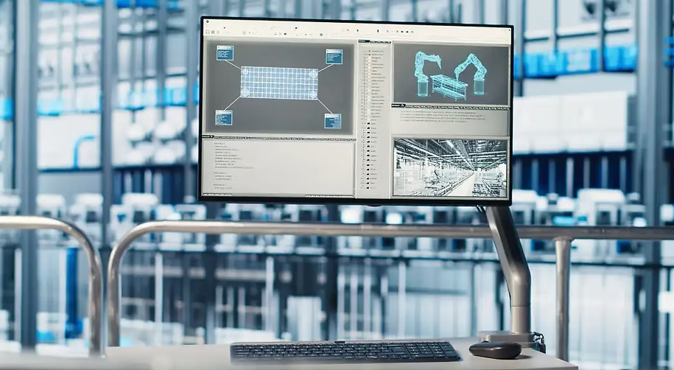
www.vadzoimaging.com
Monochrome Imaging for High-Precision Vision Systems
Vadzo Imaging delivers advanced monochrome imaging solutions for machine vision, industrial automation, and scientific applications, offering exceptional image clarity, high sensitivity, precise detail capture, and reliable performance in demanding environments.
+91- 80809-09980
support@gamethon.live
© Copyright 2025. vadzoimaging.com

Slide 4
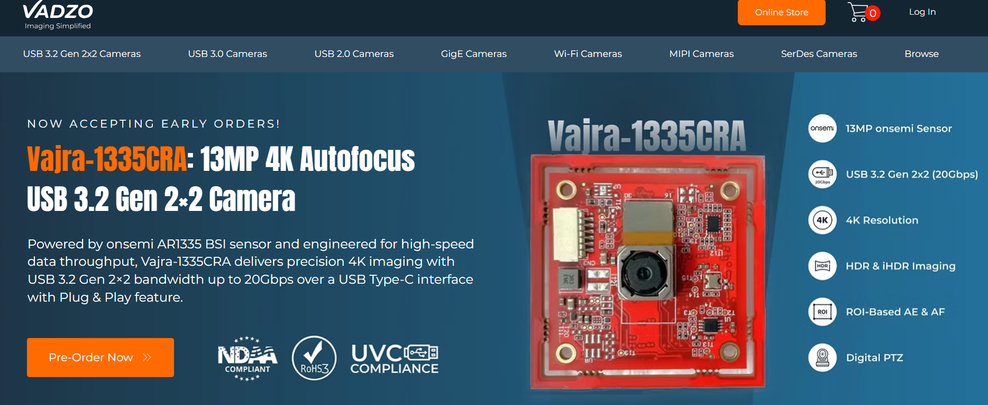
www.vadzoimaging.com
+91- 80809-09980
support@gamethon.live
+1 817-678-2139
Support@vadzoimaging.com
© Copyright 2025. vadzoimaging.com

Slide 5
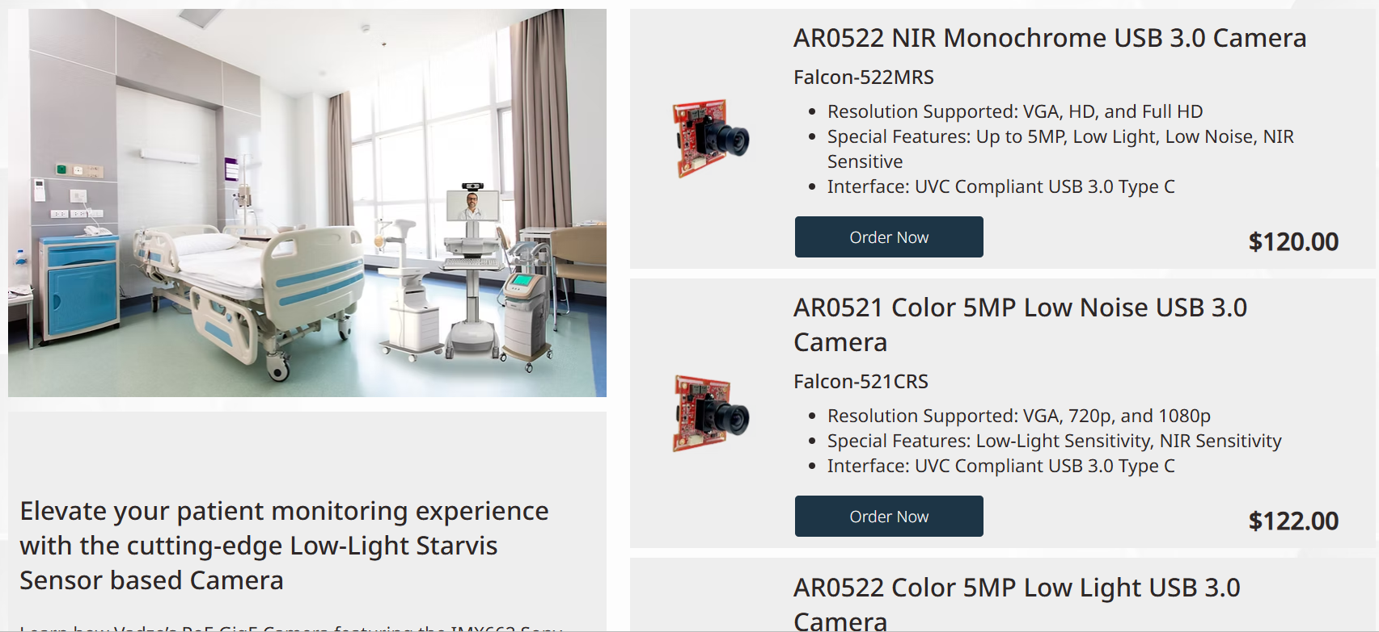
www.vadzoimaging.com
+91- 80809-09980
support@gamethon.live
© Copyright 2025. vadzoimaging.com

Slide 6

www.vadzoimaging.com
+91- 80809-09980
support@gamethon.live
© Copyright 2025. vadzoimaging.com

Slide 7

www.vadzoimaging.com
Case Studies
+91- 80809-09980
support@gamethon.live
© Copyright 2025. vadzoimaging.com

Slide 8

www.vadzoimaging.com
+91- 80809-09980
support@gamethon.live
© Copyright 2025. vadzoimaging.com

Slide 9
www.vadzoimaging.com
+91- 80809-09980
support@gamethon.live
© Copyright 2025. vadzoimaging.com

Slide 10
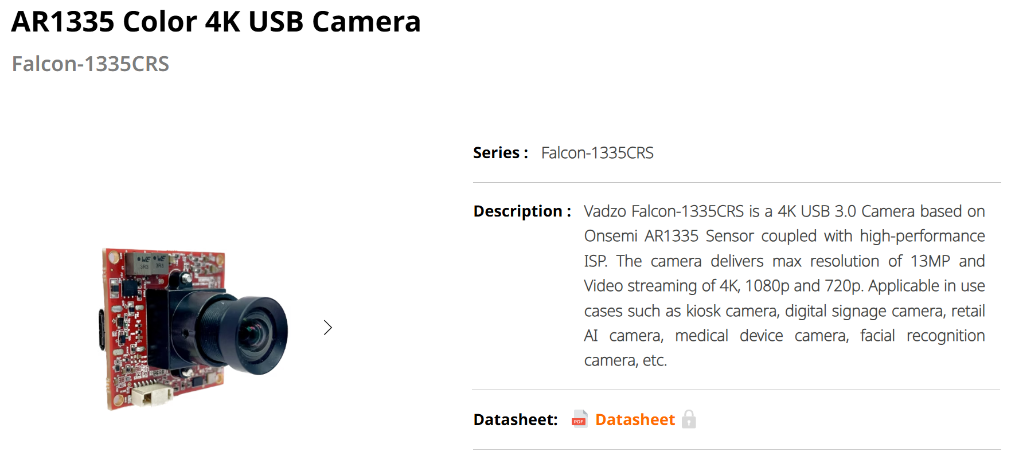
www.vadzoimaging.com
+91- 80809-09980
support@gamethon.live
© Copyright 2025. vadzoimaging.com

Slide 11
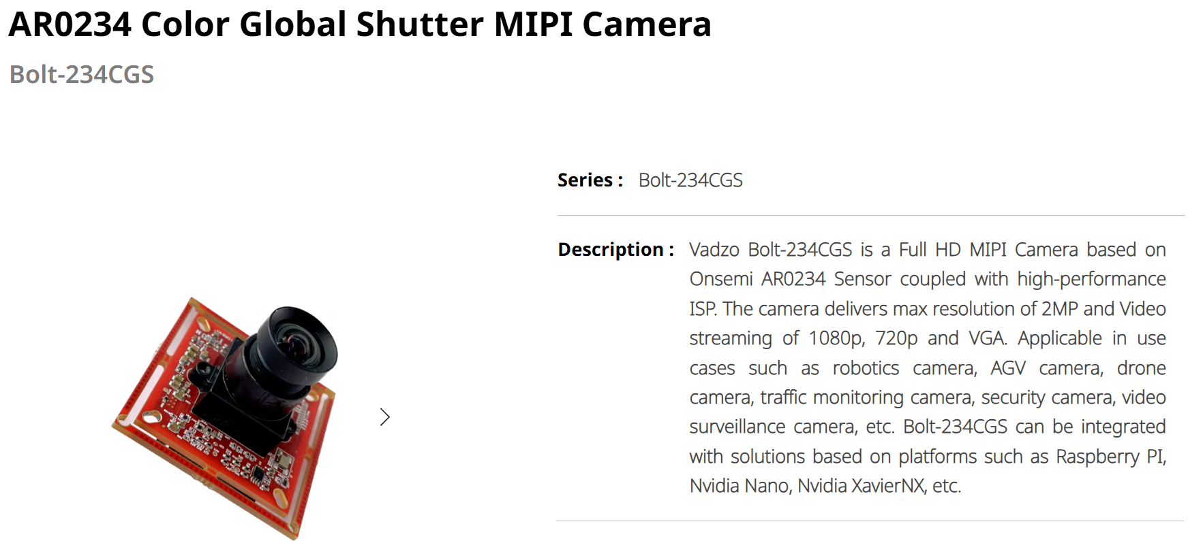
www.vadzoimaging.com
+91- 80809-09980
support@gamethon.live
© Copyright 2025. vadzoimaging.com

Slide 12

www.vadzoimaging.com
+91- 80809-09980
support@gamethon.live
© Copyright 2025. vadzoimaging.com

Slide 13
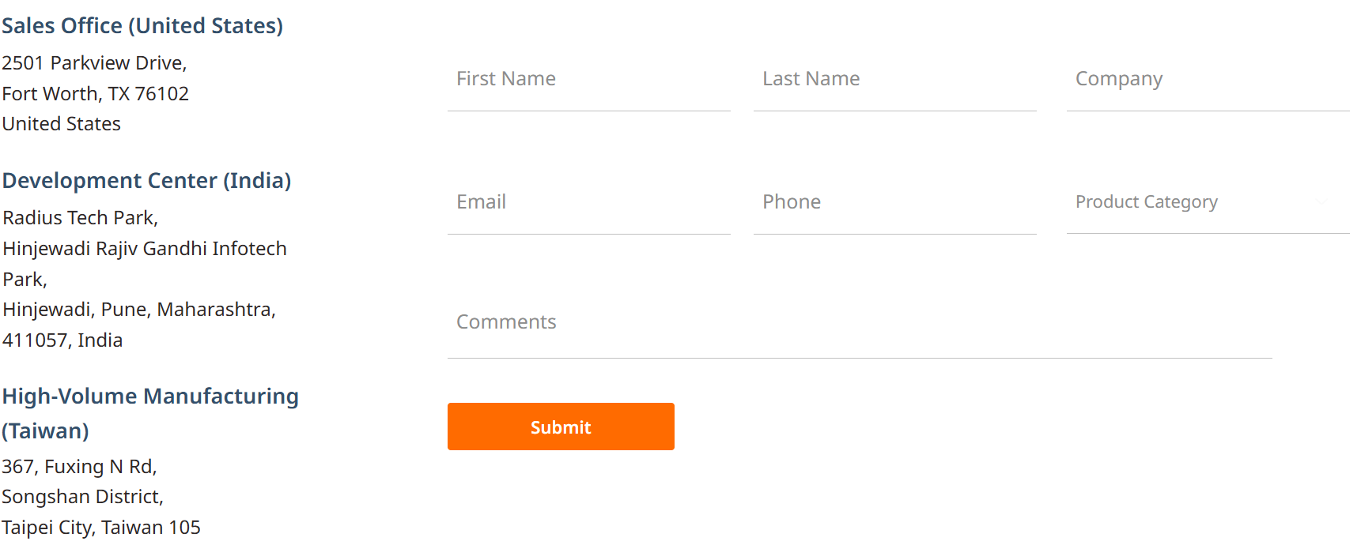
www.vadzoimaging.com
Contact Us
+91- 80809-09980
support@gamethon.live
© Copyright 2025. vadzoimaging.com

Slide 14

www.vadzoimaging.com
Thanks!
+91- 80809-09980
support@gamethon.live
+1 817-678-2139
Support@vadzoimaging.com
© Copyright 2025. vadzoimaging.com

