Slide 1



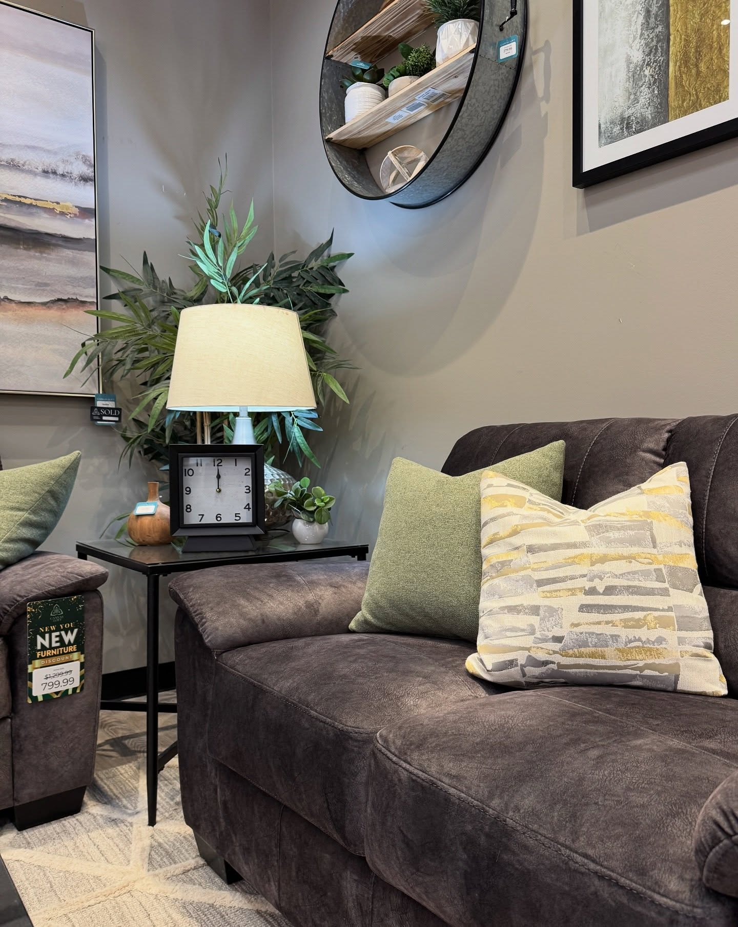

Canvas And Loft Furniture
Retail Furniture Store
Affordable furniture & home outlet store décor in Calgary. Discover quality living room, dining, and bedroom sets at Canvas + Loft with flexible financing options!
www.canvasandloft.com

Slide 2
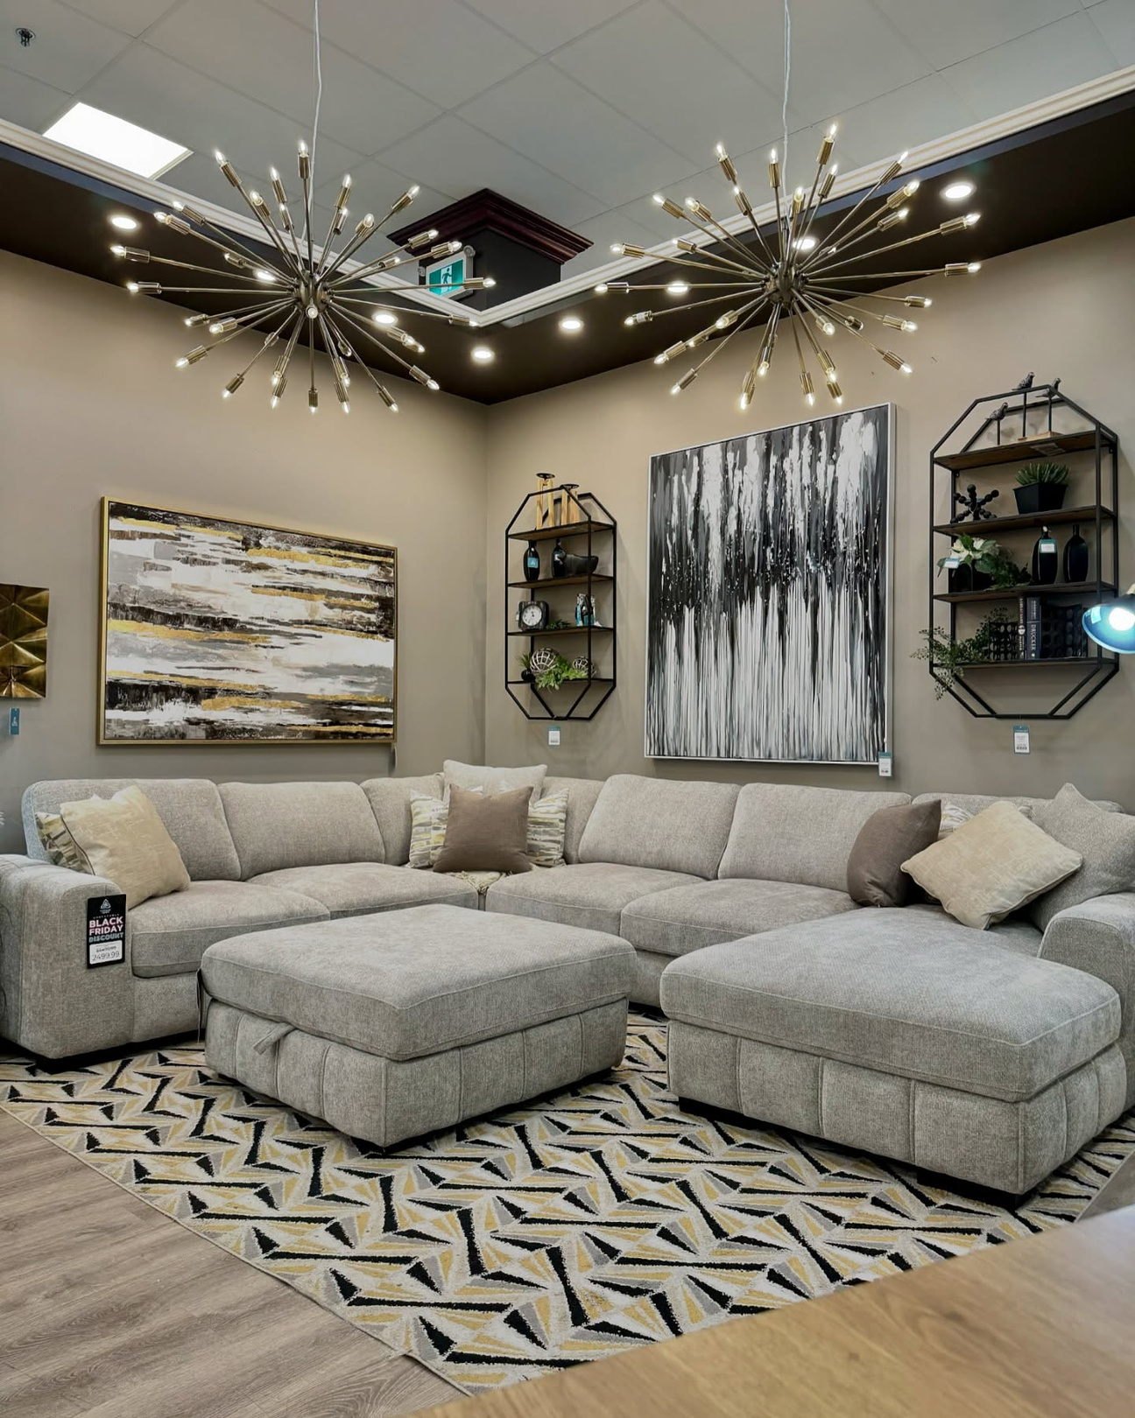
About Us
Canvas & Loft is the go-to place in Calgary for beautiful home furnishings at an affordable price. We are the premier furniture store in Calgary and carry a broad range of modern and timeless pieces for any taste. Visit our furniture outlet to enjoy exclusive offers, and make your home truly special with a unique find at our store for home décor in Calgary. Whether you are remodeling a room or designing a new space, we are here to help you create a home you will love.

Slide 3


Explore Our Signature Collections
Discover Furniture Styles That Perfectly Suit Your Taste
Sectionals Calgary
Sofas and Loveseats Calgary
Reclining Sofas & Loveseats Calgary
Kitchen and Dining Room Furniture Calgary
Bedroom Furniture Calgary

Slide 4
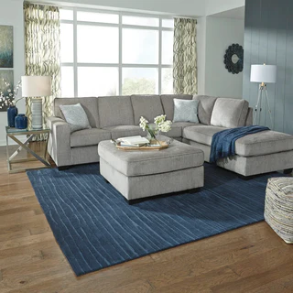
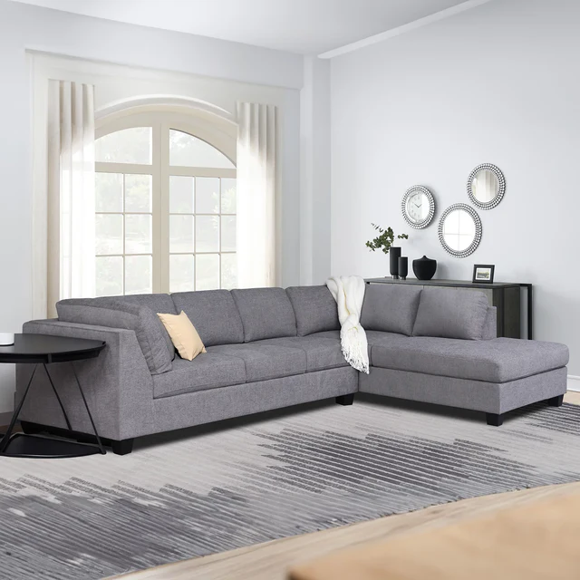

Sectionals Calgary
Explore our collection of sectionals to appoint your living room, basement or bonus room with comfort and style. With a varied selection of sizes from small and cozy to large and luxurious, Canvas + Loft Furniture in Calgary has a range of sectionals at trusted prices to fit your home.

Slide 5
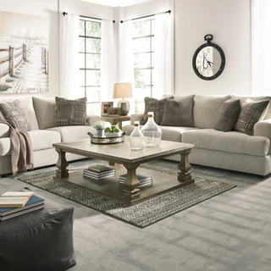
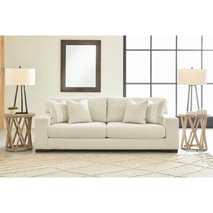
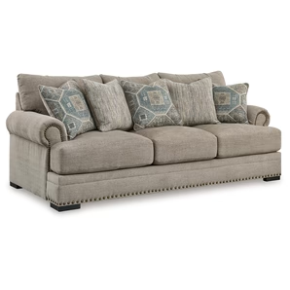

Sofas and Loveseats Calgary
Explore Canvas + Loft Furniture in Calgary's exquisite collection of sofas and loveseats, designed to turn your space into a cozy haven with a touch of elegance. With options spanning classic to modern styles and various materials, you're sure to find the perfect addition to your home. Elevate your living experience today!

Slide 6
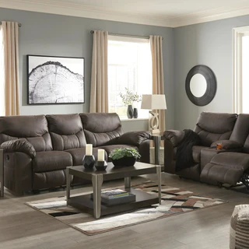
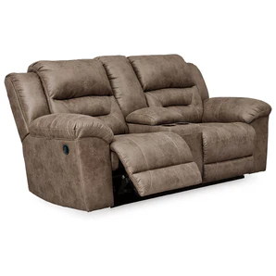
Reclining Sofas & Loveseats Calgary
Relax in style with Canvas and Loft Furniture in Calgary's collection of reclining sofas and loveseats! Choose from a variety of designs and materials to find your perfect fit.

Slide 7

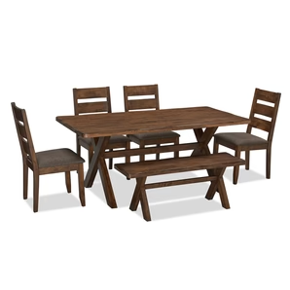
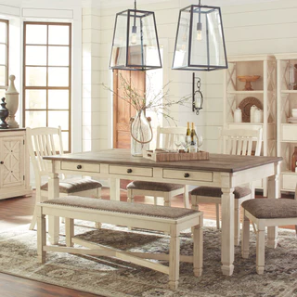
Kitchen and Dining Room Furniture Calgary
Breath life into your kitchen or dining area with a large range of furniture available at Canvas and Loft Furniture in Calgary. We provide a wide ranging selection of trendy and classic styles, for families big and small.

Slide 8
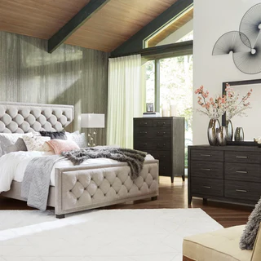
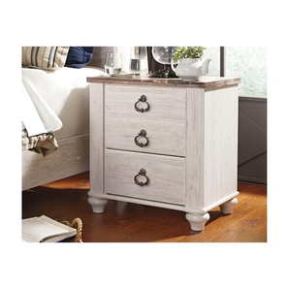
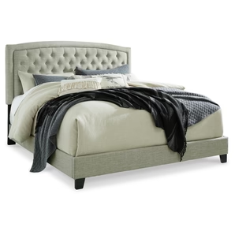

Bedroom Furniture Calgary
Explore a wide variety of bedroom furniture Calgary that will help you create a space for you and your partner to reconnect and recharge. Whether you're looking for something traditional or modern, small and cozy or large and luxurious, our selection has something for you.

Slide 9
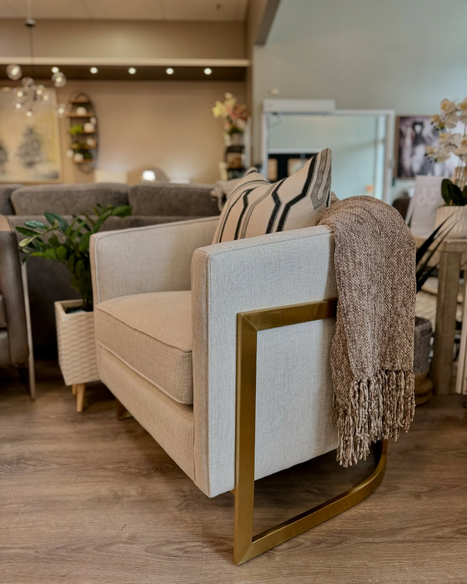




Contact Information
Visit us in store or contact our friendly team members for more information. We look forward to talking to you.
9631 Macleod Trail SW, Calgary, AB, Canada, T2J 0P6
587 353 3369
info@canvasandloft.com
www.canvasandloft.com

Slide 10
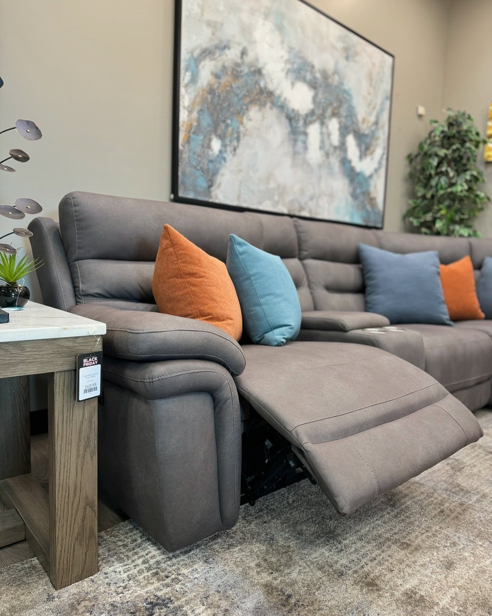
Thank You
www.canvasandloft.com

