Slide 1
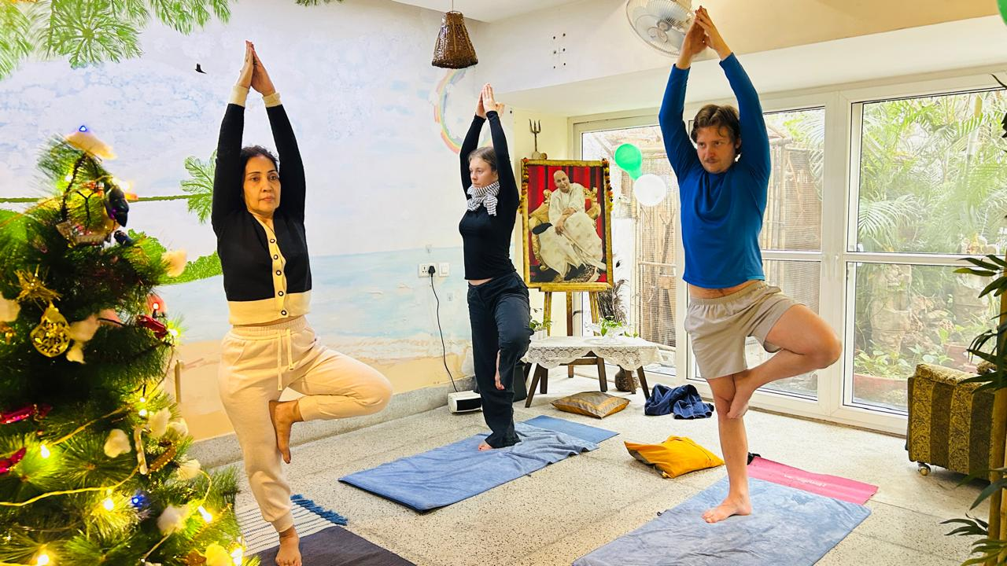
  Dr. Bali's Bliss
Yoga and Meditation Classes
Awaken strength, flexibility, and mental clarity with yoga and meditation classes that enhance sleep, skin glow, and overall physical and emotional balance.
  https://drbalisbliss.com/

Slide 2
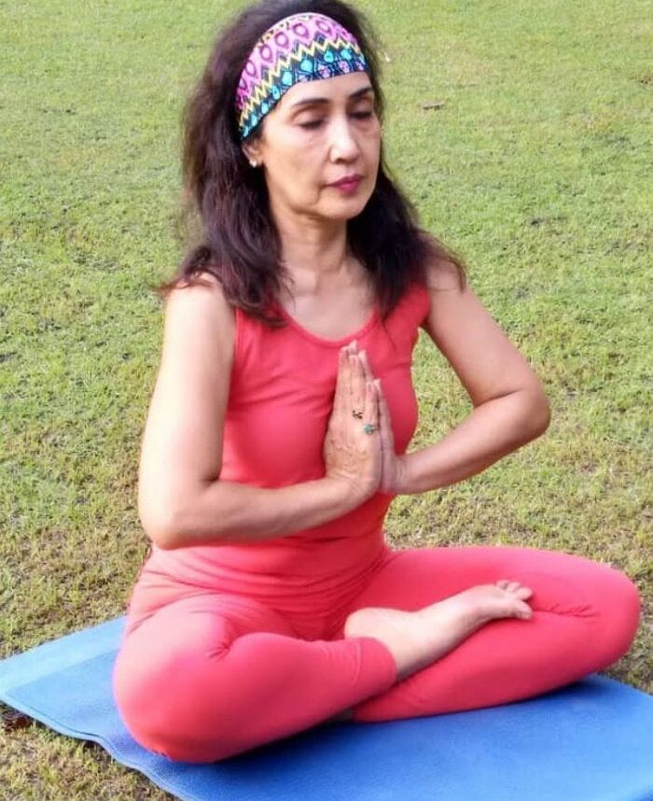
  Dr. Bali's Bliss
Meditation Centre in South Delhi
Balance your mind, body, and energy at a meditation centre in South Delhi, offering personalized meditation sessions to boost immunity, sleep, and wellness.
  https://drbalisbliss.com/

Slide 3
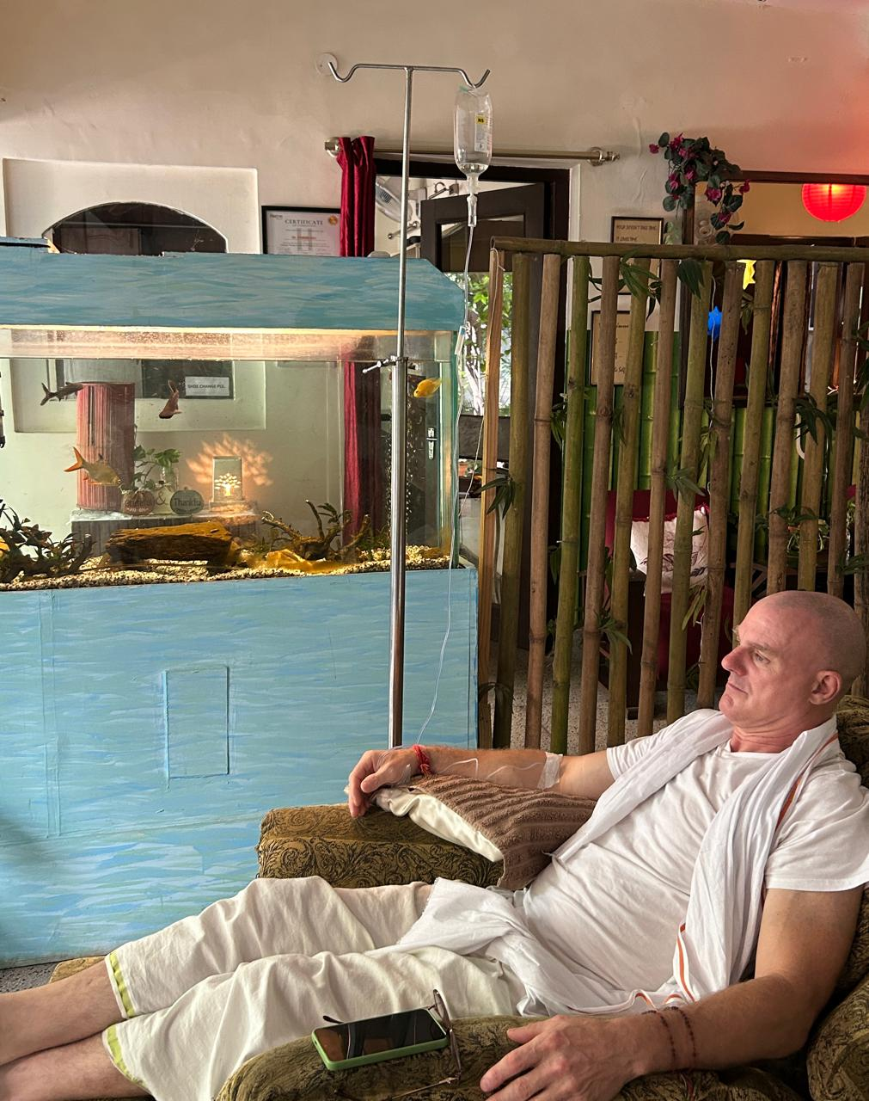
  Dr. Bali's Bliss
Ozone Therapy Treatment Centers
Enhance overall wellness, fight infections, and reduce inflammation at ozone therapy treatment centers, offering advanced IV, facial, and body ozone therapies.
  https://drbalisbliss.com/

Slide 4

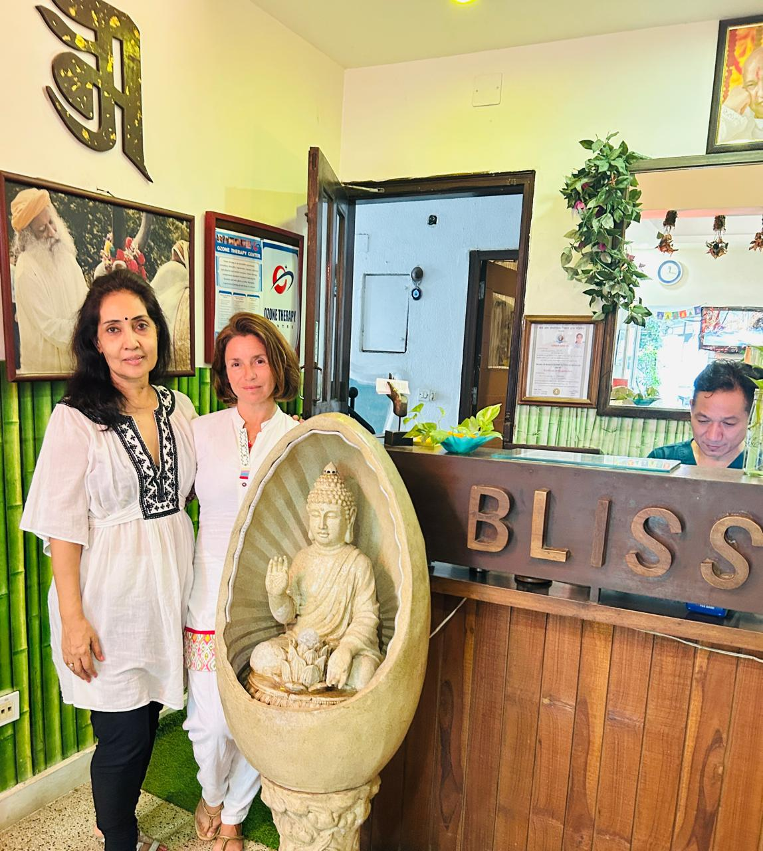



OUR CONTACT
+91 9810469956
https://drbalisbliss.com/
contact@drbalisbliss.com
23, near NIFT, Block X, Hauz Khas, New Delhi, Delhi 110016

