Slide 1

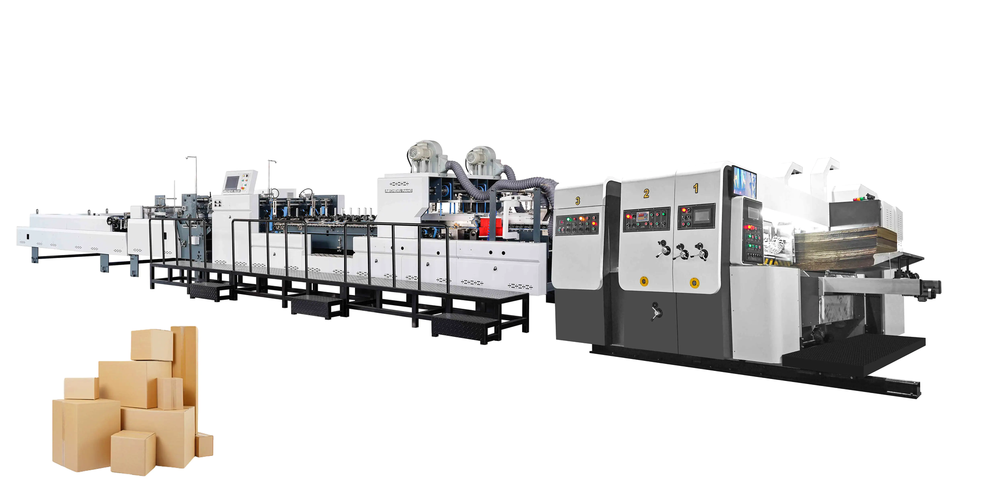
Why Are Automatic Folder Gluers Ideal for Modern Factories?
Discover how automation transforms packaging production through

Slide 2
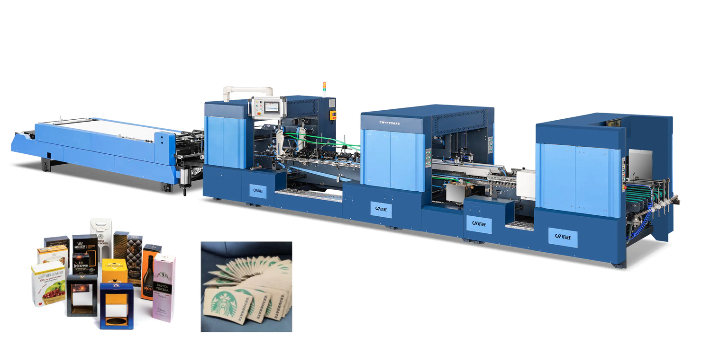
INDUSTRY CHALLENGE
The Packaging Industry's Demand for Speed and
Precision
Modern factories face relentless pressure to deliver high volumes while maintaining flawless quality standards. Traditional manual folding and gluing methods create bottlenecks, introduce costly errors, and lead to inconsistent packaging. In today’s competitive marketplace, automation is no longer optional. Investing in an automatic carton board folder gluer machine has become essential for improving efficiency, ensuring precision, and meeting demanding customer expectations.

Slide 3
Dramatic Productivity Boosts with Automation
150
1000s
Cartons Per Hour
Output capacitywithminimalhumanintervention required
Metres Per Minute
Maximum processing speed achieved by advanced automatic folder gluers
Automatic folder gluers handle thousands of cartons per hour with minimal human input, vastly outpacing manual production
lines. These impressive speeds enable factories to fulfil large-scale orders rapidly, meeting the demanding requirements of food
packaging, pharmaceutical applications, and booming e-commerce sectors with unprecedented efficiency.

Slide 4
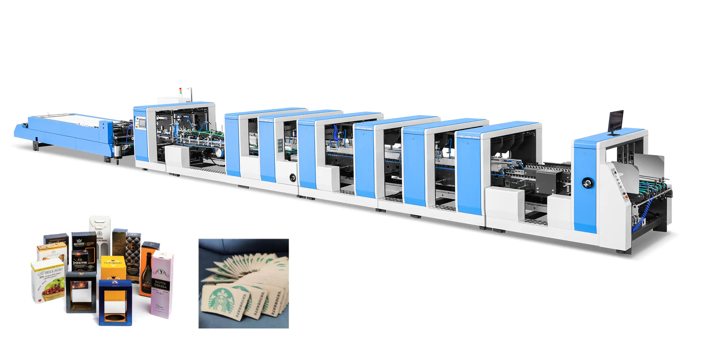
Cutting Labour Costs and Reducing Human Error
Automated Operations
Feeding, folding, gluing, and stitching processes require minimal manual
intervention
Error Elimination
Eliminates costly mistakes like misaligned folds or excessive glue application
Workforce Optimisation
Reallocatesskilled
staff to higher- value strategic and creative tasks
By minimising reliance on manual labour, factories reduce risks from labour
shortages whilst dramatically improving overall operational efficiency.

Slide 5
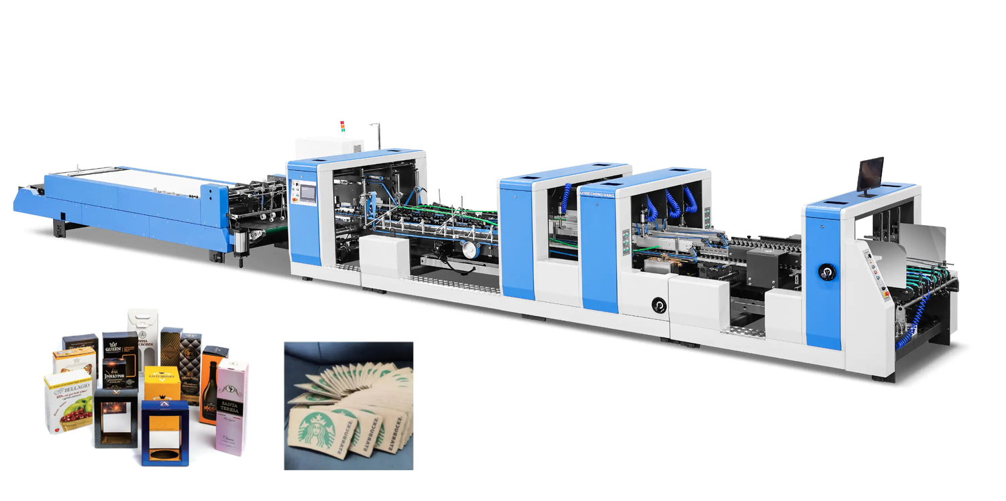
Consistent High-Quality Output Every Cycle
Precision Engineering
Excellence
Advanced automatic folder gluers deliver precision engineering that ensures uniform folds, robust adhesive bonds, and impeccable finishes on every single carton produced.
This consistency supports brand
reputation by delivering durable, visually
attractive packaging that customers
trust. Modern machines demonstrate
remarkable versatility, adapting
seamlessly to various carton dimensions,
material specifications (A/B/C flute, 3-5
ply corrugated board), and diverse box
styles from simple cases to complex
structural designs.

Slide 6

TIME EFFICIENCY
Rapid Changeovers and Smart Order Memory
Order
Quick Setup
Production
Selection
Start
State-of-the-art folder gluers enable remarkably fast changeovers in just 3-5 minutes, dramatically reducing costly downtime between production runs. Sophisticated order memory functions allow instantaneous switching between different carton designs and specifications. This exceptional flexibility supports diverse product lines and accommodates custom packaging demands, making factories more agile and responsive to changing market needs.

Slide 7



Enhanced Safety and Operator Comfort
Reduced Physical Strain
Automationeliminatesmanualhandling of heavy materials and
repetitive tasks, significantly lowering workplace injury risk
Ergonomic Design
Intuitive touchscreen controls and thoughtful machine layouts improve ease of use and operator satisfaction
Workplace Wellbeing
Saferworkingenvironments contribute to higher productivity levels,
improved morale, and better staff retention

Slide 8
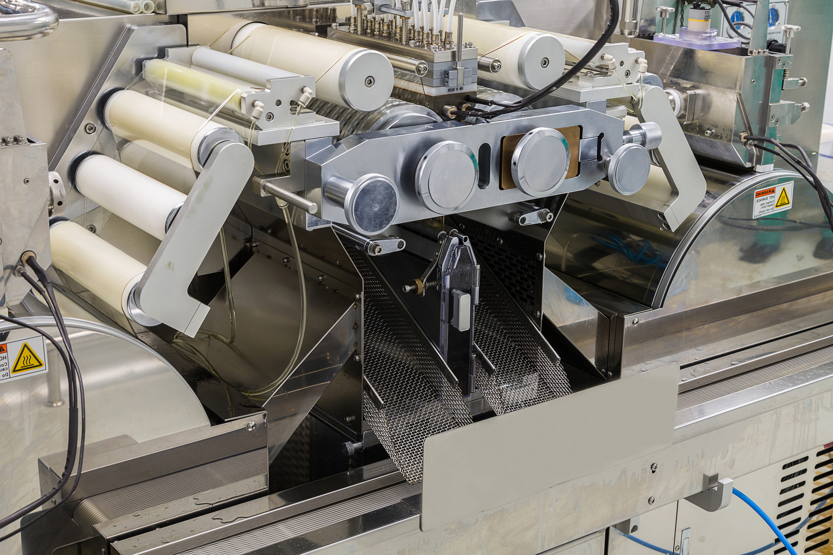
Integrated Quality Control and Data-Driven Efficiency
Modern folder gluers feature sophisticated built-in systems for counting, stacking, and comprehensive real-time monitoring that streamline downstream logistics operations.
Intelligent control systems automatically adjust glue
application rates and folding parameters to maintain optimal
quality. Advanced data connectivity enables predictive
maintenance scheduling and continuous process
optimisation, maximising uptime and operational efficiency.
Automated Counting
Precise tracking and stacking capabilities
Real-Time Monitoring
Continuous performance oversight
Intelligent Systems
Automatic parameter adjustments
Data Connectivity
Predictive maintenance capabilities

Slide 9
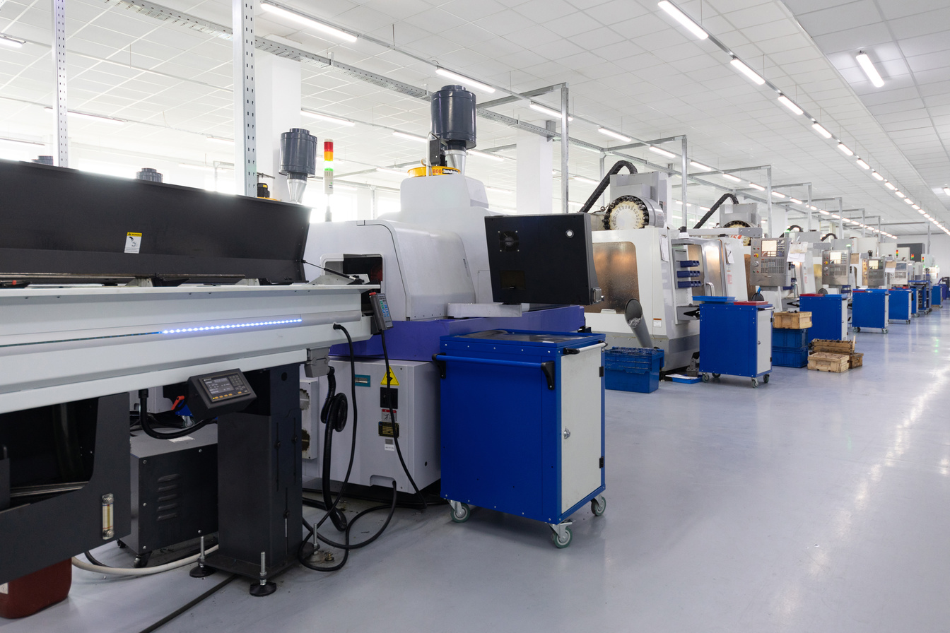
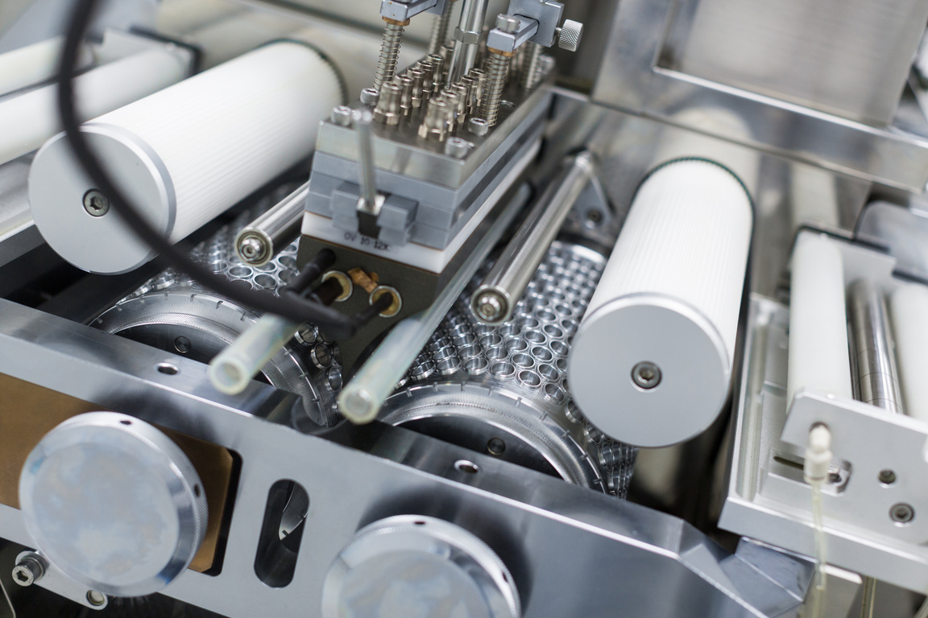
SUCCESS STORIES
Real-World Impact: Industry Leaders
Giant Corrugated
Koenig & Bauer
Modular gluers deliver high-speed production of complex carton styles for premium cosmetics and electronics
Industry-Wide Benefits
Automaticfolder gluerstitchers dramatically boost output whilst reducing labour requirements by up to
40%
Adopting factoriesreport significantly
fewer defects, reduced material waste, and faster order fulfilment cycles

Slide 10
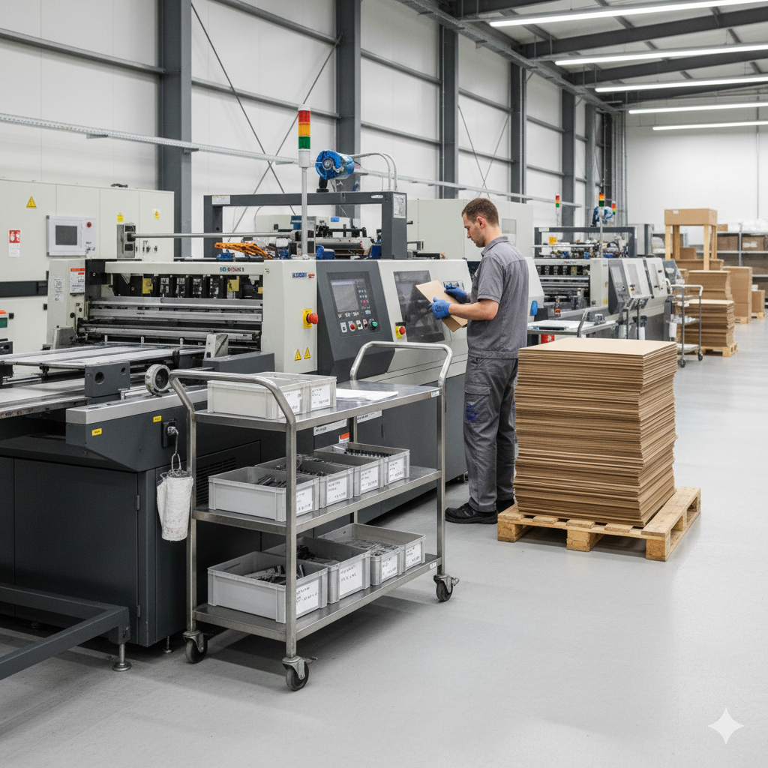

The Future of Packaging: Intelligent, Flexible, and Sustainable
AI & IoT Integration
Personalisation at Scale
Foldergluers evolvingwith artificial intelligence and Internet of Things connectivity for smarter, fully integrated production lines
Enablecustomised packaging
solutions that meet rising consumer expectations for unique, branded experiences
Strategic Investment
Investinginautomatic folder gluers means investing in factory resilience,
quality excellence, and sustainable growth
Embrace automation today to lead the packaging industry tomorrow with Cenwan Machine.

