Slide 1


Quora Web Solution
Website Design and
Development
Company
Web Design & Web Development
Company in Bangalore, India
www.quorawebsolution.com
+91 9986 056 909
info@quorawebsolutions.com
24A, 1st Main Rd, Chandra Reddy
Layout, Koramangala 4th Block,
Koramangala, Bengaluru,
Karnataka 560034

Slide 2
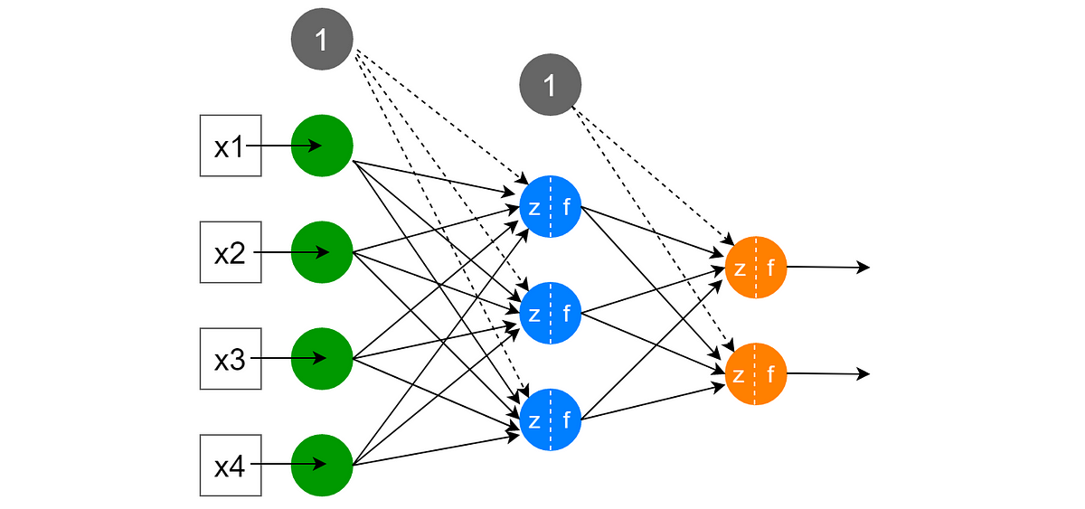
Beyond the Surface: The Hidden Layers of Effective Website Design and Development
www.quorawebsolution.com

Slide 3

The Digital Canvas: More Than Meets the Eye
www.quorawebsolution.com

Slide 4

When we think of a website, we often envision a simple collection of pages and images.
www.quorawebsolution.com

Slide 5

However, beneath this surface lies a complex interplay of design, development, and user experience principles that work together to create a seamless and engaging online experience.
www.quorawebsolution.com

Slide 6
The Foundation: Solid Infrastructure
A well-structured website is built on a strong foundation of HTML, CSS, and JavaScript. These core technologies provide the building blocks for every webpage, determining its layout, style, and interactivity.1 A skilled developer ensures that this foundation is optimized for speed, security, and compatibility across different devices and browsers.2
The Art of Design: Visually Appealing and User-Friendly
Effective website design is more than just aesthetics.3 It's about creating a visually appealing and user-friendly experience that aligns with the brand's identity and target audience. Designers carefully consider factors such as color scheme, typography, and imagery to evoke the desired emotions and create a cohesive visual language.
www.quorawebsolution.com

Slide 7
4
User Experience (UX): Putting the User First
At the heart of every successful website is a focus on user experience. UX designers strive to create intuitive and enjoyable interactions by analyzing user behavior, conducting usability tests, and implementing user-centered design principles.5 This involves optimizing navigation, page load times, and overall site performance to ensure a seamless and satisfying user journey.6
The Power of SEO: Reaching Your Target Audience
Search engine optimization (SEO) is the process of improving a website's visibility in search engine results.7 By strategically optimizing keywords, meta descriptions, and content, businesses can attract organic traffic and reach their target audience.
www.quorawebsolution.com

Slide 8
8 SEO experts work closely with designers and developers to ensure that the website is both user-friendly and search engine-friendly.9
The Future of Web Design and Development: Emerging Trends
The world of web design and development is constantly evolving, with new technologies and trends emerging regularly.10 From artificial intelligence and machine learning to augmented reality and virtual reality, these innovations are reshaping the way we interact with websites.11 By staying ahead of the curve, businesses can leverage these emerging technologies to create cutting-edge digital experiences.
www.quorawebsolution.com

Slide 9
In conclusion, effective website design and development is a multi-faceted process that requires a deep understanding of technology, design principles, and user behavior.12 By focusing on these key elements, businesses can create websites that not only look great but also drive results.
## E-commerce Website Design and Development: Driving Online Sales and Growth
Having a strong online presence is essential for businesses of all sizes in today's digital era.
www.quorawebsolution.com

Slide 10
A well-crafted e-commerce website can significantly enhance online sales and propel business growth.
**Creating a Seamless Shopping Experience**
A successful e-commerce website should provide a seamless shopping experience for customers. This involves several key elements:
* **User-Friendly Design:** A clean and intuitive interface that is easy to navigate.
* **Fast Loading Times:** Optimized images and code to ensure quick page load speeds.
A robust and secure payment gateway safeguards customer information during the checkout process.
www.quorawebsolution.com

Slide 11
* **Mobile Optimization:** Responsive design that adapts to various screen sizes for optimal mobile browsing.
* **Product Search and Filtering:** Advanced search functionality to help customers find products easily.
* **Detailed Product Descriptions:** High-quality images, informative descriptions, and customer reviews.
* **Clear Call-to-Actions:** Prominent buttons and links that guide customers through the buying process.
**Enhancing Online Visibility**
To attract potential customers, your e-commerce website needs to be visible in search engine results.
www.quorawebsolution.com

Slide 12
SEO is crucial for improving a website's visibility in search engine results, attracting organic traffic, and driving online sales.
* **Keyword Optimization:** Strategic use of relevant keywords in product descriptions, titles, and meta tags.
* **High-Quality Content:** Creating informative and engaging blog posts to attract organic traffic.
* **Backlink Building:** Acquiring backlinks from reputable websites to improve your website's authority.
* **Social Media Marketing:** Leveraging social media platforms to promote products and engage with customers.
* **Paid Advertising:** Utilizing pay-per-click (PPC) advertising to reach a wider audience.
**Building Customer Trust and Loyalty**
www.quorawebsolution.com

Slide 13
Trust is essential for building a successful e-commerce business. Here are some strategies to foster customer trust and loyalty:
* **Transparent Pricing:** Clearly displaying prices and any additional fees.
* **Secure Payment Options:** Offering multiple secure payment methods.
* **Excellent Customer Support:** Providing timely and helpful customer support.
A hassle-free return and exchange policy simplifies the customer experience.
www.quorawebsolution.com

Slide 14
* **Loyalty Programs:** Implementing rewards programs to incentivize repeat purchases.
* **Personalized Shopping Experiences:** Using customer data to tailor product recommendations.
By combining these elements, you can create an e-commerce website that not only attracts customers but also converts them into loyal buyers.
www.quorawebsolution.com

Slide 15
Quora Web Solution: Quora Web Solution is a trusted website development company based in Bangalore, India, offering a wide array of services to not only domestic but global clientele. Be it Website Design and Development, SEO services, Digital Marketing, Branding, App Development, Ecommerce Solution, and Logo Creation . Quora Web Solution has the best website developers offering top quality services and that is the reason why we are well known as one of the best Website Development Companies in Bangalore, India.
Visit Us - www.quorawebsolution.com
Call Us - +91 9986 056 909
Mail Us - info@quorawebsolutions.com
www.quorawebsolution.com

Slide 16

WORDPRESS DEVELOPMENT
ECOMMERCE DEVELOPMENT
PHP DEVELOPMENT
CMS DEVELOPMENT
DRUPAL DEVELOPMENT
WEBSITE SERVICES
WEBPORTAL DEVELOPMENT
MAGENTO DEVELOPMENT
WEBSITE DEVELOPMENT
JOOMLA DEVELOPMENT
SMALL BUSINESS DEVELOPMENT
CHEAP WEBSITE DEVELOPMENT
STATIC WEBSITE DEVELOPMENT
DYNAMIC WEBSITE DEVELOPMENT
WEBSITE DESIGN COMPANY
TOUR AND TRAVEL WEBSITE DEVELOPMENT
Services

