Slide 1

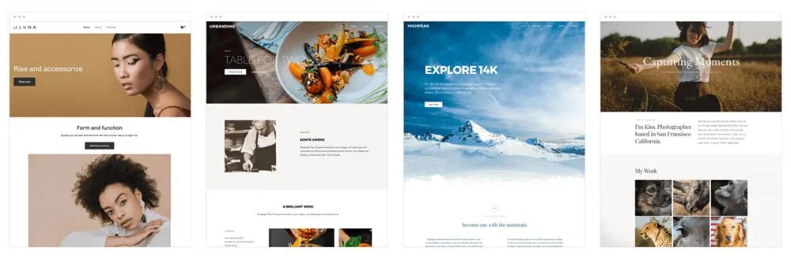
Quora Web Solution
Website Design and
Development
Company
Web Design & Web Development
Company in Bangalore, India
www.quorawebsolution.com
+91 9986 056 909
info@quorawebsolutions.com
24A, 1st Main Rd, Chandra Reddy
Layout, Koramangala 4th Block,
Koramangala, Bengaluru,
Karnataka 560034

Slide 2

## **Beyond the Basics: Advanced Website Design & Development Techniques**
www.quorawebsolution.com

Slide 3
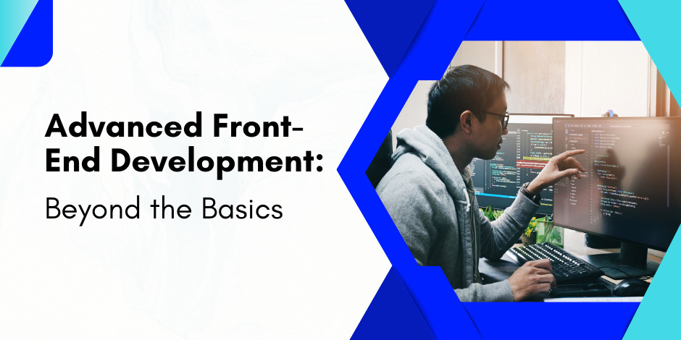
**Introduction**
Today, websites transcend their role as mere digital brochures.
www.quorawebsolution.com

Slide 4
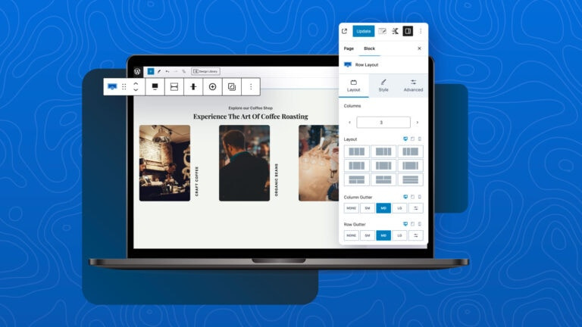
It's a powerful tool for branding, lead generation, and customer engagement.
www.quorawebsolution.com

Slide 5
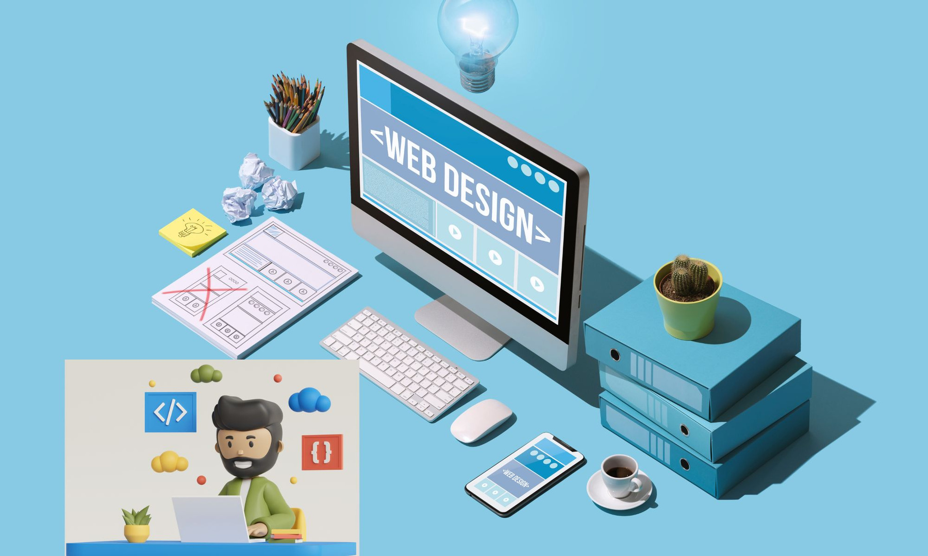
While basic website design and development principles are essential, mastering advanced techniques can elevate your online presence and drive significant results.
www.quorawebsolution.com

Slide 6
This article delves into some cutting-edge strategies that go beyond the basics, empowering you to create websites that are not only visually stunning but also highly functional and user-centric.
### **1. Progressive Web Apps (PWAs)**
Progressive Web Apps (PWAs) effectively bridge the divide between traditional websites and mobile applications. They offer a seamless user experience by providing app-like features, such as push notifications, offline functionality, and the ability to be installed on the user's home screen.
www.quorawebsolution.com

Slide 7
**Key Benefits:**
* **Enhanced User Experience:** Offer a faster, more reliable experience, even in areas with poor connectivity.
* **Improved Engagement:** Push notifications and home screen installation increase user engagement and retention.
Streamlined user experiences and app-like features within PWAs can significantly boost conversion rates.
### **2. Artificial Intelligence (AI) and Machine Learning (ML)**
www.quorawebsolution.com

Slide 8
AI and ML are revolutionizing website design and development in several ways:
* **Personalized Experiences:** AI can analyze user behavior to deliver personalized content recommendations, product suggestions, and targeted offers.
* **Chatbots:** AI-powered chatbots provide instant customer support, answer frequently asked questions, and guide users through the sales funnel.
* **Visual Search:** ML algorithms enable visual search capabilities, allowing users to search for products or images by simply uploading a photo.
### **3. Voice Search Optimization**
www.quorawebsolution.com

Slide 9
Given the rapid surge in voice search popularity, optimizing your website for voice queries is now essential.
**Key Considerations:**
* **Natural Language Processing (NLP):** Focus on using natural language and conversational keywords in your website content.
* **Answer Schema:** Implement schema markup to help search engines understand the intent of your content and provide more accurate voice search results.
* **Local SEO:** Optimize your website for local searches, as many voice searches are location-based.
www.quorawebsolution.com

Slide 10
### **4. Accelerated Mobile Pages (AMP)**
AMP is an open-source framework for creating lightweight and fast-loading web pages, particularly for mobile devices.
**Key Benefits:**
* **Improved Page Load Speed:** Faster loading times result in a better user experience and higher search engine rankings.
www.quorawebsolution.com

Slide 11
* **Increased Visibility:** AMP pages are prioritized in Google search results, making it easier for users to find your website.
* **Enhanced Mobile Performance:** Provides a smooth and seamless experience on all mobile devices.
### **5. Cybersecurity and Data Privacy**
In an increasingly data-driven world, cybersecurity and data privacy are paramount.
* **Robust Security Measures:** Implement strong passwords, HTTPS encryption, and firewalls to protect your website from cyber threats.
www.quorawebsolution.com

Slide 12
* **Data Privacy Compliance:** Ensure your website complies with relevant data privacy regulations, such as GDPR and CCPA.
* **Transparent Data Collection Practices:** Be transparent with users about how you collect, use, and store their data.
**Conclusion**
By incorporating these advanced techniques, you can create a website that is not only visually appealing and user-friendly but also competitive, engaging, and secure. Remember, the digital landscape is constantly evolving, so staying updated on the latest trends and technologies is essential for success.
www.quorawebsolution.com

Slide 13
## Website Design & Development: Is It Worth the Investment?
A robust online presence is no longer a luxury in today's hyper-connected world; it's an absolute necessity. For businesses of all sizes, a well-designed and developed website serves as the digital storefront, connecting with potential customers, showcasing products or services, and driving sales. But with the associated costs, many business owners wonder: is investing in website design and development truly worth it?
**The answer is a resounding yes.**
### Why Website Design & Development is a Smart Investment
www.quorawebsolution.com

Slide 14
1. **Enhanced Brand Image:** A professional website reflects positively on your brand. It conveys credibility, professionalism, and a commitment to quality. Visually appealing and user-friendly websites leave a lasting impression, fostering trust and encouraging greater engagement with your brand.
2. **Well-structured websites with optimized content are more likely to achieve higher search engine rankings, thus increasing visibility.** This increased visibility translates to more organic traffic, meaning more potential customers finding your business online.
3. **24/7 Accessibility & Global Reach:** A website operates around the clock, making your business accessible to customers worldwide at any time. This expands your reach beyond geographical limitations, opening up new markets and opportunities.
www.quorawebsolution.com

Slide 15
4. **Improved Customer Experience:** A user-friendly website with intuitive navigation, clear calls to action, and valuable content enhances the overall customer experience. This results in heightened customer satisfaction, loyalty, and repeat business.
5. **Cost-Effectiveness:** Compared to traditional marketing channels like print advertising or cold calling, a website offers a cost-effective way to reach a large audience. Once the initial investment is made, ongoing maintenance costs are relatively low, making it a sustainable marketing tool.
6. **Data-Driven Insights:** A website can provide valuable data and analytics, such as visitor traffic, bounce rates, and conversion rates. This data can be used to track the effectiveness of your website and make informed decisions about future marketing strategies.
www.quorawebsolution.com

Slide 16
### Making the Most of Your Investment
To ensure a successful return on your investment, it's essential to work with experienced website design and development professionals. Here are some key factors to consider:
* **Clear Goals & Objectives:** Define your goals for the website, whether it's to generate leads, increase sales, or build brand awareness.
* **User-Centric Design:** Focus on creating a website that is easy to navigate and provides a positive user experience.
* **Responsive Design:** Ensure your website is mobile-friendly, as a significant portion of traffic comes from mobile devices.
www.quorawebsolution.com

Slide 17
* **Content Marketing:** Create high-quality, engaging content that attracts and retains visitors.
* **Regular Maintenance & Updates:** Keep your website up-to-date with the latest technology and security standards.
In conclusion, investing in website design and development is a strategic decision that can significantly impact your business's success. By creating a professional, user-friendly, and effective website, you can enhance your brand image, increase visibility, improve customer experience, and drive growth.
www.quorawebsolution.com

Slide 18
Quora Web Solution: Quora Web Solution is a trusted website development company based in Bangalore, India, offering a wide array of services to not only domestic but global clientele. Be it Website Design and Development, SEO services, Digital Marketing, Branding, App Development, Ecommerce Solution, and Logo Creation . Quora Web Solution has the best website developers offering top quality services and that is the reason why we are well known as one of the best Website Development Companies in Bangalore, India.
Visit Us - www.quorawebsolution.com
Call Us - +91 9986 056 909
Mail Us - info@quorawebsolutions.com
www.quorawebsolution.com

Slide 19

WORDPRESS DEVELOPMENT
ECOMMERCE DEVELOPMENT
PHP DEVELOPMENT
CMS DEVELOPMENT
DRUPAL DEVELOPMENT
WEBSITE SERVICES
WEBPORTAL DEVELOPMENT
MAGENTO DEVELOPMENT
WEBSITE DEVELOPMENT
JOOMLA DEVELOPMENT
SMALL BUSINESS DEVELOPMENT
CHEAP WEBSITE DEVELOPMENT
STATIC WEBSITE DEVELOPMENT
DYNAMIC WEBSITE DEVELOPMENT
WEBSITE DESIGN COMPANY
TOUR AND TRAVEL WEBSITE DEVELOPMENT
Services

