Slide 1
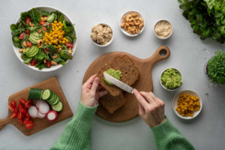
Dr. Bali’s Bliss
Food Nutrition and Balanced Diet
Nourish your body with tailored food nutrition and balanced diet plans, supporting diabetes, thyroid, weight loss, detox, and cancer-prevention goals daily.

Slide 2
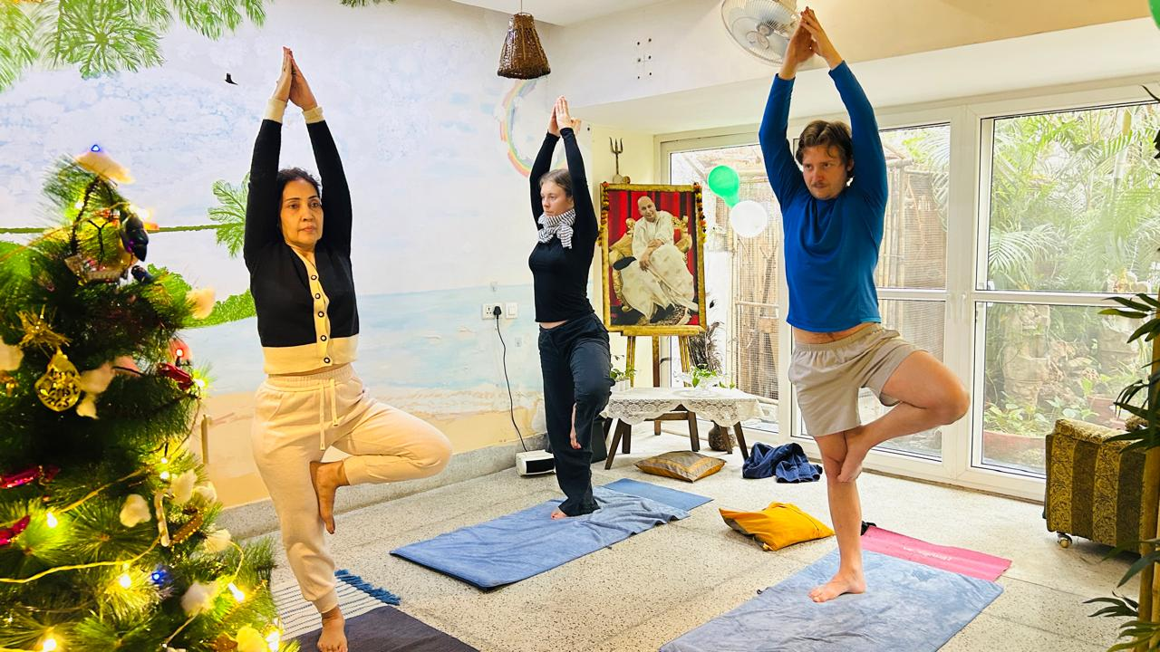
Dr. Bali’s Bliss
Yoga and Meditation Classes
Awaken strength, flexibility, and mental clarity with yoga and meditation classes that enhance sleep, skin glow, and overall physical and emotional balance.

Slide 3
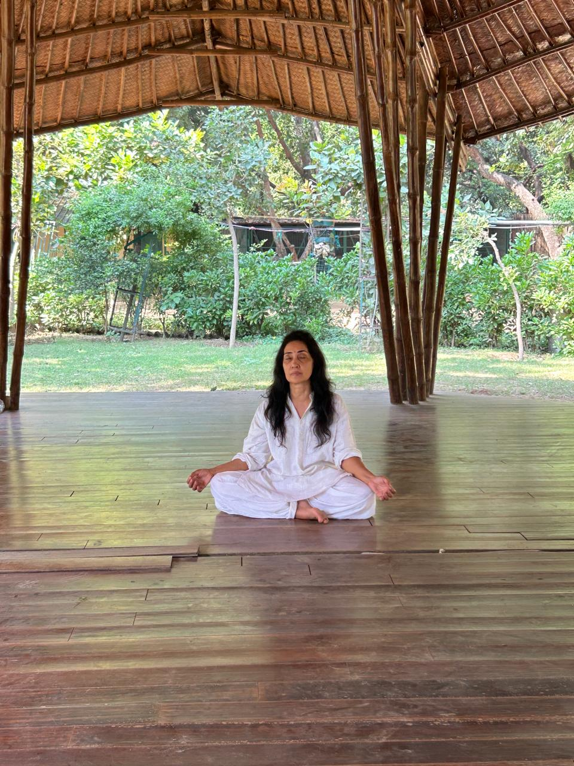
Dr. Bali’s Bliss
Meditation Centre in South Delhi
Balance your mind, body, and energy at a meditation centre in South Delhi, offering personalized meditation sessions to boost immunity, sleep, and wellness.

Slide 4






Dr. Bali’s Bliss
THANK YOU
At Dr. Bali’s Bliss, our expert team brings together years of experience in holistic health & wellness. We combine natural therapies like Homeopathy, Ayurveda, Naturopathy, and Yoga with advanced treatments. Our main approach is to focus on healing the mind, body & spirit by offering personal care.
23, near NIFT, Block X, Hauz Khas,
New Delhi, Delhi 110016
https://drbalisbliss.com/
contact@drbalisbliss.com

