Slide 1
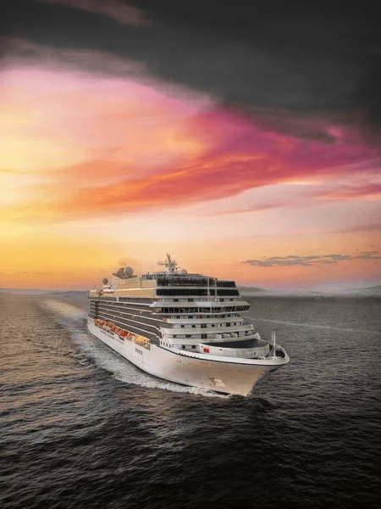
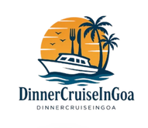
Best Dinner Cruise in Goa for Family
Enjoy Magical Nights on the Mandovi River
Luxu ry
Premium triple-deck cruise experience
Entertainment
Live DJ, dance & cultural shows
Buffet Dinner
Unlimited veg & non-veg spread
Family Fun
Memorable evenings for all ages
www.dinnercruiseingoa.in

Slide 2

Experience the Perfect Family Evening in Goa
Afamilydinner cruisein Goaoffersa beautifulcombination ofsightseeing,liveentertainment, delicious food,and relaxing moments on the Mandovi
River.Families canenjoy music,dance performances,buffet dining,andstunningnightviews ofPanaji citywhile cruising in comfort.
S ightseei ng
Live Entertainment
Glide past Panaji's glittering skyline, historic forts, and floating casinos as the city comes alive after dark.
Enjoy Bollywood DJ sets, Goan folk dance performances, karaoke, and games that keep every family member engaged.
Buffet Dining
Relaxation
Savour an unlimited spread of Goan specialities, Indian cuisine, starters, desserts, and complimentary beverages.
Unwind on spacious open-air decks or in air-conditioned dining areas as the gentle river breeze sets the mood.

Slide 3


Perfect for Every Family Member
Familydinnercruises ontheMandovi Riverarethoughtfullydesigned forcouples, children, parents, and groups seeking a memorable evening
together.Whetheryou aretravelling withtoddlersorgrandparents,the experience caters to all ages with safety, comfort, and non-stop entertainment.
Safe & Family-Friendly
Live DJ & Cultural Shows
A secure, welcoming environment with professional crew ensuring the safety and comfort of every passenger, including young children.
Energetic Bollywood DJ music and vibrant Goan folk dance performances keep the atmosphere lively and entertaining throughout the cruise.
Scenic Night Views
Delicious Buffet Dinner
Breathtaking views of Goa illuminated at night 4 from Panaji's city lights to the shimmering reflections on the Mandovi River.
A generous veg and non-veg buffet spread with Goan specialities, Indian dishes, desserts, and complimentary drinks for all guests.

Slide 4
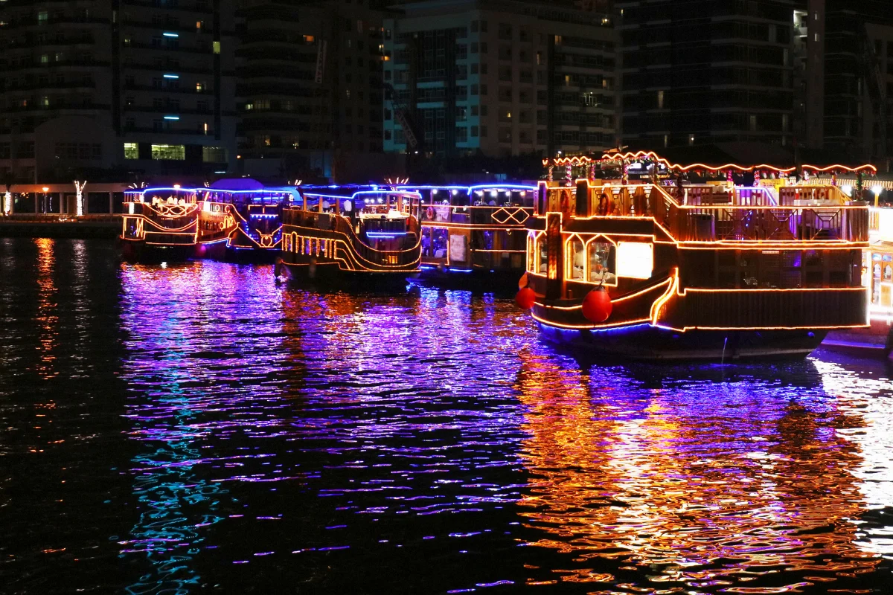
What You Can Enjoy Onboard
Premium dinner cruises on the Mandovi River offerapacked2to3-hourexperience
that combinessightseeing, dining,and entertainment.Fromtheopen-airupperdeck to the air-conditioneddining area, every detail is craftedforcomfortandenjoyment.Most premium cruises include a full buffet dinner andsightseeingaroundPanajicityand
Aguada Bay.
Onboard Facilities
Entertainment & Dining
2 to 3-hour river cruise experience Open-air upper deck with
panoramic views
Air-conditioned dining area
Comfortable seating and spacious
decks
Live Bollywood DJ and dance floor Goan folk dance performances Karaoke and entertainment games Complimentary drinks and snacks
Full buffet dinner included

Slide 5
Discover Goa's Night Beauty
While sailingonthe Mandovi River,families are treatedto some ofGoa'smost iconic and picturesque landmarks. The peaceful river atmosphere
makes theevening specialfor photography and creating lasting familymemories.
Panaji City Lights
Floating Casinos
Reis Magos Fort
The glittering waterfront of Goa's capital city creates a magical backdrop as you cruise along the river.
Spot the iconic floating casinos moored on the Mandovi, brilliantly lit and buzzing with activity.
One of Goa's oldest Portuguese-era forts, dramatically illuminated against the night sky.
Adil Shah Palace
Fort Aguada
A historic landmark visible from the river, adding a touch of Goa's rich cultural heritage to your cruise.
The majestic 17th-century Portuguese fort at the mouth of the Mandovi, a stunning sight from the water.

Slide 6

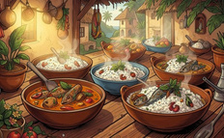
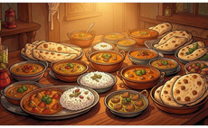

Unlimited Buffet Dinner on the Cruise
Thediningexperienceaboarda Goafamilydinner cruiseis ahighlightinitself. Familiescanenjoyawide variety of freshly prepared dishes served in a comfortable, hospitablesetting. Manycruisesoffer luxury diningexperiences withcomfortabletableseating and quality hospitality, ensuring every guest leaves satisfied.
Starters
Goan Special Cuisine
Indian Buffet
Desserts & Beverages
A generous selection of veg and non-veg starters to whet your appetite as the cruise sets sail.
Authentic Goan dishes including local specialities that capture the true flavour of the region.
A rich spread of Indian buffet favourites 4 from aromatic curries to freshly baked breads and rice
dishes.
Round off your meal with indulgent desserts and complimentary
drinks, included with every cruise
package.

Slide 7
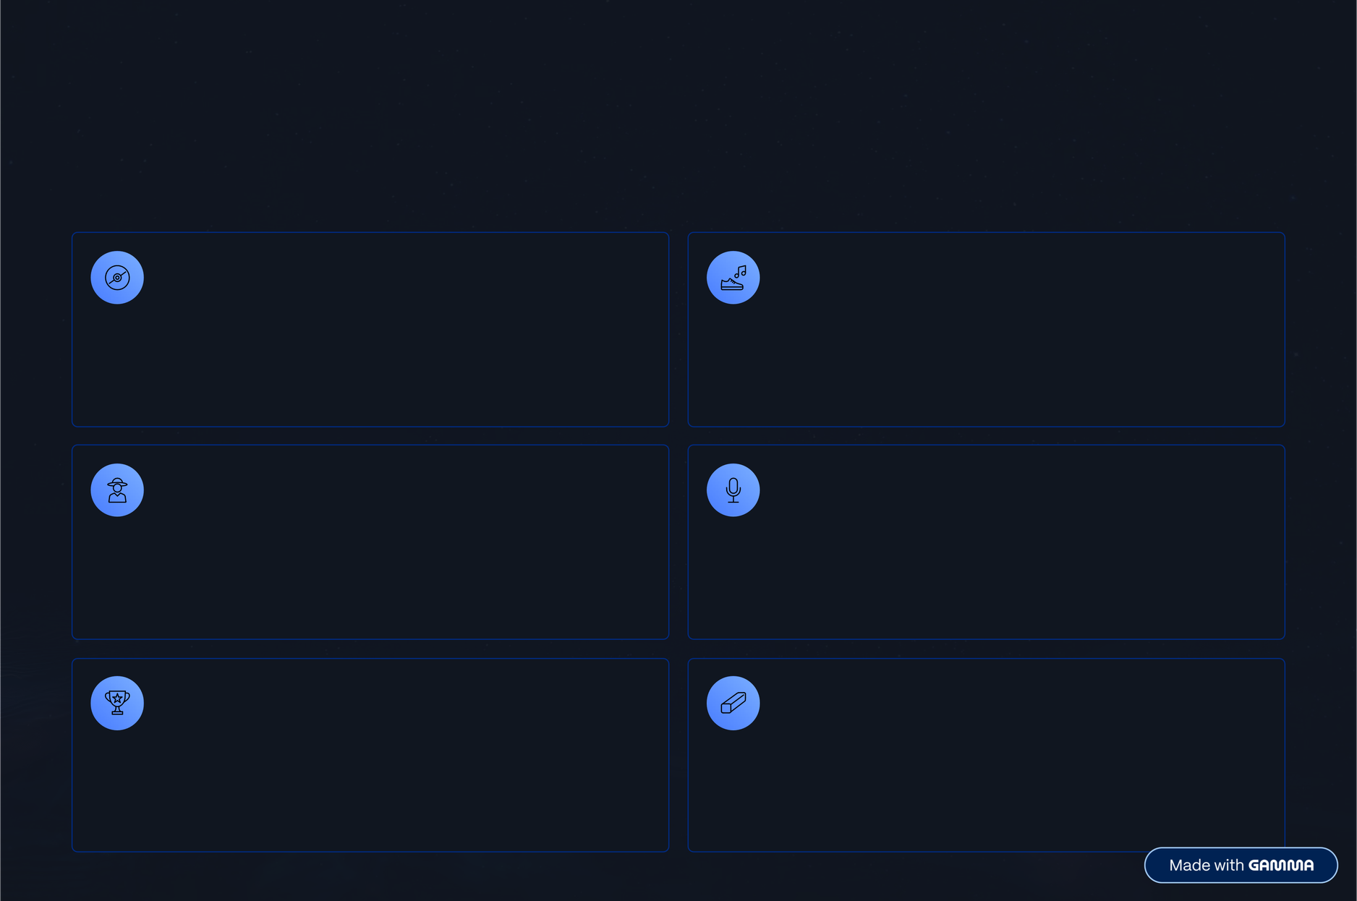
Music, Dance & Fun Activities
Theentertainment programmeonboard isdesignedtokeepeveryfamilymember engaged from the moment the cruise departs. A lively mix of music,
dance, games,and specialeffects ensuresthereisneveradullmomentontheMandovi River. These activities create a vibrant, festive atmosphere suitable for families andchildren ofall ages.
Live DJ Music
Bollywood Dance Rounds
Non-stop Bollywood and party hits to keep the dance floor alive throughout the cruise.
Energetic Bollywood dance performances and interactive rounds where guests can join in.
Goan Cultural Performances
Karaoke Sessions
Vibrant Goan folk dance shows celebrating the rich cultural heritage of the region.
Grab the mic and sing your favourite songs 4 a crowd favourite for families and groups.
Games & Spot Prizes
Kids' Mascots & Laser Shows
Fun onboard games with exciting spot prizes to win, keeping guests entertained between performances.
Special laser light shows and kids' mascots ensure the youngest family members have a magical time.

Slide 8
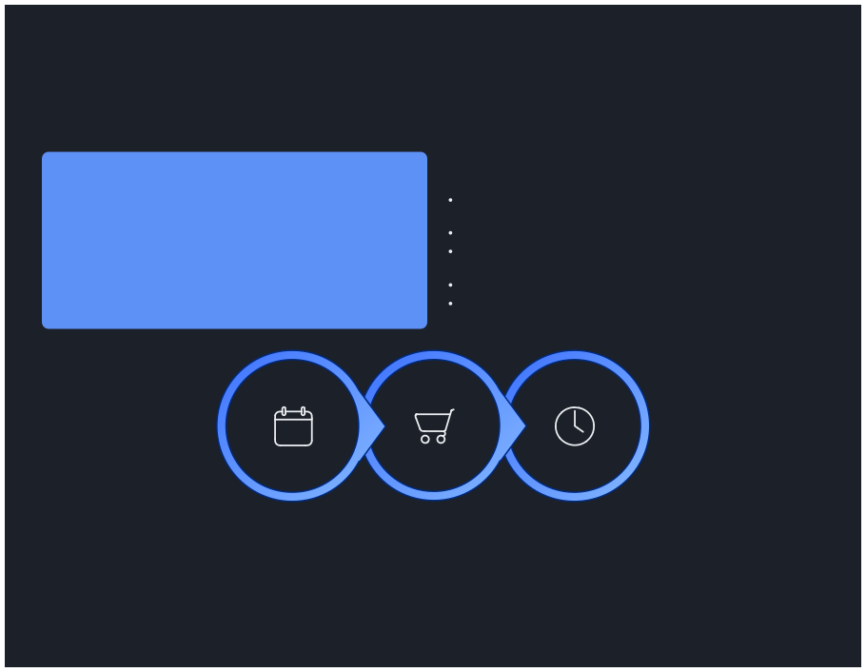

Plan Your Perfect Cruise Evening
Timing yourvisitandplanningaheadcanmakeallthedifferencetoyourdinnercruiseexperience. The best months to visit Goa for a dinner cruise are
OctobertoMarch,whentheweatherispleasant,theskiesareclear,andtheriverisatits most beautiful. Advance booking is highly recommended during thetouristseason,especiallyoverholidaysandweekendswhencruisesfillupquickly.
Best Season
Booking Tips
October to March is the ideal window 4 cool evenings, calm waters, and the full vibrancy of Goa's tourist season make for an unforgettable cruise experience.
Book early during holidays and weekends to secure your preferred slots
Arrive at the boarding point at least 30 minutes before departure
Choose family-exclusive cruises for a more comfortable, tailored experience
Carry light jackets for the cool evening river breeze
Advance online booking is strongly recommended during peak
tourist season
Choose Date
Book Online
Arrive Early
Following these simple steps ensures a smooth, stress-free evening for the whole family.

Slide 9
Trusted Family Cruise Experience
Dinner Cruise inGoa is a trusted nameforfamily cruise experiencesonthe Mandovi River, offering carefully curated packages that combine luxury,
entertainment, andvalue. Popular optionsinclude luxury tripledeckcruises andfamily party cruises, all designed to deliver memorable evenings for families and groups.
Luxury Packages
Affordable Pricing
Premium family dinner cruise packages including triple deck cruises with all-inclusive entertainment and buffet dining.
Competitive and transparent pricing options to suit different budgets, with no hidden charges.
OnlineBooking
Professional Hospitality
Easy and secure online booking support available through the official website, with instant confirmation.
Experienced and courteous cruise staff ensuring every guest receives attentive, professional service throughout the evening.
Full Inclusions
Family & Group Focus
Entertainment, buffet dinner, complimentary drinks, and sightseeing all included in one seamless package.
Specially designed experiences for families, couples, and large groups seeking a memorable evening together in Goa.

Slide 10
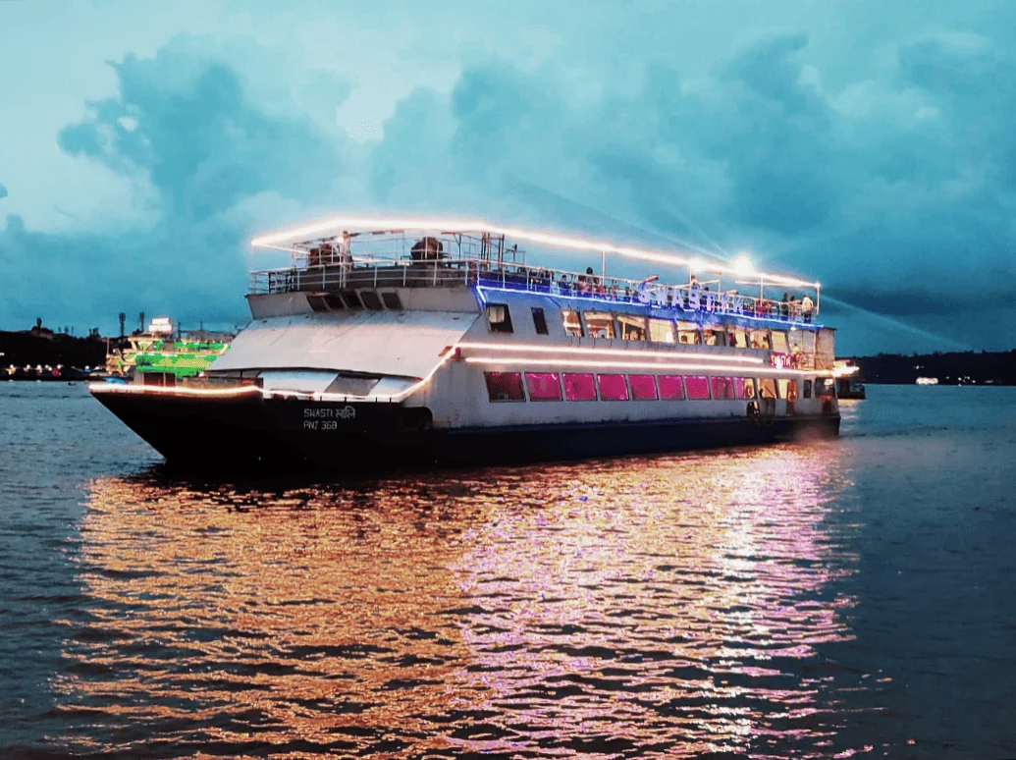
Book Your Family Dinner Cruise Today
Create unforgettable momentswithyourlovedonesonGoa'smostexcitingdinner
cruise experience.Whether it'safamilyholiday,aspecialcelebration,orsimplya magical evening out 4the MandoviRiverawaits.
Website
Call Us
www.dinnercruiseingoa.in
+91-7579794875
Email Us
dinnercruiseingoa@gmail.com
Enjoy Food " Music " Dance " Family Fun in Goa

