Slide 1
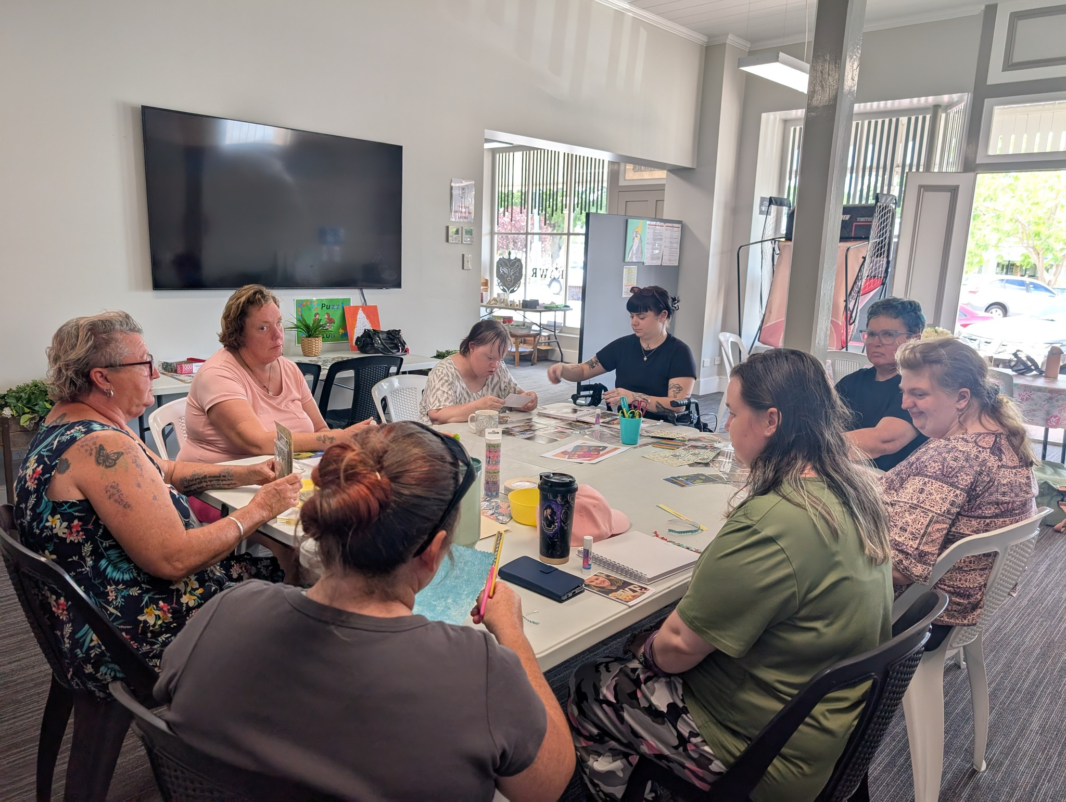

NDIS Providers in Burwood Heights
Starting your path to independence? At Circle of Hope, we collaborate with you to understand what matters most in your daily routine and aspirations — then build support around it.

Slide 2
What NDIS Support Really Offers
Support is not limited to one area. Services are designed to fit your lifestyle and needs.
Personal Care
Community Participation
Skill Development
Daily living assistance tailored to you
Stay socially active and connected
Build independence through learning
Transport Assistance
Therapy Services
Getting to appointments with ease
Physical and mental well-being support

Slide 3

Personalised Plans That Reflect You
Every individual has a different story. That is why NDIS in Burwood Heights focuses on plans built around you — not standard options.
Conversations & Check-ins
We take time to understand your situation through regular dialogue.
Goal-Centred Planning
Plans reflect your personal goals, not a one-size-fits-all approach.
Full Transparency
You stay informed and always know what your plan includes.

Slide 4
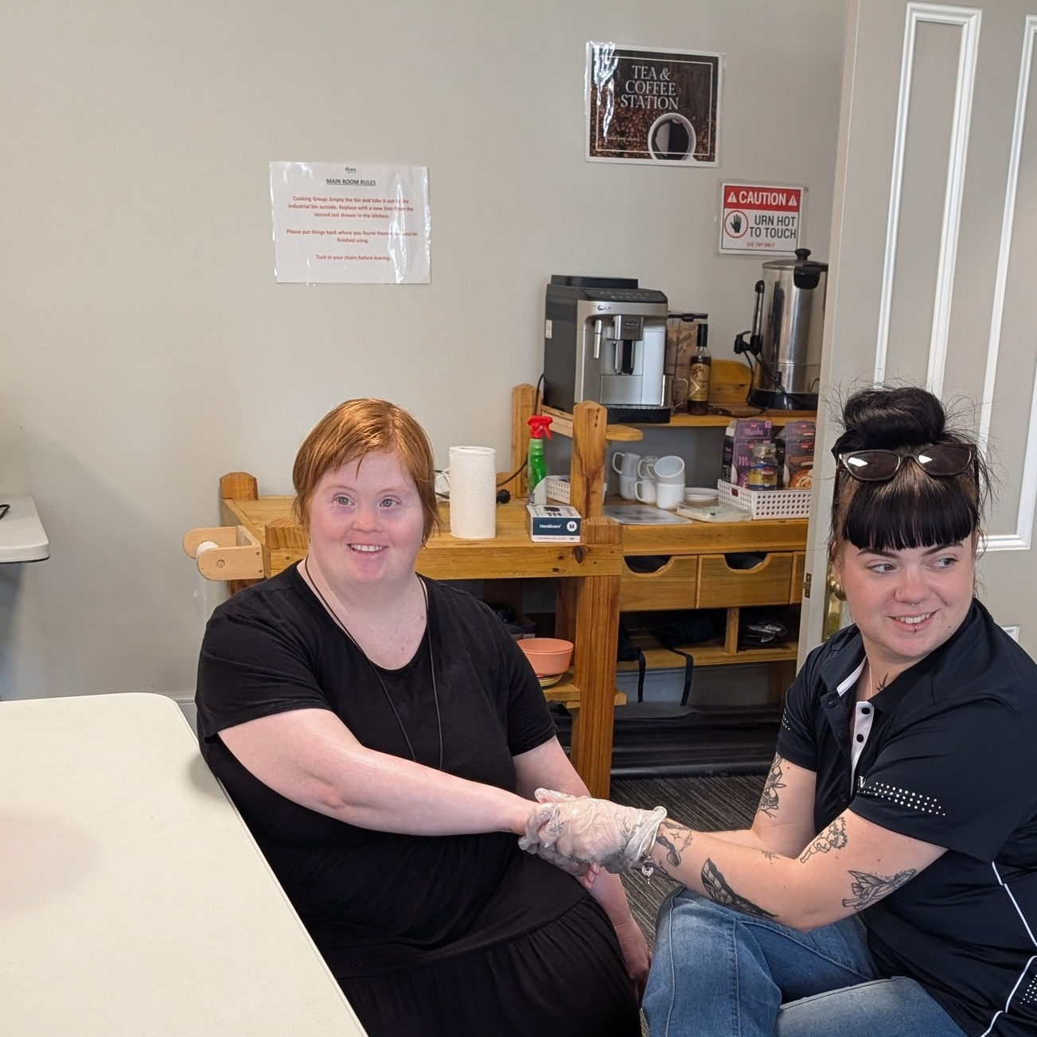
EXPERIENCE MATTERS
Trusted, Experienced Professionals
Our staff includes therapists, support workers, and medical care providers who understand a wide range of conditions and care requirements.
With Circle of Hope, you have people who respect your choices and appreciate your independence.

Slide 5

Clear Communication, Every Step
Effective communication ensures you are always certain about your plan. We keep things simple and keep you informed.
Plan Changes
Service Options
Government Updates
Notified promptly whenever your plan is updated
Clear guidance on what is available to you
Stay current with relevant NDIS policy changes
Plans can be modified to meet short-term needs or fluctuating conditions — flexibility is built in.

Slide 6
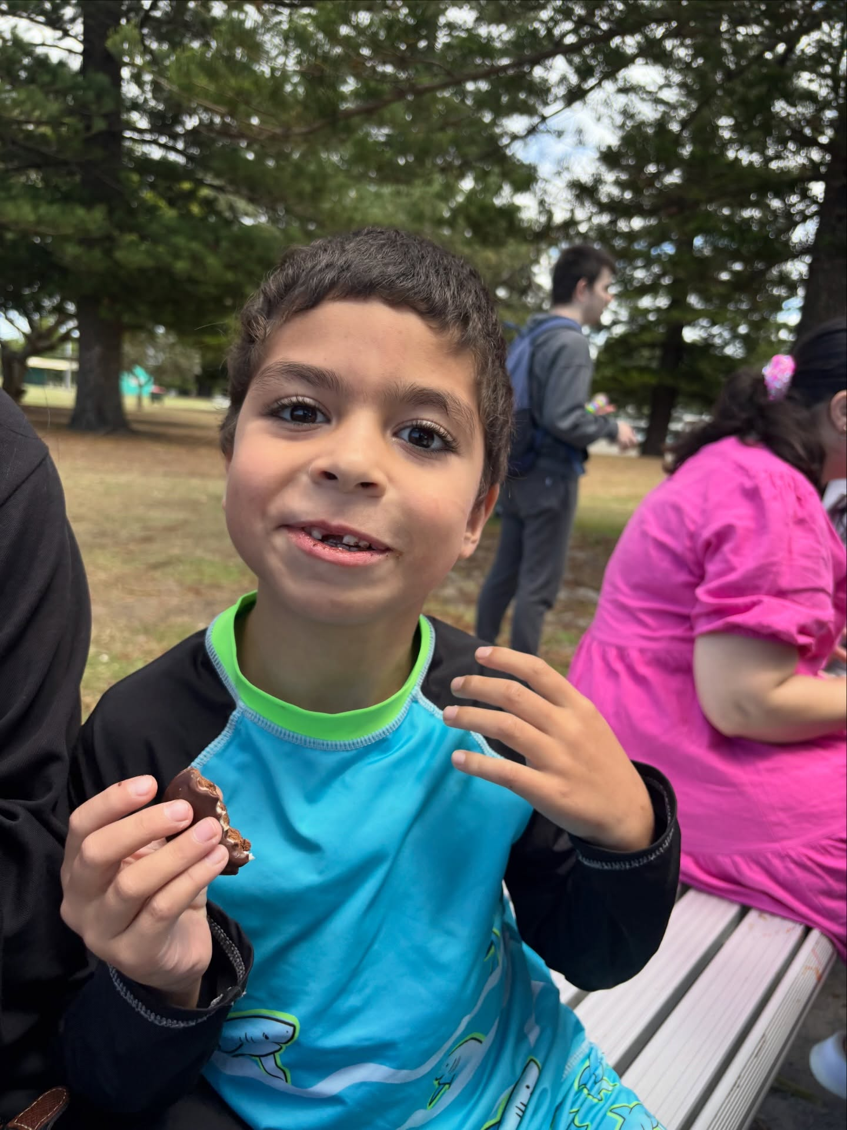
Your Path to a More Independent Future
Choosing the right support system can change everything. Circle of Hope is devoted to respectful, personalised care that supports your goals and daily routine — helping you move toward a more independent and confident future.
01
02
Choose a provider
Build your plan
Look for personalised plans, clear communication, and experienced staff
Collaborate on goals that reflect your lifestyle and needs
03
Live with confidence
Receive ongoing support as you grow toward independence

