Slide 1

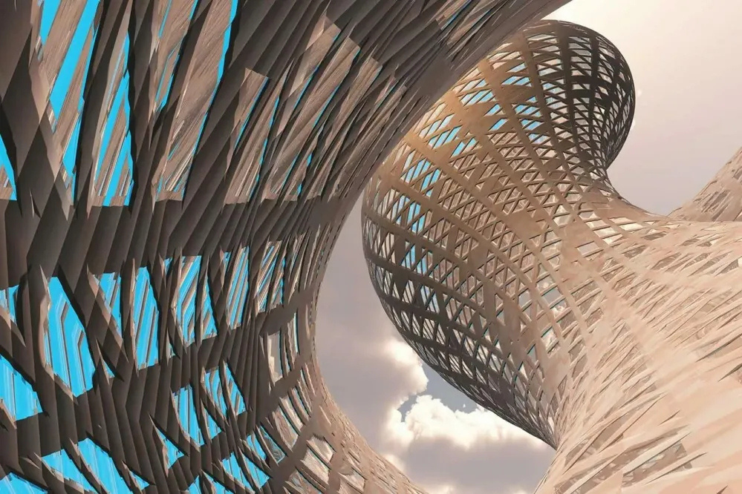
Quora Web Solution
Website Design and
Development
Company
Web Design & Web Development
Company in Bangalore, India
www.quorawebsolution.com
+91 9986 056 909
info@quorawebsolutions.com
24A, 1st Main Rd, Chandra Reddy
Layout, Koramangala 4th Block,
Koramangala, Bengaluru,
Karnataka 560034

Slide 2

## The Architects of Online Success: Unveiling the Expertise of a Top-Tier Design & Development Firm
www.quorawebsolution.com

Slide 3

**Introduction:**
Businesses of all sizes today absolutely require a robust online presence to thrive in the digital world.
www.quorawebsolution.com

Slide 4
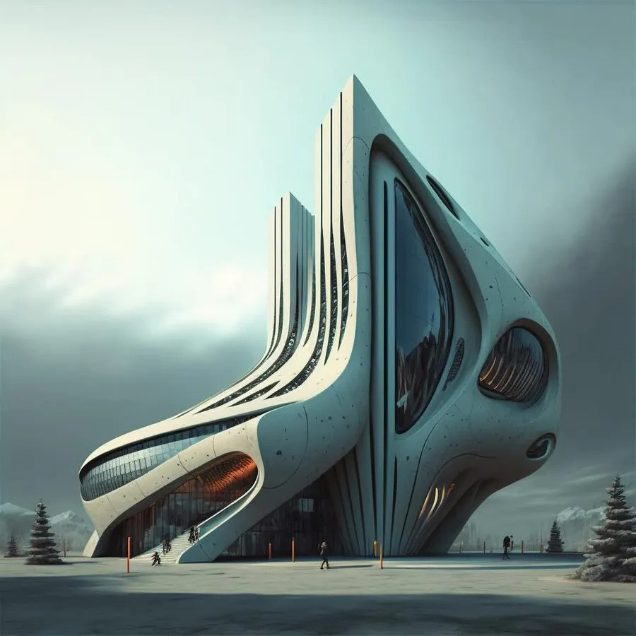
A well-designed and developed website is the cornerstone of this online presence, serving as the virtual face of your brand and the primary point of interaction with potential customers.
www.quorawebsolution.com

Slide 5

This is where the expertise of a top-tier website design and development company becomes invaluable.
www.quorawebsolution.com

Slide 6
**The Importance of Professional Website Design and Development:**
A professional website is far more than just a display of pages and pictures. It is a strategic tool that can help you achieve a variety of business goals, including:
* **Increased brand awareness:** A visually appealing and user-friendly website can help you make a strong first impression and establish your brand identity.
* **Improved customer engagement:** A well-designed website can keep visitors interested and encourage them to explore your offerings.
www.quorawebsolution.com

Slide 7
* **Enhanced lead generation:** A website with clear calls to action can help you capture leads and convert them into customers.
* **Boosted sales and revenue:** A well-optimized website can improve your search engine ranking and drive more traffic to your site, ultimately leading to increased sales.
**The Role of a Top-Tier Design & Development Firm:**
A top-tier website design and development company brings a wealth of expertise and experience to the table. They can help you:
www.quorawebsolution.com

Slide 8
* **Plan and strategize:** From understanding your business goals to defining your target audience, a top-tier firm can help you develop a comprehensive website strategy.
* **Design and develop:** They can create a visually stunning and user-friendly website that is tailored to your specific needs and brand identity.
* **Optimize for search engines:** They can ensure your website is optimized for search engines, helping you rank higher in search results and attract more organic traffic.
* **Maintain and update:** They can provide ongoing maintenance and support to keep your website running smoothly and up-to-date.
www.quorawebsolution.com

Slide 9
**Choosing the Right Design & Development Partner:**
Selecting the right website design and development company is crucial for the success of your online presence. Here are some factors to consider:
* **Experience and expertise:** Look for a company with a proven track record and a team of experienced professionals.
* **Portfolio:** Review their portfolio to see examples of their work and assess their design and development capabilities.
www.quorawebsolution.com

Slide 10
* **Client testimonials:** Read testimonials from past clients to get an idea of their satisfaction levels.
* **Communication and collaboration:** Choose a company that communicates effectively and is willing to collaborate closely with you throughout the project.
**Conclusion:**
Investing in a top-tier website design and development company is an investment in your business's future. By partnering with the right firm, you can create a powerful online presence that drives results and helps you achieve your business goals.
From Pixels to Performance: How a Leading Agency Transforms Ideas into Stunning Websites
www.quorawebsolution.com

Slide 11
In today's hyper-connected world, a website is more than just a digital brochure; it's a dynamic platform for engagement, interaction, and growth.1 It's the virtual storefront, the online hub, and the 24/7 representative of your brand.2 This is where the expertise of a leading website design and development agency truly shines, transforming abstract ideas into high-performing digital experiences.
Beyond Aesthetics: A Holistic Approach
The journey from concept to completion is a collaborative process, requiring a deep understanding of client needs, target audiences, and market trends.3 A leading agency goes beyond mere aesthetics, focusing on a holistic approach that encompasses:4
  Strategic Foundation: Every successful website begins with a solid strategy.
www.quorawebsolution.com

Slide 12
  5 Leading agencies invest time in understanding client goals, identifying target audiences, and conducting thorough market research. This data-driven approach ensures that the website aligns with business objectives and delivers measurable results.
  User-Centric Design: The focus is firmly on the user experience (UX).6 Leading agencies prioritize intuitive navigation, seamless interactions, and a visually appealing design that is both engaging and accessible to all users.
  Technical Excellence: A robust and scalable website is essential for long-term success.7 Leading agencies leverage cutting-edge technologies, ensuring optimal performance, security, and compatibility across all devices.
  Content that Connects: Compelling content is the lifeblood of any successful website.
www.quorawebsolution.com

Slide 13
  Leading agencies collaborate with clients to develop engaging and informative content that resonates with the target audience and drives conversions.
  Data-Driven Optimization: The work doesn't stop at launch.8 Leading agencies utilize data analytics to track website performance, identify areas for improvement, and continually optimize the website for better user experience and increased conversions.
The Transformation: From Pixels to Performance
  Idea Conception: The journey begins with a spark, an idea, a vision.9 Leading agencies work closely with clients to understand their unique needs and aspirations, translating them into a clear and achievable digital strategy.10
  Design & Development: This is where the magic happens.
www.quorawebsolution.com

Slide 14
  Skilled designers and developers bring the vision to life, creating visually stunning and functionally robust websites that are a true reflection of the brand.
  Testing & Refinement: Rigorous testing ensures a seamless user experience.11 Leading agencies conduct thorough testing across different devices and browsers, identifying and addressing any potential issues.
  Launch & Beyond: The website is launched, but the journey continues. Leading agencies provide ongoing support, including website maintenance, security updates, and performance optimization.
The Result: A High-Performing Digital Asset
The result of this collaborative effort is a high-performing digital asset that:
  Enhances Brand Image: A visually appealing and user-friendly website reflects positively on the brand, building trust and credibility with potential customers.
www.quorawebsolution.com

Slide 15
  12
  Drives Customer Engagement: Interactive elements and personalized experiences keep visitors engaged and encourage them to explore further.13
  Boosts Sales & Revenue: A well-optimized website can improve search engine rankings, attract more organic traffic, and ultimately drive conversions.
  Provides a Competitive Edge: In today's digital landscape, a strong online presence is crucial for businesses to stand out from the competition.14
By partnering with a leading website design and development agency, businesses can unlock the full potential of their online presence and achieve their digital aspirations.
www.quorawebsolution.com

Slide 16
Quora Web Solution: Quora Web Solution is a trusted website development company based in Bangalore, India, offering a wide array of services to not only domestic but global clientele. Be it Website Design and Development, SEO services, Digital Marketing, Branding, App Development, Ecommerce Solution, and Logo Creation . Quora Web Solution has the best website developers offering top quality services and that is the reason why we are well known as one of the best Website Development Companies in Bangalore, India.
Visit Us - www.quorawebsolution.com
Call Us - +91 9986 056 909
Mail Us - info@quorawebsolutions.com
www.quorawebsolution.com

Slide 17

WORDPRESS DEVELOPMENT
ECOMMERCE DEVELOPMENT
PHP DEVELOPMENT
CMS DEVELOPMENT
DRUPAL DEVELOPMENT
WEBSITE SERVICES
WEBPORTAL DEVELOPMENT
MAGENTO DEVELOPMENT
WEBSITE DEVELOPMENT
JOOMLA DEVELOPMENT
SMALL BUSINESS DEVELOPMENT
CHEAP WEBSITE DEVELOPMENT
STATIC WEBSITE DEVELOPMENT
DYNAMIC WEBSITE DEVELOPMENT
WEBSITE DESIGN COMPANY
TOUR AND TRAVEL WEBSITE DEVELOPMENT
Services

