Slide 1
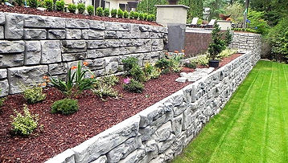
Professional Landscaping Services
Transform Your Yard With professional landscaping services Designed To Enhance Beauty, Boost Curb Appeal, And Create A Clean, Well-maintained Outdoor Space.

Slide 2
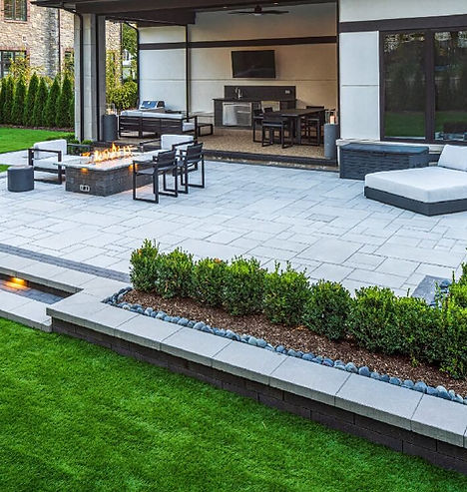
Professional Patio Installation
Upgrade your backyard with professional patio installation that combines quality materials & expert design to create a best space for relaxing or entertaining.

Slide 3
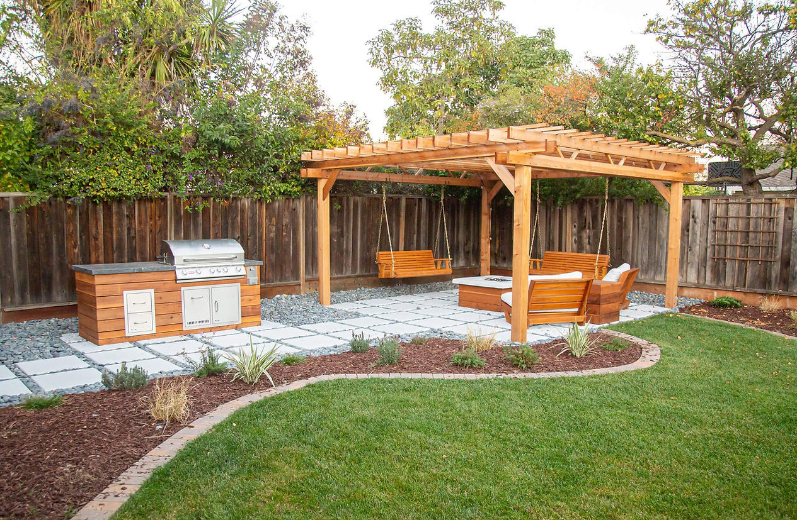
Expert Landscaping Services
Experience Stunning Results With expert landscaping services Tailored To Fit Your Space, Whether You Need Fresh Designs, Planting, Or Full Landscape Makeovers.

Slide 4

Contact Us
About: At PrairieScapes Landscaping, we offer expert landscaping, hardscaping, patios, decks, sod, mulch, and seasonal services to transform your outdoor space across North Liberty & nearby areas.
Address: 170 Greenfield Dr. Unit C, Tiffin, IA, 52340 United States
Website: https://www.prairiescapepros.com/

