Slide 1


FENG IMMIGRATION LAW
Feng Immigration Law: Bridging Borders with Expert Legal Guidance in California
READ MORE

Slide 2

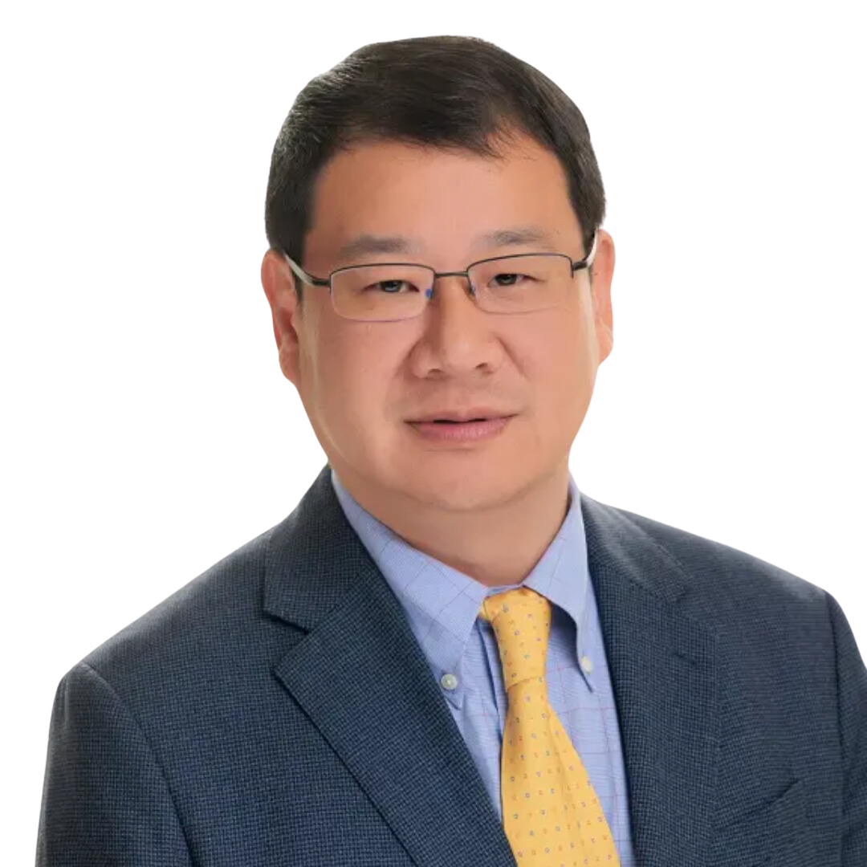

FENG IMMIGRATION LAW
About Founder
Zechen was admitted to practice before the Illinois Supreme Court and is eligible to practice immigration law across the United States. He is a member of the
American Immigration Lawyers Association (AILA).

Slide 3




About Us
At Feng Immigration Law, we are dedicated to providing compassionate and expert legal support for individuals navigating the complexities of U.S. immigration. With over 20 years of legal experience, our firm specializes in family-based immigration, nonimmigrant visas, asylum applications, and naturalization processes.
20+
90%
1-3
Years of experience
Petitions Approved
Months to prepare

Slide 4
Vision
And Mission
Our Vision
Our Mission
We strive to be recognized as a leading immigration law firm in California, delivering unparalleled legal expertise and compassionate support to our clients, while fostering a global community connected through shared opportunities.
Our mission is to simplify the complexities of U.S. immigration law by providing personalized, reliable, and effective legal solutions to individuals, families, and businesses.
Our Value
We pride ourselves on our in-depth knowledge of
ever-evolving immigration laws and our ability to develop tailored legal strategies that meet your unique needs.

Slide 5





Why Choose Us
Proven Track Record of Success
Tailored Legal Strategies
Timely Case Management
With years of experience in immigration law, we have a strong history of successfully navigating complex cases. Over 90% of our family-based immigration petitions are approved on the first attempt, demonstrating our commitment to excellence and precision.
We recognize that no two cases are alike. Our team takes the time to understand your unique circumstances and designs customized legal solutions to meet your goals efficiently and effectively.
We prepare your case thoroughly and promptly—most cases are completed within 1-3 months, depending on the timely submission of documents. We also respond to all inquiries within 24 hours, keeping you informed and assured.

Slide 6
Practice Areas
Family-Based Immigration
Employment-Based Immigration
Non-immigrant Visas
We assist with petitions to help families reunite and stay together, including:
  Spouse and Fiancé
  Parent, Child, and Sibling Petitions
  Adjustment of Status for Green Cards
  Consular Processing for Family-Based Visas
We provide guidance for individuals and companies in securing employment-related visas, such as:
  L-1 Visa
  O-1 Visa
  H-1B Visa
  Employer-Sponsored Green Cards
Whether for work, study, or travel, we assist clients in applying for:
  Student Visas (F-1 and M-1 Visas)
  Visitor Visas (B-1 and B-2 Visas)
  Work Visas
  J-1 Exchange Visitor Visas
Asylum and Refugee Applications
Naturalization and Citizenship
Green Card Applications
We offer compassionate representation for individuals seeking safety in the U.S., including:
  Asylum Applications
  Protection for Victims of Persecution
  Assistance with Refugee Status
We guide clients through the process of becoming U.S. citizens, including:
  Citizenship Eligibility Assessments
  Application Filing and Document Preparation
  Interview and Exam Preparation
We help individuals residing in the U.S. apply for permanent residency through adjustment of status, providing a seamless and stress-free process.

Slide 7
Meet Our Lawyer
Zechen Feng is the founding attorney of Feng Immigration Law, bringing a unique blend of international education, professional experience, and a deep passion for helping clients navigate the complexities of U.S. immigration law.
With over 20 years of experience, Attorney Feng has built a reputation for providing personalized, effective, and results-driven legal solutions. His diverse background, including time spent as a business executive, gives him a well-rounded perspective on the challenges faced by individuals and families pursuing their immigration goals.
Educational and Professional Background
  Attorney Feng holds advanced legal and business qualifications from both domestic and international institutions, ensuring a comprehensive understanding of global legal practices.
  His experience spans a wide range of immigration matters, from family-based petitions to complex employment and business-related visas.
Expertise and Achievements
  Attorney Feng has successfully handled hundreds of immigration cases, with over 90% approval rates on family-based petitions filed through USCIS.
  Known for his meticulous attention to detail and in-depth knowledge of immigration law, he has earned the trust and gratitude of clients from all walks of life.
Philosophy and Approach
Attorney Feng believes that every client deserves empathy, respect, and personalized attention. His approach to immigration law is rooted in clear communication, strategic planning, and a genuine desire to help clients achieve their dreams of living and thriving in the United States.
Languages Spoken
To better serve a diverse clientele, Attorney Feng is fluent in multiple languages, allowing him to connect with clients across cultural and linguistic barriers.
Zechen Feng
Owner

Slide 8




Need More Information?
+1 657-543-9308
8 Corporate Park # 130, Irvine 92606
www.fenglawoffice.com
FENG IMMIGRATION LAW

Slide 9

FENG IMMIGRATION LAW
Thank You
See You Later

