Slide 1

What Makes a Varanasi Best Beauty Parlour Stand Out
Finding a Varanasi beauty parlour is easy. Finding one that truly cares is not. In Varanasi, beauty is closely tied with tradition, trust, and personal care. A standout parlour makes people feel special from the moment they walk in.

Slide 2

Skilled Professionals Who Truly Listen
The staff is the first thing that makes a great parlour. Qualified practitioners listen to your needs, asking about your skin, hair, and comfort levels. They don't rush, providing clear explanations for each step, building essential trust in beauty care.

Slide 3
Clean, Safe, and High-Quality Services
Impeccable Cleanliness
Quality Products
Best parlours maintain all corners clean and tidy. Tools are washed after each use, products are well-stored, and chairs, floors, and mirrors are spotless. This level of care ensures clients feel safe and relaxed.
Trusted parlours use skin-friendly, branded products appropriate for Indian skin and hair types. These gentle, tested products minimize irritation and offer better, long-lasting results.

Slide 4
Personal Attention Makes All the Difference
Every client is unique, with different skin tones, face shapes, hair textures, and style preferences. A standout parlour individualizes services to each person, ensuring clients return for tailored care.

Slide 5
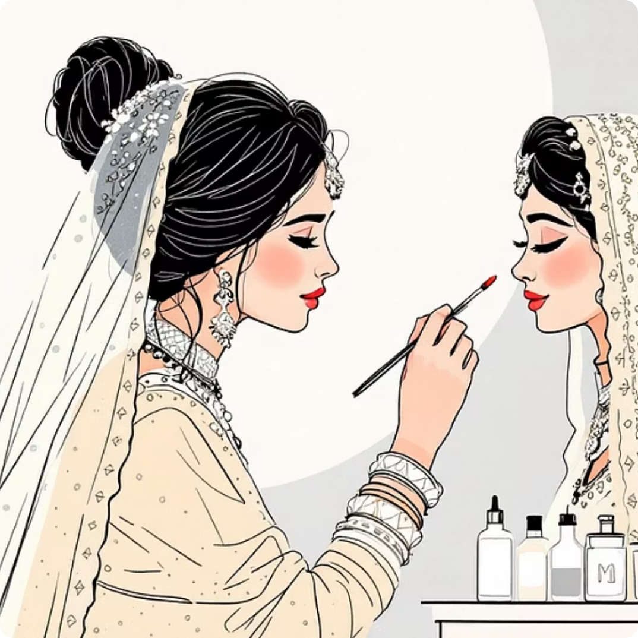

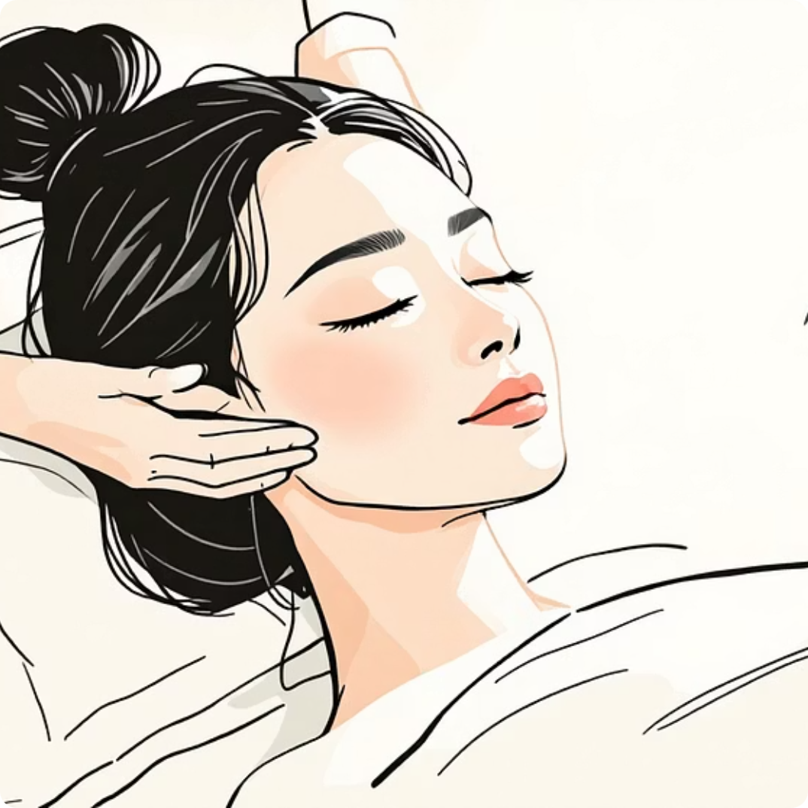
Experience Over Trends
Bridal Makeup
Hair Spa
Skincare
Blending modern styles with traditional techniques for natural, elegant results.
Treatments that leave hair feeling balanced and revitalized, never overdone.
Personalized routines that enhance natural beauty and promote healthy skin.

Slide 6

Honest Advice and a Comfortable Experience
Honest Recommendations
Prioritized Comfort
Consistent Quality
Experienced experts propose only what's needed, sometimes even saying no to unnecessary services. This candor builds long-term relationships.
A relaxing atmosphere, soothing music, friendly staff, and punctuality ensure a stress-free experience. Comfort is key to a great salon.
The quality remains the same every time, whether it's your first visit or your tenth. Clients know what to expect and trust the outcome.

Slide 7
Reputation Speaks Volumes
Positive customers share their experiences with friends and family, building a reputation through real experiences rather than paid reviews. This trust is earned through years of hard work and dedication.

Slide 8

The Essence of a Great Beauty Parlour
Trust
Competence
Build lasting client relationships
Skilled services and trained staff
Hygiene
Attentiveness
Spotless salon and safe practices
Personalized care and listening
A great beauty parlour is built on these fundamental principles, ensuring clients receive exceptional care and feel truly valued.
Source:- https://sooperarticle.com/what-makes-a-varanasi-best-beauty-parlour-stand-out/

